Slide 1

Holly Hill Heroes Assembly
HOLLY
HILL
SUMMER TERM, 2026

Slide 2
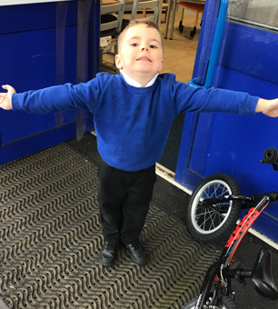
Our Cygnets Hero
Romeo is a true Holly Hill hero!
He has grown in so many ways this year and we are so proud of him.
Romeo always joins in with our carpet time sessions and he always has his brain switched on. He is always ready to learn!
We are pleased with the way Romeo plays with others and how he can now share the toys and use his imagination to create games.

Slide 3

Our Cygnets Hero
Poppy-Leigh is our hero this week1 She is such a lively character with a bubbly personality who often makes us laugh.
She is particularly impressing us with her phonics learning and she is trying so hard to use this knowledge when writing a sentence. She is starting to do this independently!
Believe in yourself, you can do it Poppy-Leigh!

Slide 4
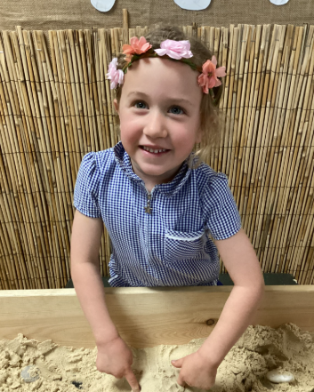
Our Cygnets Hero
Ivy is our first hero! Ivy could be a hero every week. She is always following our school rules and she is such a wonderful little girl who is always aiming to please. She has impressed me this week with her creativity in the sand! She has been creating all sorts of scenes and settings with her friends. Well done Ivy you are a super Cygnet!

Slide 5
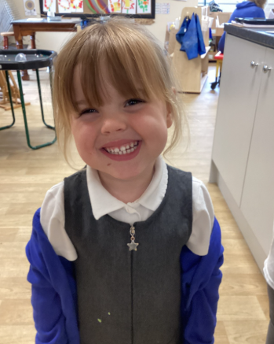
Our Cygnets Hero
Willow is our next hero! Willow is such a lovely little girl who always does the right thing. She is gaining more and more confidence every day and we are starting to see her personality shine through. Someone new to our class might mistake her for being one of the older children but she is only nursery. She is definitely ready for F2 and we can’t wait to see how well she gets on! Well done Willow!

Slide 6
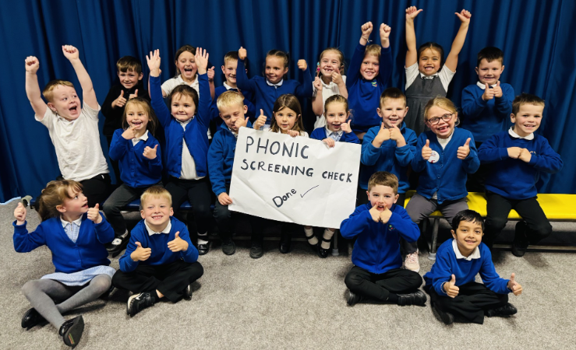
Our Puffin Hero
Wow what a week our gorgeous Year 1s have had! Every single child has worked incredibly hard all year in Phonics - not just in preparation for the Phonics Screening Check which is a statutory test but most importantly so that they can be fluent readers. Regardless of the end result, I am immensely proud of every child in my class who tried their very best in the weeks leading up to the check and on the day. PUFFIN CLASS you are ABSOLUTELY AMAZING PERFECT PUFFINS!

Slide 7
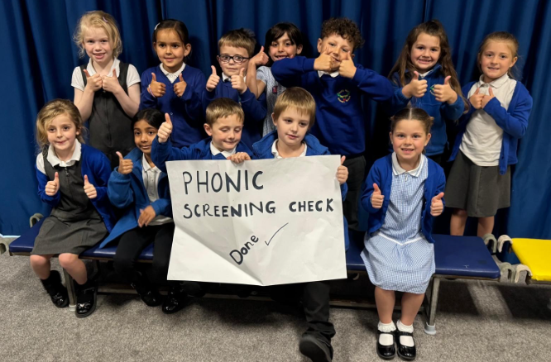
Our Wren Hero
Our heroes in Wrens this week are all the Year Ones who have really worked hard with their phonics not only practicing at school, but lots have practiced at home too. Well done everyone, you really are wonderful Wrens, we are all so proud of you!

Slide 8
Our Wren Hero

Slide 9
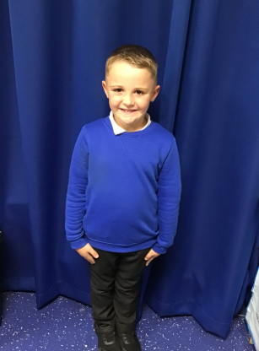
Our Woodpecker Hero
This weeks Woodpecker heroes are Chester and Ella.
Chester has been chosen by Mr Ellis who took some children to play in a football tournament. He was really impressed, not only by Chester's ability and playing the game, but also his attitude and enthusiasm. He said he was an absolute super star and a credit to Holly Hill.
Well done Chester!

Slide 10
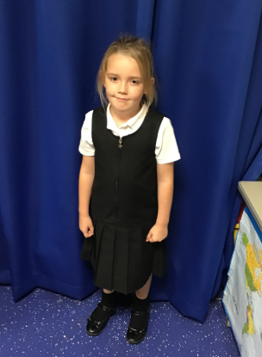
Our Woodpecker Hero
My other hero is Ella. We did an assessment this week and I was so proud of Ella. We had been looking at ways of answering questions in maths last week and Ella used these to work out her answers. I was so impressed Ella. Well done. Keep up the hard work.

Slide 11
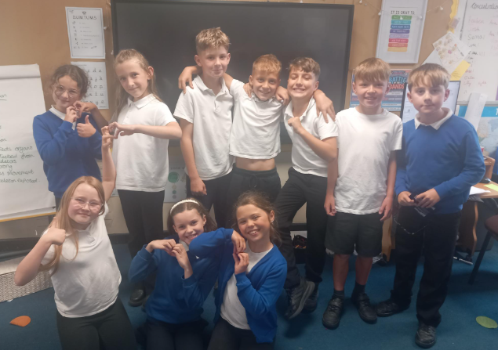
Our Dove Heroes
Dove heroes this week are all our year 4s. They have done so well learning their times tables and did brilliantly this week when they undertook the multiplication check. Well done guys- you are amazing!!!

Slide 12
Our Swallow Heroes
This week our times tablers are the heroes again. We have had another successful week and the children have completed their test with great success! We had more full marks, high scores and children who on the day beat their personal score. We are so proud of all the Year 4s who have worked hard on these. Well done all.

Slide 13
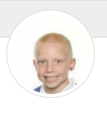
Our Swallow Heroes
.
A special mention to Jack. In the last 2 days I have witnessed him carrying out two random acts of kindness. These were not because anyone has asked him, or because someone is watching him, just because it is a nice thing to do. Well done Jack - this, in life, will take you far.

Slide 14
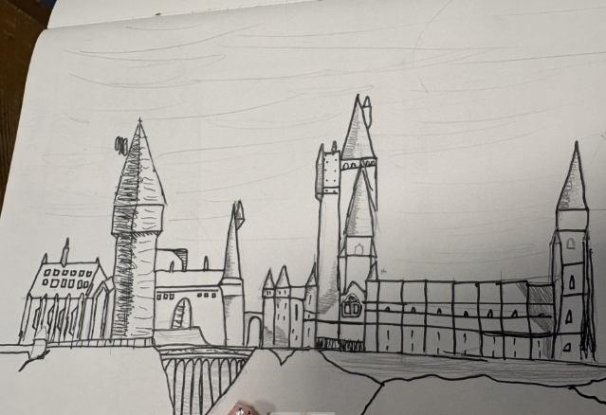
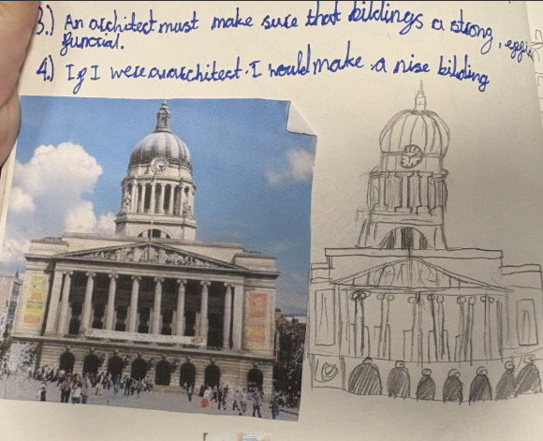
Our Falcon Hero
I would like to celebrate James and Lockie for their incredible artwork this week. They have both put considerable time and effort into ensuring their pieces were accurate and detailed. Lockie’s Town Hall and James’s Hogwarts castle are truly amazing indeed - I am sure you will all agree!

Slide 15
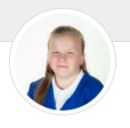
Our Swan Heroes
Shayla is a hero this week for always being her happy and smiley self. We've all really missed Miss M this week since she's left for her American adventures, and Shayla has kept being her happy and bubble self. You're such a mature Swan Shayla and we're really proud of you 🦢
.

Slide 16
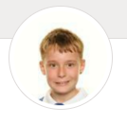
Our Swan Heroes
Vinni is a hero this week for his amazing Viking longship information text that he has written in English this week. I read it to Mrs Watson and she was blown away by the vocabulary and sentence structures that he'd used. Well done Vinni - you always work so hard and it has shown in your fabulous writing ✍️ 🦢

Slide 17
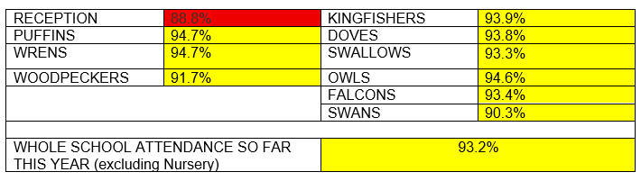
Class Attendance winners
CLASS | WIN 1 | WIN 2 | WIN 3
Cygnets 1
Cygnets 2
Puffin
Wren
Woodpecker
Kingfisher
Dove
Swallow
Owl
Falcon
Swan
Well done Puffins and Wrens! This week’s winners with 94.7% attendance!!
Wrens, you’ve won your treat now.
Remember, when you reach 3 wins, your class will get £25 to spend on books and 15 minutes extra play! Try to come to school every day to help your class be the winners!

Slide 18

Have a fabulous weekend everyone!
Don’t forget about Sports Day on Monday!
Mrs. Steed
xxx

