Slide 1
Year 1 Phonics Screening Test
Parents Meeting
10th February 2026

Slide 2
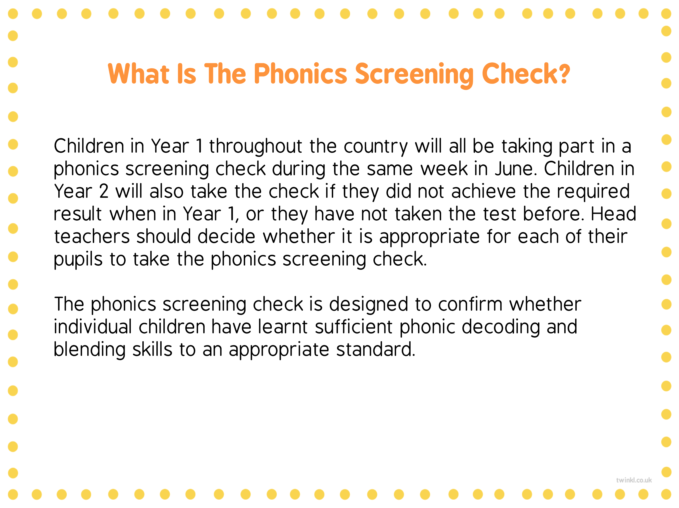

Slide 3
What date is the Phonics Screening Check?
Week beginning 8th June 2026

Slide 4
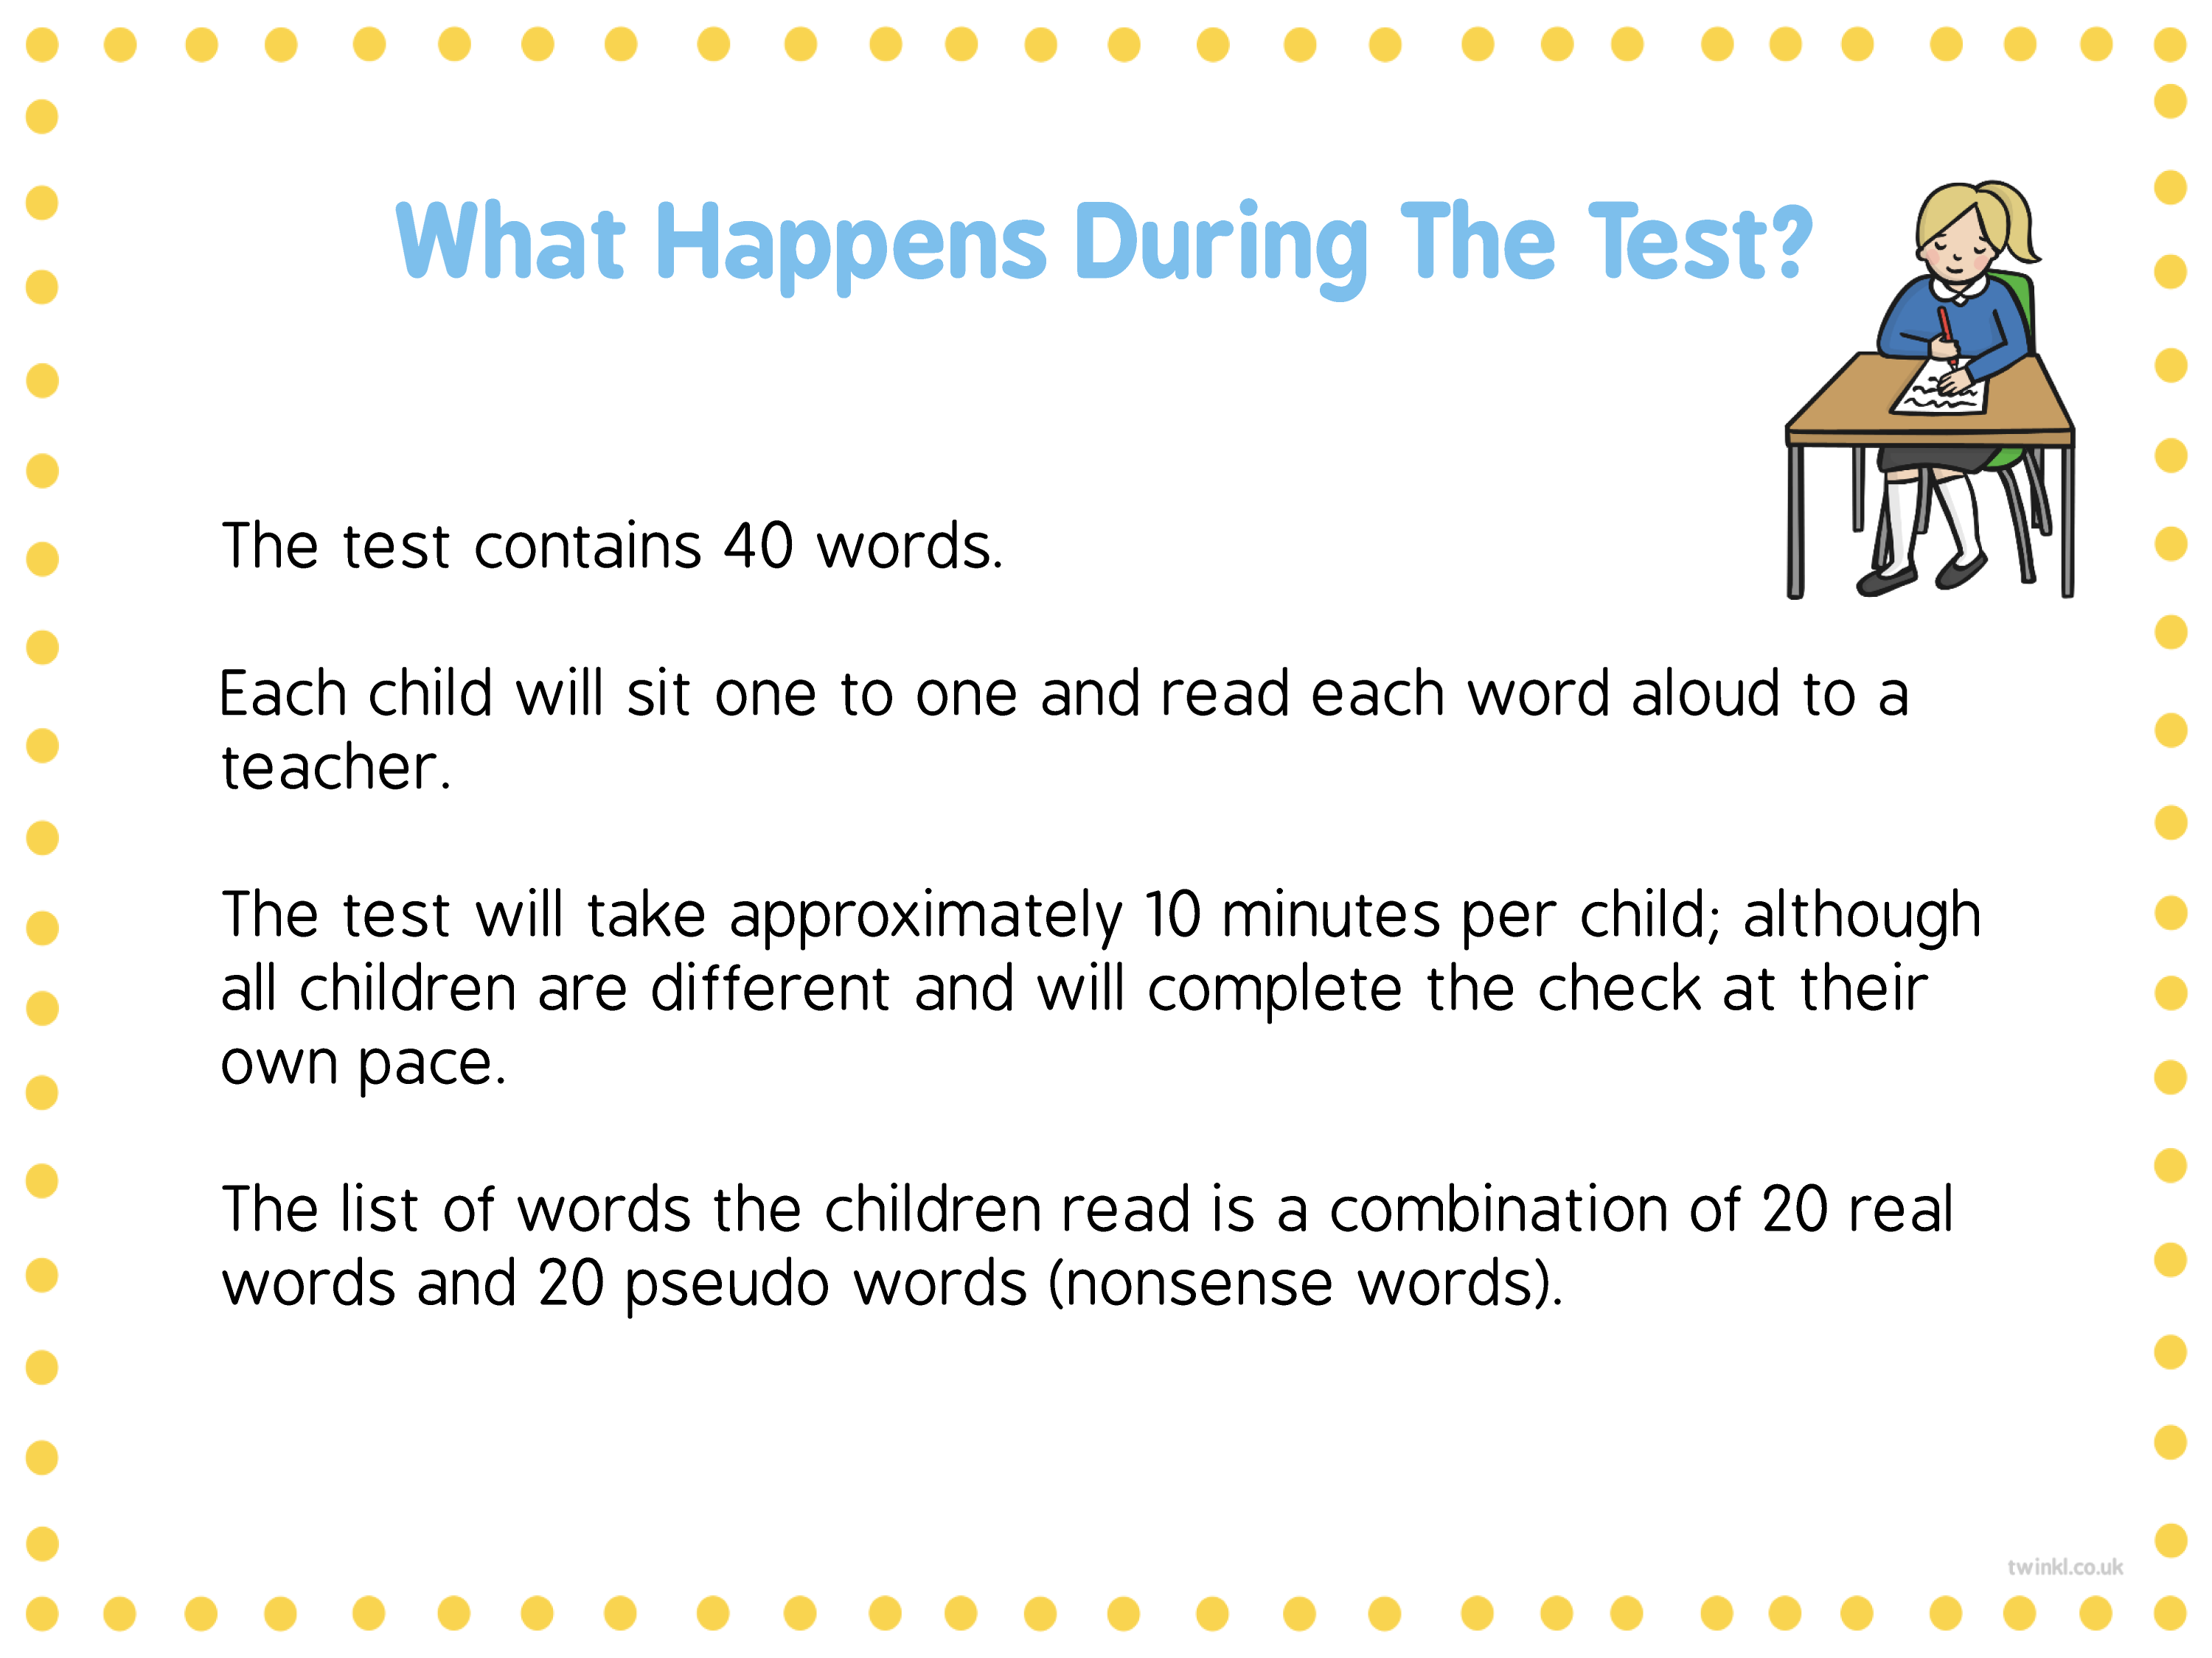

Slide 5
What is the pass mark?
For the past few years the pass mark has been
32
We do not know until after the results have been submitted what it will be.

Slide 6
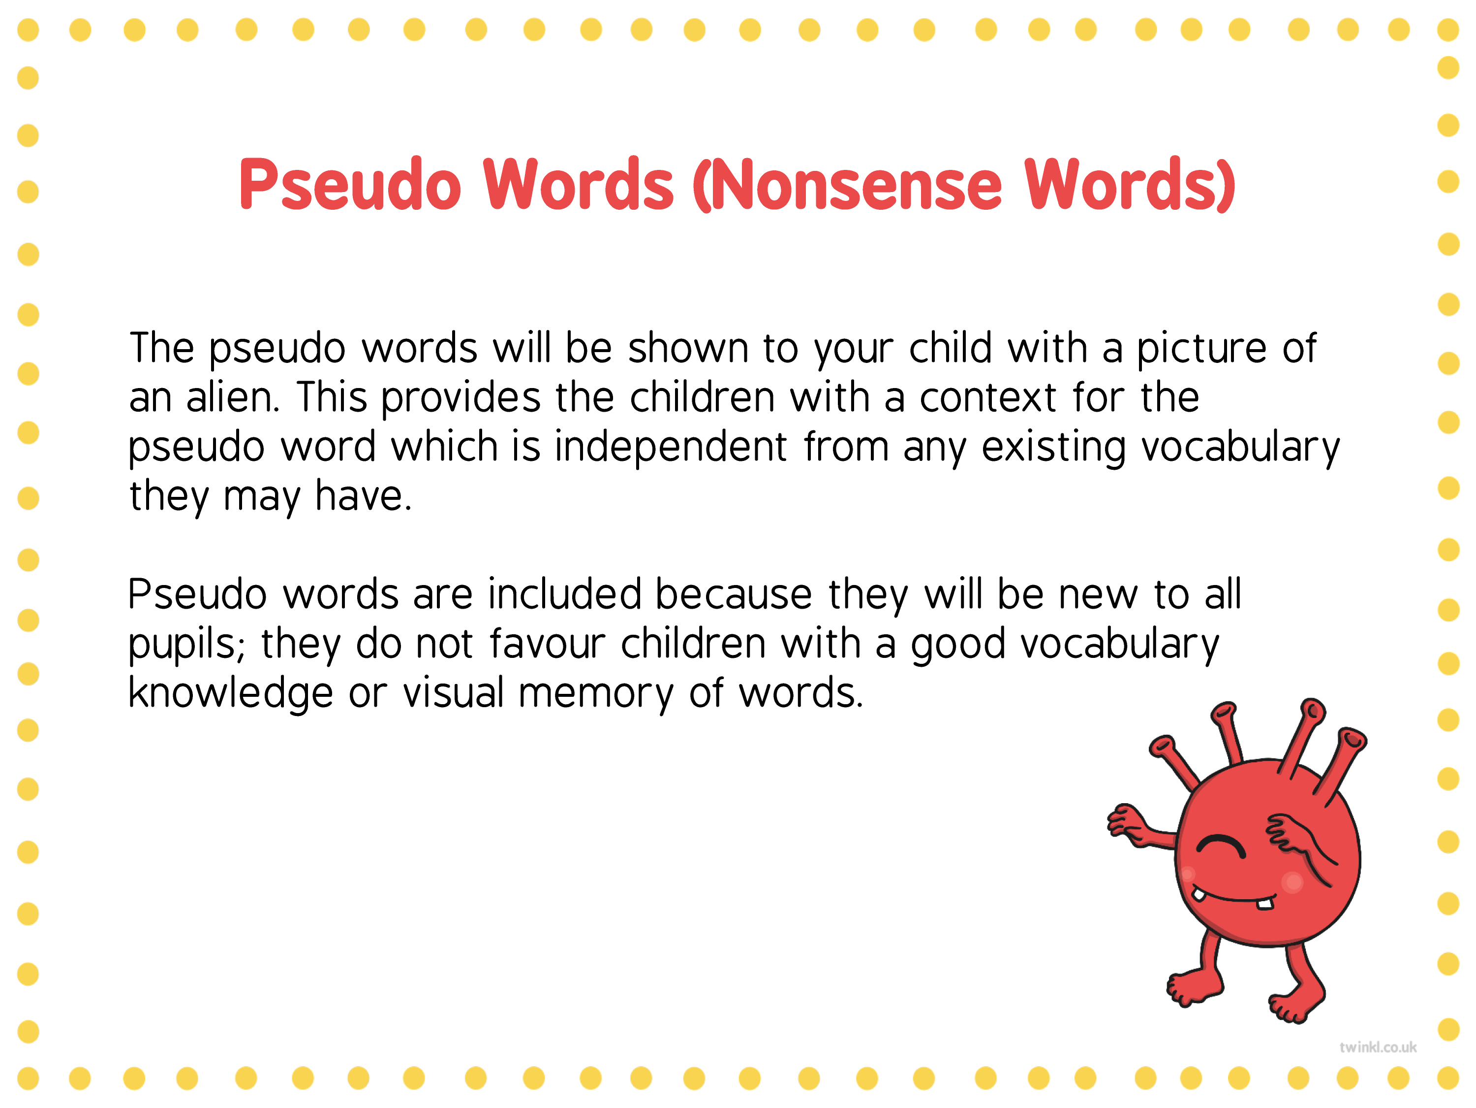

Slide 7
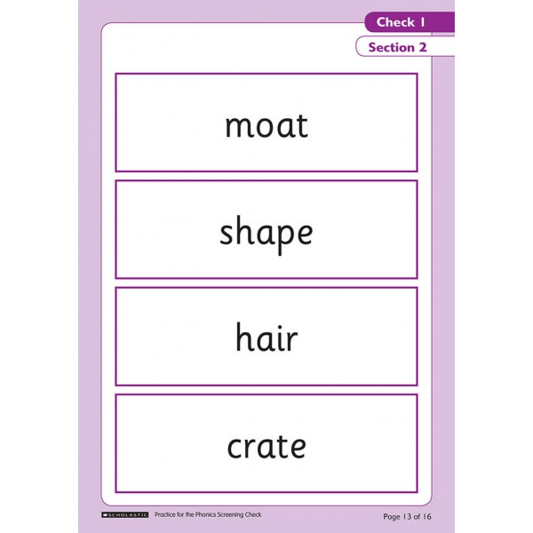
Example of a past paper
Real Words

Slide 8
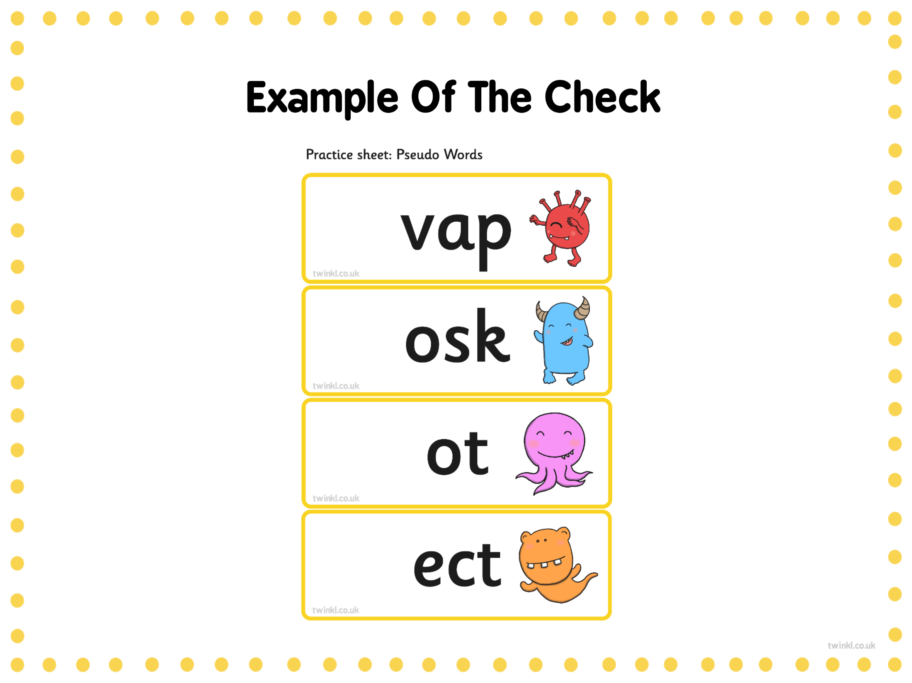

Slide 9


Slide 10
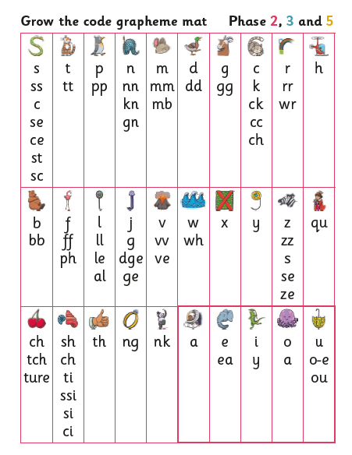

Slide 11
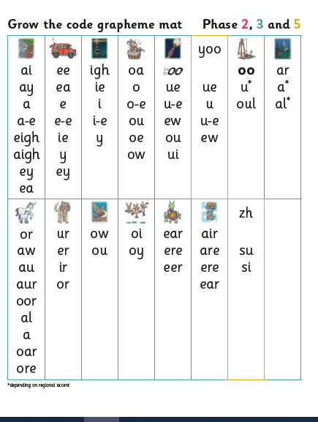

Slide 12
Section 1
The words in section 1 will have a variety of simple word structures (for example CVC, VCC, CCVC and CVCC) using:
single letters (a, b, c, d, e, f, g, h, I, j, k, l, m, n, o, p, q(u), r, s, t, u, v, w, x, y, z)
some consonant digraphs (ch, ck, ff, ll, ng, sh, ss, th, zz)
frequent and consistent vowel digraphs (ar, ee, oi, oo,or)

Slide 13
Section 2
The words in section 2 will have a variety of more complex word structures (for example CCVCC, CCCVC, CCCVCC, two syllable words etc) using the grapheme phoneme correspondences (GPCs) from section one as well as the GPCs listed below:
additional consonant digraphs (ph, wh)
less frequent and consistent vowel digraphs, including split digraphs (a-e, ai, au, aw, ay, ea, e-e, er, ew, i-e, ie, ir, oa, o-e, ou, ow, oy, ue, u-e, ur)
trigraphs (air, igh)
alternative pronunciations (a, c, ch, e, ea, er, g, i, ie, o, ou, ow, s, u, ue, u-e)

Slide 14
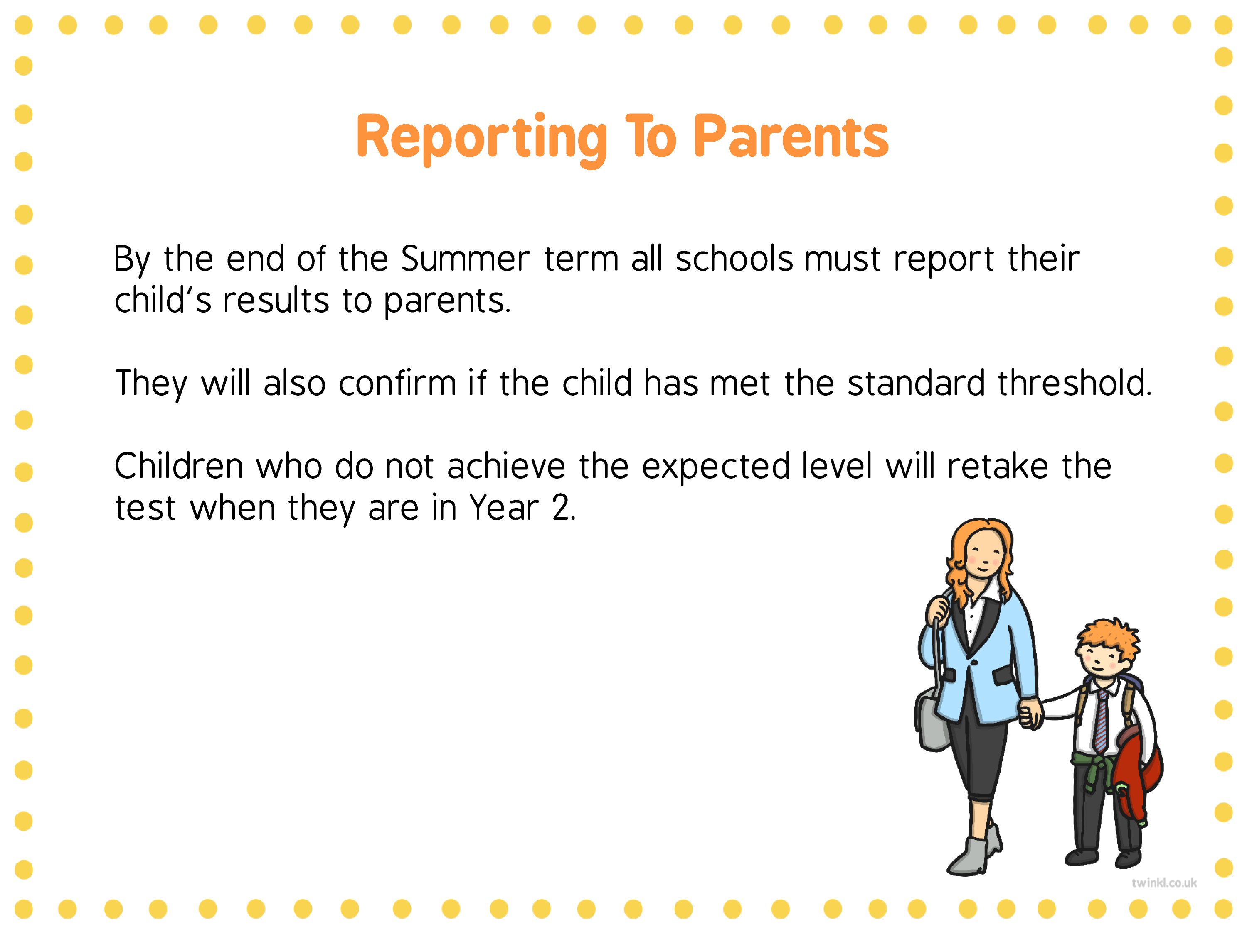

Slide 15
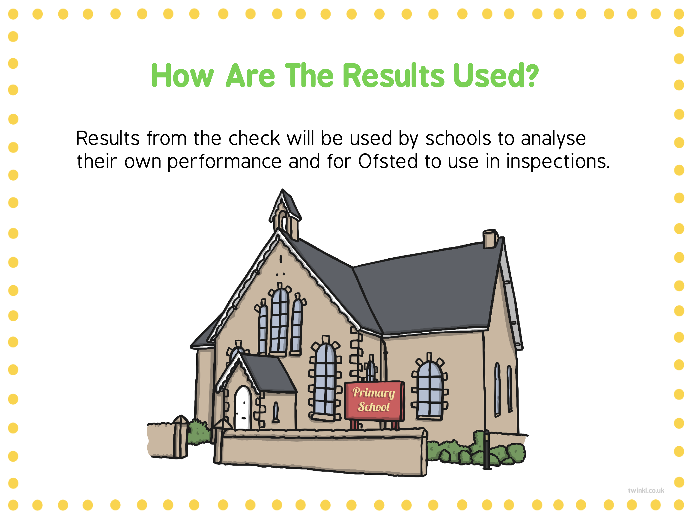

Slide 16
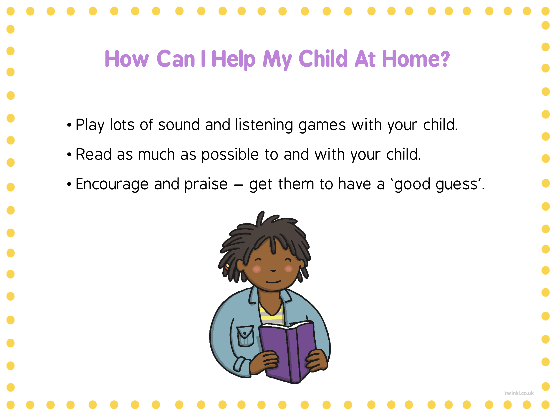

Slide 17
What happens if my child is poorly or on holiday?
Scores for all children have to be submitted so if a child is absent for the week a zero is recorded.
If a child is poorly but can come into school at some point that week, it is really important that they do so!

Slide 18
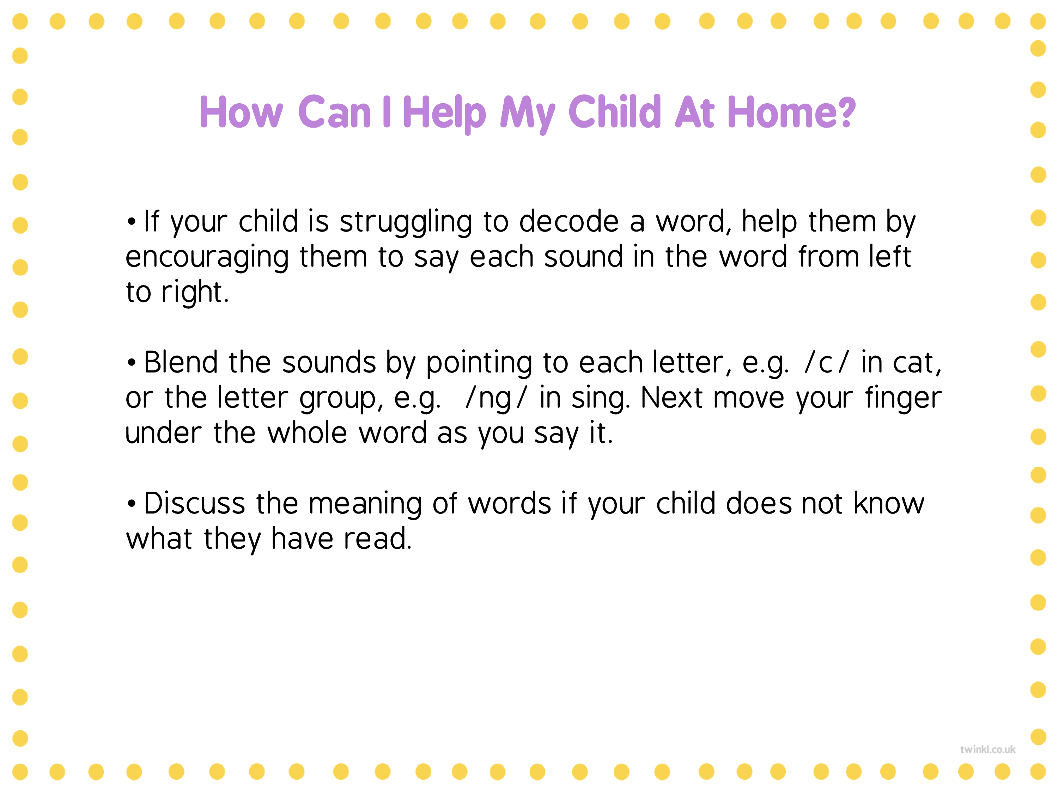

Slide 19

Any questions?
Please come and see us if you have any questions!
Thank you for listening

