Slide 1

Holly Hill Heroes Assembly
HOLLY
HILL
AUTUMN TERM, 2024

Slide 2
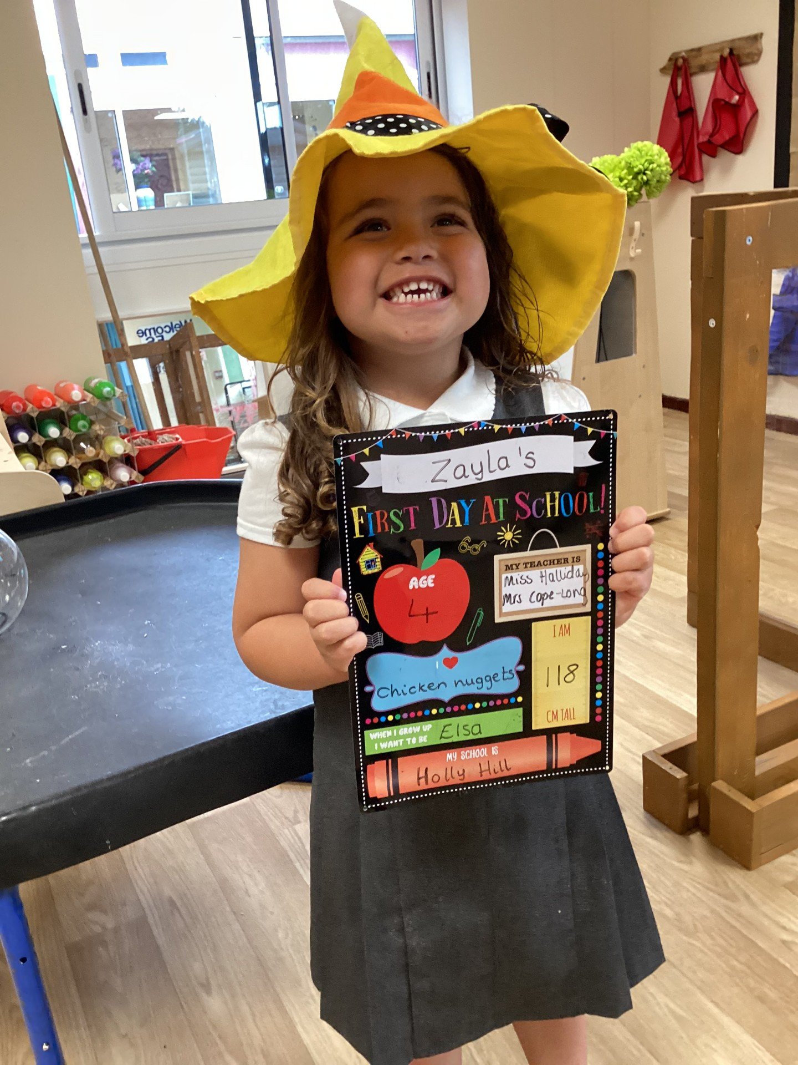
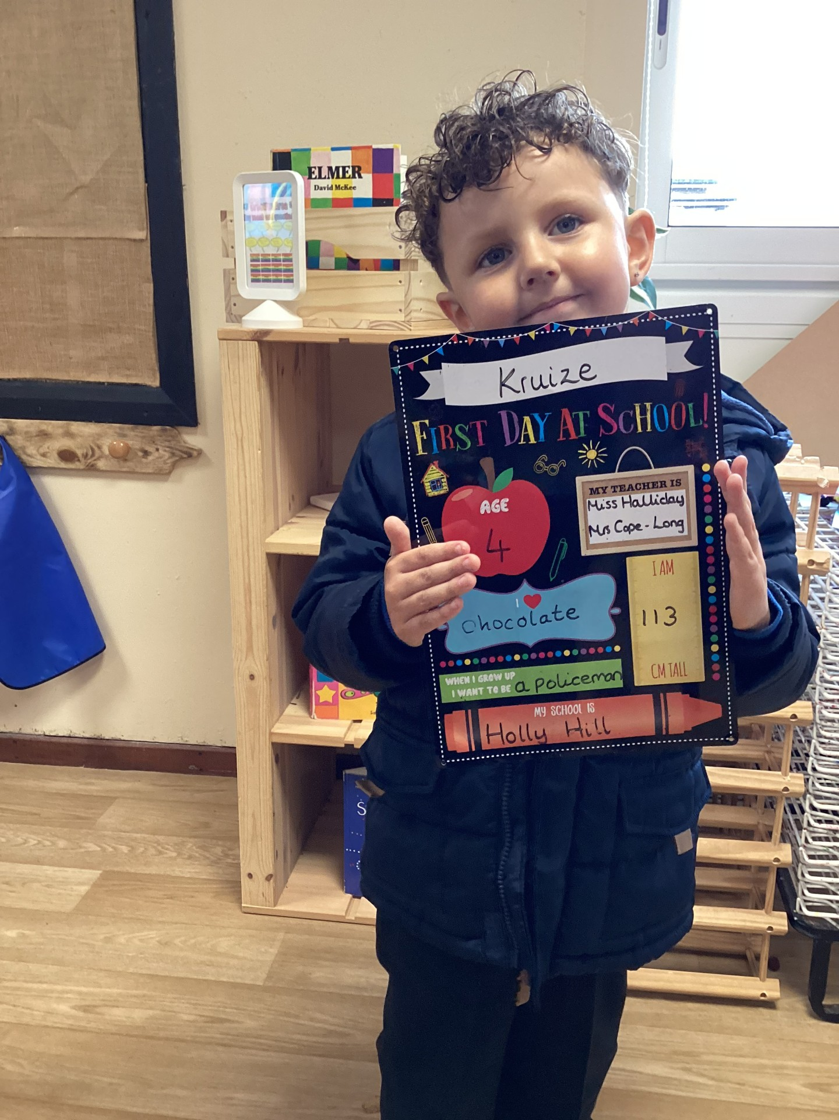
Our Cygnets Hero
Zayla and Kruize are our heroes from Cygnets Class 1 this week. We are so proud of how well all of the children have settled into life at Holly Hill in EYFS but Kruize and Zayla have really shone. They show kindness and are good friends to others modelling the values from the Holly Hill Way. When we had a special visitor this week, we read the story the Blue Chameleon together and they were respectful to our visitor and demonstrated great listening skills. A wonderful start to the year! Well done!

Slide 3
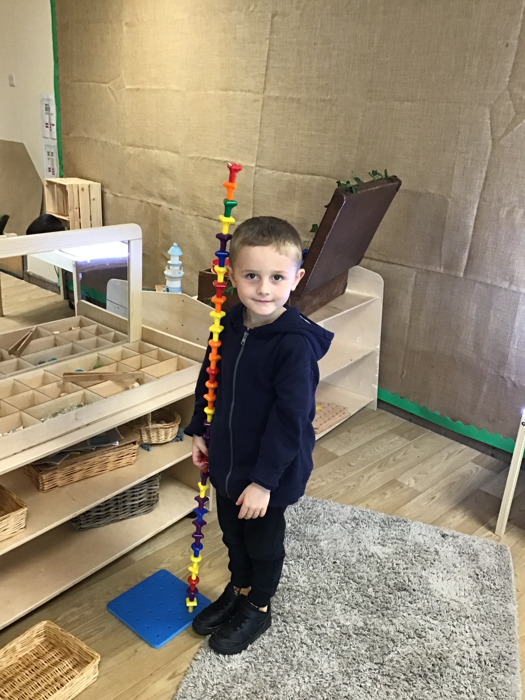
Our Cygnets Hero
Benjamin is one of my heroes this week because he has just been such a good role model for all our other children. He really impressed me with story time and how much he could remember. He also made a tower and was able to tell me that it was taller than him! Well done Benjamin!

Slide 4
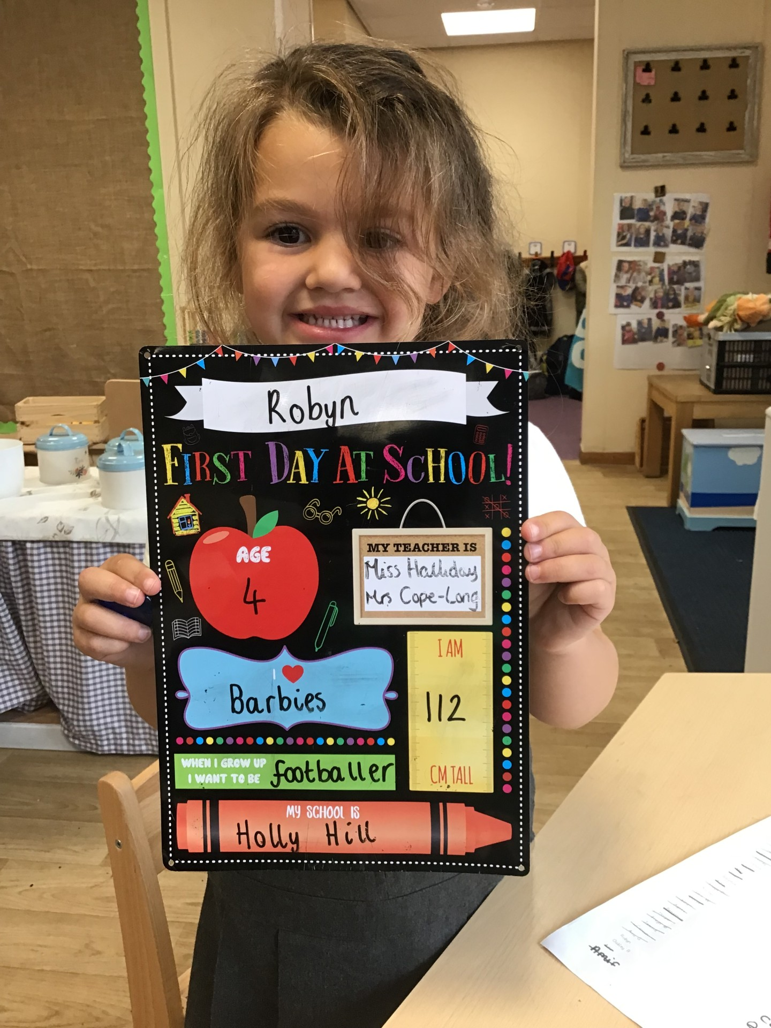
Our Cygnets Hero
Robyn is our next hero because she has been working so hard to be a respectful young lady. She is always helping to tidy even when it isn't her mess. She is always the first one on the carpet ready to learn. Well done Robyn!

Slide 5
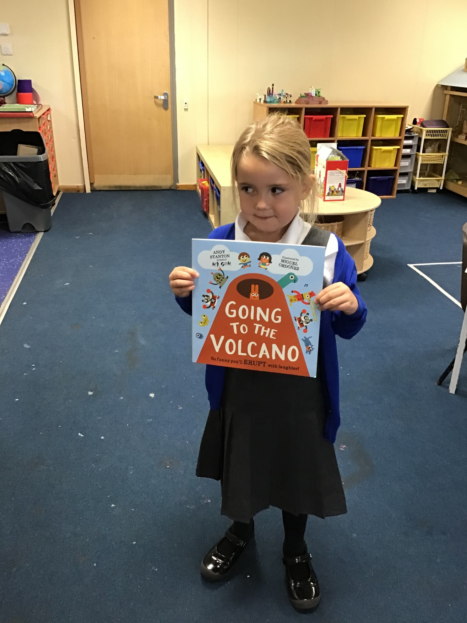
Our Puffin Hero
Ella is a Puffin Class Hero this week. She has settled really well into Year One and always comes into school with a smile on her face. During our ‘No Outsiders’ workshop, she listened really carefully and always had her hand up to answer questions. She made some really well thought out comments and was a credit to her class. Well done Ella you are one of our first Perfect Puffin's of the school year!

Slide 6
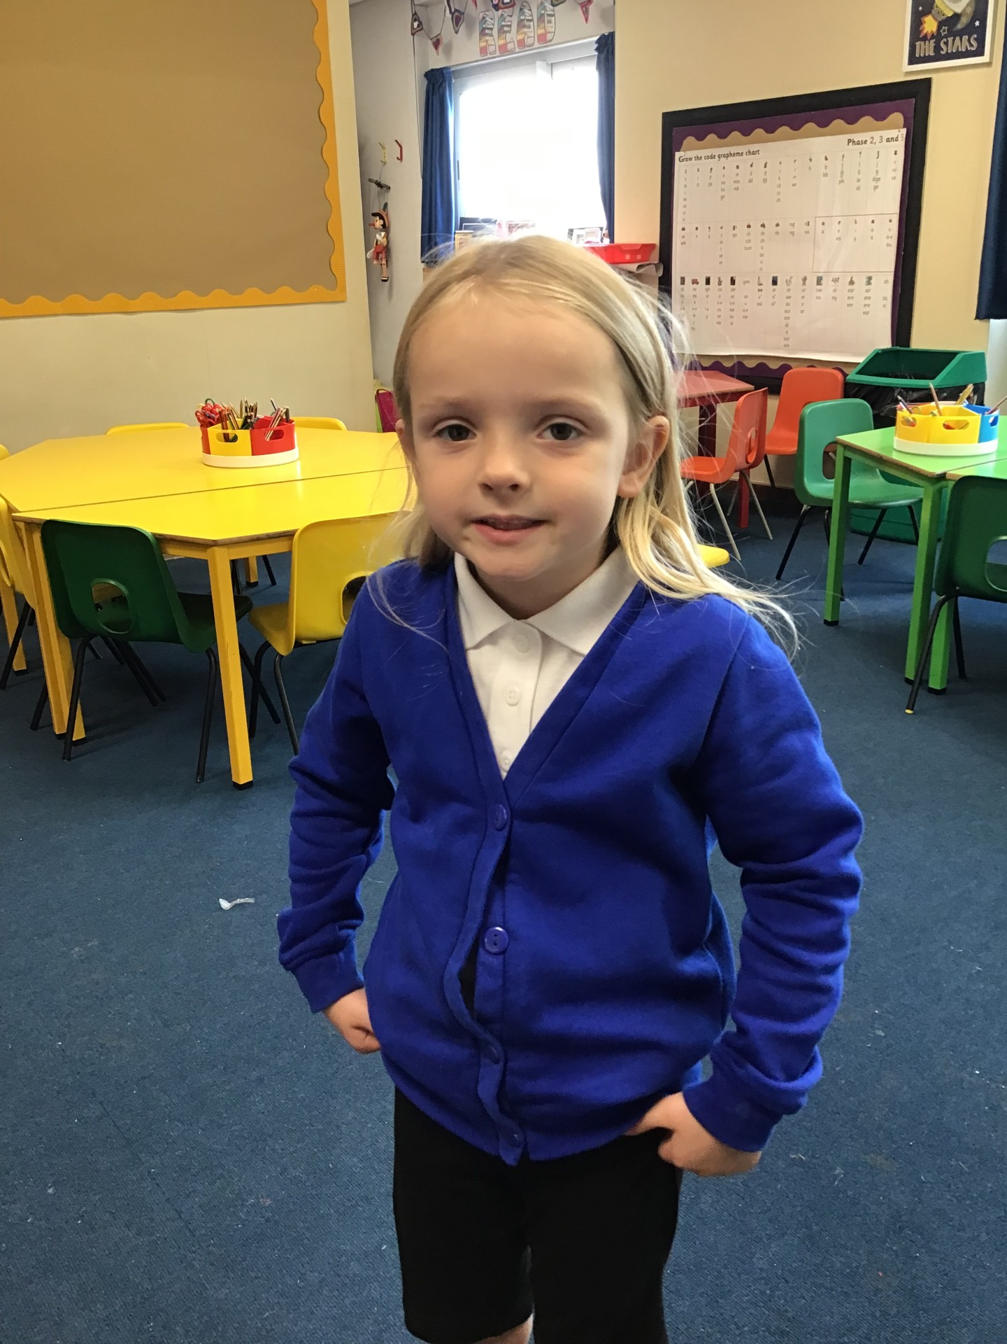
Our Puffin Hero
Liliarna is Puffin Class Hero this week because she has settled into Year One so well. She is always one of the first children sat on the carpet ready to start the new day. She has worked hard, listened attentively and joined in enthusiastically with every activity. She has particularly tried hard with her writing this week both in English and during Phonics. Well done Liliarna, you have made such a great start to Year One and I am really proud of you. You are most certainly a Perfect Puffin!

Slide 7
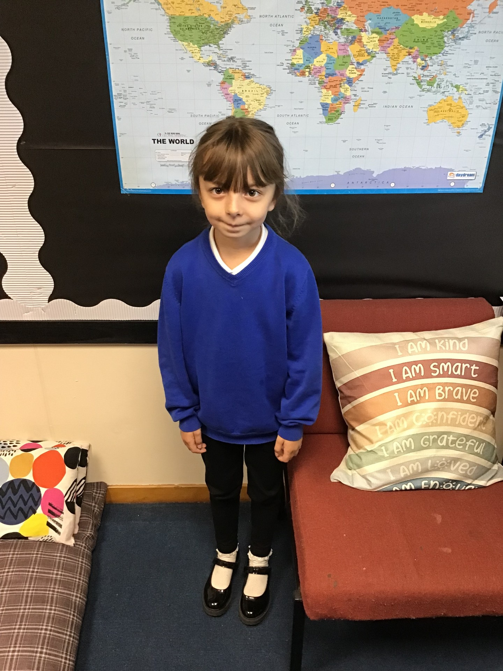
Our Wren Hero
Evie-Rose has been WOWing me with her writing this week. She has been trying hard to complete her writing jobs and has been working on keeping her writing looking neat and well presented. Keep it up Evie, I am already looking forward to seeing more of your work this year.

Slide 8
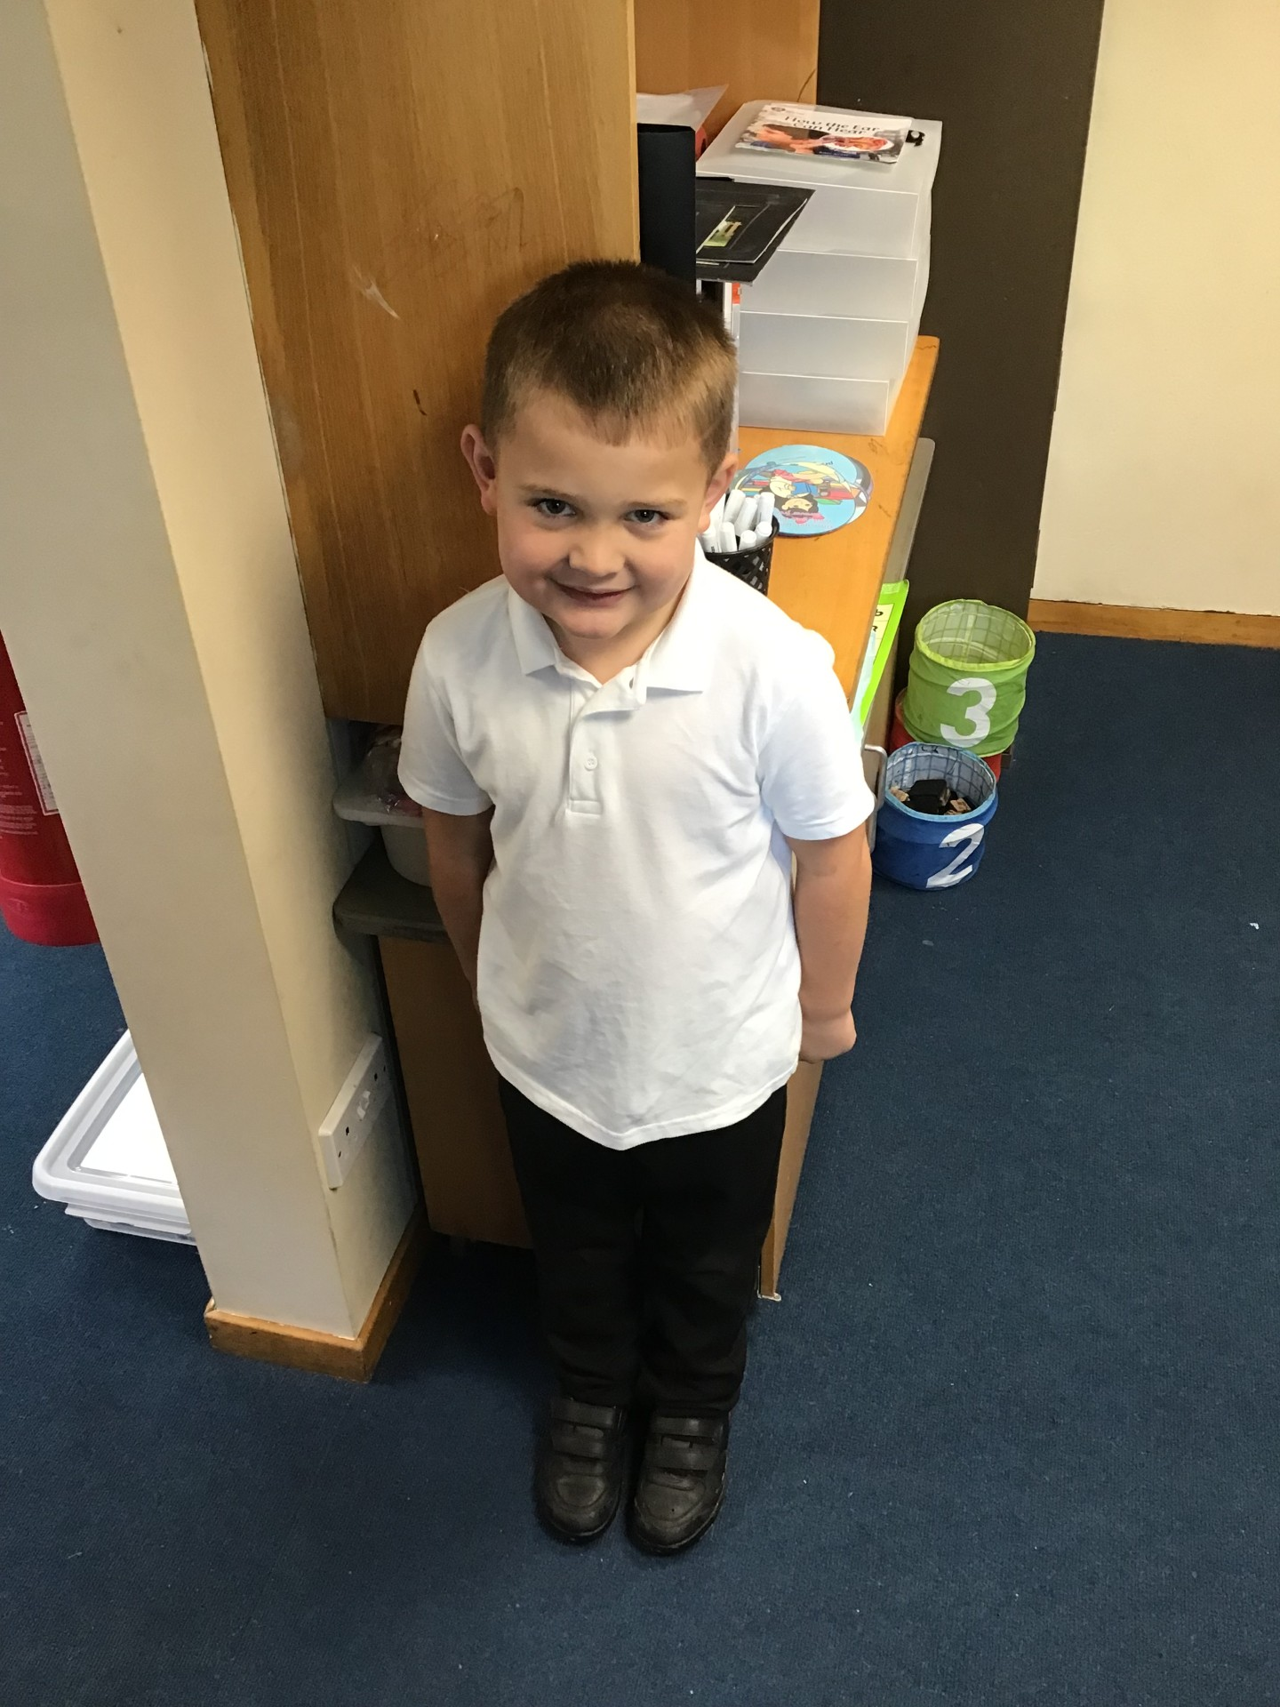
Our Wren Hero
Carson has a wonderful passion for Maths and he has shown me how fantastic he is at working out mathematical problems during our maths sessions this week. Keep up the hard work Carson - you are so ready for our year 2 maths challenges 🙂

Slide 9
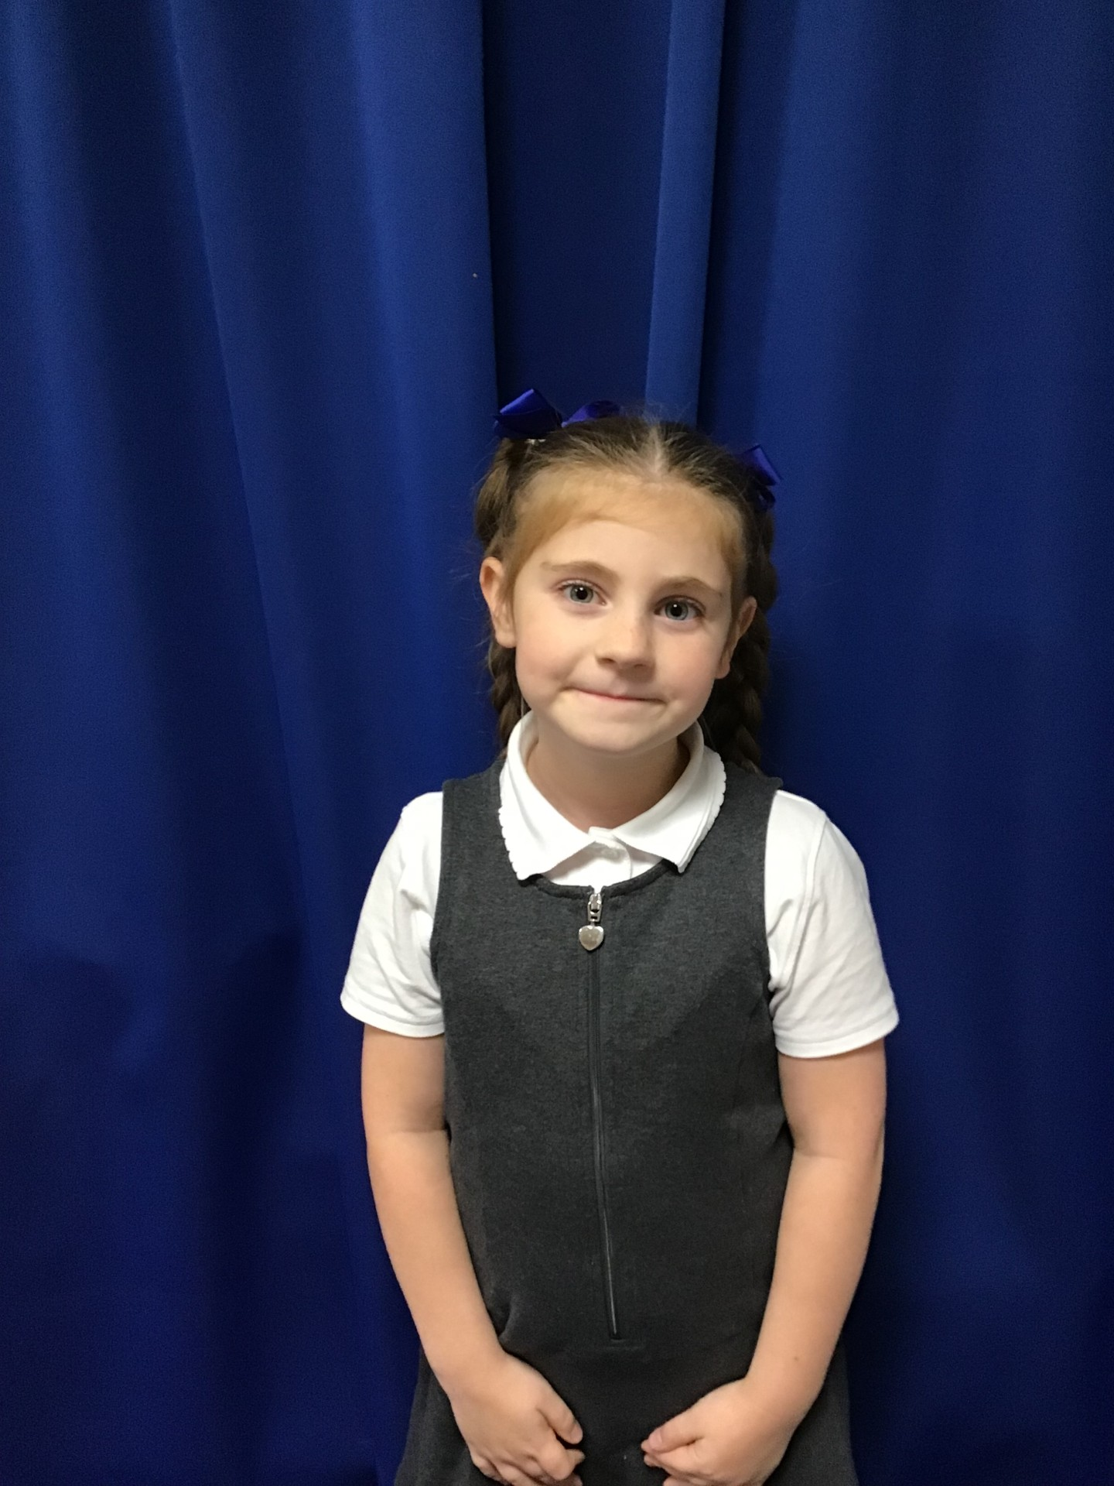

Our Woodpecker Hero
This week’s Woodpecker heroes are Adam and Ayda.
Adam only started at Holly Hill last week and he has settled in brilliantly. It is as if he has been here ages! He comes in happily and always works hard and has made lots of friends already.
Ayda has had a brilliant start to Woodpecker class and has settled back in to school fantastically. She is always polite and is always one of the first children ready to learn.
A fantastic start both of you - well done!

Slide 10

Our Kingfisher Heroes
This week, I have chosen all the children who are brand new to our school to be our Kingfisher heroes.
The have settled in brilliantly and we’re so happy to have them as part of our Holly Hill family 💙
Jude, Bree, Killian, Evie, Jason and Connie, what a fantastic start to Year 3 - Congratulations! 🌟

Slide 11
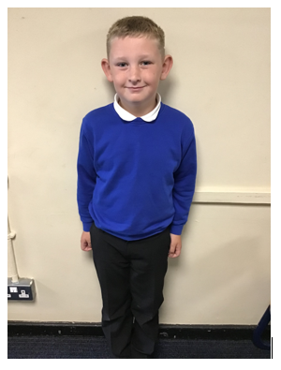
Our Dove Hero
The first Dove hero this week is Charlie. Charlie has really impressed us this week with how sensible he is and how he is always ready to listen and learn. Every time anyone is talking, he listens, showing the utmost respect for others and following our Holly Hill Way. He is kind and supportive towards others and a pleasure to have in the classroom. Well done Charlie!

Slide 12
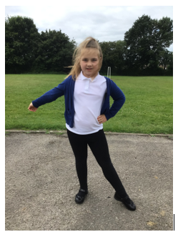
Our Dove Hero
The second Dove Hero is Esmee. What a hard worker you are! Esmee has demonstrated some beautiful handwriting and created some fantastic pieces of work in the last week. She always tries her best and is a sensible member of the class, setting a perfect example to the year 3's who have come up into the juniors. Another fabulous Dove! Well done!

Slide 13
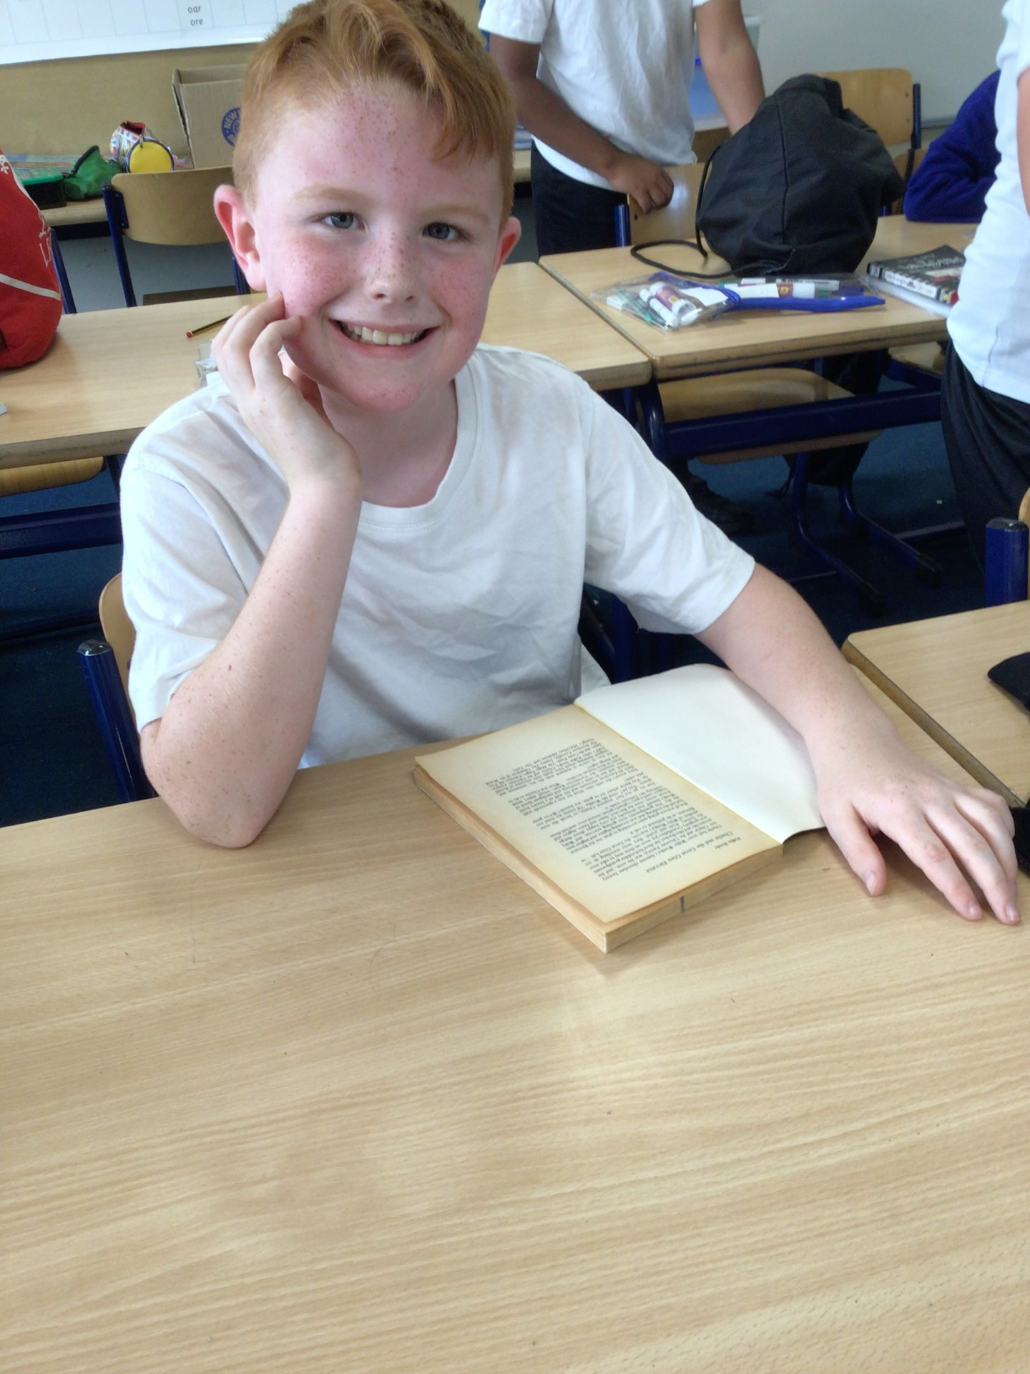
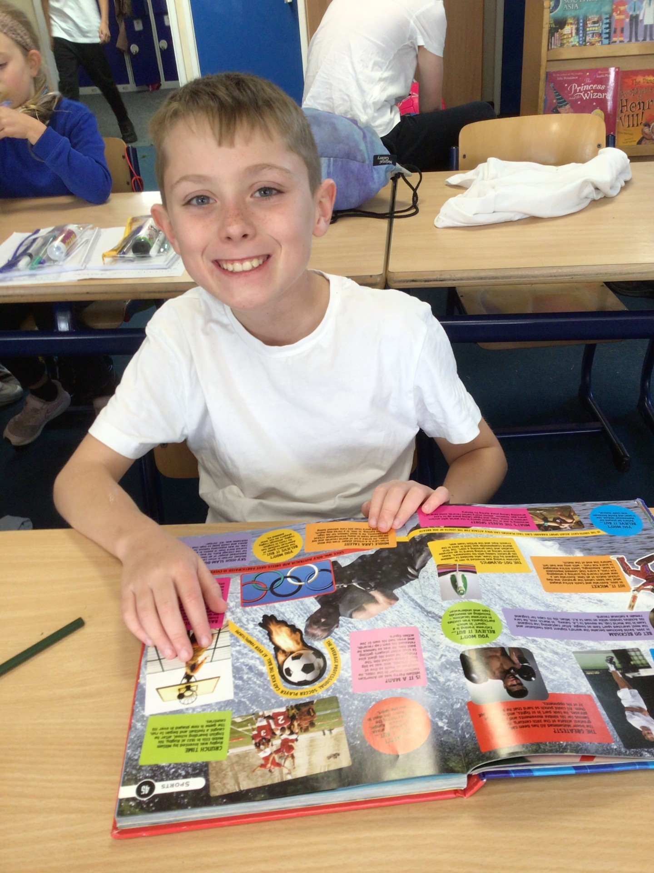
Our Swallow Hero
Swallow class have had an absolutely brilliant week. They have quickly settled into their new routines and have shown a positive attitude to year 4 learning.
My two heroes this week go to two boys who have shown great listening skills and are always ready to learn.
Well done Jackson and George - keep up this fantastic attitude to your work!

Slide 14
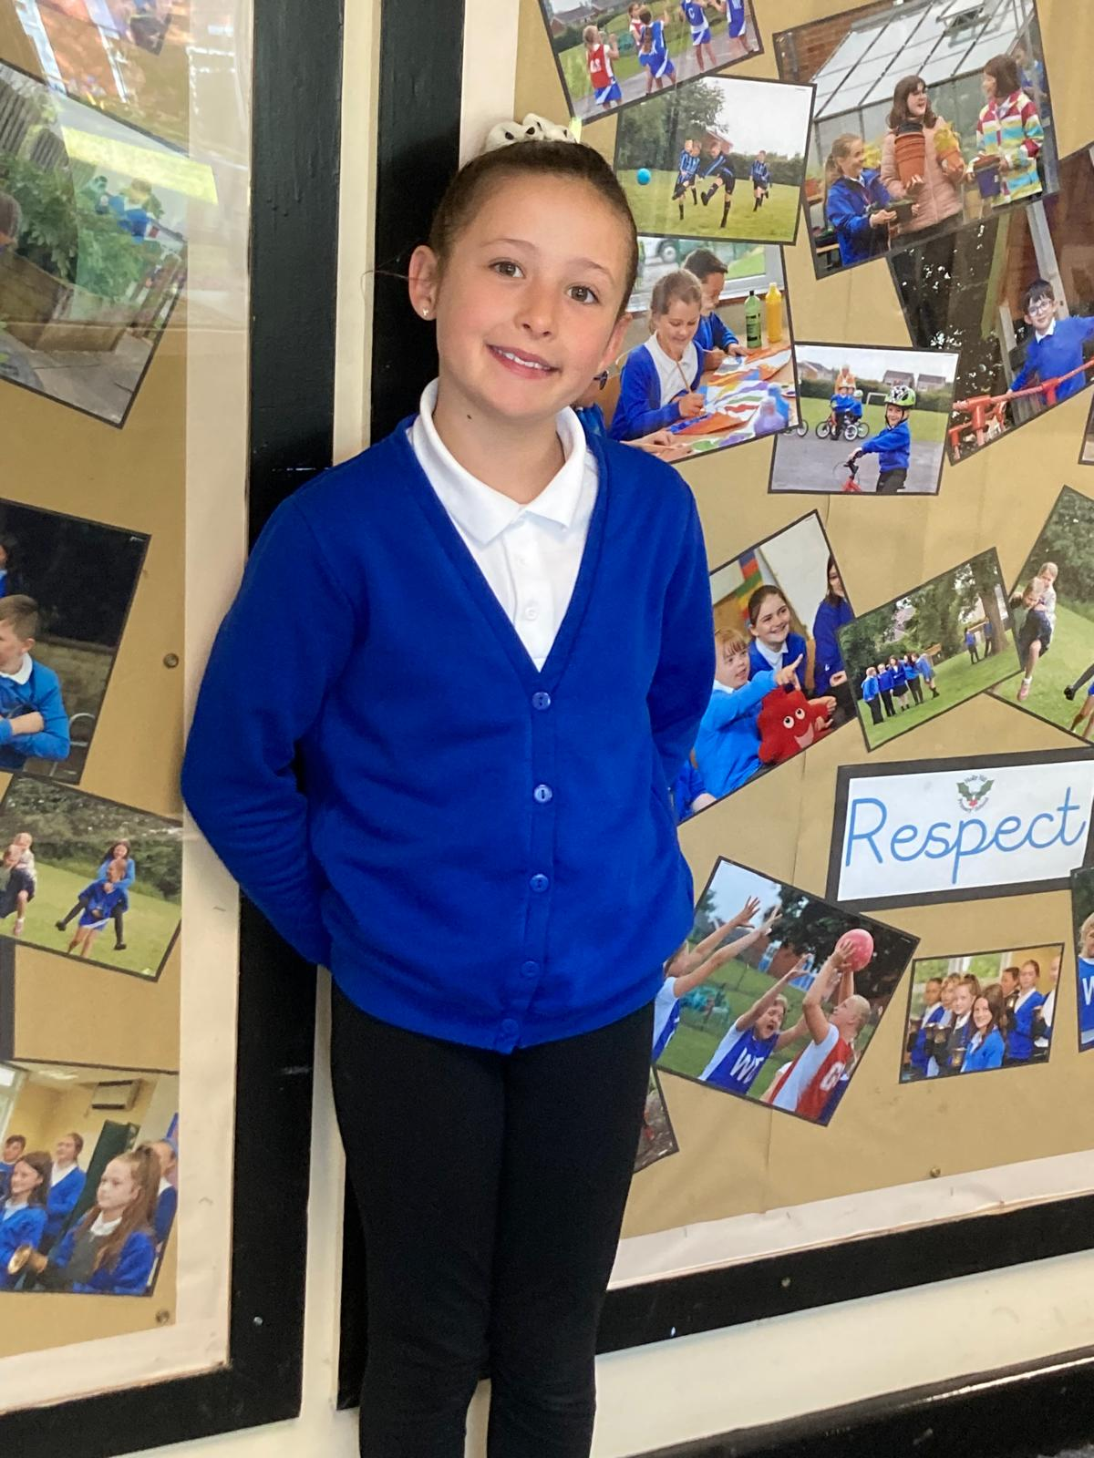
Our Owl Hero
Our Owl hero this week is Sophie. She has made a great start to Year 5 and particularly impressed me with her thoughtful responses in our ‘No Outsiders’ session yesterday. Well done Sophie – you impressed us all with your respectful, thoughtful and mature responses.

Slide 15
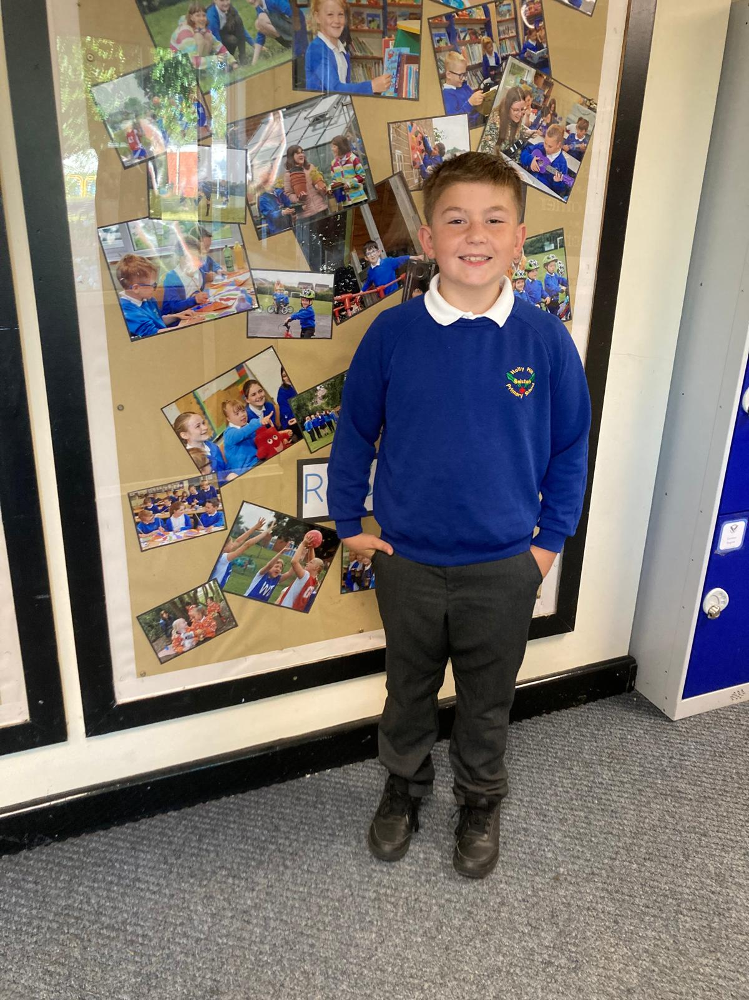
Our Owl Hero
Ben is Owl hero because he has made a tremendous start to his learning in Year 5. His behaviour and attitude in class have been impeccable and he has really taken an active part in all our class work. Well done Ben - keep it up!

Slide 16
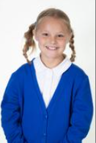
Our Falcon Hero
This week’s first Falcon hero is Annabell! She has really got stuck into the new year, proving herself ready to learn and ready to share her ideas. I love her confidence during our class discussions and she also shared some fabulous opinions during our No Outsiders assembly. Keep it up Annabell and we’re going to have the best year! 🤩

Slide 17
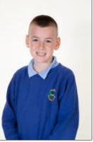
Our Falcon Hero
The second Falcon hero is Elliot! Elliot has got a great Y6 attitude, being a great listener and a deep thinker! I have been really impressed with Elliot’s quick responses and his eagerness to join in with everything. Awesome start Elliot, let’s keep it going! 🤗

Slide 18
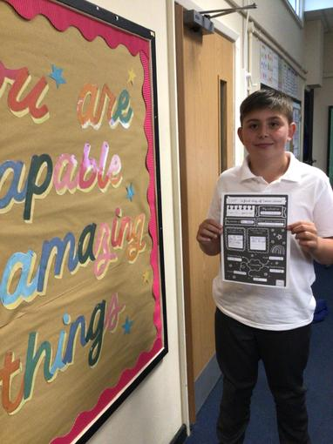
Our Swan Hero
Oliver is my hero this week because of his kind attitude towards his peers. Oliver is the first person to help his partner and is so supportive. I'm so proud of the kindness you've shown this week Oliver!

Slide 19
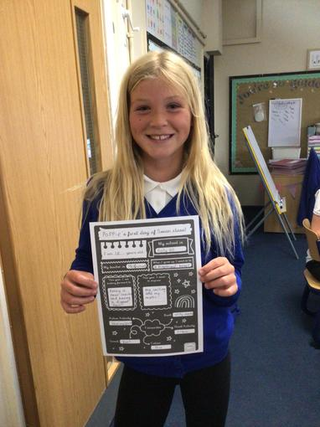
Our Swan Hero
Poppie is my hero this week because of her thoughtful insights during our 'No Outsiders' workshop. Poppie gave a lovely response about making everybody feel welcome and stop people feeling less alone. I'm so glad you're a Swan, Poppie!

Slide 20

Our Lunchtime Heroes
Our Midday Supervisors have chosen Ela as one of our lunchtime heroes this week. Ela has been exceptionally kind and caring to one of new children in Year 3. She has welcomed him into her play as well as being thoughtful and kind when he has been feeling sad.
Ela, your smiley face and kind heart helps to make our KS2 playground a lovely place to be.

Slide 21
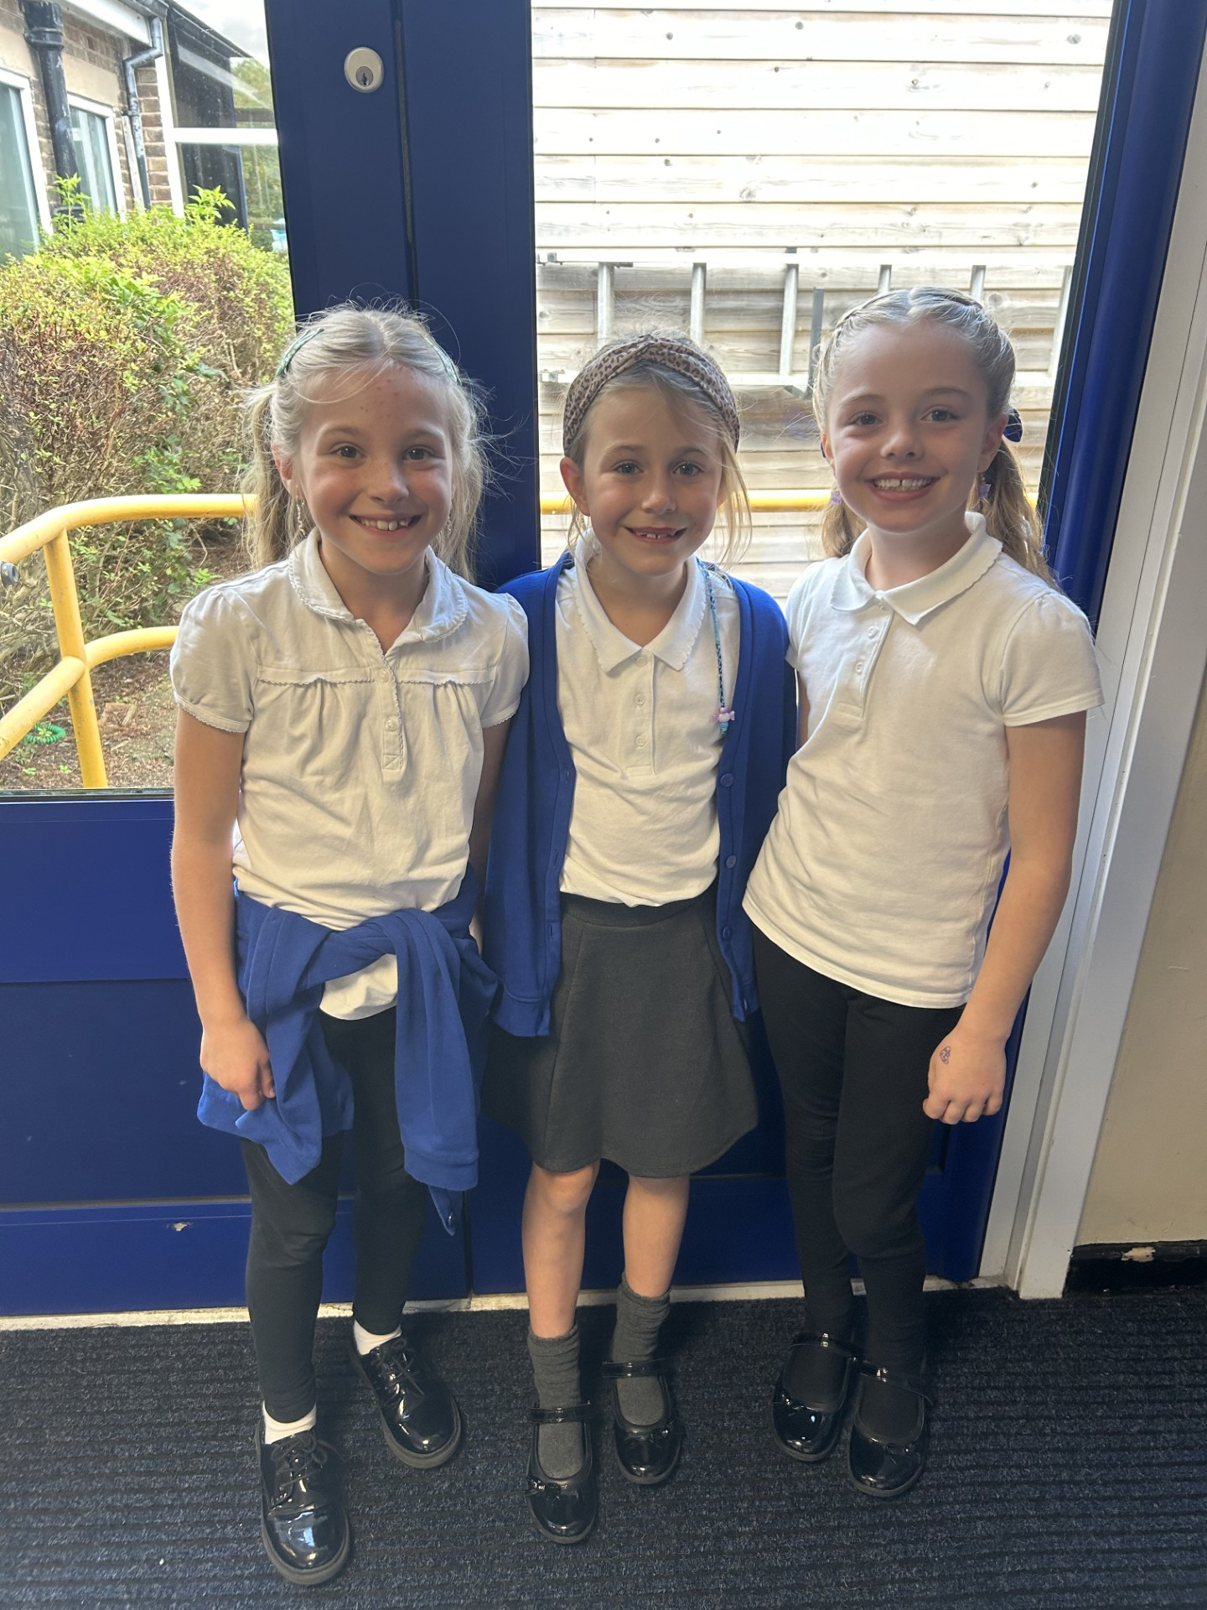
Our Lunchtime Heroes
Our Midday Supervisors have also chosen Dana, Rosie and Olivia as lunchtime heroes this week.
This absolute dream team of girls are so kind to everyone on the playground. They are especially kind and thoughtful to one of their peers who sometimes needs a little support through lunchtime. They include him in their play, remind him to come in for lunch and help him with his wrappers if he needs it. They have a very mature way of supporting when it’s needed without taking away independence.
Their kindness, patience and understanding is admirable and one Midday described the girls perfectly when she said “they warm my heart”.
Thank you for making our school a warmer place to be girls.

Slide 22
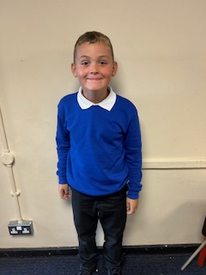
My Headteacher’s Hero
My Headteacher’s hero this week is Ronnie.
Ronnie’s behaviour in every assembly is absolutely exemplary. He sits beautifully, listens carefully and is a great role model for everyone else who is sat in the hall.
He’s also had a wonderful, super sensible start to Year 4 – I am extremely proud of you Ronnie!

Slide 23
Class Attendance winners
This week’s winners with 98.9%% are Swallow class! Well done Swallow!
Remember, when you reach 3 wins, your class will get £25 to spend on books and 15 minutes extra play! Try to come to school every day to help your class be the winners!
CLASS | WIN 1 | WIN 2 | WIN 3
Cygnets 1
Cygnets 2
Puffin
Wren
Woodpecker
Kingfisher
Dove
Swallow
Owl
Falcon
Swan

Slide 24

What a wonderful start to a new school year it has been. We’ve had an amazing week with you and can’t wait for the year ahead!
Have a fabulous weekend everyone.
Mrs. Steed xxx

