Slide 1

Holly Hill Heroes Assembly
HOLLY
HILL
AUTUMN TERM, 2024

Slide 2
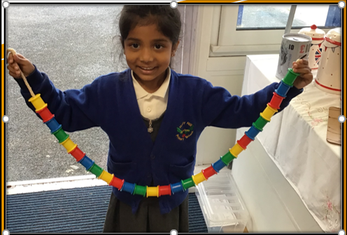
Our Cygnets Hero
Jesona is one of our heroes this week because of her amazing pattern making! She wowed us last week by making a repeating pattern completely independently. She has also been working hard in the provision to help her friends tidy up. Well done Jesona!

Slide 3
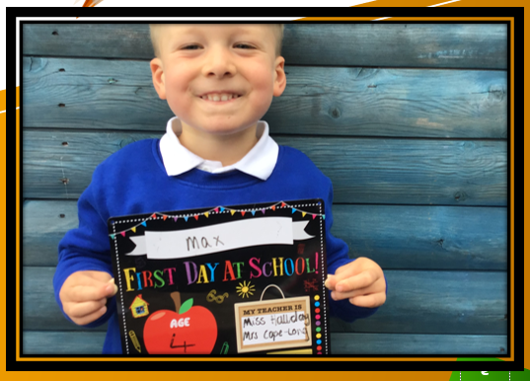
Our Cygnets Hero
Max is our other hero this week because he has made a fantastic start to our school. He is now following all of our rules and works incredibly hard in all our sessions too. I know his mummy is super proud of him because he has recently been a superstar at home too. Well done Max!

Slide 4
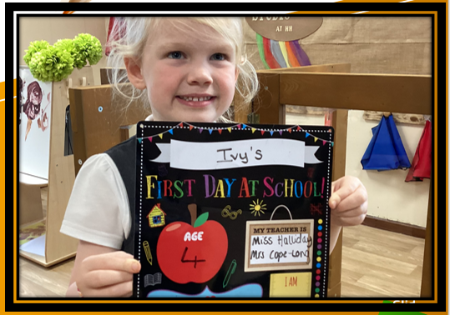
Our Cygnets Hero
I'd love to nominate Ivy for hero this week. She has shown so much kindness to others - checking they are ok and have a friend. Ivy looked for a Peppa Pig story to share with a younger friend because she knew it was her favourite and took the time to sit and read it to her. She always follows our value of care and respect.
Well done Ivy!

Slide 5
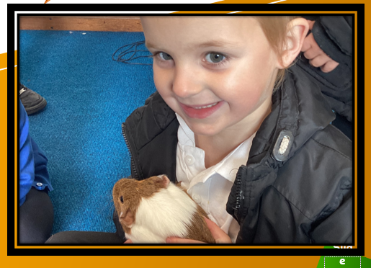
Our Cygnets Hero
Finnley has also really impressed me with his knowledge of how to care for living things. He asked insightful questions about how to care for guinea pigs when he met Eric and Muffin and treated them with kindness. When we explored the pumpkins in the garden he knew exactly what they needed to help them grow and thrive. Well done Finnley!

Slide 6
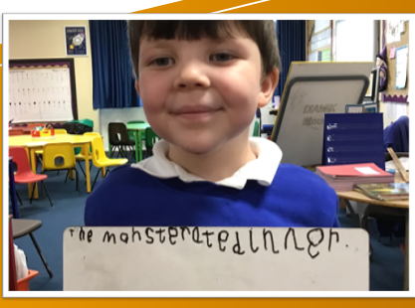
Our Puffin Hero
Luca is Puffin Class Hero this week because of his enthusiasm when we went on our trip to Papplewick Pumping Station two weeks ago. He was so interested in everything we did and got stuck in with all the activities. He also asked and answered questions and showed real empathy towards the character Wilf who was a boy who worked in the Pumping Station in the Victorian times. Luca, it was a real pleasure to see you enjoy this experience so much.
This week Luca has also been working really hard on his writing. Well done Luca - you really are a Perfect Puffin!

Slide 7
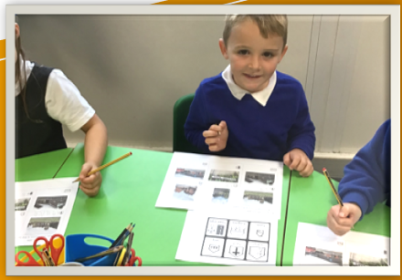
Our Puffin Hero
Chester is Puffin Class Hero this week as he has blown me away with his attitude to his learning and especially his writing. This week we have been writing the story ‘Not Now Bernard’ and Chester has tried incredibly hard each day to remember his sentence, use his phonics to write words and remember finger spaces. He has rightly been proud of his work and it has been lovely to see his beaming face.
Well done Chester, you really are a Perfect Puffin!

Slide 8
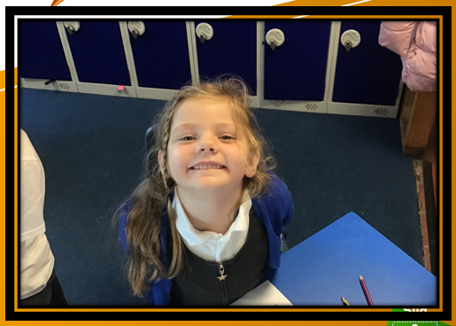
Our Wren Hero
Our Wren hero this week is Lucy.
Well, Lucy has been trying super hard in Wren class since becoming a year 2 and will always give everything a go, even when she finds it a bit tricky. She always puts her hands up and joins in sharing her ideas in class. She always sits beautifully on the carpet and gives the best cuddles.
Keep it up Lucy!

Slide 9
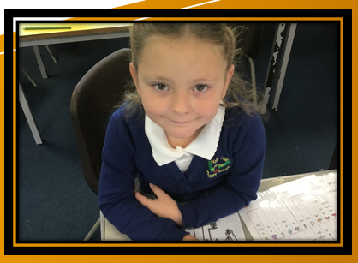
Our Wren Hero
I couldn't not choose Bella this week after she amazed me in our Science and History lessons this week. She remembered so much information from our previous lessons, every time I asked a question her hand went straight up. What a superstar! She has also been trying extra hard in phonics and has been listening beautifully on the carpet. Keep it up Bella!

Slide 10
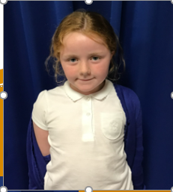
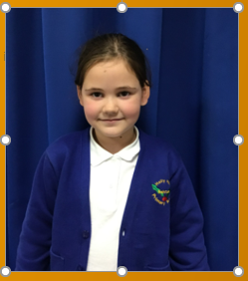
Our Woodpecker Hero
This weeks Woodpecker heroes are Phoebe and Larna.
We have done lots of paired work this week and Phoebe has worked brilliantly with every partner she has been with. When she worked with Larna they took everything in turns and listened to each others ideas. Larna is a hero not just for her paired work but also for settling in to Woodpecker Class brilliantly.
We feel very lucky to have you in Woodpecker class.

Slide 11
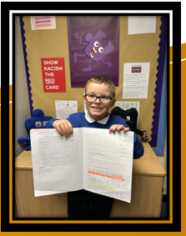
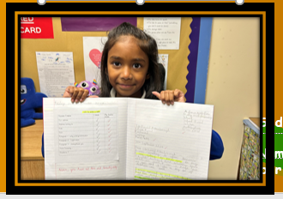
Our Kingfisher Heroes
This week I have chosen Finley and Adona as English heroes.
We have been writing a letter to send to David Attenborough and they have both wowed me with their letter writing skills - a tricky skill to do!
Their letters have turned out beautifully and they have shared with Sir David what makes them an earth hero.
Your hard work has paid of, keep being amazing writers! ✍️🌟

Slide 12
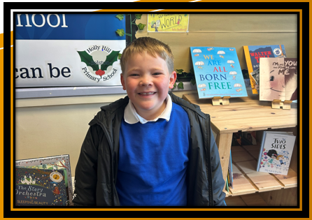
Our Kingfisher Heroes
My hero this week is Zach.
During our break dancing and beat-boxing workshop, Zach embraced it all! He listened, and tried everything that was taught (even the tricky spin moves!) I think we’ve found our future break-dancer. Watch this space…
Well done Zach, you were awesome!

Slide 13
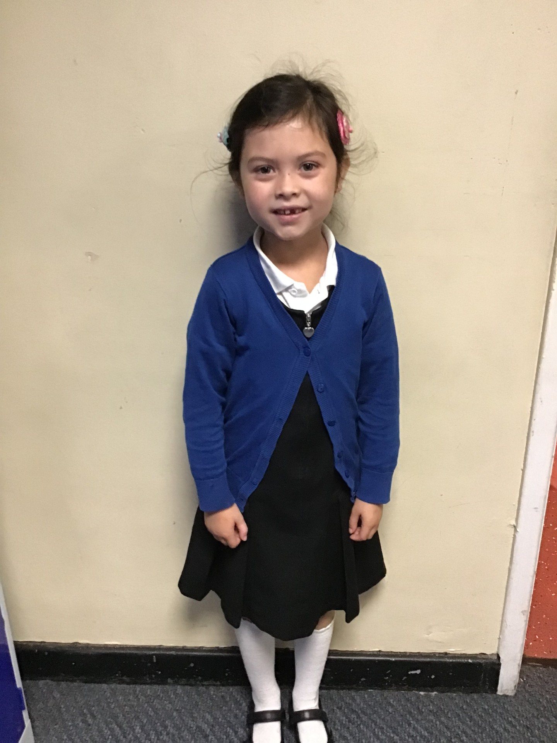
Our Dove Hero
Milarose is a perfect Dove.
She is kind, caring, very sensible and exceptionally hard working. Even when she finds something a challenge, she doesn’t ever give up. Her handwriting is absolutely beautiful, maybe even nearly worthy of a pen licence soon!
Well done Milarose!

Slide 14
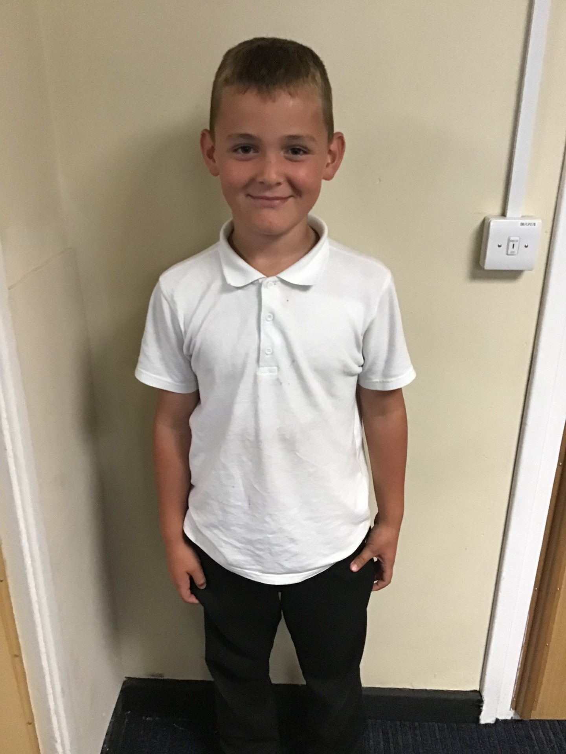
Our Dove Hero
Another Dove hero this week is Ronnie.
We have witnessed him on numerous occasions being a fantastic friend to others in Dove class. He is the first to put an arm around anyone who is upset or is struggling and he has a brilliant sense of humour which always cheers his friends up.
What a fabulous member of the class you are Ronnie!

Slide 15
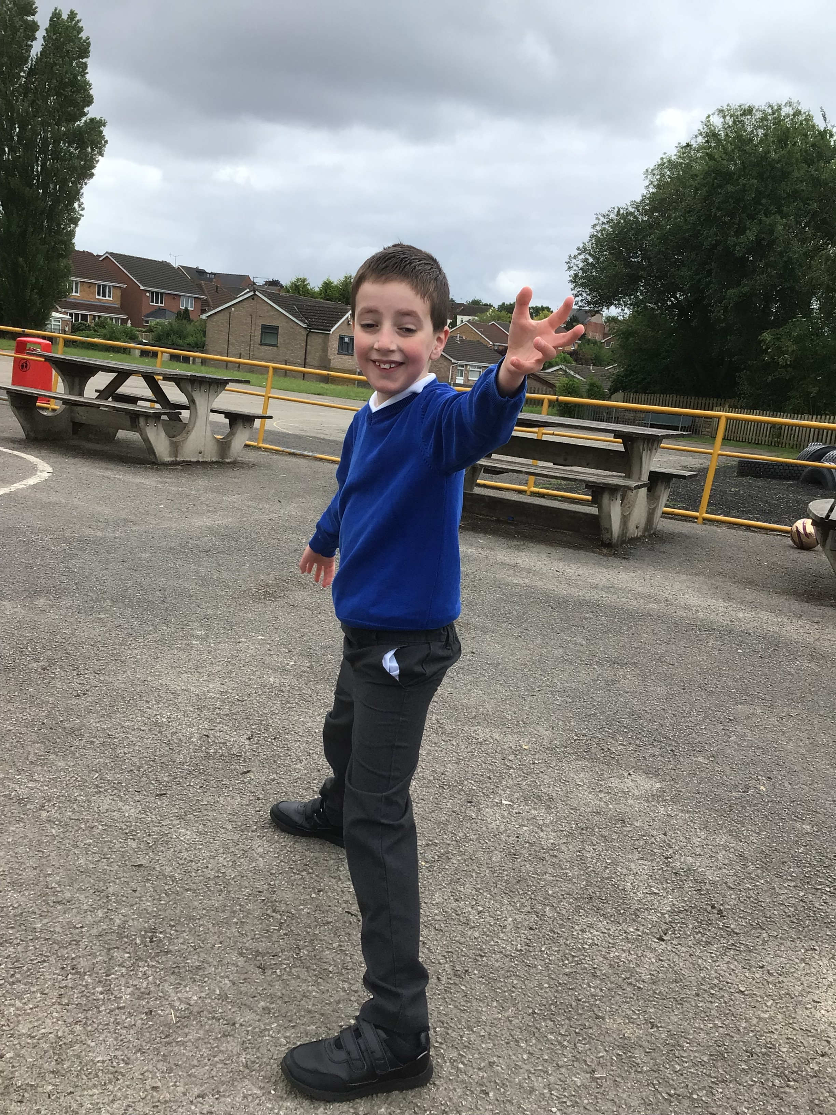
Our Dove Hero
Stanley is also Dove's hero this week. He has been working super hard in class and has developed his concentration and listening skills. He is much more focussed and this can be seen in the quality of his work. We have been so impressed with Stanley and he has even been star of the day this week!
Well done Stanley!

Slide 16
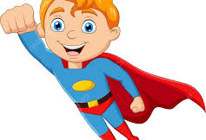
Our Dove Hero
Our final hero this week is James. James has been working really hard with his writing: sounding out carefully, spelling tricky words and doing beautiful handwriting. His hard work is really paying off!
Well done James!

Slide 17
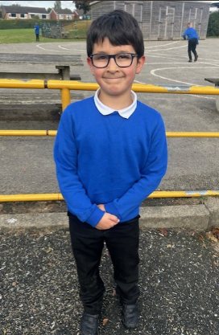
Our Swallow Hero
Jasper is such a positive and kind member of Swallow who arrives each day with a big smile. He has always been a role model for thinking creatively and asking interesting questions in class, along with supporting others. And on top of this, he wowed everyone this week with a phenomenal effort at beatboxing. Well done Jasper! I'm sure we'll see you on stage at Glastonbury soon!

Slide 18
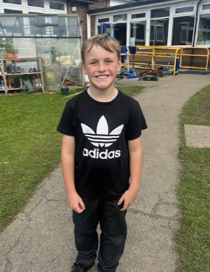
Our Swallow Hero
Tyler has shown an excellent focus and attitude this week. Something it is clear he has been working hard on. We have been really impressed with some of his writing work and how he has supported his partner when making a David Attenborough video about Penguins. Tyler is also really helpful at doing many jobs around class, especially when he arrives in the morning and gets everyone's places set up.
Thank you Tyler and well done!

Slide 19
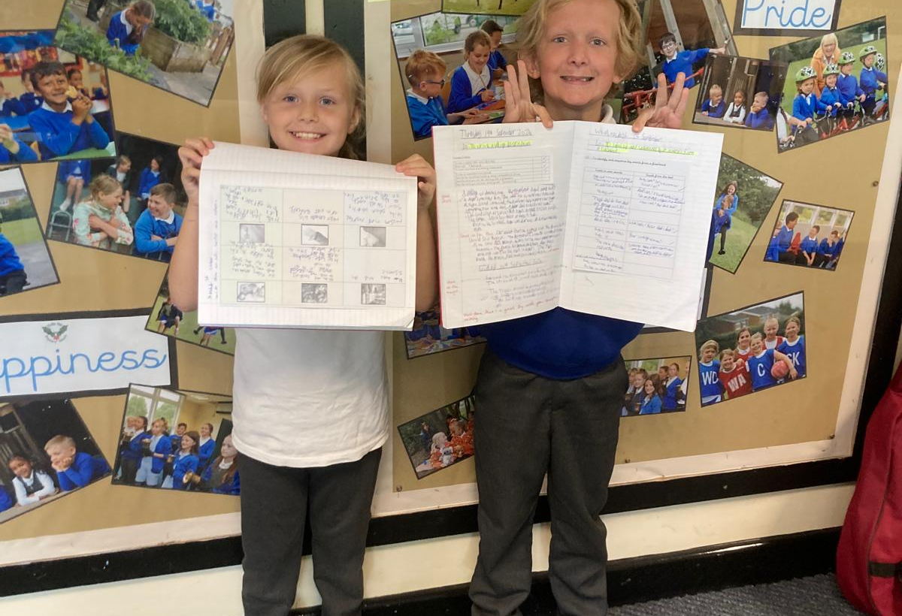
Our Owl Hero
Anastacia and Alex are writing heroes this week as I am so impressed with their work. Anastacia’s own ideas for her chase scene were great and Alex has already produced 3 pieces of lovely Year 5 writing where he is trying hard to use things that we have learned in class.
Well done both of you!

Slide 20
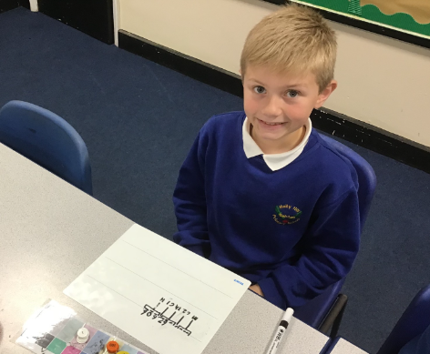
Our Falcon Hero
The first Falcon Hero this week is Harry! Harry has been super engaged in Maths and this has had a great impact on his understanding of factors, multiples and primes. He has been ready to learn and has listened to me so well. Harry also takes great care with his work in all lessons and I love seeing the beautiful presentation in his books! Keep it up Harry!

Slide 21
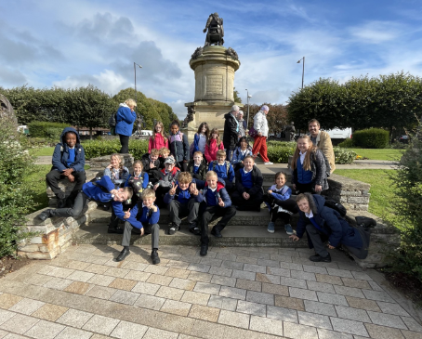
Our Falcon Hero
The other Falcon Heroes are all my Year Sixes! When we were on the trip last week to Stratford-Upon-Avon, their behaviour was absolutely exceptional! They listened so well and were the most sensible group I’ve ever taken at crossing all the busy roads. I was really proud of them all day and look forward to being impressed with their great behaviour many more times this year.

Slide 22
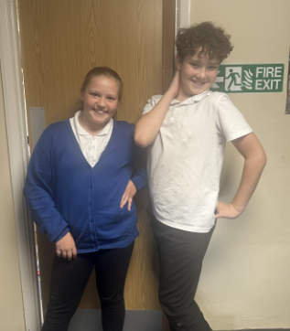
Our Swan Hero
Lilly and Jordan are my dream team heroes this week for their amazing teamwork in class this week. Particularly in English, Jordan and Lilly have been working together to write some instructions for a mechanical man and I love how enthusiastic and engaged they've been working together.
Well done dream team!

Slide 23
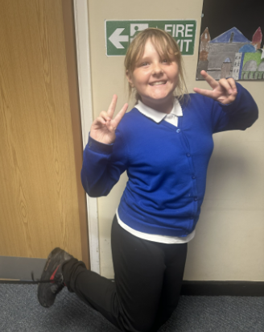
Our Swan Hero
Ruby is a hero this week for her incredible writing in our English lessons. Ruby has made such incredible progress in only a few short weeks and I'm so proud of how hard she's working in class.
Well done Ruby!

Slide 24
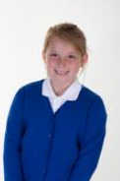

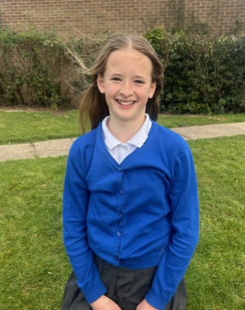
Our Lunchtime Heroes
Our marvellous Middays have nominated three children to be their lunchtime heroes this week.
Firstly, Heidi for always having beautiful manners in the dining hall and being a wonderful role model for lunchtime behaviour.
Also Willow for always eating all of her dinner and sitting beautifully in the dining hall.
Last but not least, Amelia, for exceptional kindess to a friend. When someone had been left out of a game, she helped them to join in and chatted to them kindly about not being too rough.

Slide 25
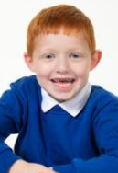
My Headteacher’s Hero
Joe is my Headteacher’s hero this week. His ‘Not Now Bernard’ writing blew me away. He had used his story sequence to help him create lots of sentences and had written lots of words independently. Mrs. Warsop had shiny eyes when she brought him to show it me and the Year 5s who were in my room at the time, were also amazed! I thought Joe’s story was even better than the original!! Keep up the hard work Joe – you are a very wonderful Woodpecker!

Slide 26
Class Attendance winners
This week’s winners with 97% are Wren class! Well done Wrens!
Remember, when you reach 3 wins, your class will get £25 to spend on books and 15 minutes extra play! Try to come to school every day to help your class be the winners!
CLASS | WIN 1 | WIN 2 | WIN 3
Cygnets 1
Cygnets 2
Puffin
Wren
Woodpecker
Kingfisher
Dove
Swallow
Owl
Falcon
Swan

Slide 27
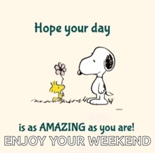
Have a lovely weekend everyone!
Maybe you could impress your families with your beat boxing and break dancing skills!
Mrs. Steed xxx

