Slide 1

Holly Hill Heroes Assembly
HOLLY
HILL
AUTUMN TERM, 2024

Slide 2
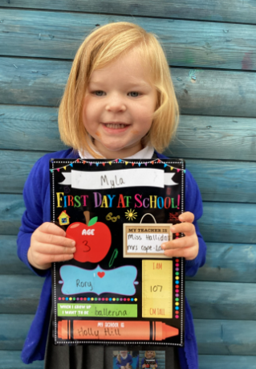
Our Cygnets Hero
Myla is a Cygnet hero this week. Her behaviour really is impeccable and she always follows the Holly Hill Way. She is a pleasure to have in the class and enjoys all learning activities on offer. I was so proud of Myla for using descriptive vocabulary to describe porridge and trying some this week! Myla said it was 'yummy' with a big smile on her face! Well done Myla!

Slide 3
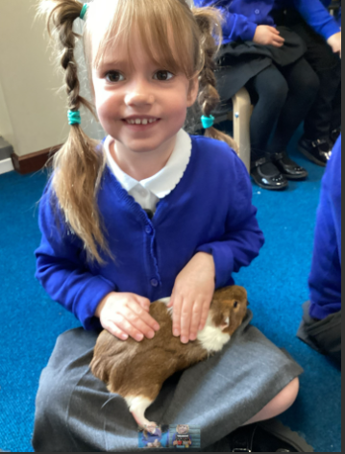
Our Cygnets Hero
Agnes is a Cygnet hero this week. Agnes has settled in so well and is growing in confidence more and more each day. She always is a kind friend to others and has an infectious giggle that just brightens your day. Her phonic knowledge is really progressing and she has started to write words and label pictures! Well done Agnes - we are very proud of you!

Slide 4
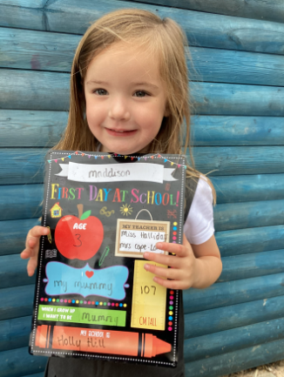
Our Cygnets Hero
Maddison is one of our hero's this week for her super effort in phonics! She is absolutely smashing it. She is blending and remembering so many sounds! Go Maddison!

Slide 5
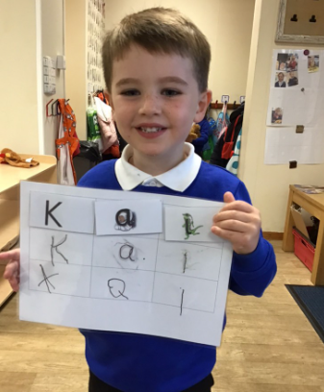
Our Cygnets Hero
Kai is our other hero because of his super morning work. Kai is working hard to hold his pen correctly and form his name. He practises everyday and he is getting so much better. Well done Kai!

Slide 6
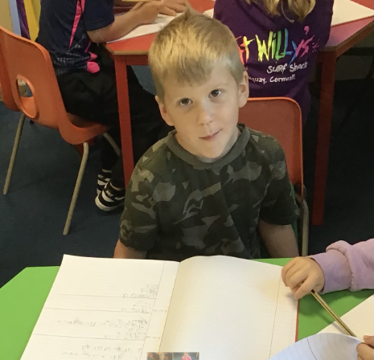
Our Puffin Hero
Seth is Puffin Class Hero this week. He has developed a fabulous attitude to his learning over the last few weeks and this week has worked particularly hard with his writing. He is also trying really hard to be sensible and grown up. Well done Seth, you really are a Perfect Puffin!

Slide 7
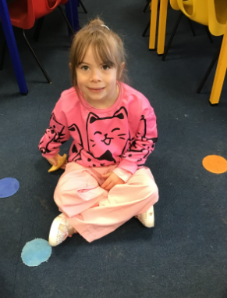
Our Puffin Hero
Oceana is Puffin Class Hero this week due to her amazing attitude to everything we do. She has worked hard over the last few weeks to work independently. This week she has worked particularly hard with her writing. Oceana is always impeccably well behaved and kind to other children. Well done Oceana you truly are a Perfect Puffin!

Slide 8
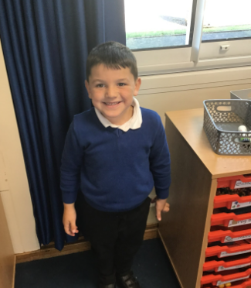
Our Wren Hero
Frankie for trying really hard with his writing this week, we have been reading Six Dinner Sid and Frankie has completed his writing all about Sid's six different dinners. He worked hard on all of his six sentences, using the phoneme mat when needed to help him write independently. Keep it up Frankie!

Slide 9
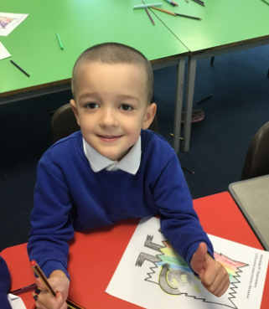
Our Wren Hero
Donald for settling into year 2 really well! Even though the expectations have increased, he is giving his work his all and is completing some wonderful pieces within all of our lessons. It has been fabulous to see the progress Donald has made since being a Robin with myself in F2 to being a wonderful Wren now in year 2 creating so many more fabulous pieces of writing and maths.

Slide 10
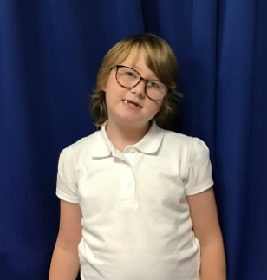
Our Woodpecker Hero
This weeks Woodpecker heroes is Phoebe H.
Phoebe has tried really hard this week to follow instructions and work independently and has been an absolute superstar. She has been working really hard and trying her very best. Well done Phoebe.

Slide 11
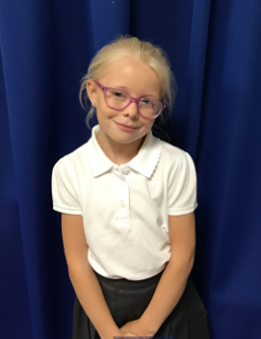
Our Woodpecker Hero
This weeks Woodpecker heroes is Jasmine.
Jasmine has been noticed lots this week for trying so hard and being helpful to others. She has worked hard in maths and was helping others in the classroom and being really kind. Well done Jasmine.

Slide 12
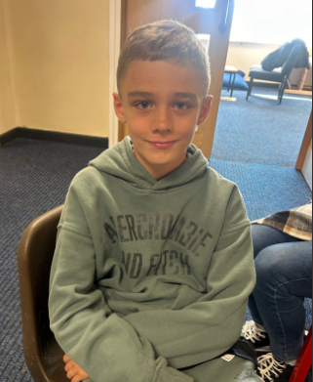
Our Swallow Hero
Daniel for being such a trooper after his recent accident. He's got straight back into work with an excellent attitude, even when things have been uncomfortable at times. He's stayed positive, and focused and always kept trying his best!

Slide 13
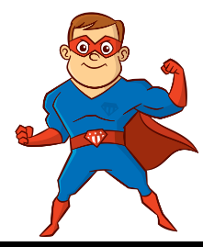
Our Swallow Hero
Blake has been a real role model for effort and listening this week. He's always motivated to try his best and has been coming to school with a lovely cheerful attitude each day. He has exceptional presentation and has been a great friend, helping others when they need it around school.

Slide 14
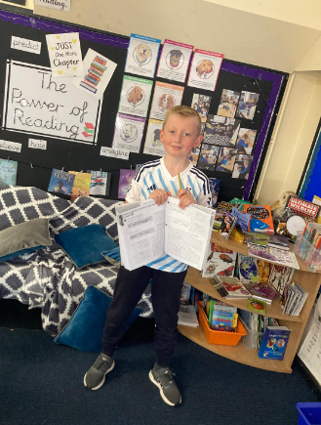
Our Owl Hero
Our Owl hero this week is Alfie.
I’ve been really impressed with Alfie recently. He’s been working really hard and is making great progress. His attitude to learning is great and he is trying hard in all areas.
Well done Alfie!

Slide 15
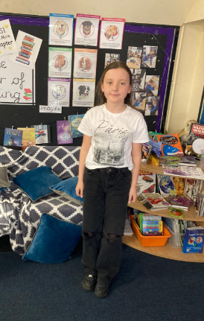
Our Owl Hero
Bella is our hero this week. Bella was new to our school in September and she is hero today because we are really happy with how she has settled in. It’s like she’s always been here! She’s made lots of friends and is trying hard with her work. Well done Bella!

Slide 16
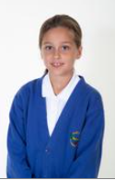
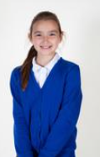
Our Lunchtime Heroes
Molly has been chosen by the dining hall Midday supervisors for always setting a great example at lunchtime. She sits beautifully and always demonstrates respect and manners. Well done Molly!
Phoebe has also been chosen for the care she has shown to our school grounds this week. I commented this week that the field was looking untidy and Phoebe went to fetch a litter picker and a bin bag and worked tirelessly to ensure it is looking much better! Thank you so much Phoebe – your hard work has been noticed by us all.

Slide 17
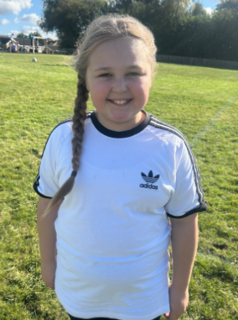
My Headteacher’s Hero
Lola is my Headteacher’s hero this week.
Lola is an exceptionally kind and thoughtful girl who always looks out for people and is sensitive to their feelings. Lola is wise beyond her years.
This week, in her own time, Lola wrote a letter to a member of staff who has suffered a bereavement. It moved those of us who were fortunate enough to read it, to tears. Lola knew exactly what to say to offer comfort.
It was a reminder to all of us grown ups that even when life is tricky, there is always something to smile about.
Wonderful people like Lola make the world a nicer place.

Slide 18
Class Attendance winners
This week’s winners with 99.2% are Falcon class! Well done Falcon!
Remember, when you reach 3 wins, your class will get £25 to spend on books and 15 minutes extra play! Try to come to school every day to help your class be the winners!
CLASS | WIN 1 | WIN 2 | WIN 3
Cygnets 1
Cygnets 2
Puffin
Wren
Woodpecker
Kingfisher
Dove
Swallow
Owl
Falcon
Swan

Slide 19
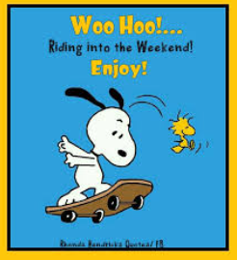
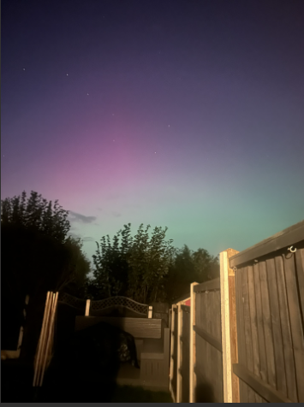
Have a lovely weekend everyone!
Ask a grown up at home if they’ll help you look for the Northern Lights tonight when they may be visible again. This was my garden last night.
Mrs. Steed xxx

