Slide 1

Holly Hill Heroes Assembly
HOLLY
HILL
AUTUMN TERM, 2024

Slide 2
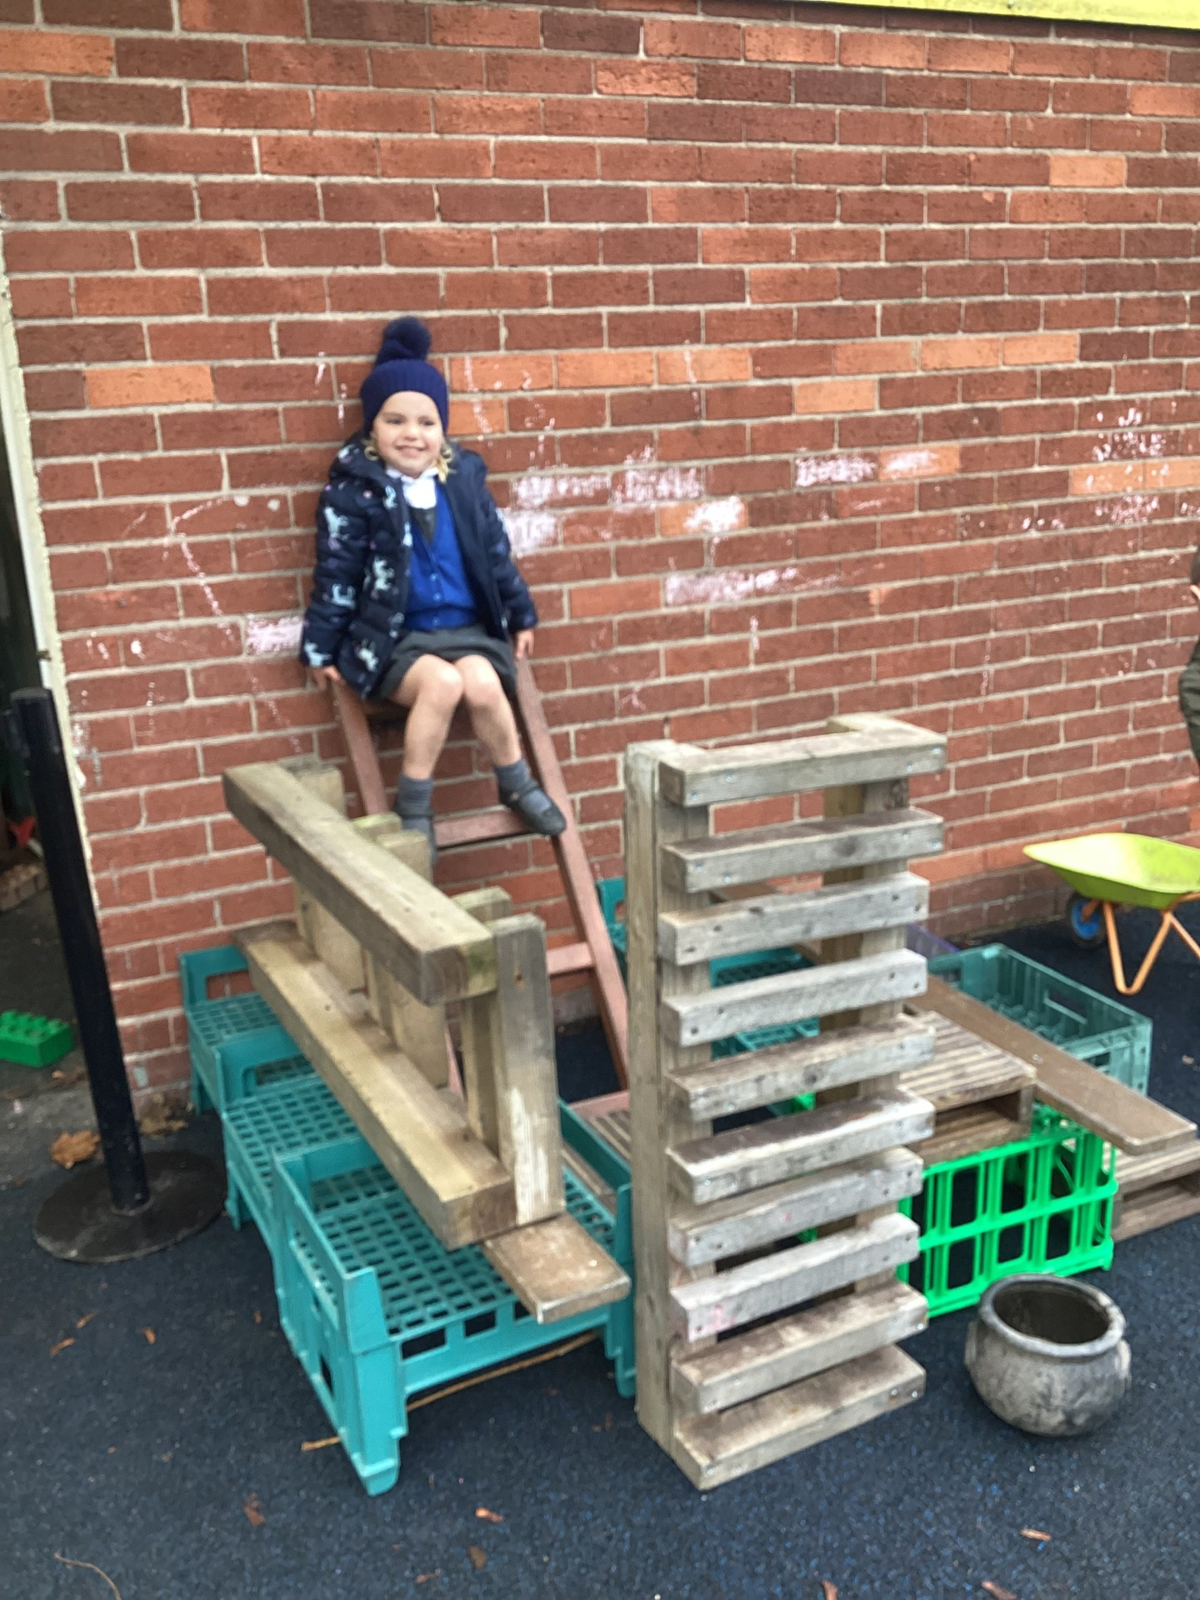
Our Cygnets Hero
Harper is so imaginative in her play. Harper created a world where she was the Queen of Hearts in her castle outdoors and included other children in her game. Harper was able to communicate her ideas brilliantly, share and include everyone. The resulting castle was fantastic and a real team effort. Well done Harper!

Slide 3
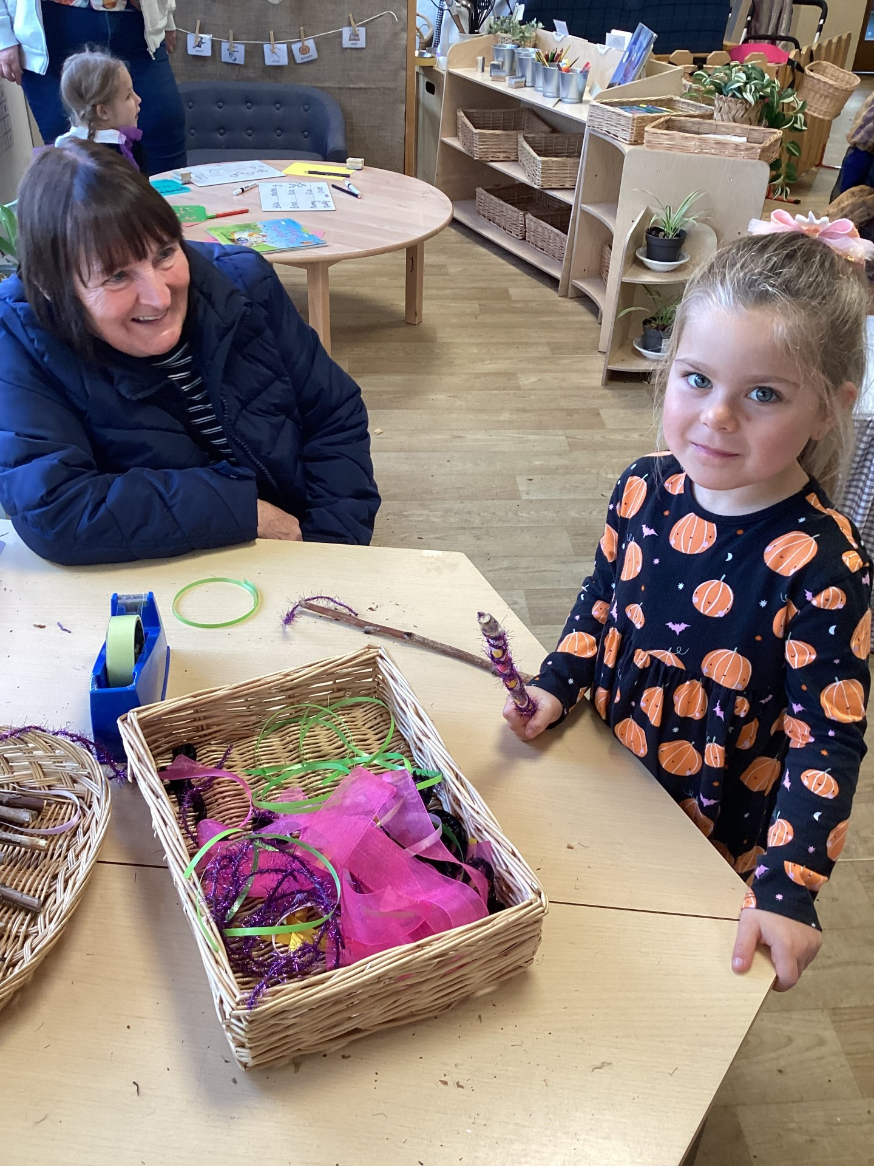
Our Cygnets Hero
Also, Ella is a Cygnet hero! Ella's behaviour is always impeccable - she is kind to others and follows our Holly Hill Way and is always eager to learn. Ella has been practising her learning at home and can now write her first and last name, words and short sentences all by herself! Keep practising Ella - your determination is fantastic and makes you a real role model to others. Well done!

Slide 4
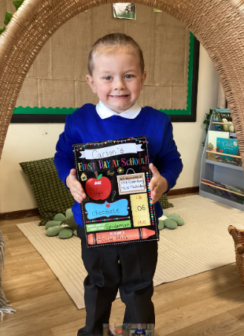
Our Cygnets Hero
Carson is one of our heroes this week! Carson was a very shy little boy at the start of the year and he would often cover his face when he was worried. He is now super confident and is trying really hard in his group time and his playtime. We are so proud of you Carson! What a superstar!

Slide 5
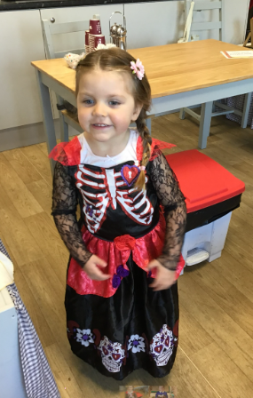
Our Cygnets Hero
Hallie is another one of our heroes this week because she is just an all round superstar. She is always looking after her friends and she is super kind. Hallie enjoys taking care of her friends and this is such a beautiful quality to have. Well done Hallie!

Slide 6
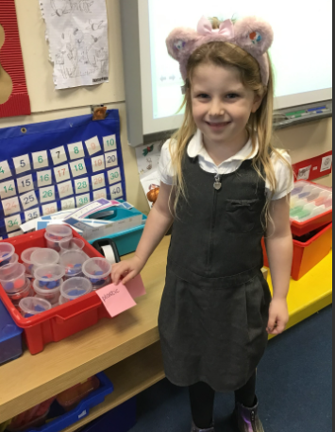
Our Puffin Hero
Olivia is Puffin Class Hero this week because of her fabulous contributions to our discussions. This week she has made some brilliant suggestions for what might happen in our new book Journey by Aaron Becker. She has used varied vocabulary and spoken clearly for others to hear. Well done Olivia, I love hearing all your fantastic ideas and the other children really benefit from them too. You are most definitely a perfect Puffin Olivia!

Slide 7
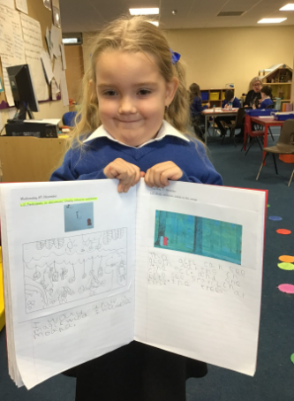
Our Puffin Hero
Ella has been amazing this week. She has challenged herself to write three sentences about our story Journey. She worked independently using her phonics and including punctuation. Wow Ella - your attitude is fantastic. You really are a Perfect Puffin!

Slide 8

Our Wren Hero
Ava has been a superstar completing her maths this week - she has been counting objects to five and building towers with five blocks. She knew exactly when to stop adding more blocks and objects to her pile, whilst they counted the numbers and she always stopped on five. Well done Ava!

Slide 9
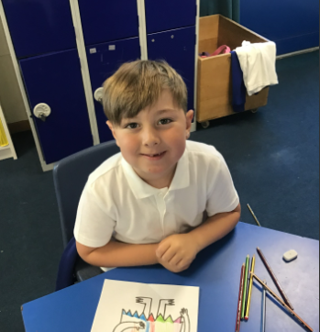
Our Wren Hero
Finley really impressed me this week with his descriptive writing. We have been exploring a fantastic wordless picture book called 'Journey' which has some fabulous illustrations within. Finley created a wonderful description based on one of the settings, a forest scene, and he tried his best to make all of his sentences make sense too. Well done Finley!

Slide 10
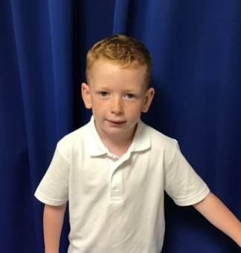
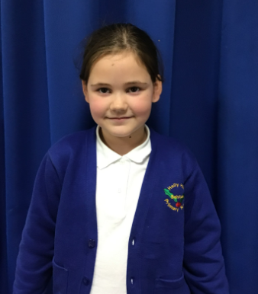
Our Woodpecker Hero
In English this week, our book has been the journey and everyone has produced some amazing writing this week so it has made it really difficult to choose just 2 heroes. The two I have chosen are for slightly different reasons.
Rupert is our first hero for having some fantastic vocabulary ideas when describing the setting in the book – well done Rupert!
Larna is our second for her descriptive sentences and her choice of vocabulary. Great work Larna!

Slide 11
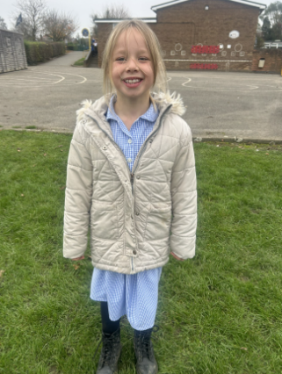
Our Kingfisher Heroes
Kingfisher Heroes this week are Connie and Evie.
In English, we have been retelling the story of ‘Picture Perfect’ These girls both did a lovely detailed story map, and then retold their part of the story with clear speech and actions.
What really impressed me was, they were both quite shy about performing in front of an audience, but did the job anyway!
Well done for showing good resilience and retelling the story successfully 🌟

Slide 12
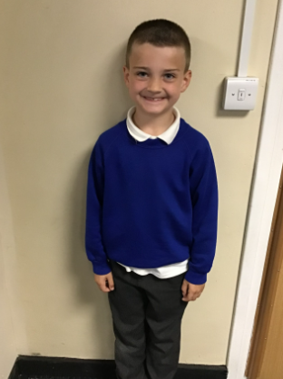
Our Dove Hero
﻿Our first Dove hero this week is Corbyn. Corbyn has had a tough few weeks yet every morning he walks into school with a wonderful smile on his face and a super positive attitude. He always gives everything his all and is such a helpful member of the class. Thank you for always being such a ray of sunshine Corbyn.

Slide 13
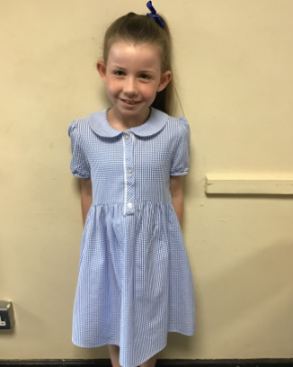
Our Dove Hero
Our second hero this week is Amelia. Amelia has gone from strength to strength with her confidence and independence since the beginning of the year and is making great progress. She is also such a caring member of the class who always checks in with others to see that they are ok. What a fabulous Dove you are Amelia and a pleasure to have in the class.

Slide 14
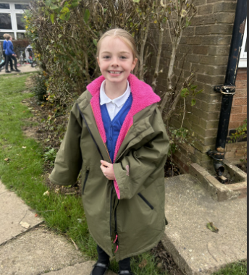
Our Swallow Hero
Our Swallow hero this week is Rosie. Rosie has been a superstar this week. She has been really helpful and kind to others and incredibly focused, especially in our Art lessons. I was really impressed with her printed portraits in the style of Andy Warhol which she managed to do without any help!

Slide 15

Our Swallow Hero
Our second Swallow hero this week is Leo. Leo has been working really hard this week. We have been impressed with his focus, especially in Maths sessions, where is making lots of great progress! Keep it up Leo!

Slide 16
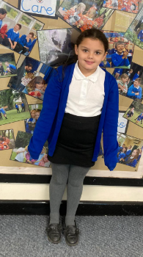
Our Owl Hero
Kailah is Owl’s hero this week. She only joined our school on Monday and she has had an amazing first week! She has settled really well, has made lots of new friends and has produced some great work!
Well done Kailah – a great start to life in Owl class!

Slide 17
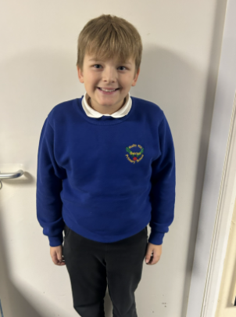
Our Falcon Hero
The First Falcon Hero this week is Kai! Kai is always trying his best in lessons, not just with his independent work, but also trying his best to listen to instructions. He is very often the first one to listen and be ready to learn! This week Kai has worked especially hard with learning long division. He has showed great resilience with this very tricky new method and by Friday was so competent that Mrs Cordon was having to get out her pen and paper to work out his answers! Well done Kai- you should be really proud of yourself for sticking with it and being a Fabulous Falcon!

Slide 18
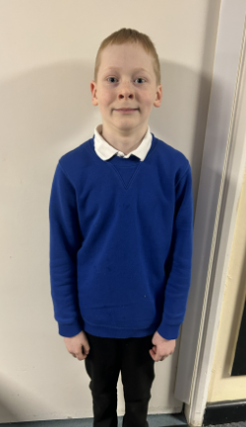
Our Falcon Hero
The next Falcon Hero this week is Jaxon! Jaxon is the kind of person that anyone would be lucky to have as their friend, being funny and kind (as well as a brilliant learner too!) Jaxon has been an excellent example of a desk partner this week. He has been sat with a student who is new to our school and has shown care and respect by taking the time to explain things and check that she has understood the way things are done in Falcon Class. Thank you Jaxon- Falcon Class is better for having you in it!

Slide 19
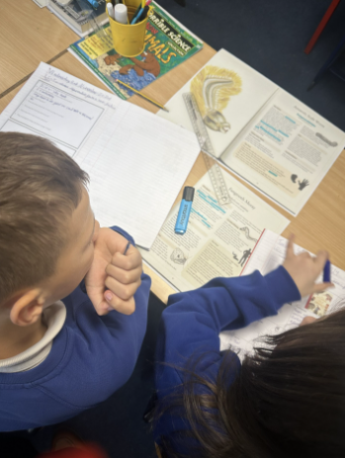
Our Swan Hero
Luca is my hero this week for how hard he has been working in class. Luca is an incredibly intelligent boy, with amazing knowledge about so many things in the world. He’s loving our new book all about ugly animals and uses high level vocabulary to talk about the animals in the book. Luca – you’re so kind and clever. It’s a pleasure to have you in Swan class!

Slide 20
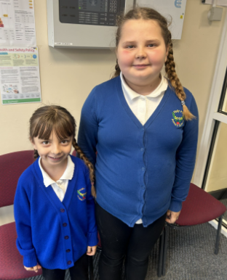
Our Lunchtime Heroes
Our lunchtime heroes this week are these superstar sisters – Lilly and Evie! These girls are an absolute delight to have around at lunchtime. They are both kind, helpful, caring and will do anything for anyone!
Evie is particularly helpful in the dining hall and shows her nurturing thoughtful nature with the support she gives to a friend.
Lilly is particularly kind on the playground – always welcoming to new children and acting as a super role model to all when demonstrating kindness, thoughtfulness and inclusive play.
We are extremely proud of you both girls – well done!

Slide 21
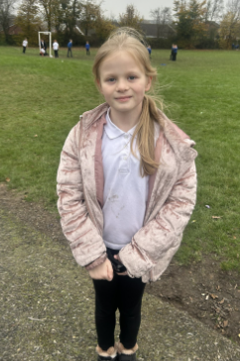
Our Lunchtime Hero
Holly is one of our lunchtime heroes for being so helpful and kind!
Holly will always run and fetch an ice pack for a grown up when they are doing first aid and is the first to offer to play with someone who is looking for a friend.
You are a superstar Holly and make the playground a lovely place to be for adults and children!

Slide 22
Class Attendance winners
This week’s winners with 99.2%% are Wren class! Well done Wrens!
Remember, when you reach 3 wins, your class will get £25 to spend on books and 15 minutes extra play! Try to come to school every day to help your class be the winners!
CLASS | WIN 1 | WIN 2 | WIN 3
Cygnets 1
Cygnets 2
Puffin
Wren
Woodpecker
Kingfisher
Dove
Swallow
Owl
Falcon
Swan

Slide 23

What a lovely first week back!
Well done everyone – have a fabulous weekend!
Mrs. Steed xxx

