Slide 1

Holly Hill Heroes Assembly
HOLLY
HILL
AUTUMN TERM, 2024

Slide 2
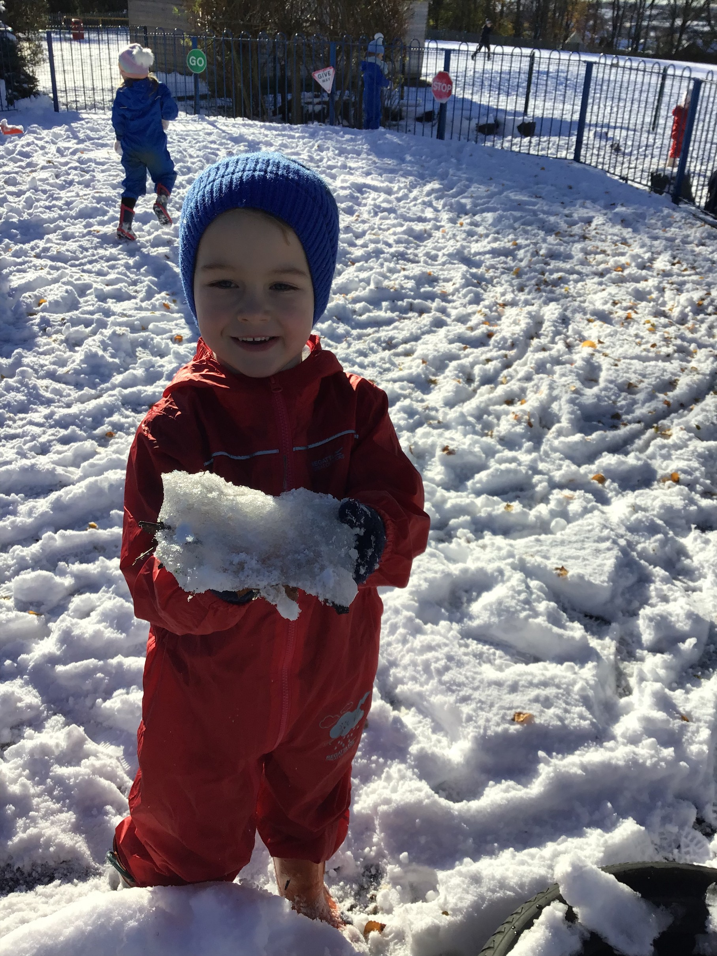
Our Cygnets Hero
Karter is one of our Cygnet heroes this week because he is just a wonderful young man. He is growing so much in confidence every single day, showing us how clever he really is. We never have to ask Karter to do something more than once, he is such a good listener! He works super hard in all our learning times and looks after our environment too. Karter we are so proud of you! Well done superstar.

Slide 3
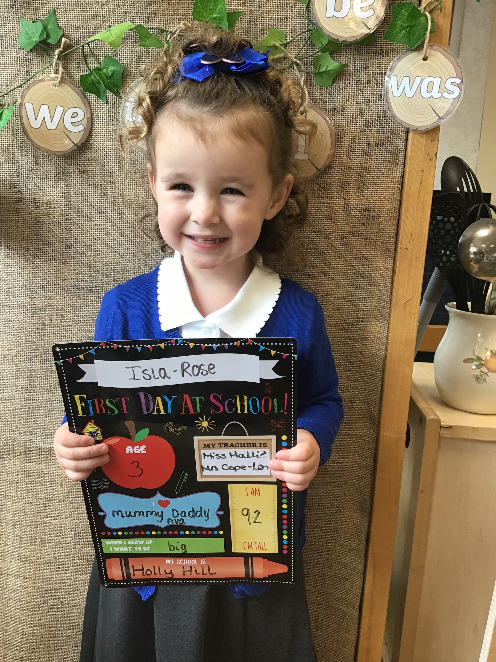
Our Cygnets Hero
Isla-Rose is one of our Cygnet heroes for her bravery in the mornings leaving her sister and mummy. Isla was finding it super tricky to come in without crying in a morning but she is getting more confident every day! Isla has come to school with a smile on her face every day this week and it makes her teachers and her family so happy. Isla also wowed me with her super duper counting. We practised counting to 5 using currant buns and pennies, well done Isla!!

Slide 4
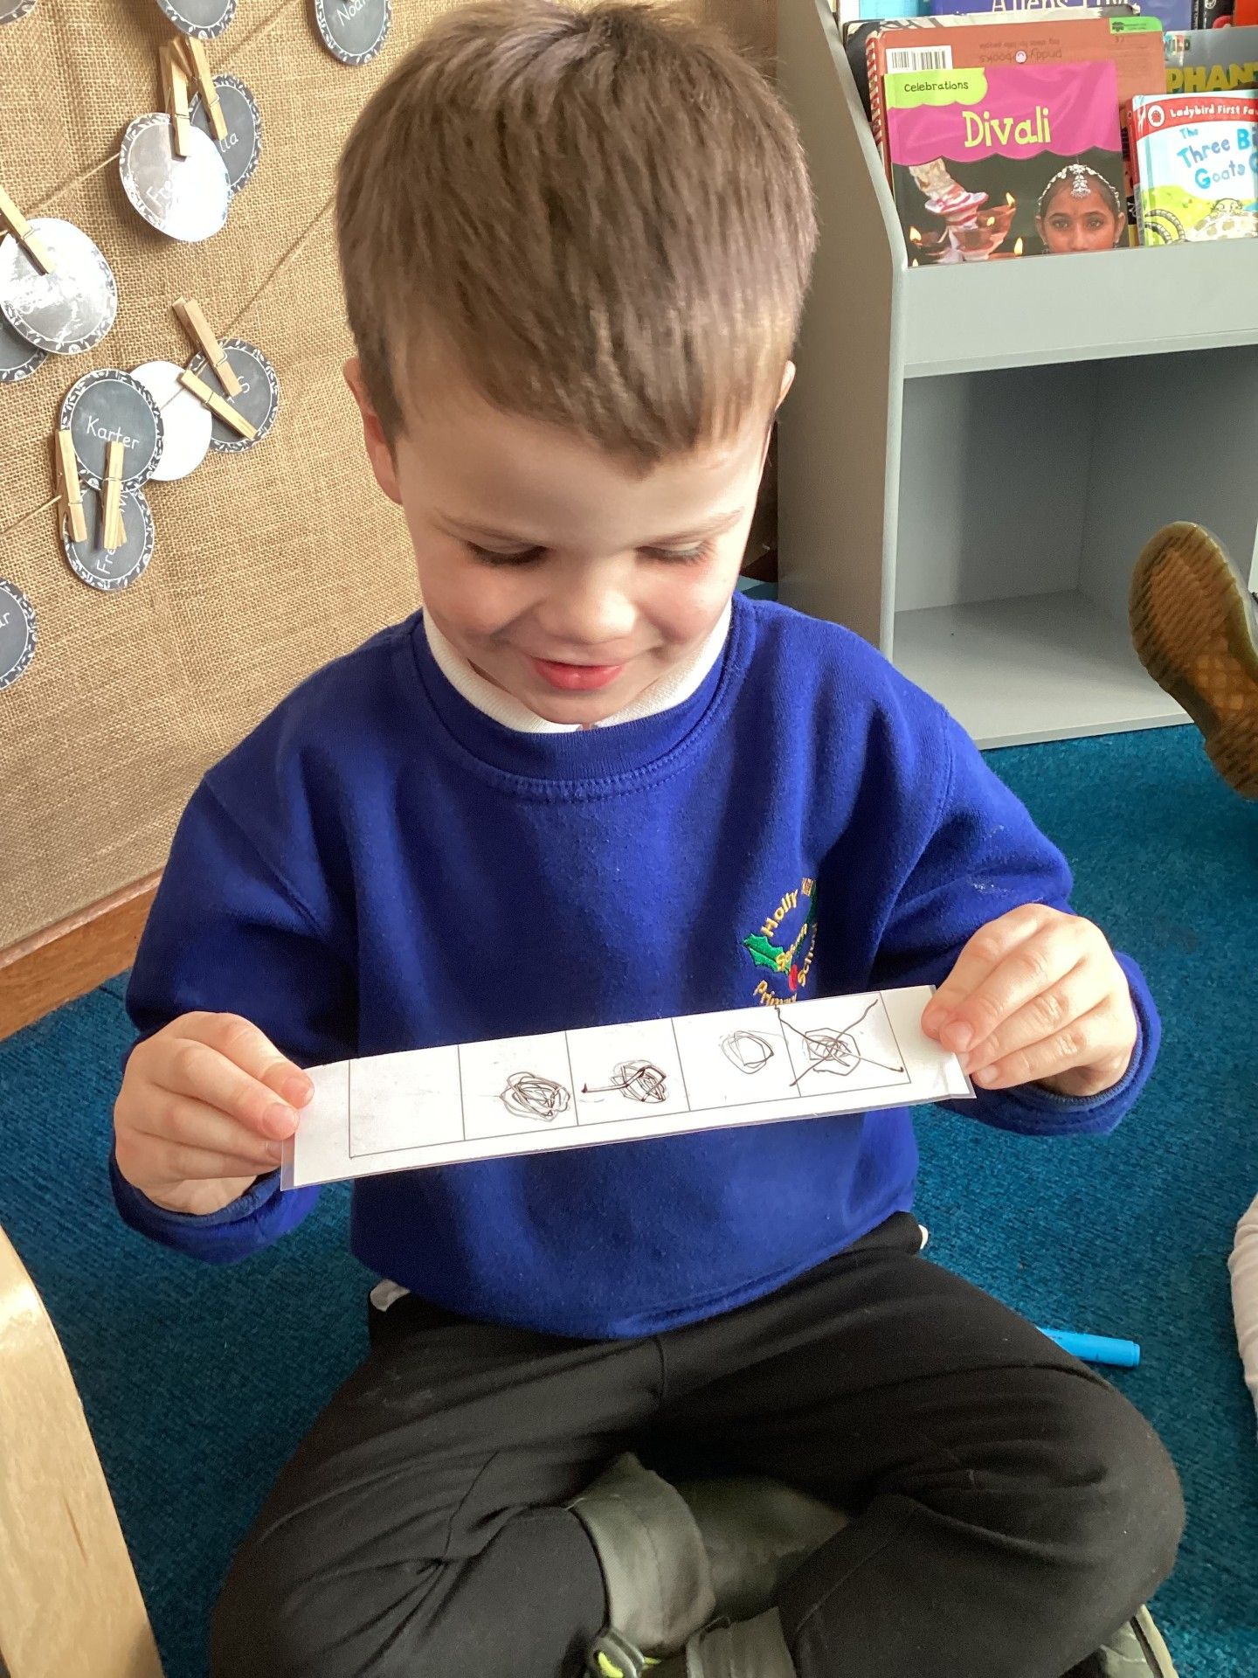
Our Cygnets Hero
Bobby-Dean is a hero this week because he is impressing every adult in Early Years with his learning. He is reading sentences and books independently using his phonics skills and can explain his reasoning to others in maths. Keep working hard Bobby-Dean we are very proud of you!

Slide 5
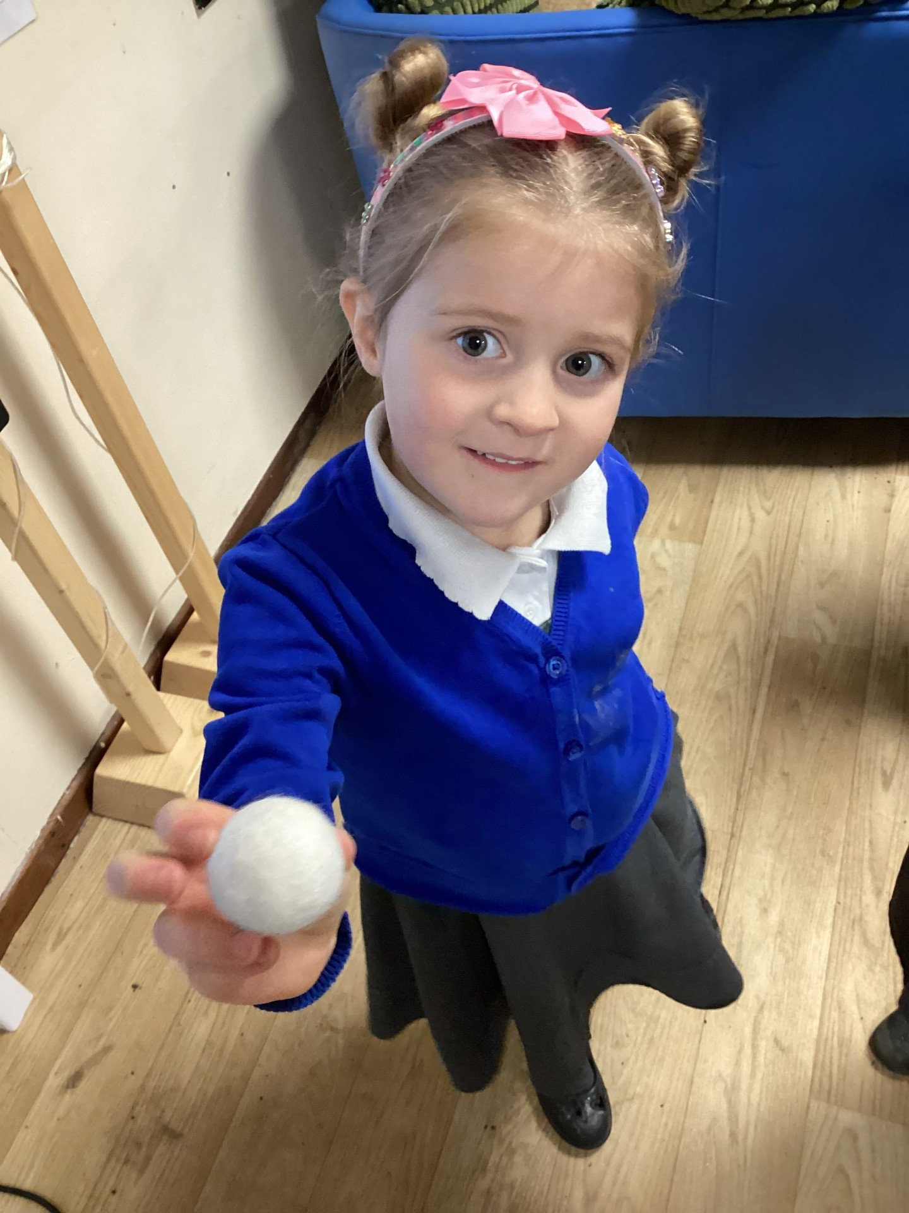
Our Cygnets Hero
Holly is a hero this week because her understanding and reasoning skills in maths are fantastic! Holly can add and take away using a 5 and 10 frame. She used all of the key vocabulary in our sessions this week and created her own first, then and now story. Well done Holly! :)

Slide 6
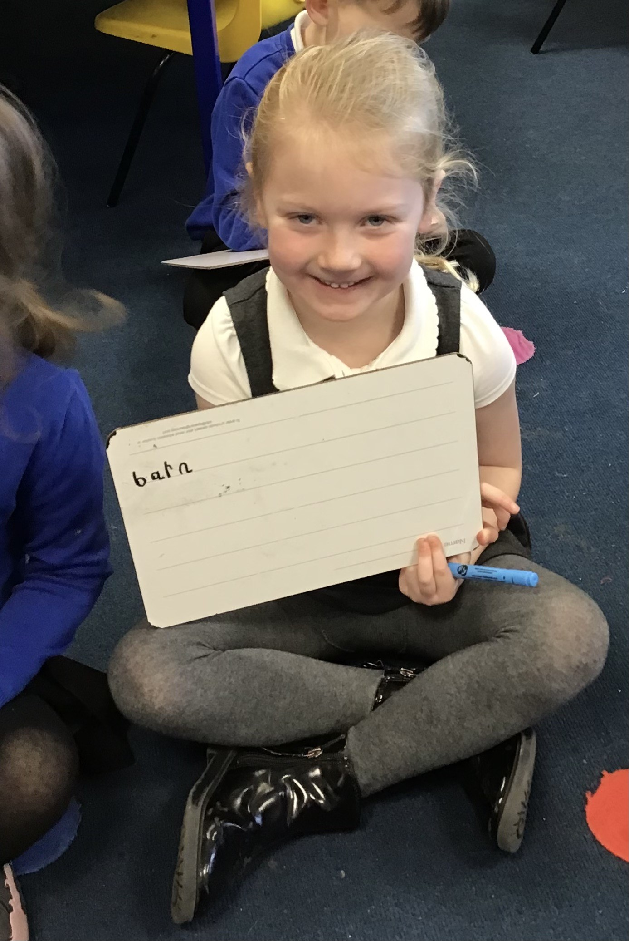
Our Puffin Hero
Lottie has to be a Puffin Class Hero this week as she has absolutely worked her socks off with her writing. Lottie always tries her best but this week she has really amazed me with her attitude and hard work with our English work. She has tried so hard to use her phonics to write words and form simple sentences about our book Journey.
Lottie ALWAYS has a smile on her face and a positive attitude which makes her an absolutely PERFECT PUFFIN every week but this week she has gone over and above with her effort.
A huge well done Lottie.

Slide 7
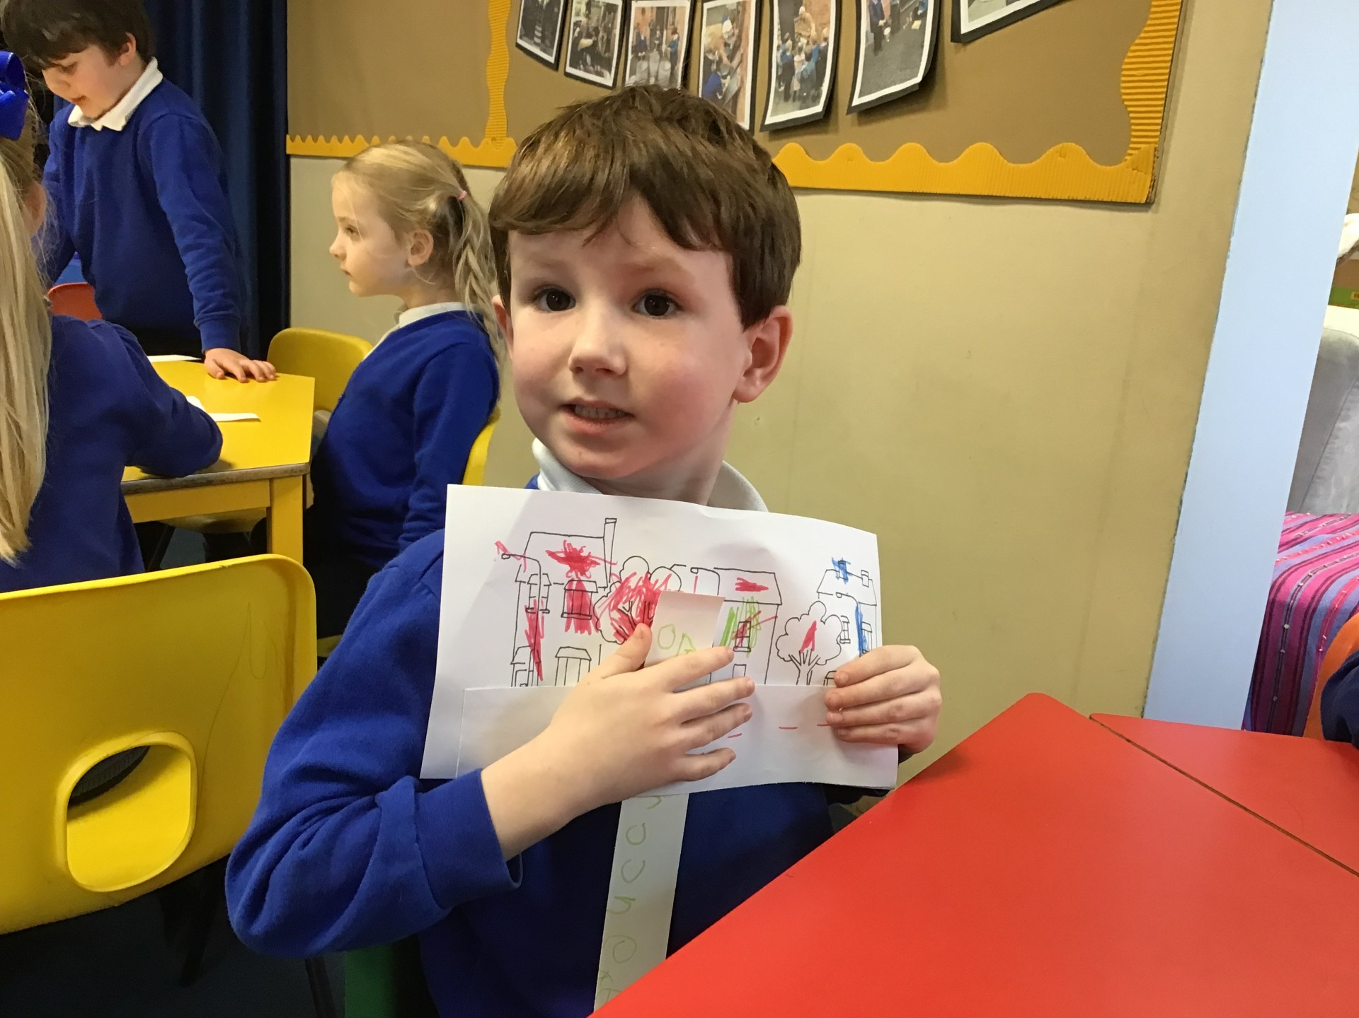
Our Puffin Hero
Alfie is one of our Puffin Class Heroes this week. He has worked so hard with both his English and Maths. He has completed speaking tasks retelling our core book Journey, sequenced the story and tried super hard to write sentences about the book. In Maths he has tried really hard to complete some tricky take away number sentences. I am particularly proud of how hard he has worked to be independent in organising himself this week - trying incredibly hard to put his own outdoor clothes on (including the extra snowy day clothes such as wellies) and remembering his belongings.
Well done Alfie, you have had the most fabulous week. We are so proud of you and you are definitely a very PERFECT PUFFIN!

Slide 8
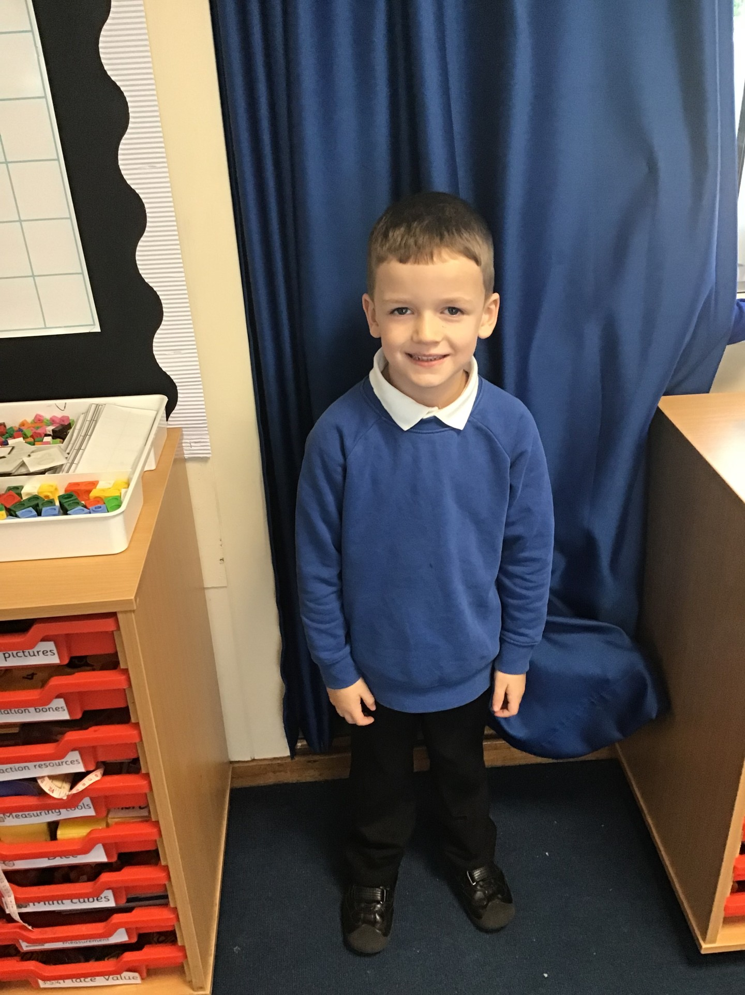
Our Wren Hero
Our first Wren hero this week is Archie. This is for trying really hard with his writing this week, we have been writing a five sentence story for our book 'Journey' and he has done a fabulous job writing sentences independently for each part, also adding in some detail to describe the setting. Keep it up Archie!

Slide 9
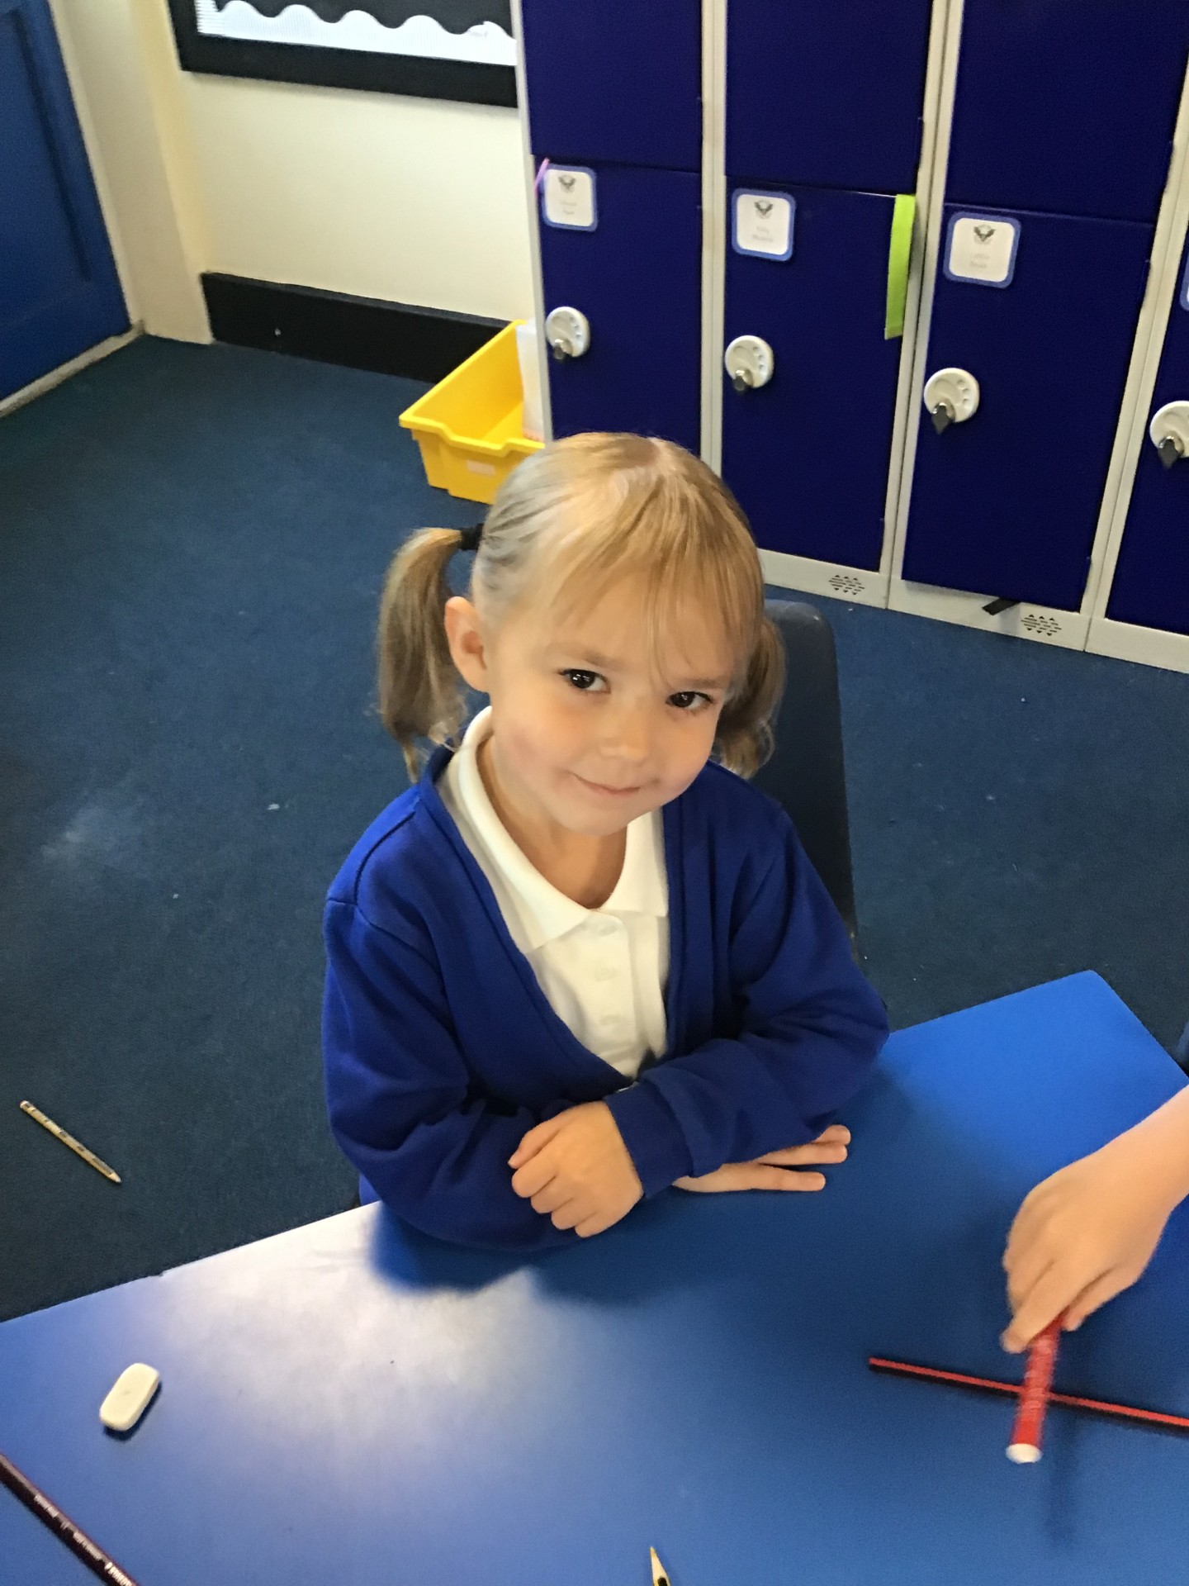
Our Wren Hero
Our second hero this week in Wren class is Olivia. Olivia has also been working hard with her writing over the last two weeks and wrote a wonderful descriptive piece describing the setting within our story. We created a class toolkit together to help gather ideas. Olivia added lots of her own ideas into her writing independently which made it even more fantastic. Keep it up Olivia!

Slide 10
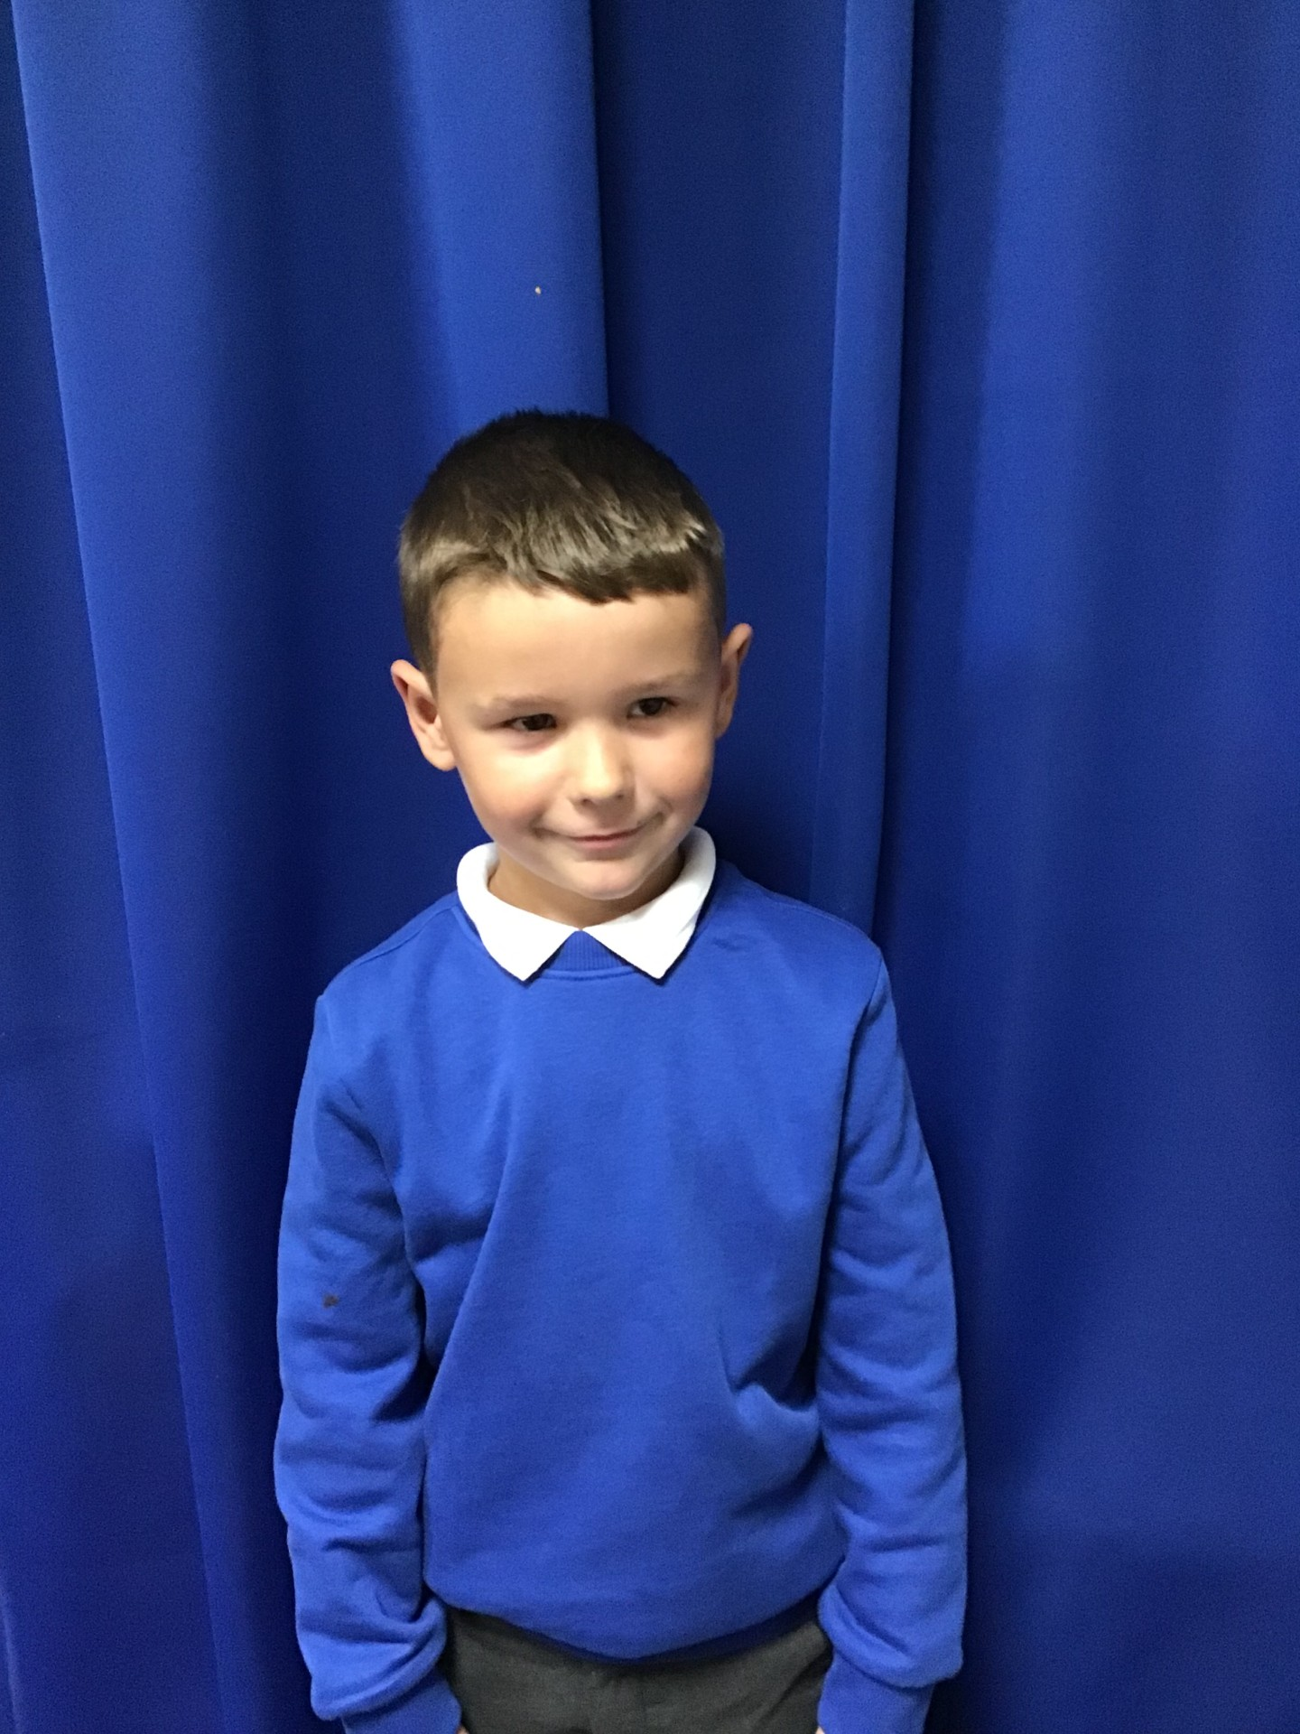
Our Woodpecker Hero
Our Woodpecker hero this week is Noah.
Noah is really impressing everyone at the moment with his super attitude and effort in everything. He has really gained confidence since the start of the year and we have noticed that every lesson Noah has his hand up, wanting to put his ideas and answers forward. It is lovely to see his confidence grow and him setting such a fabulous example to everyone.

Slide 11
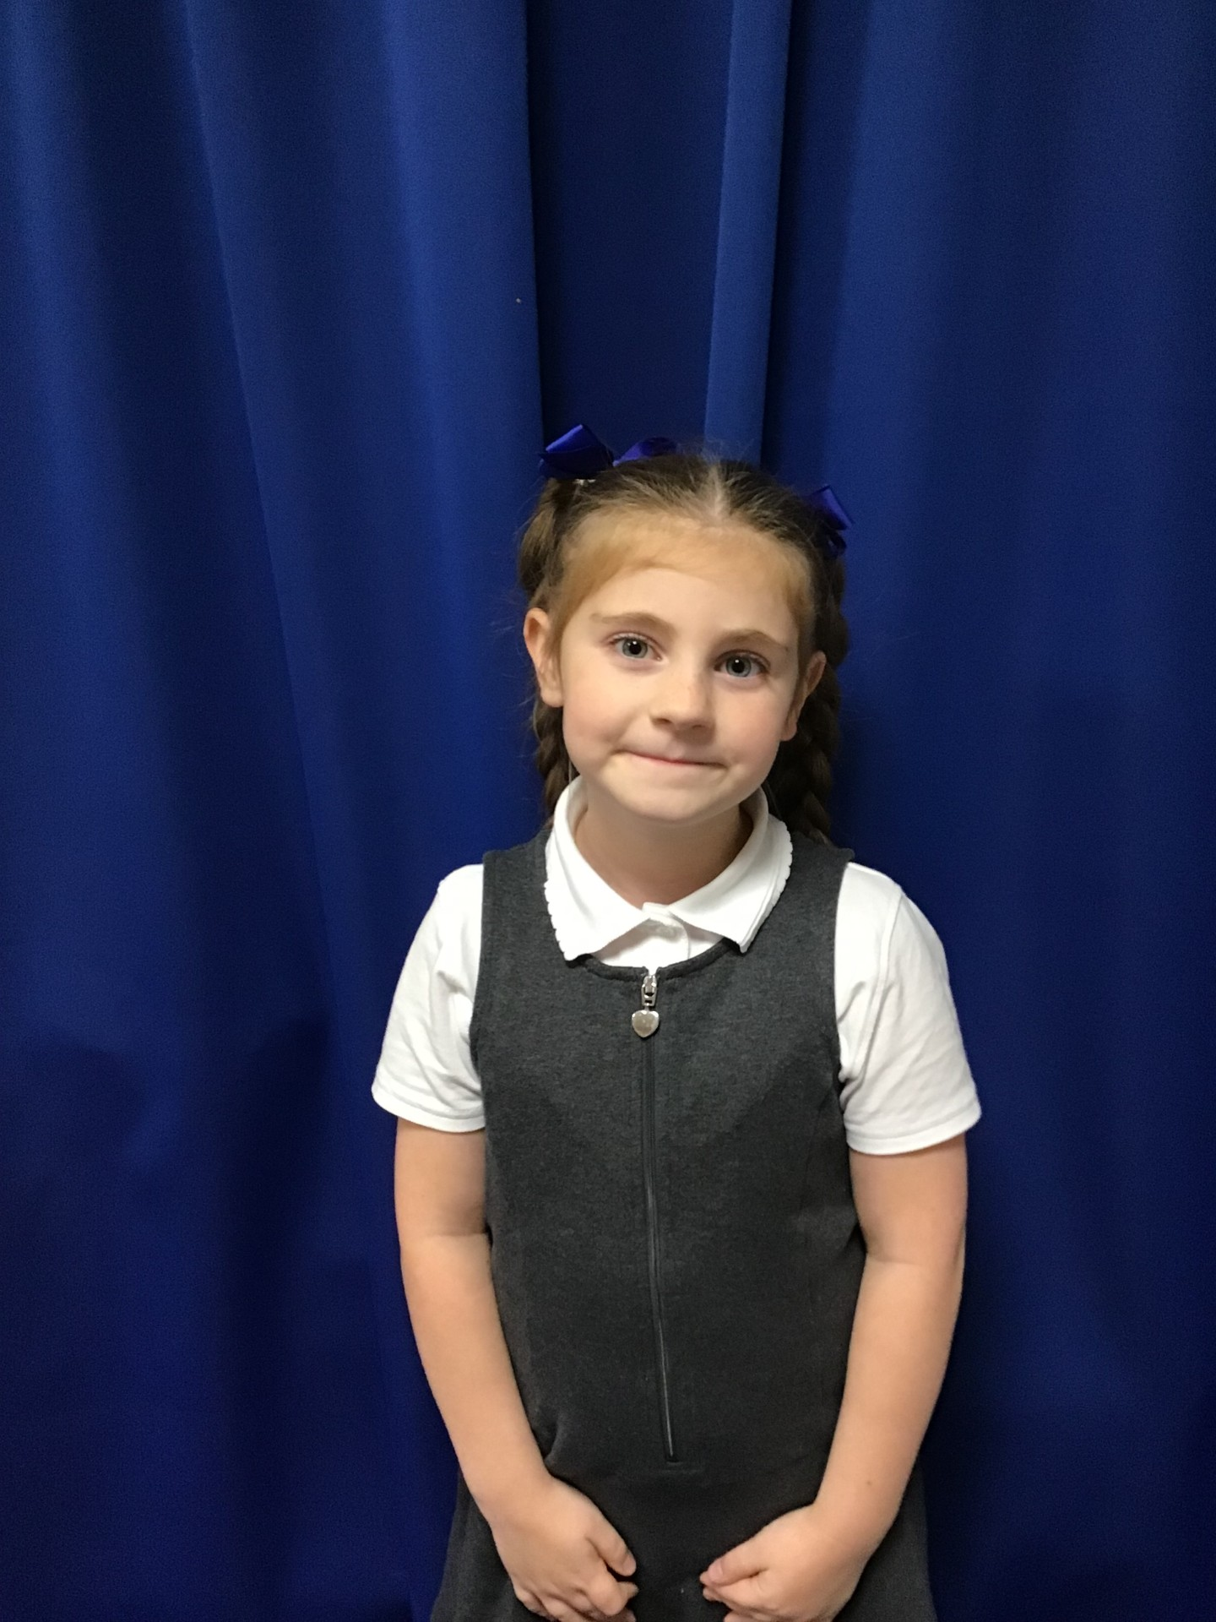
Our Woodpecker Hero
Our second hero this week is Ayda. Ayda is one of those children who could be a hero every week. She is always kind and helpful, works hard and is always so polite and well behaved. It is a real pleasure to have Ayda in Woodpecker Class. She is a fantastic example of the Holly Hill way and a real superstar.

Slide 12
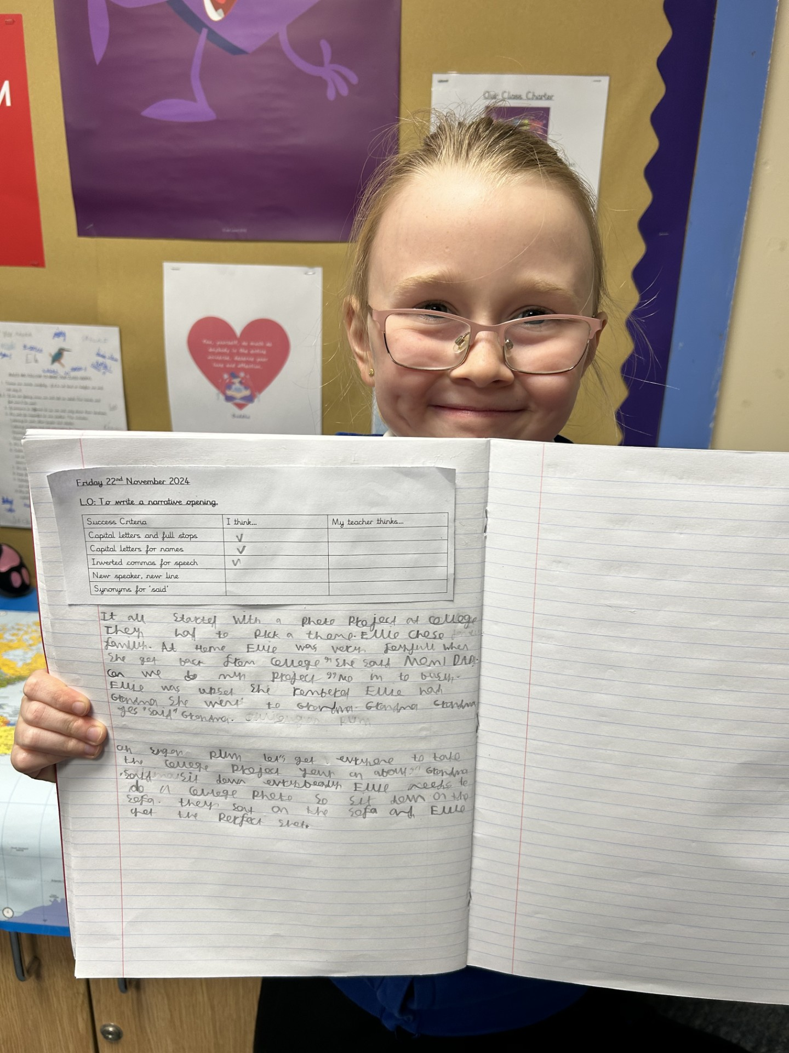
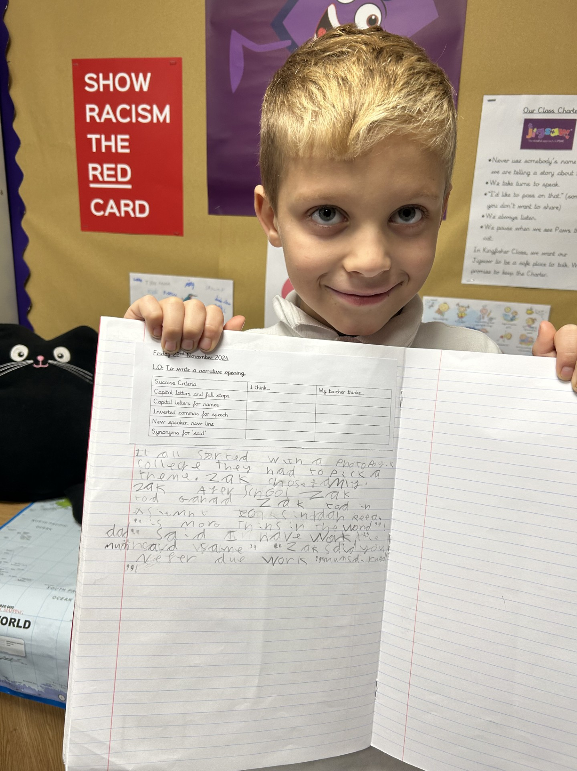
Our Kingfisher Heroes
My two heroes this week are Hope and Reuben.
This week we have been planning hard and boxing up our text, ready to start writing our own version.
They have both impressed me with their writing skills.
Firstly, Hope has thought of some lovely ideas and has been able to make the story hers own, adding some great vocabulary.
Reuben has impressed me with his writer’s skill of reading his work and making adjustments. He has focused well and written a great story opening.
Well done both of you, keep up the fabulous writing 🌟

Slide 13
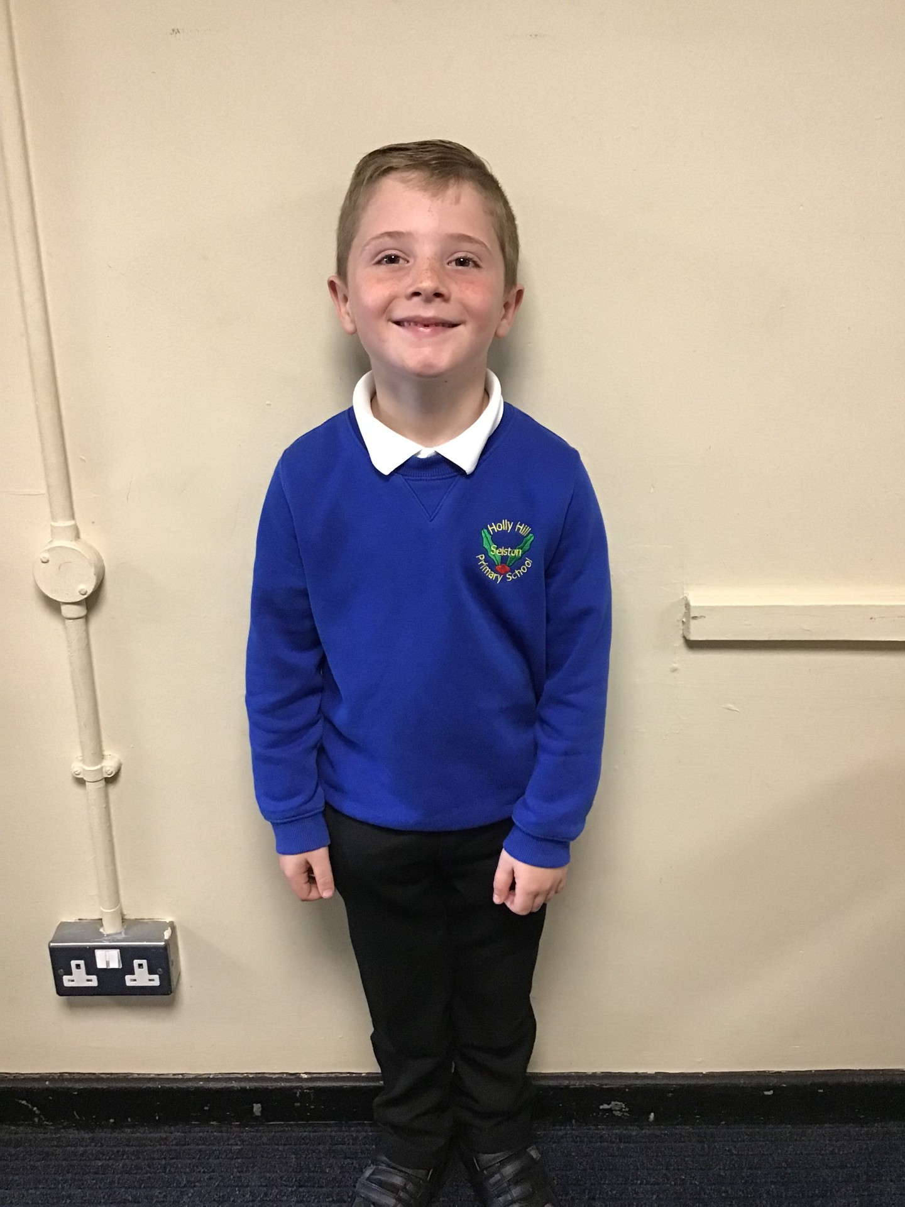
Our Dove Hero
﻿The first Dove hero this week is Thomas. Thomas always tries really hard in class and shares some fabulous contributions to class discussions. He has a sensible and mature attitude to learning and can always be relied upon. Keep it up Thomas!
﻿

Slide 14
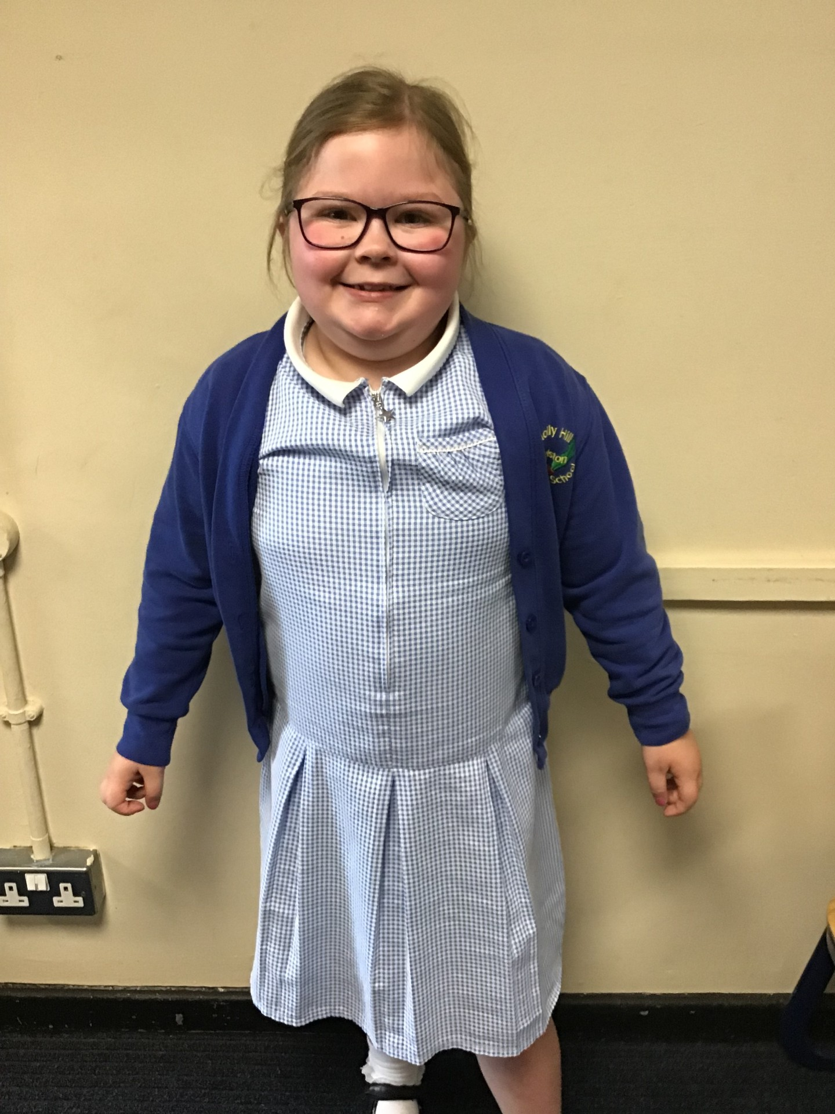
Our Dove Hero
Our second Dove hero is Aleyna. Aleyna has really started to grow in confidence and is now offering more ideas to the group. She always gives everything her all, even when she struggles, showing great perseverance. Well done Aleyna. Keep it up!
﻿

Slide 15
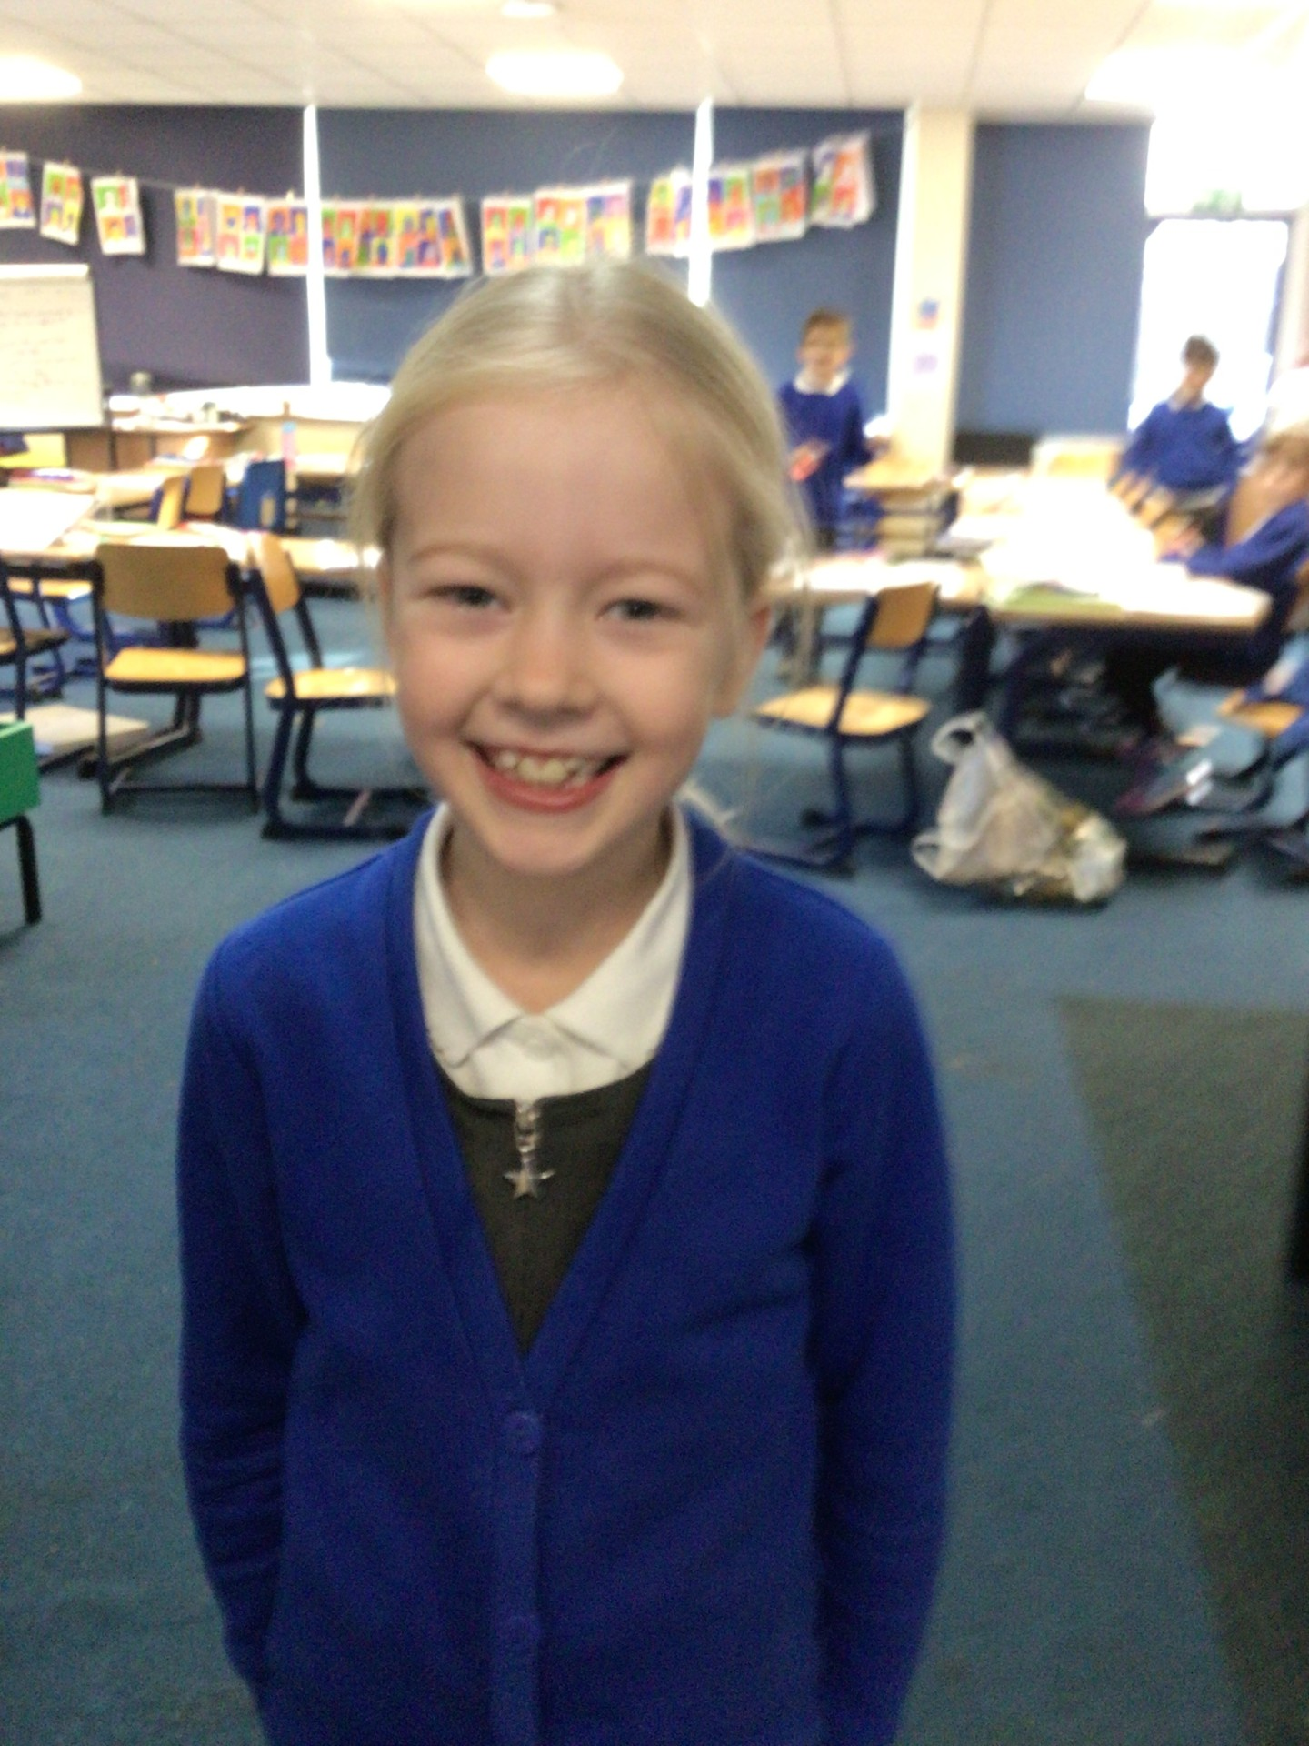
Our Swallow Hero
The first Swallow's hero this week is Olivia. Olivia has been working incredibly hard at her writing. It has been a such a pleasure to read her fabulous story so far. She has thought carefully about her presentation and handwriting and even is starting to think very carefully about where her full stops and capitals go! Well done Olivia, what an excellent author you are fast becoming. We can't wait to read the finished story!

Slide 16
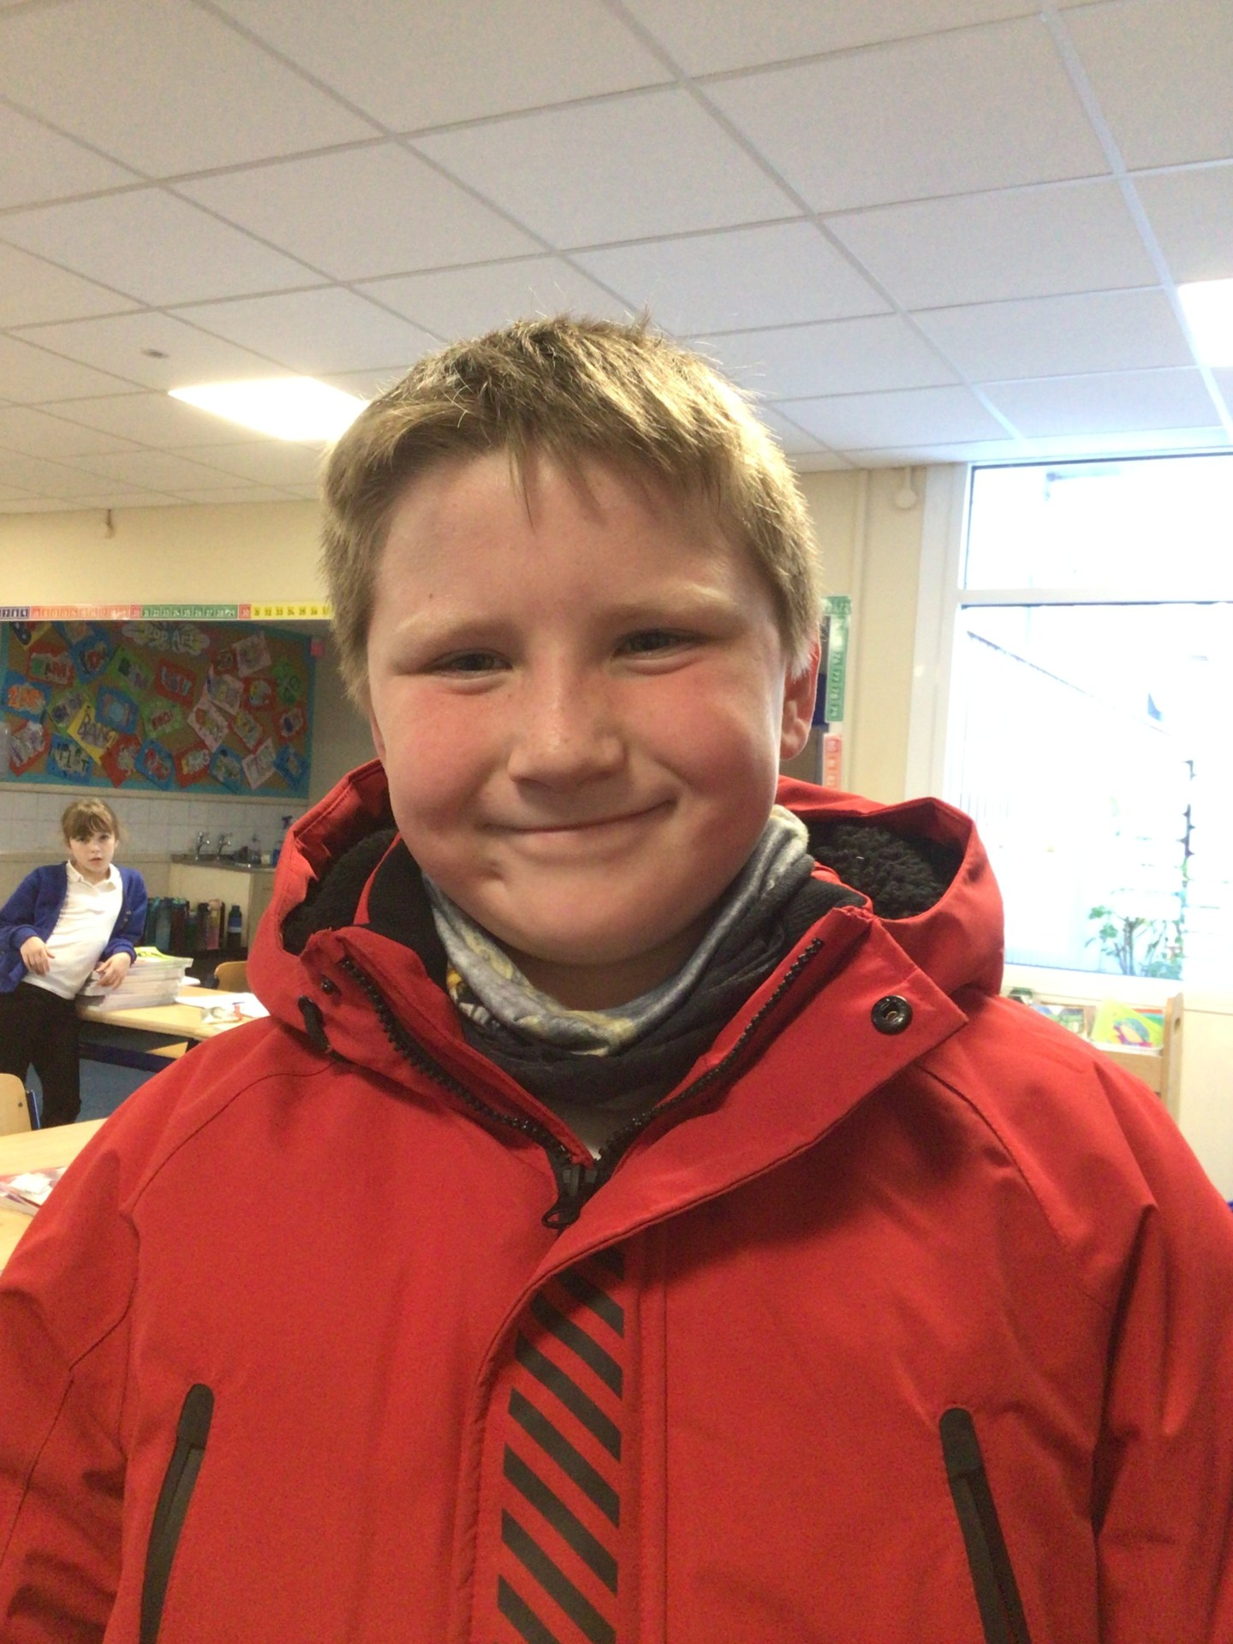
Our Swallow Hero
The second Swallow hero this week is George. George is always so polite and helpful in class and towards others. He listens to peoples ideas and is great at sharing his own observations too. He has really taken on board our focus on presentation recently. There has been a real improvement in his handwriting this week, with more words on the line and lots more joins between his letters. It is lovely to see him working so hard, and pleasure to look at such carefully considered presentation. Keep it up George!

Slide 17
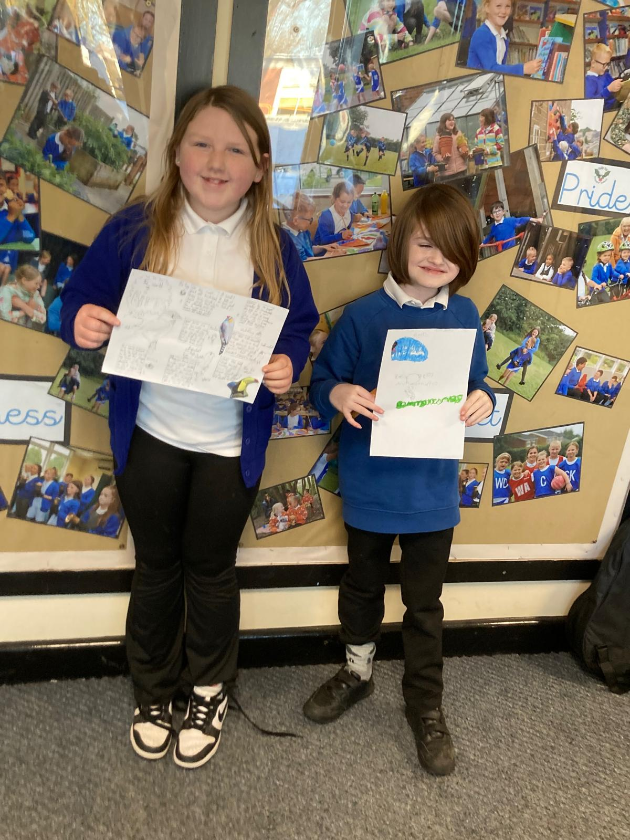
Our Owl Hero
Our Owl heroes this week are Isla and Miller for their amazing Science work. They did a fabulous job on their animal group research and they both produced a fabulous poster showing their findings. Well done both of you – two Scientists in the making I think!

Slide 18
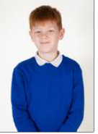
Our Falcon Hero
This week’s Falcon Hero is Jacob T! Jacob has been on fire this week🔥. On several occasions he has contributed to the class discussion and made sure to use subject vocabulary in his answer, setting a great example for how to apply previous learning to the current lesson. Jacob has really been pushing himself to think deeply and regularly impresses us with his considered ideas. Keep up the fabulous work Jacob!
From Mrs. Steed – He has also been super helpful at lunchtime and helped to get rid of a big icy patch (with some help from Brandon and Sonny of course!)

Slide 19
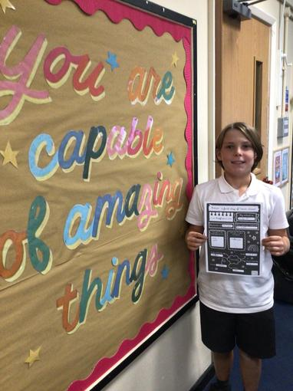
Our Swan Hero
Austen is my hero this week for how hard he has been trying during lessons. On the carpet, Austen is the first to turn to his partner and talk to them during partner talk and gives great explanations. He has been working really hard in Maths especially, trying super hard to improve his mental methods and times table recall to support his fractions work. Well done Austen - I'm so proud of what you've achieved this week!

Slide 20
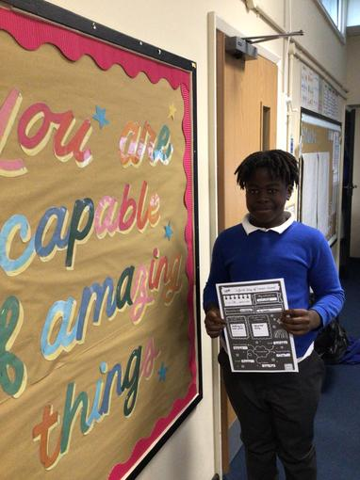
Our Swan Hero
Kayden is my hero for the kindness that he has shown during our kindness week. Kayden turned up at school with a bouquet of flowers in his hand and gave them to Mrs Ward for her birthday! He told Mrs Ward that he paid for them with his own pocket money. Kayden has been kind to his classmates too, helping his partner as much as he can when they need it. Well done Kayden - you are a super Swan!

Slide 21
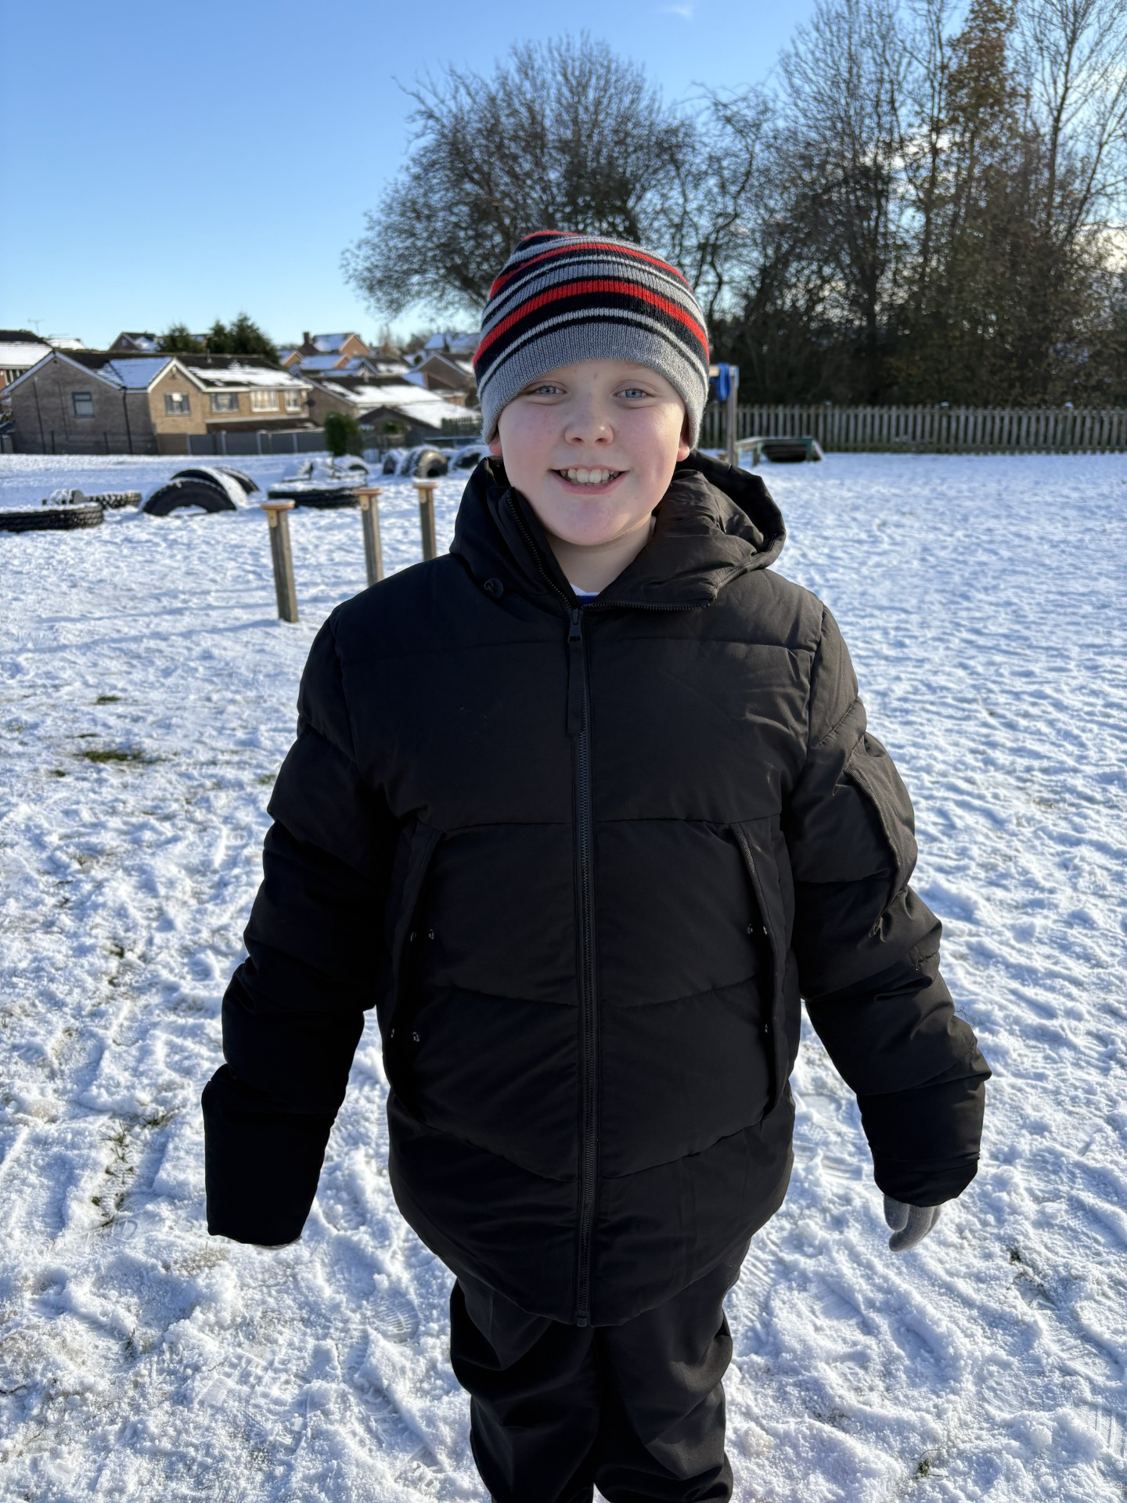
Our Lunchtime Hero
Jake has been chosen by the Midday Supervisors this week as lunchtime hero for being an ‘always’ child. Jake is always polite, always kind, always willing to help others and always a pleasure for children and adults to spend time with. Exactly what we see in the classroom too Jake – well done! We are very proud of you!

Slide 22
Class Attendance winners
This week’s winners with 97.5%% are Kingfisher class! Well done Kingfishers!
Remember, when you reach 3 wins, your class will get £25 to spend on books and 15 minutes extra play! Try to come to school every day to help your class be the winners!
CLASS | WIN 1 | WIN 2 | WIN 3
Cygnets 1
Cygnets 2
Puffin
Wren
Woodpecker
Kingfisher
Dove
Swallow
Owl
Falcon
Swan

Slide 23
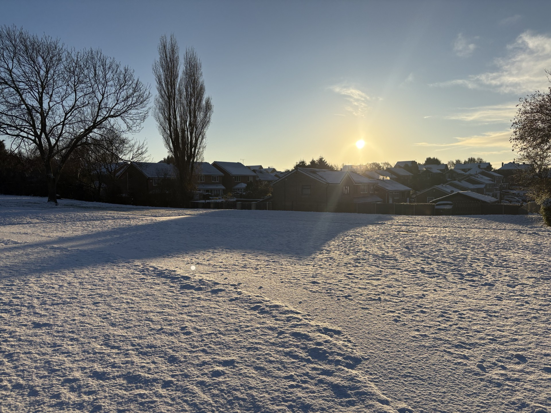
I hope you’ve all had a lovely snowy week in school. At my children’s school, they haven’t been out to play in the snow once!!! Boooooo!
We’ve had a great week and it has been lovely spending my snowy lunchtimes with you.
Have a great weekend!
Mrs. Steed xxx

