Slide 1

Holly Hill Heroes Assembly
HOLLY
HILL
AUTUMN TERM, 2024

Slide 2
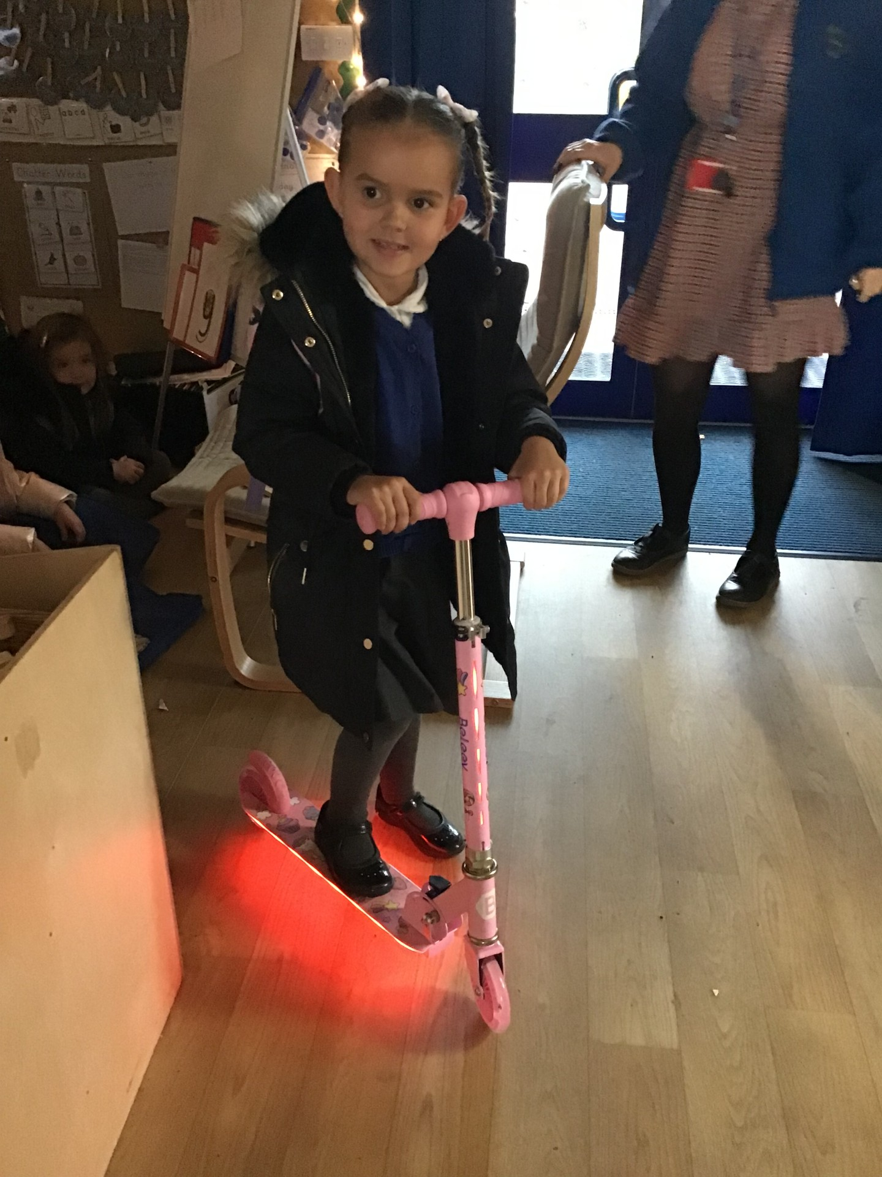
Our Cygnets Hero
Sienna is one of our heroes this week because she has just been a super star all week! She has been super focused during our concert practise and also during our christingle service. She is so respectful and such a good girl at school. She is a pleasure to have in Cygnets class!

Slide 3
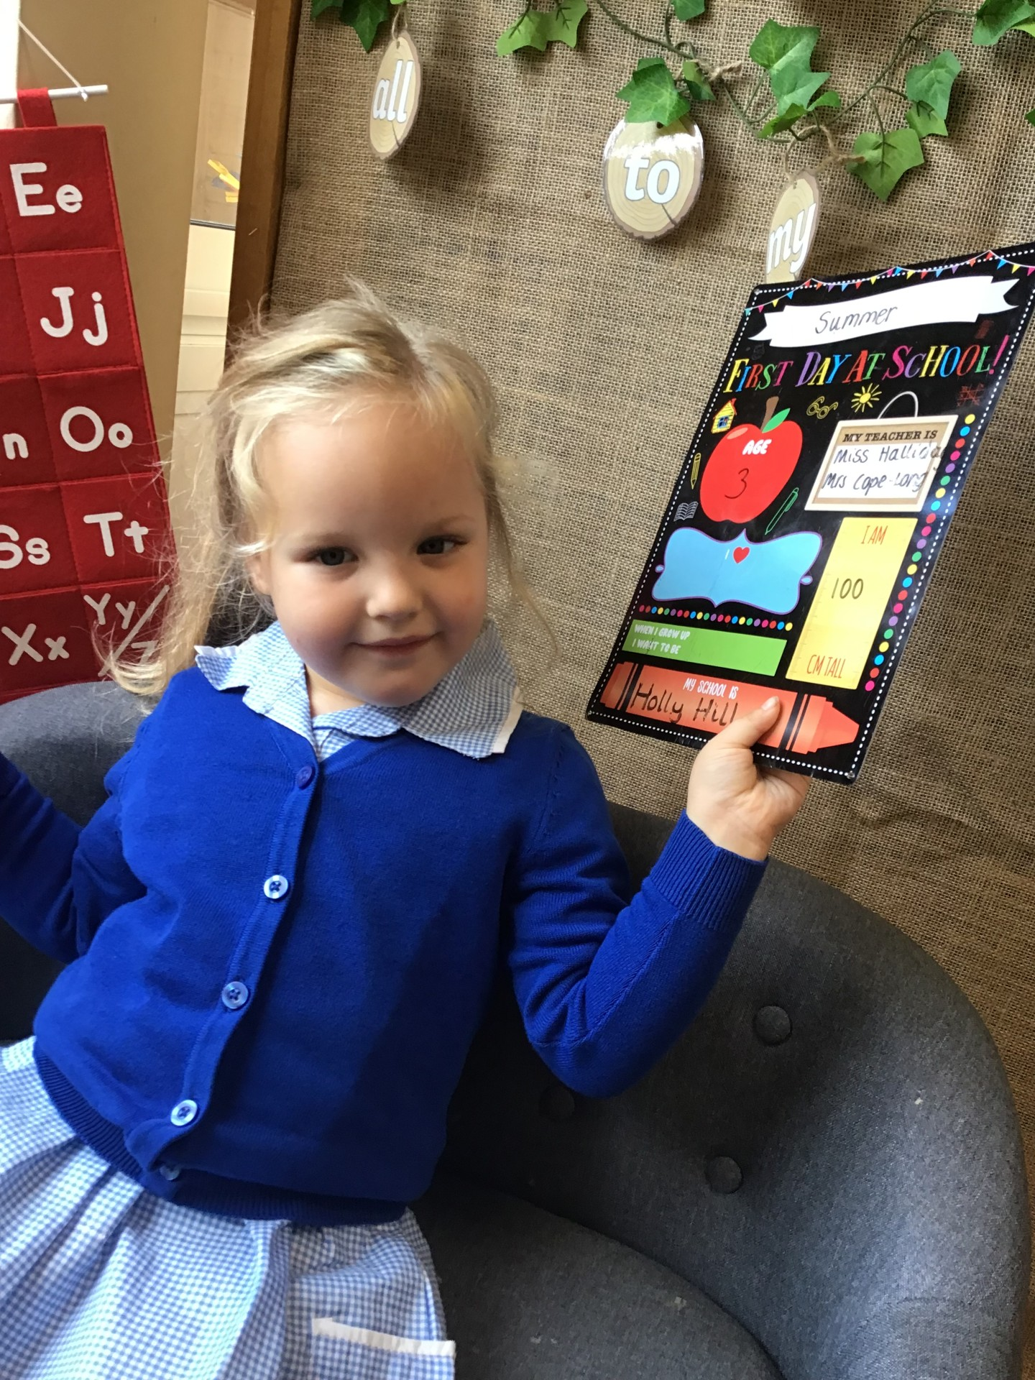
Our Cygnets Hero
Our other hero is Summer! Summer only started with us in September but she has made such a great start. She can sit for our story sessions and she LOVES to sing, this has been great for our concert practise. Summer is helping her friends and playing so nicely, she always helps to tidy up and look after our classroom. We are so proud of you Summer, well done!

Slide 4
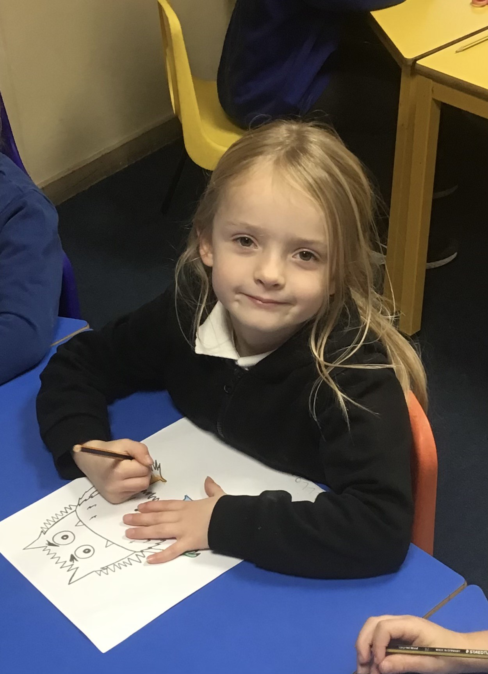
Our Puffin Hero
Liliarna is Puffin Class Hero this week. She has the most fabulous attitude to all aspects of school and consistently works hard. More importantly she is always happy, kind and caring towards other children as well as being helpful around the classroom. Well done Liliarna you truly are a PERFECT PUFFIN!

Slide 5
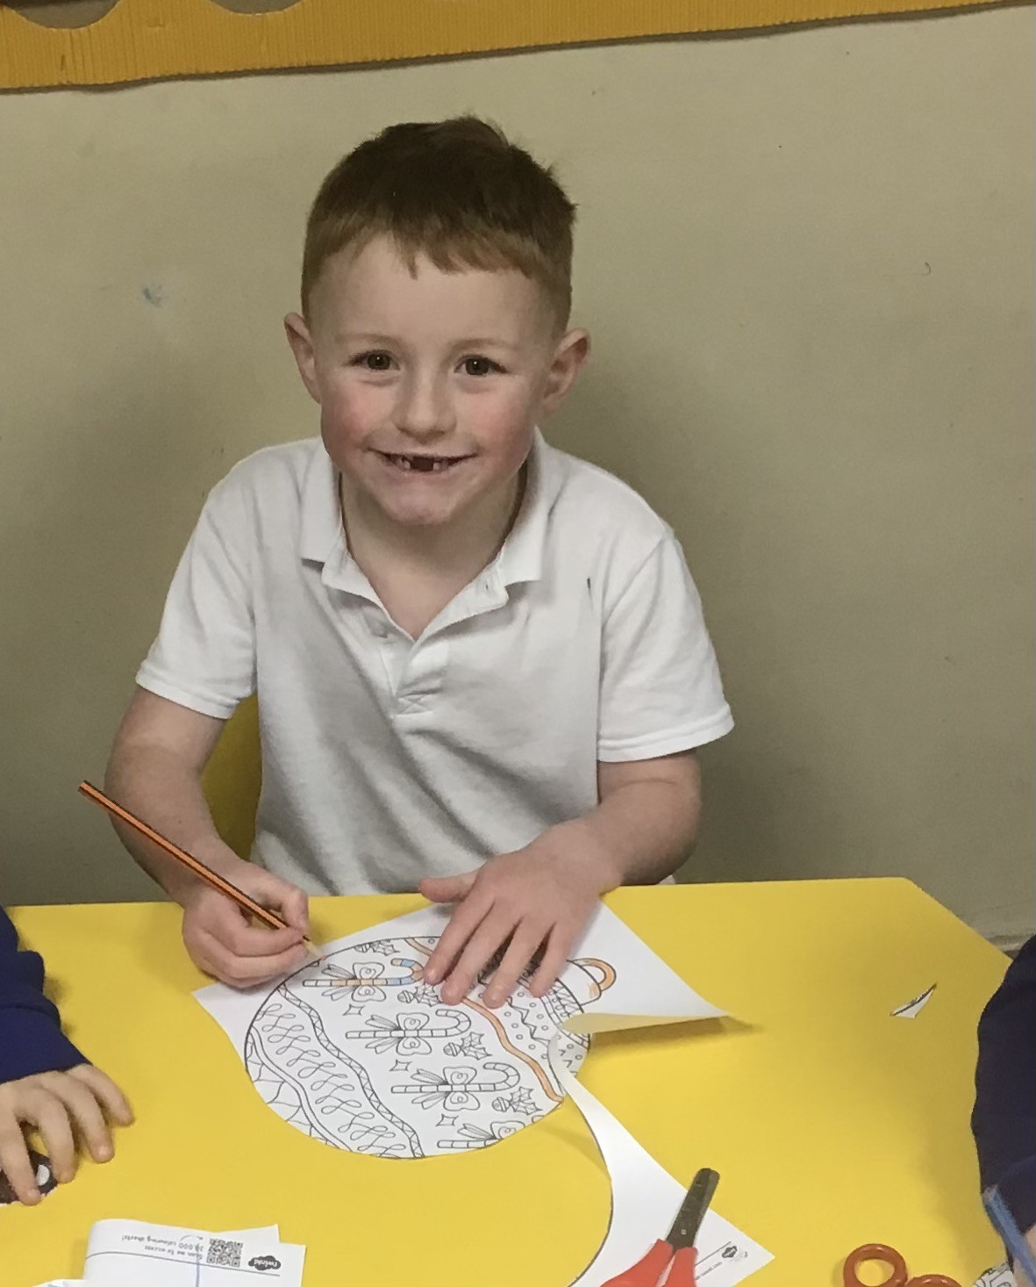
Our Puffin Hero
Ronnie is also a Puffin Class Hero this week. This term he has worked incredibly hard to improve his writing and can now write independently. He has also excelled in Maths and has shown maturity by challenging himself to complete some of the harder Power Maths questions. Well done Ronnie you are most certainly a PERFECT PUFFIN!

Slide 6
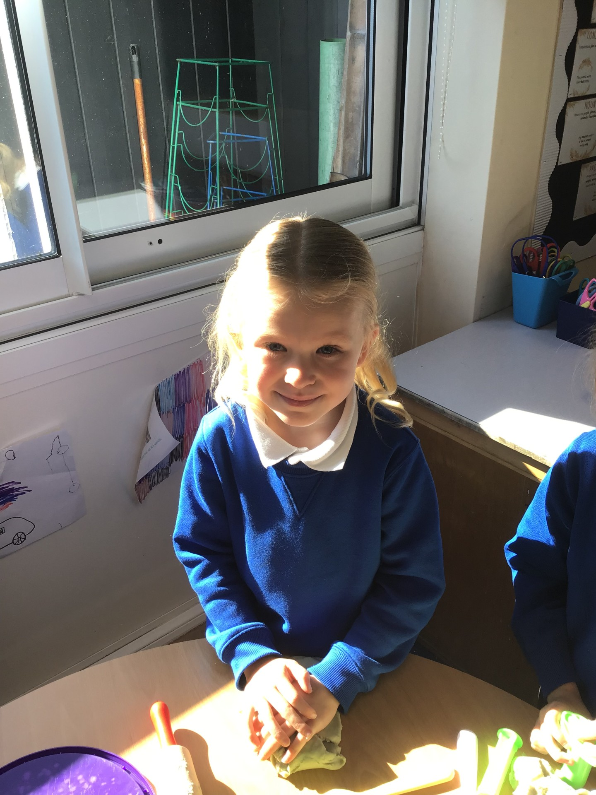
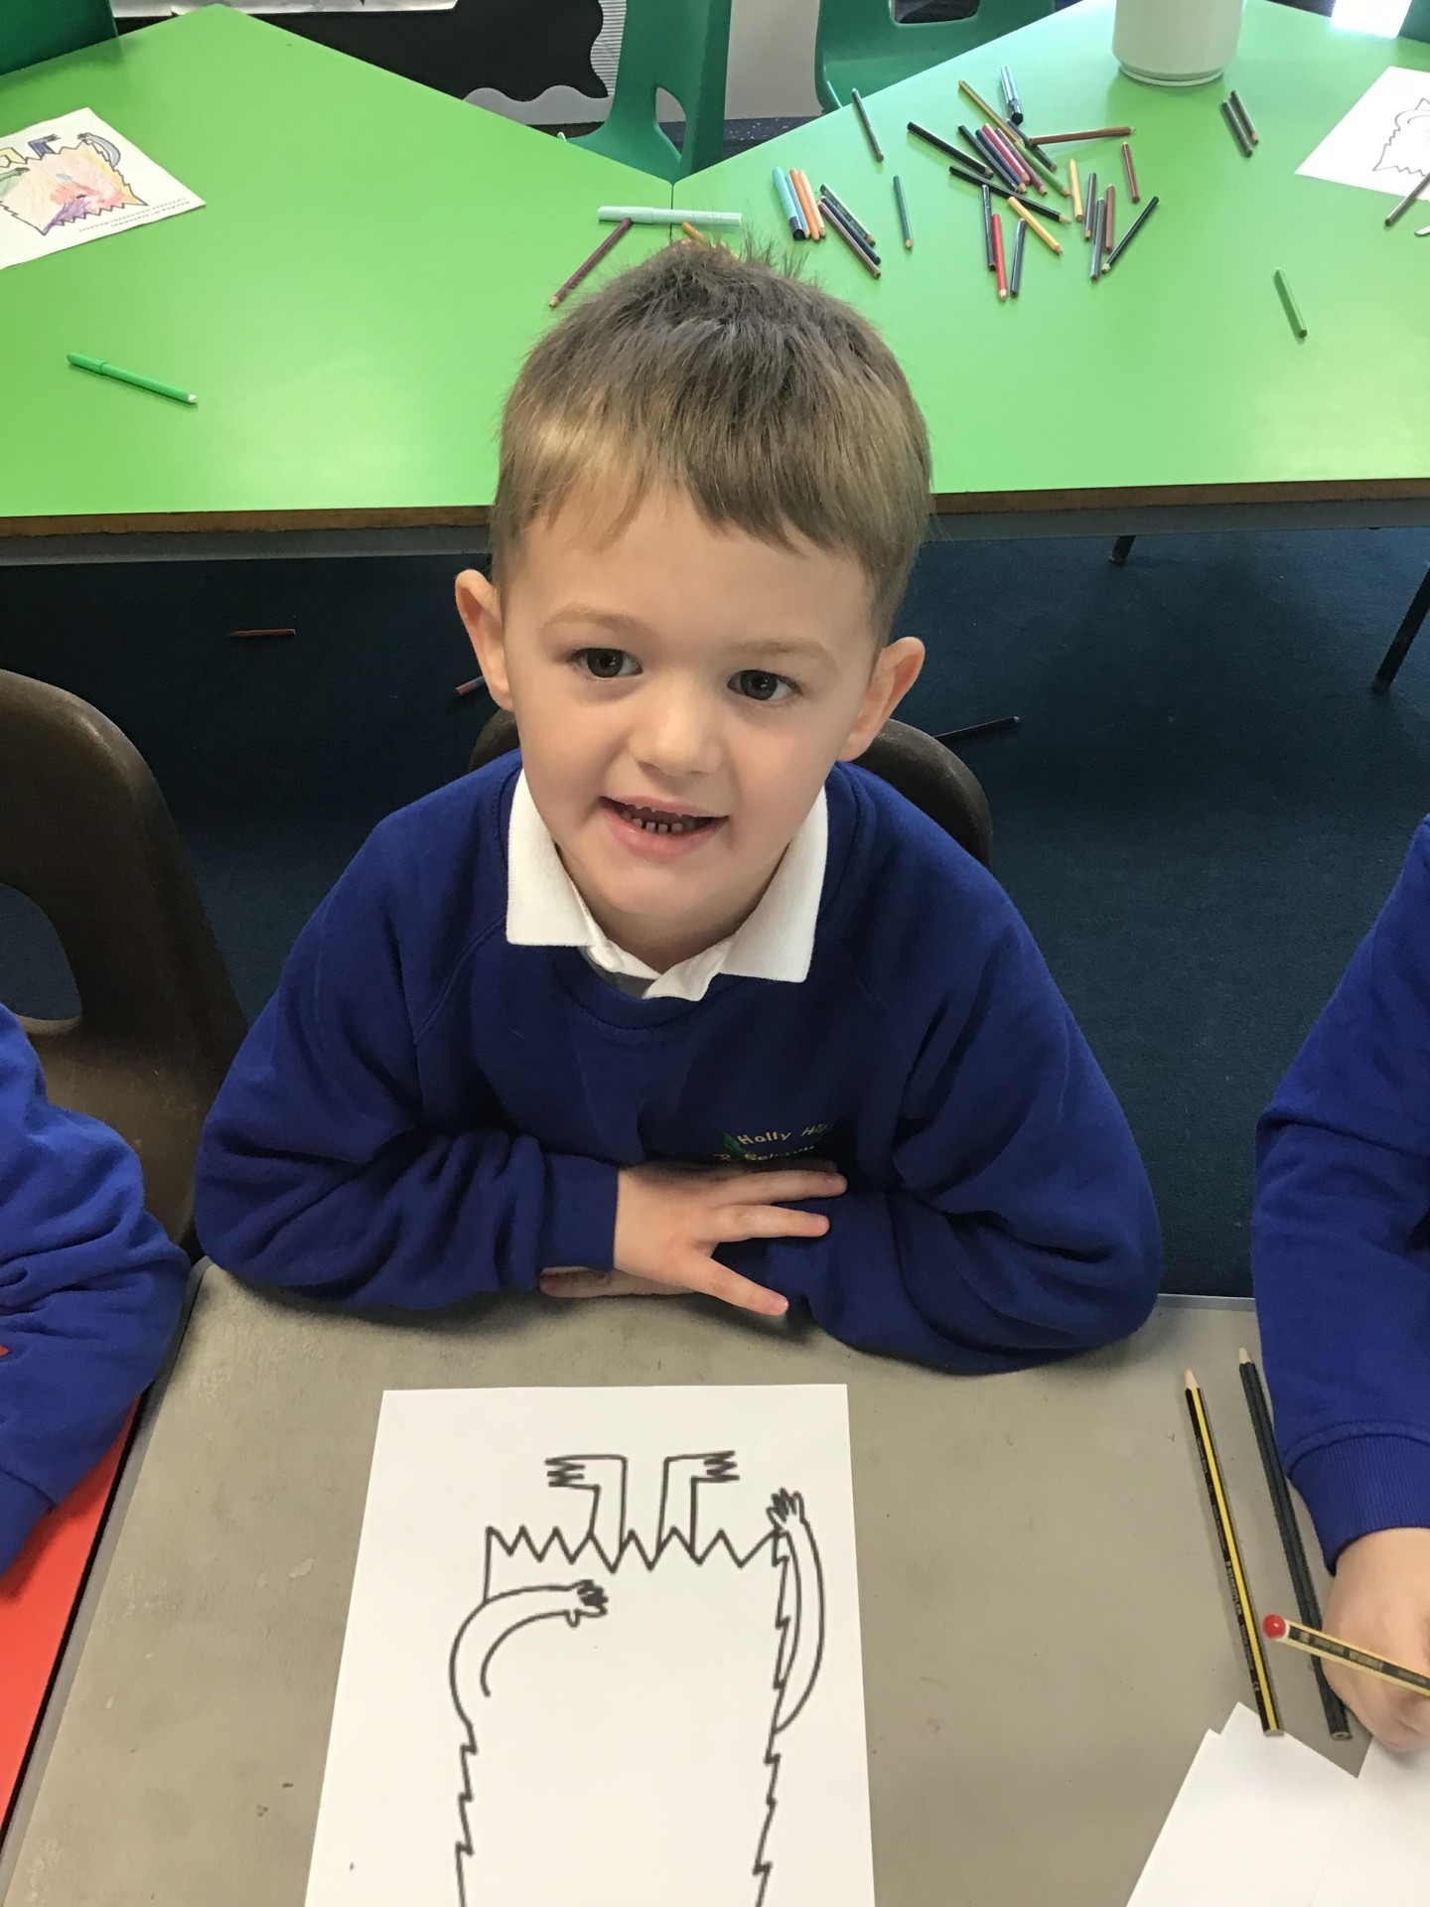
Our Wren Hero
Our Wren heroes are Lottie and David.
They both amazed me last week with their writing based around our story 'Ouest', following on from the first book Journey. They both wrote wonderful sentences using the colourful semantic sentence structure to independently build their own detailed sentences all about the key events which happened throughout the story.
Amazing work from you both! Well done and keep it up!

Slide 7
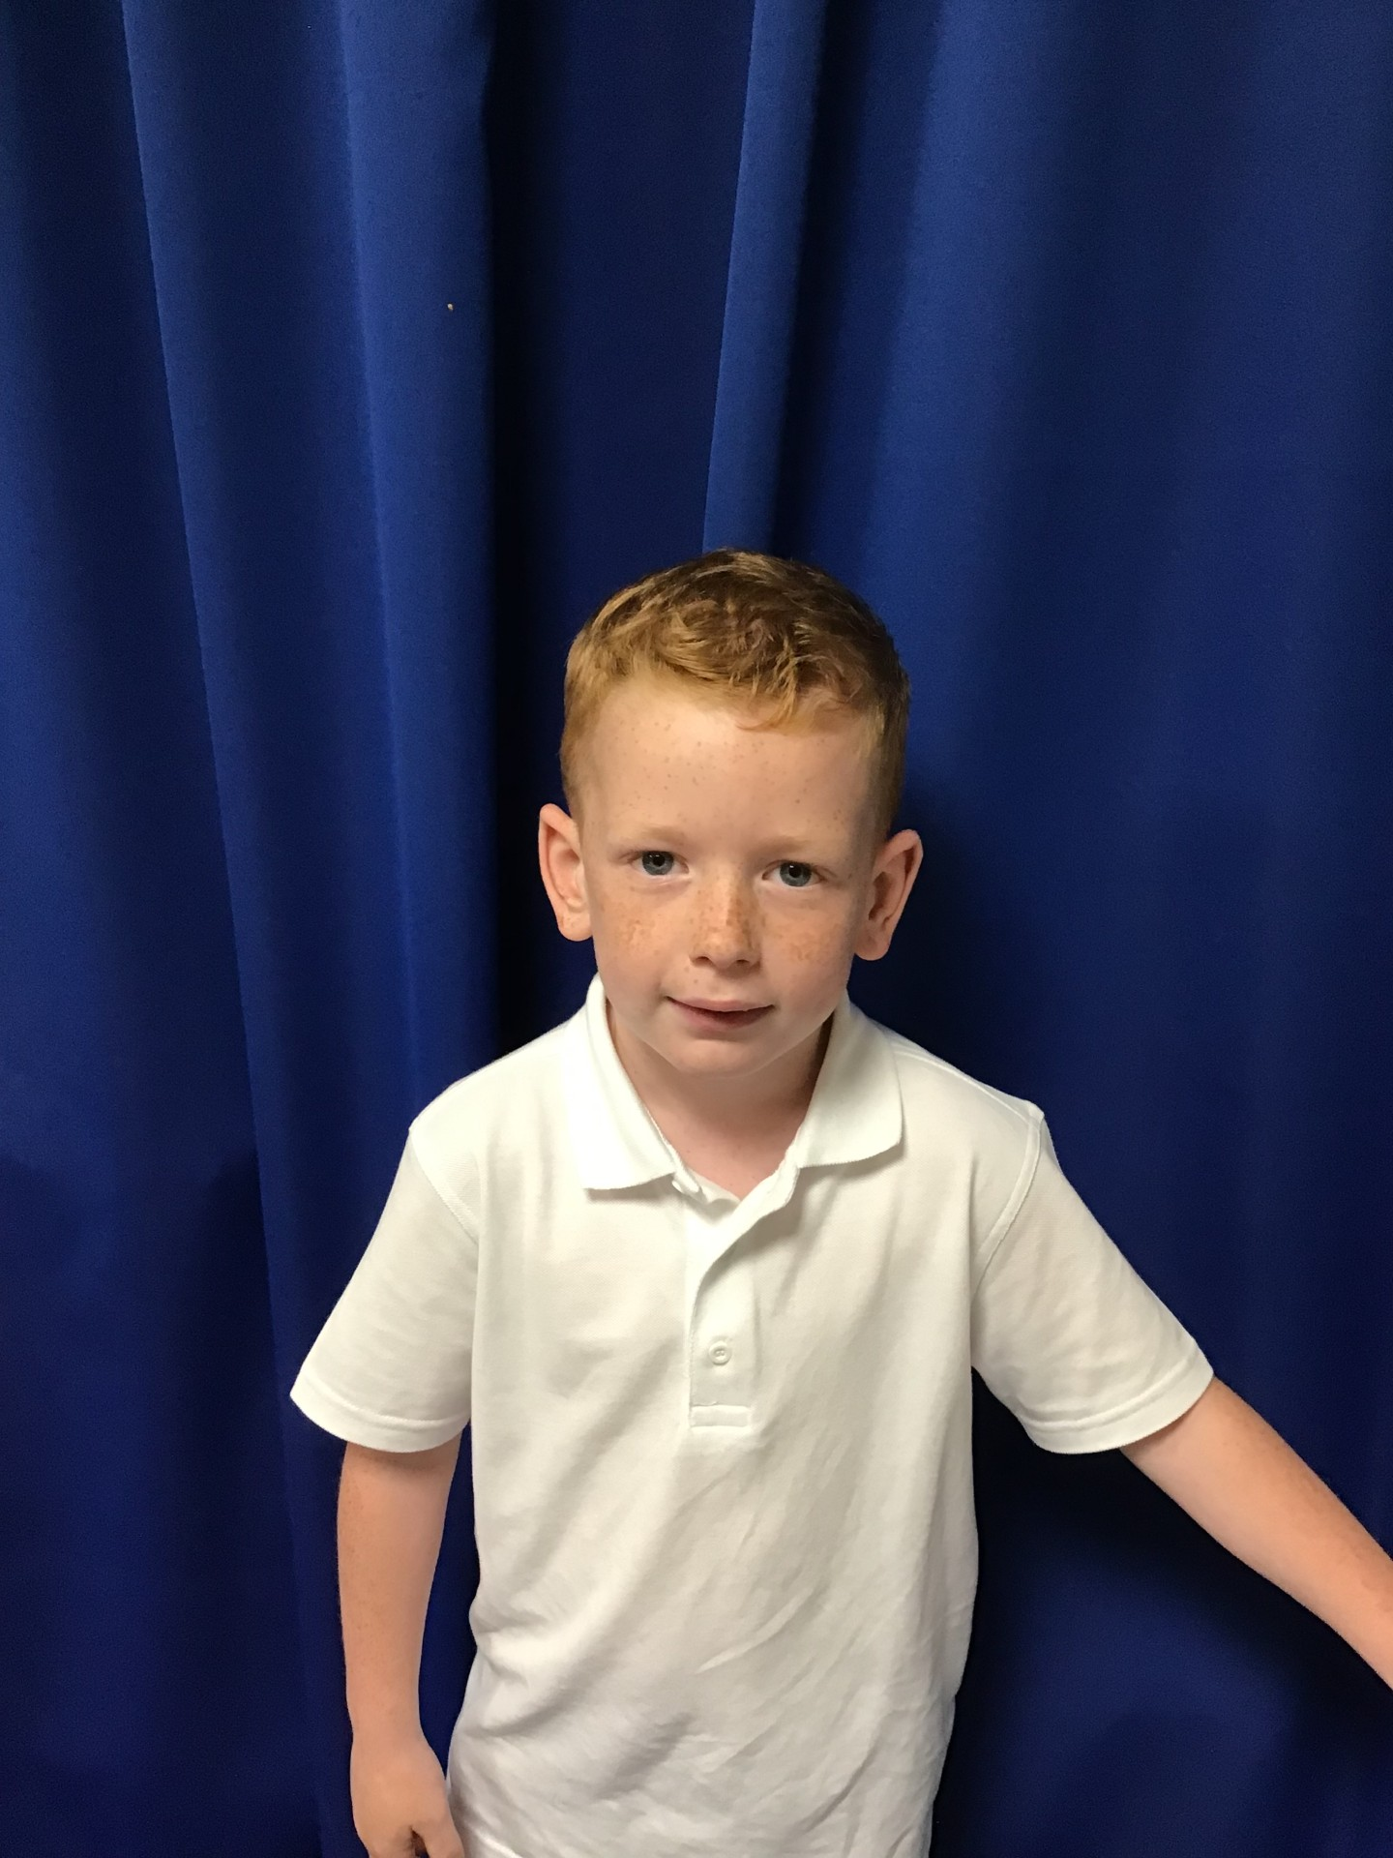
Our Woodpecker Hero
This weeks Woodpecker hero is Rupert. Rupert has been trying really hard in everything and has been answering lots of questions, particularly in maths. He has really impressed me this week with his score in the times tables assessment we have done. He is an absolute whizz at these - and that is before we have learned them at school. Well done Rupert.

Slide 8
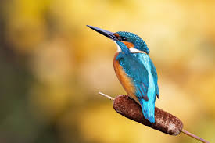
Our Kingfisher Hero
All of Dove class have been super amazing this week for Mrs Brooks whilst Mrs Ward has been poorly. They’ve smashed 10 maths lessons as well as being very patient whilst making their Christingles.
Mrs Ward would be very proud of you Kingfishers 😊

Slide 9
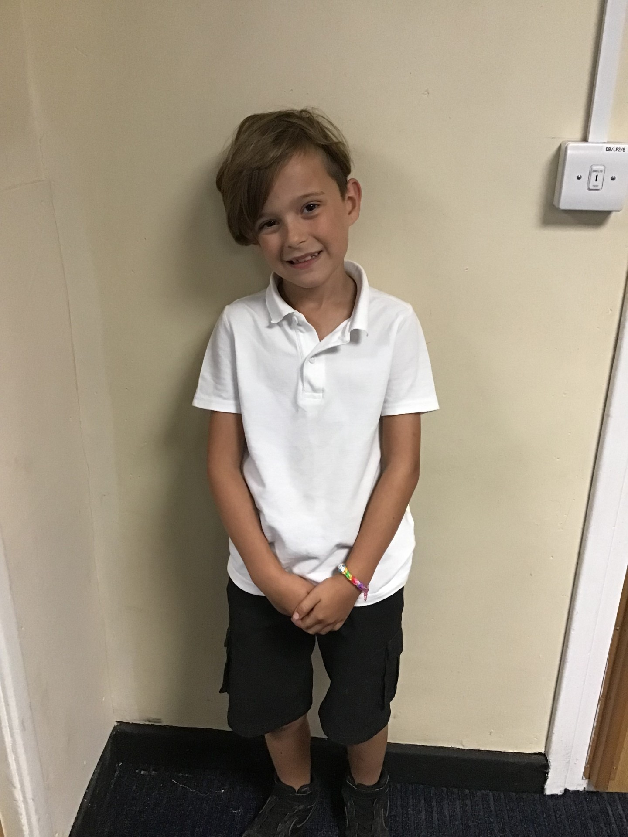
Our Dove Hero
Our first Dove hero this week is Cruiz. Cruiz is always a very sensible member of the class who is super supportive and helpful to others. He has tried exceptionally hard with his recent end of term assessments and has clearly made lots of progress. During our recent concert practises, he has pushed himself out of his comfort zone to do something he wouldn’t normally offer to do which has been fabulous to see! Well done Cruiz!
﻿

Slide 10
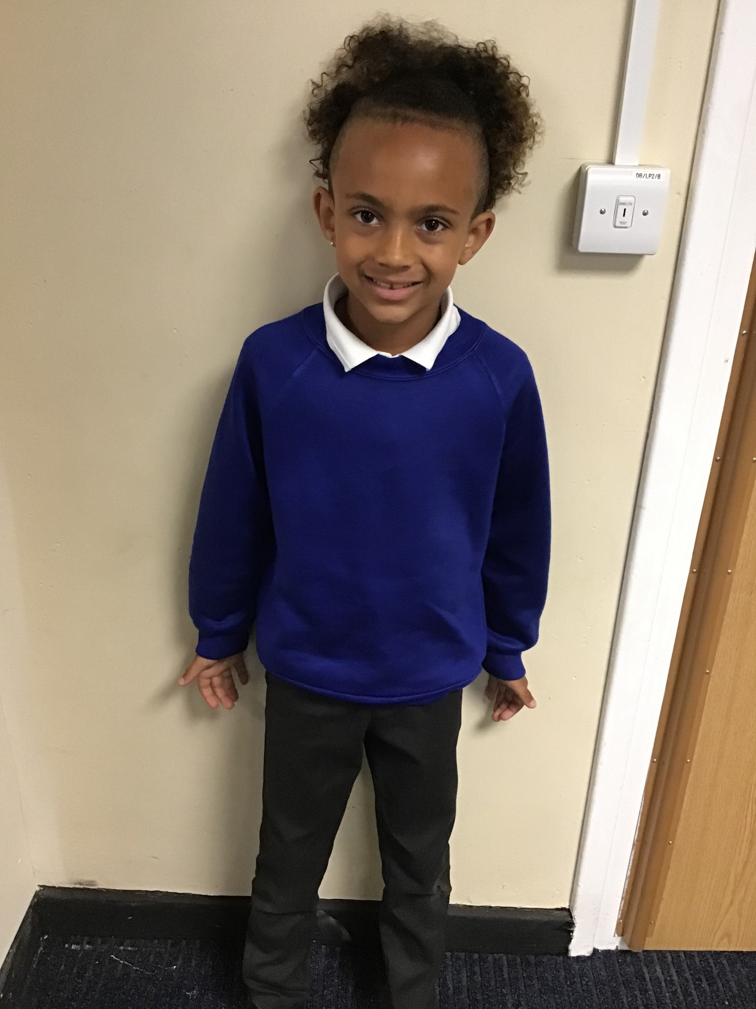
Our Dove Hero
The next Dove hero this week is Karson. Karson has shown lots of enthusiasm this week during lessons and has tried really hard in maths and science to ensure he has listened fully and joined in during discussions. When he has found something difficult he has shown more perseverance which has really helped him. Great work Karson!
﻿

Slide 11
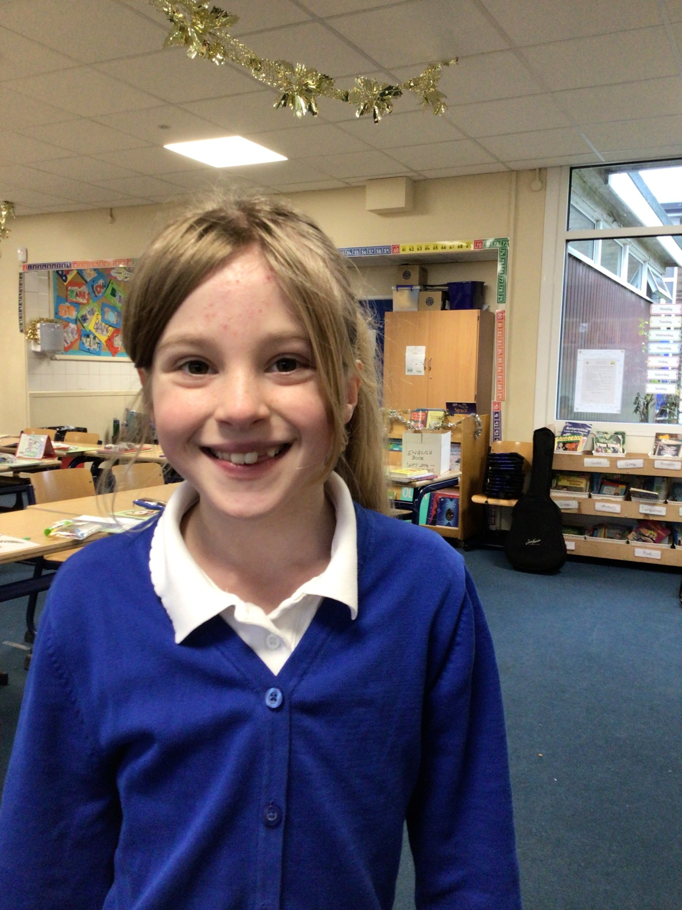
Our Swallow Hero
Dana is a superstar day in day out. She has such a positive attitude to everything she does and never gives up on a tricky task. We have been really impressed with her efforts in every lesson, especially with the way she is focused and attentive to detail in her work. She really sets a wonderful example of how to get the most out of every school day!

Slide 12
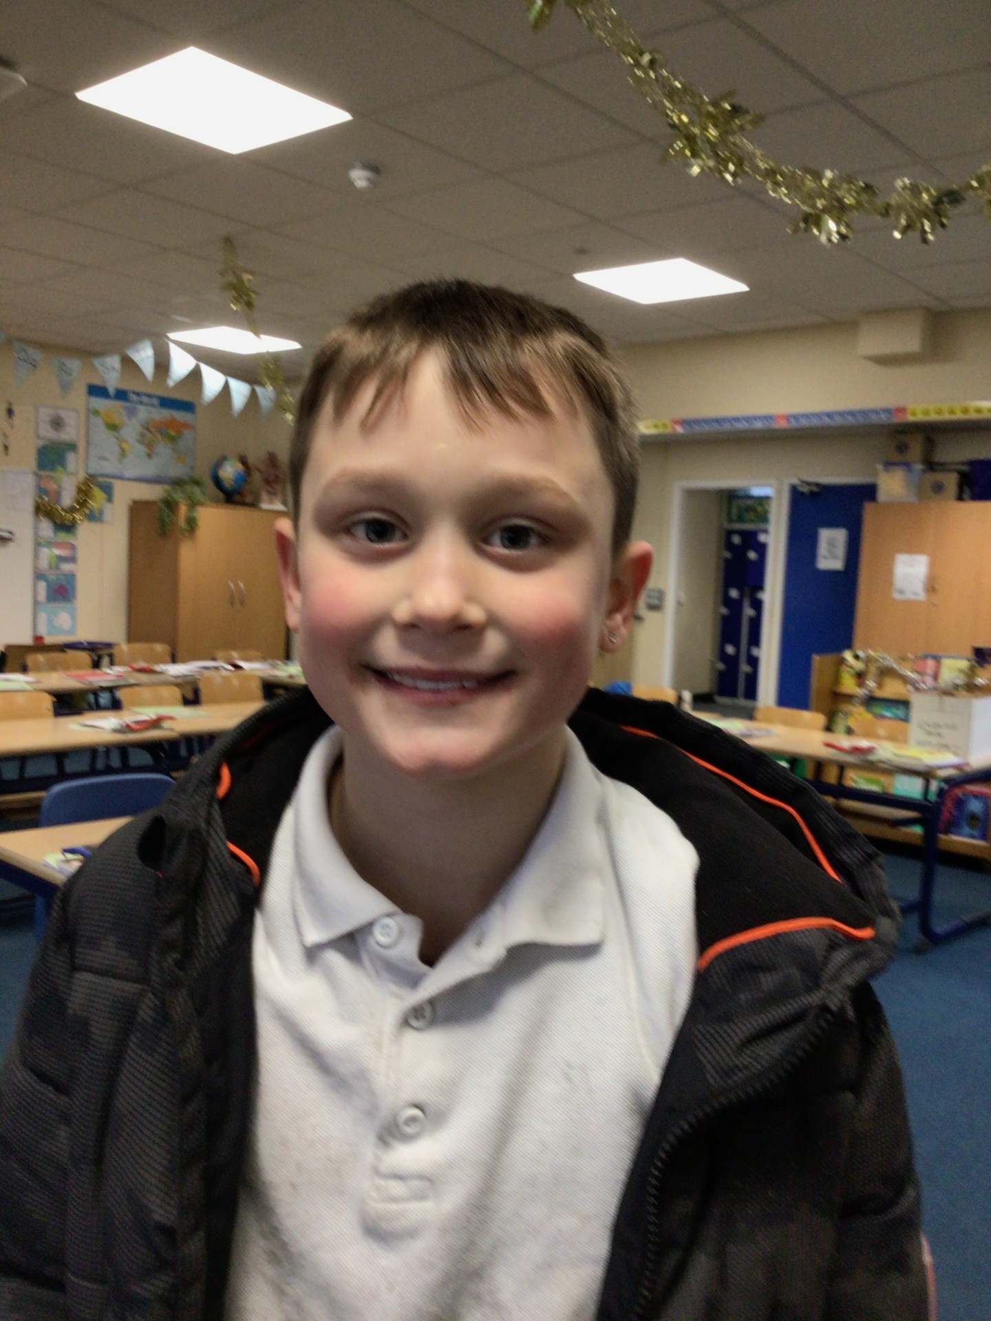
Our Swallow Hero
Lockie has had a really good week. It has been lovely to see Lockie trying his best to keep his focus as much as possible, and although there are still times where he does get distracted it is clear he is trying to change things. On top of this, it was so impressive the way he flourished at our residential last week. Lockie was great at creating nature art and locating things on maps, and it was nice to see him show all his talents in a different setting. Lockie- man of the wild! Keep up the hard work!

Slide 13
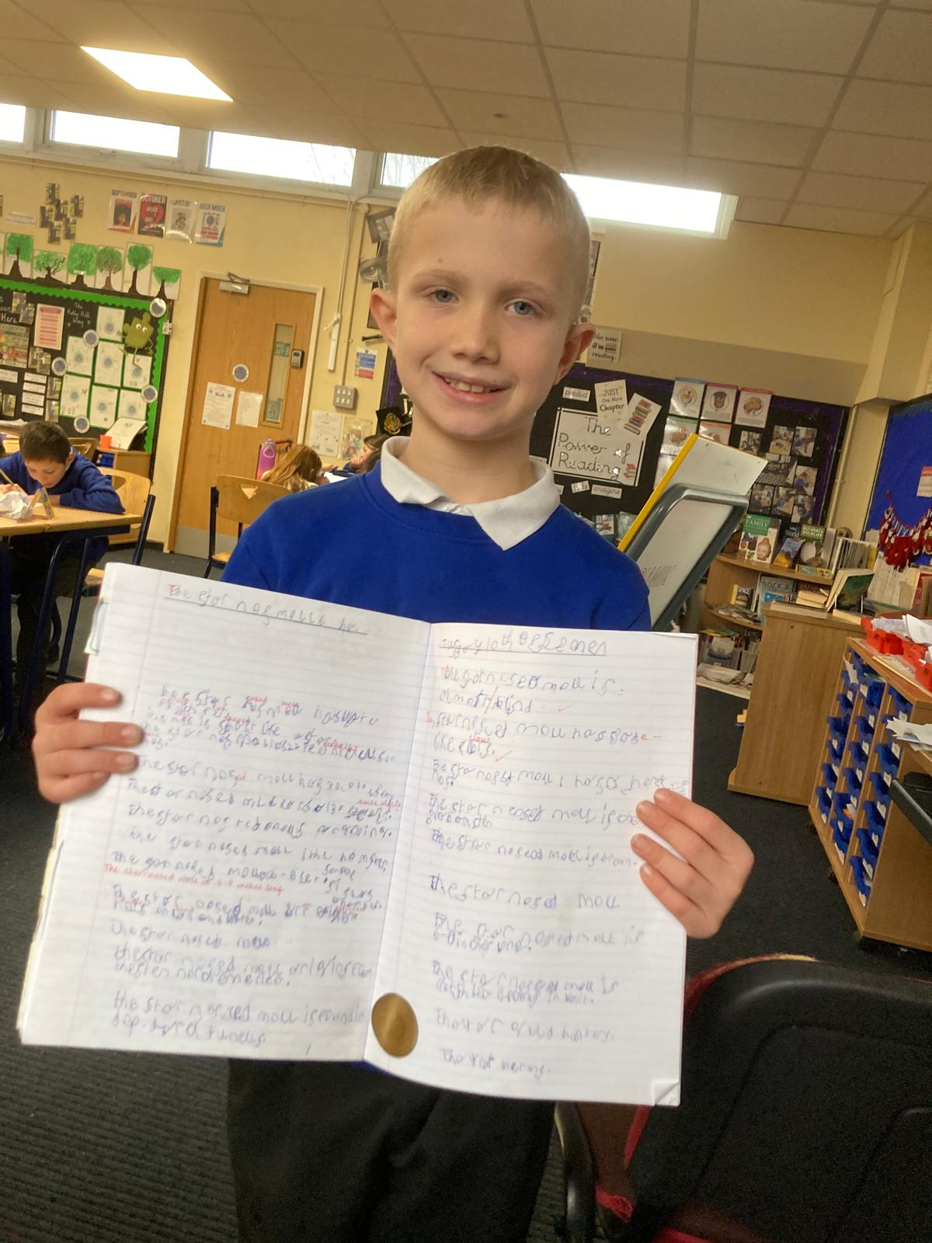
Our Owl Hero
Theo is an Owl hero this week as I am sooo very proud of his writing. Theo has produced his best Year 5 piece yet! His non-fiction sentences about the star nosed mole were great. Well done Theo!

Slide 14
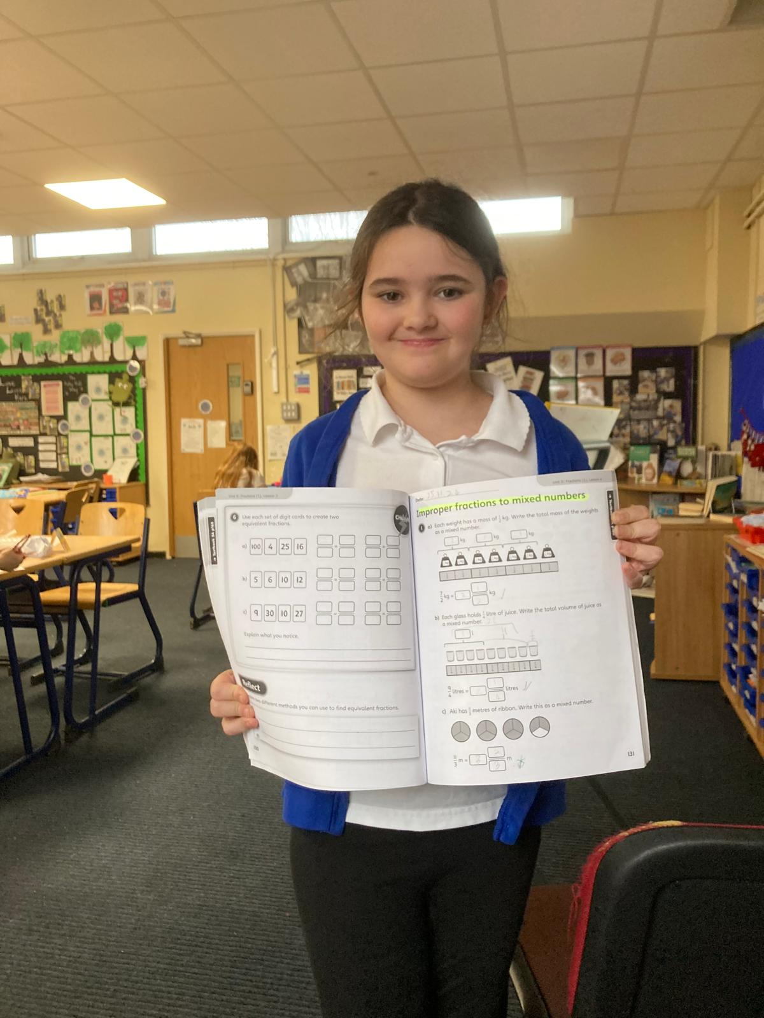
Our Falcon Hero
Gwen is Owl hero today for her growing confidence in all lessons but particularly in Maths. Gwen is developing her ability to work through maths problems, remembering and discussing strategies and calculation methods. Well done Gwen for becoming a brilliant Owl class mathematician!

Slide 15
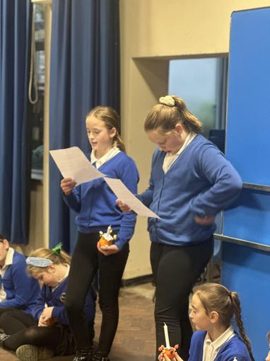
Our Swan Hero
My heroes this week are Heidi and Lilly.
Heidi and Lilly gave a beautiful reading at our Christingle service this week, with very little notice! They spoke confidently in front of the vicar and all of Y5/6. This is just an example of why Heidi and Lilly are deserved heroes every week - they are always ready to lend a helping hand to their peers, myself and every member of staff in school and they can always be trusted to be responsible with anything they do. Girls - I'd be lost without you both! 💙

Slide 16
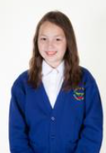
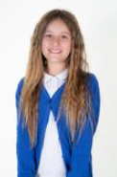
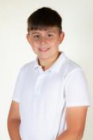
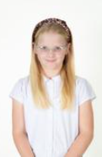
Our Lunchtime Hero
Mrs. Leal has nominated Oliver, Sienna, Amelia and Alice for doing a fabulous job as sports leaders with KS1 children at lunchtimes.
They have introduced the children to new activities, like the parachute and hoop games, leading by example, teaching new games, rules and fairness.
The KS1 children absolutely love having them over to play! 😊

Slide 17
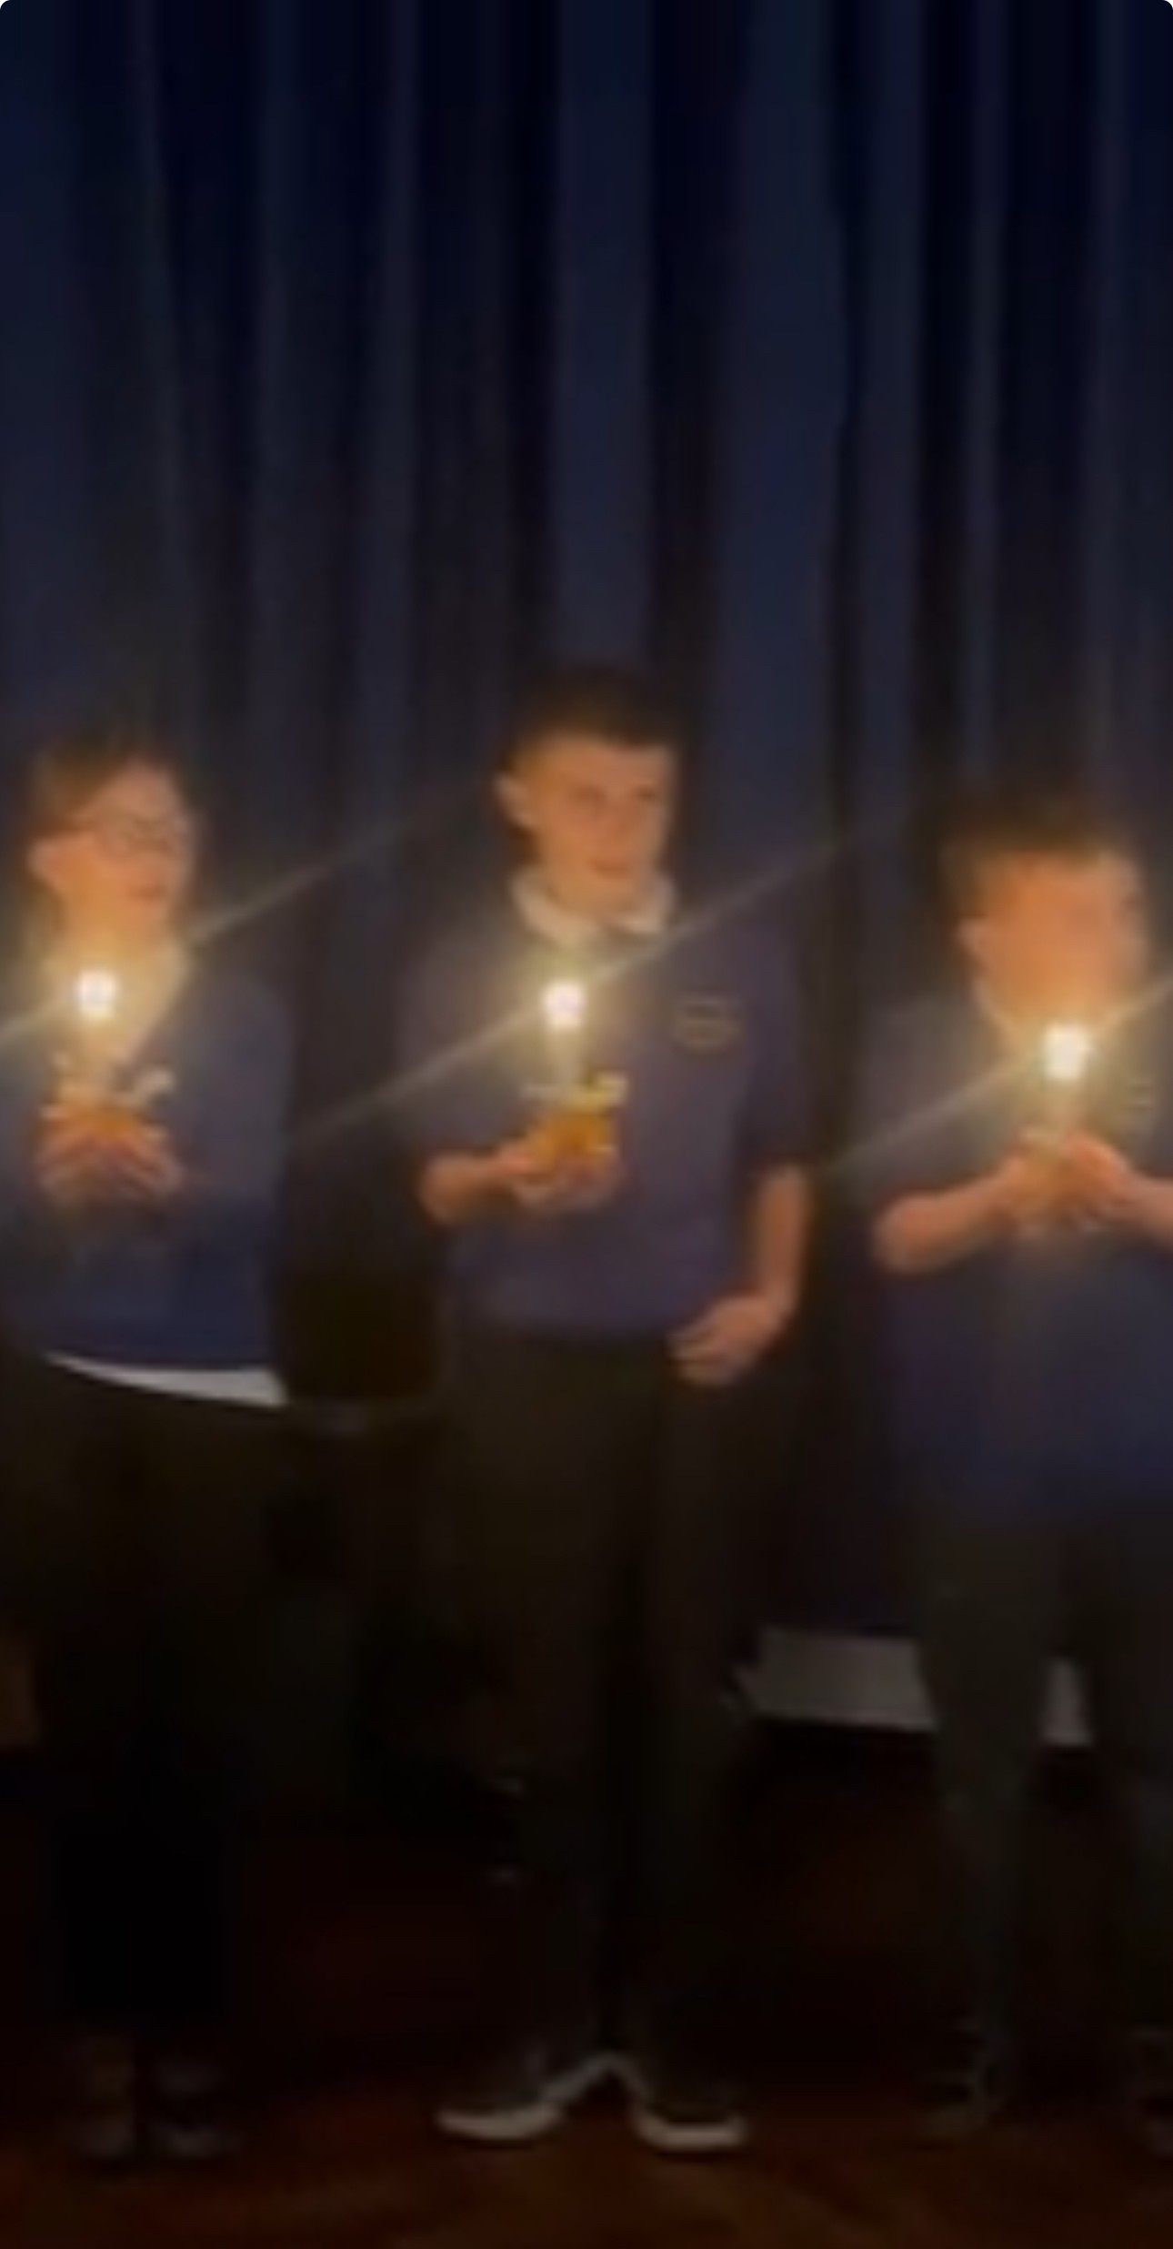
My Headteacher Hero
Charlie is my Headteacher’s hero this week because of his kindness of generosity of his time this week. Yesterday, Charlie spent his entire dinner time helping the EYFS staff with the chairs for their Christmas show completely off his own back - he offered to help them and did so happily. As his reward, the teachers invited him to go and watch the performance in the afternoon, which he absolutely loved! Acts of kindness certainly don't go unnoticed at Holly Hill Charlie! 💙

Slide 18
Class Attendance winners
CLASS | WIN 1 | WIN 2 | WIN 3
Cygnets 1
Cygnets 2
Puffin
Wren
Woodpecker
Kingfisher
Dove
Swallow
Owl
Falcon
Swan
This week’s winners with 97.8% are Dove class! Well done Doves.

Slide 19
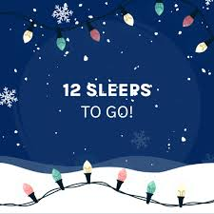
So excited for our fabulous Christmas week next week!
Mrs. Steed xxx

