Slide 1

Holly Hill Christmas Heroes Assembly
HOLLY
HILL
AUTUMN TERM, 2024

Slide 2
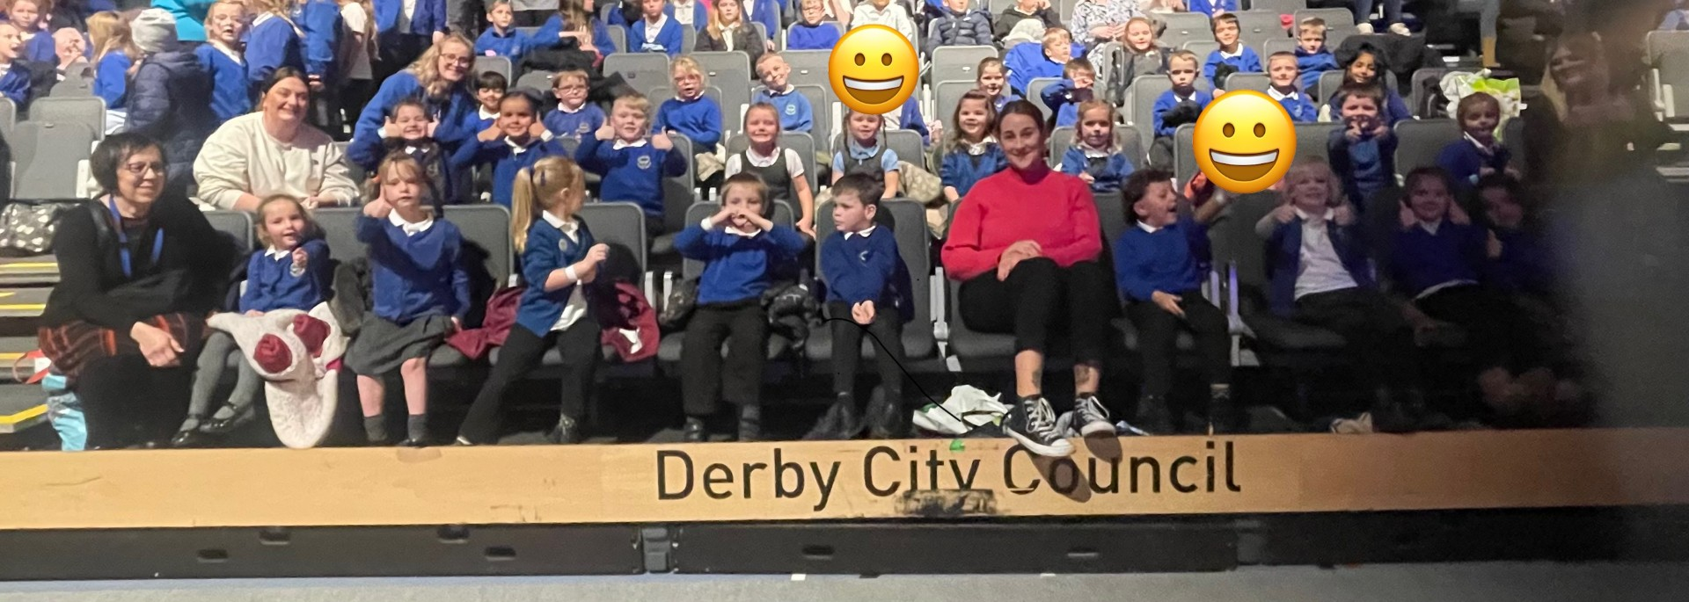
Our Cygnet Christmas Hero
We would like to nominate all of the Cygnet F2s for being absolutely AMAZING at the pantomime. All the adults were super impressed with not only your behaviour but how much you joined in and actually enjoyed the show. It was some (most) of the children's first time on a school trip which meant there were many new things to tackle, but you guys absolutely smashed it. We thought the Holly Hill children were absolute superstars. Well done you guys!! Super duper proud ❤️

Slide 3
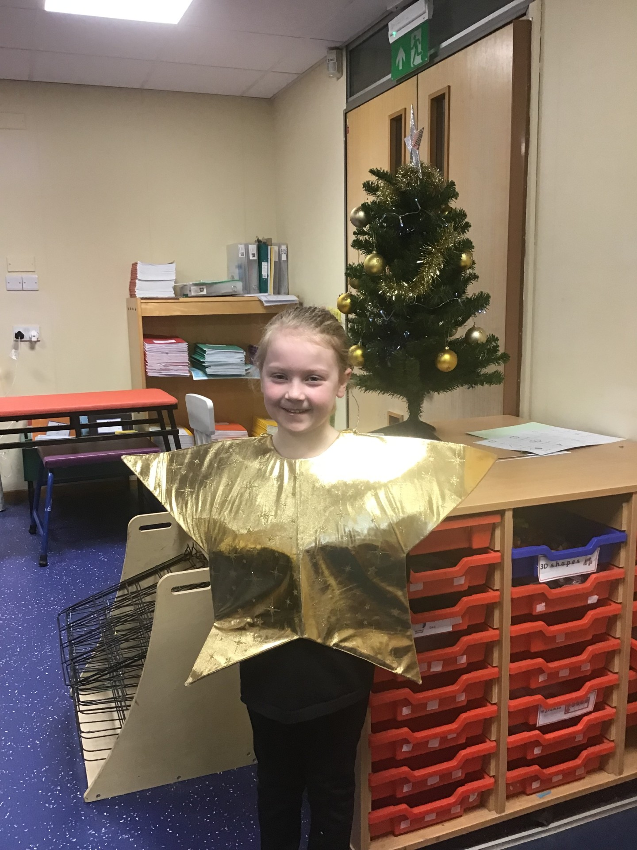
Our Puffin Christmas Hero
Lottie has got to be a Puffin Class Christmas Hero this year. She has been quite poorly and been off school for a while but came back to school on the day of our Christmas Performance and sang every single word to our songs. She has also enthusiastically joined in with all Christmas activities and just loved dancing to all the songs we had on in the classroom. Well done Lottie you have loved our Christmas celebrations and it has been a pleasure to see your enjoyment.

Slide 4
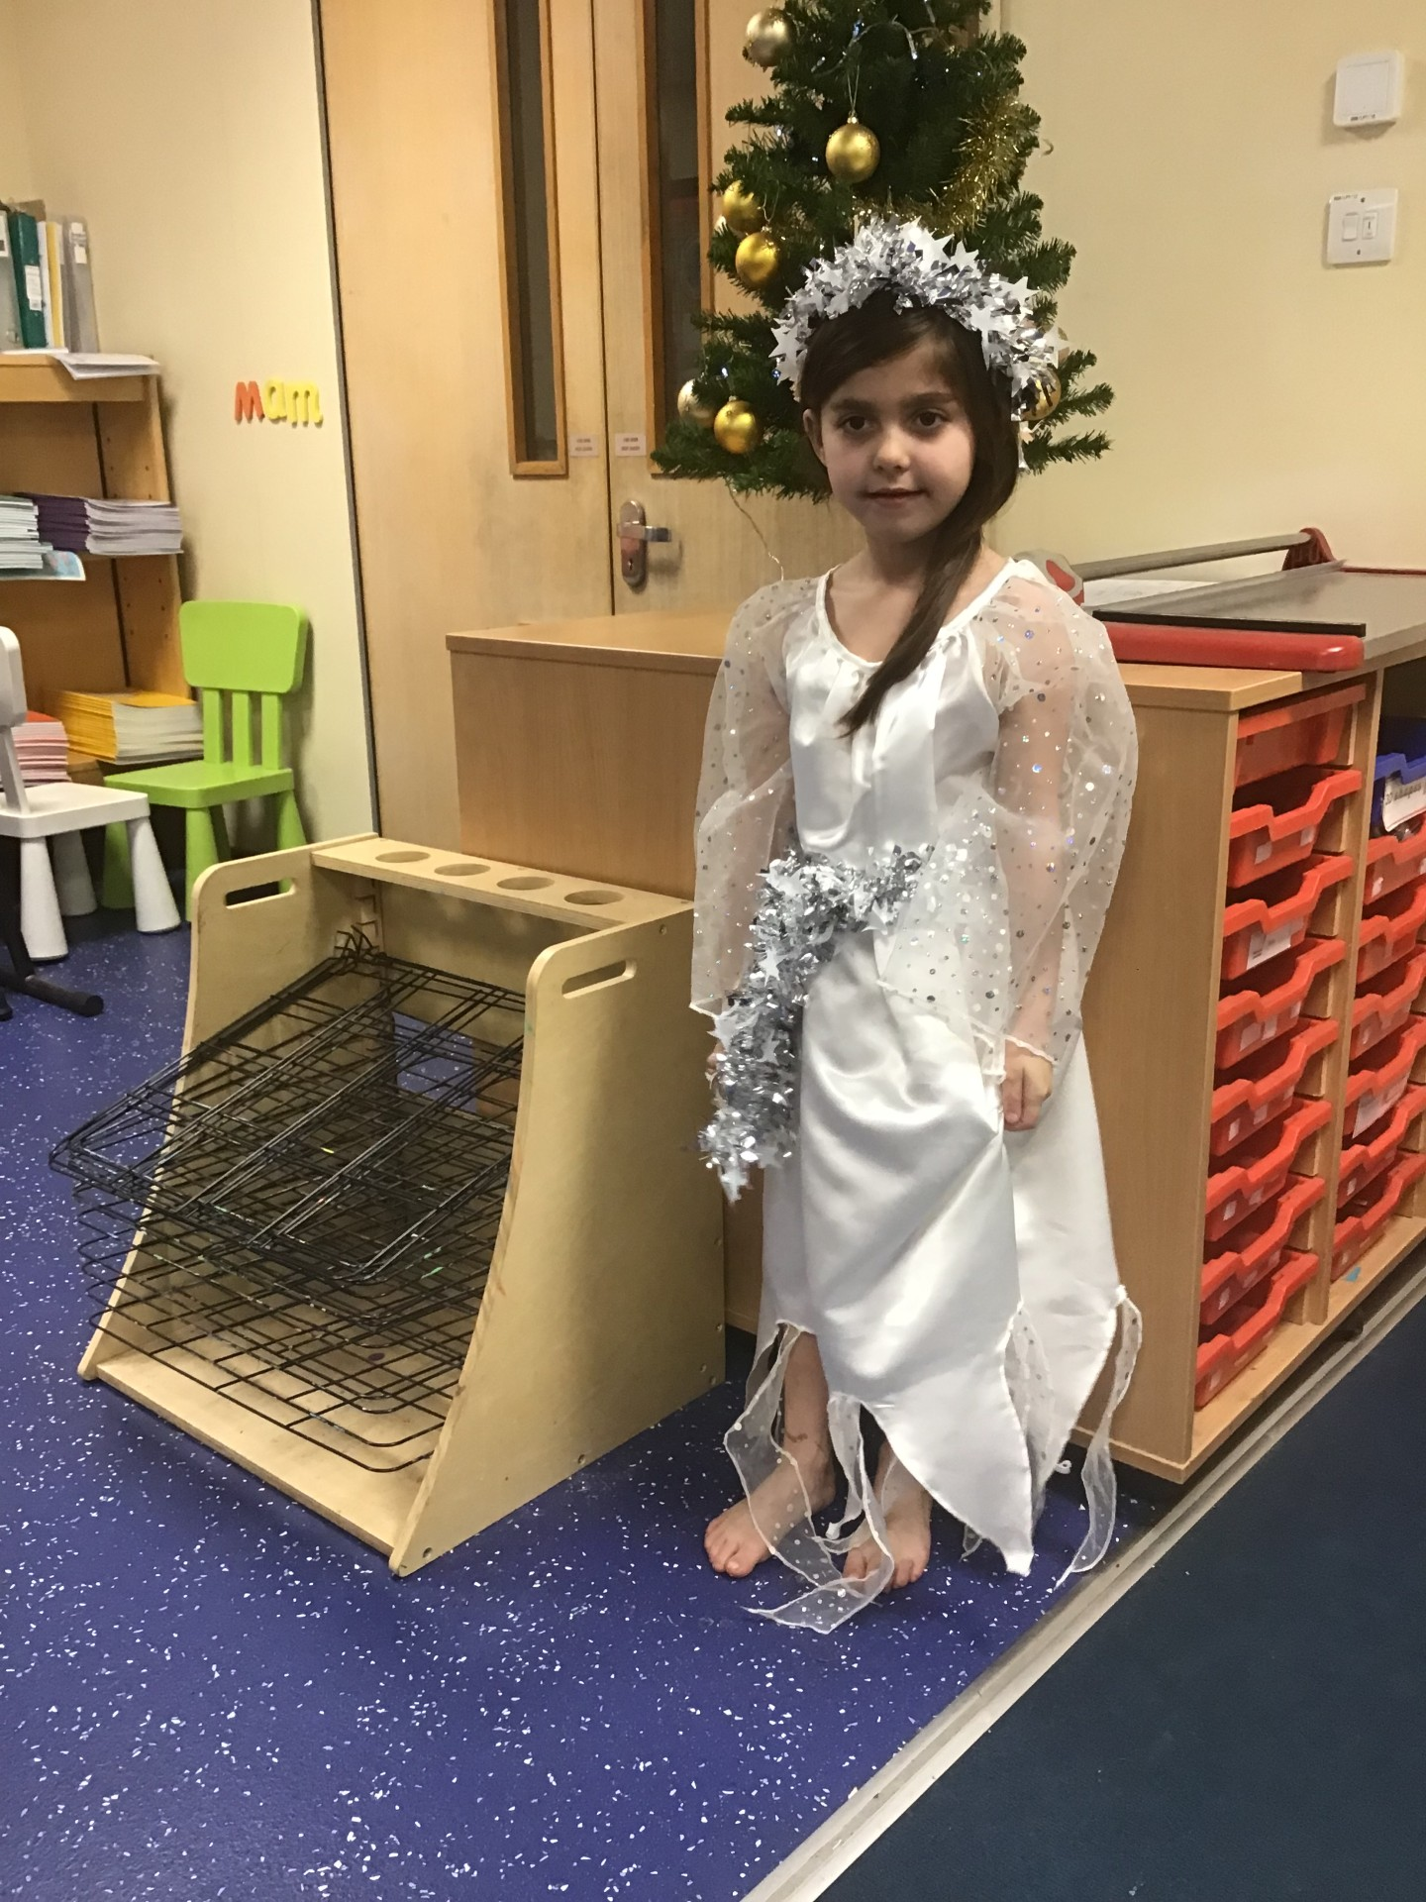
Our Puffin Christmas Hero
Ruby has also got to be a Puffin Class Christmas Hero as she has joined in with everything so enthusiastically. She was a very beautiful angel in our concert and always knew what she had to do and joined in with the singing. She loved the pantomime and talked to me about how much she had enjoyed it on the way back on the bus. She has also really enjoyed colouring and doing Christmas craft activities but always tidied up at the end of the session without being asked. Well done Ruby, I have loved seeing how much you have enjoyed our Christmas week activities.

Slide 5
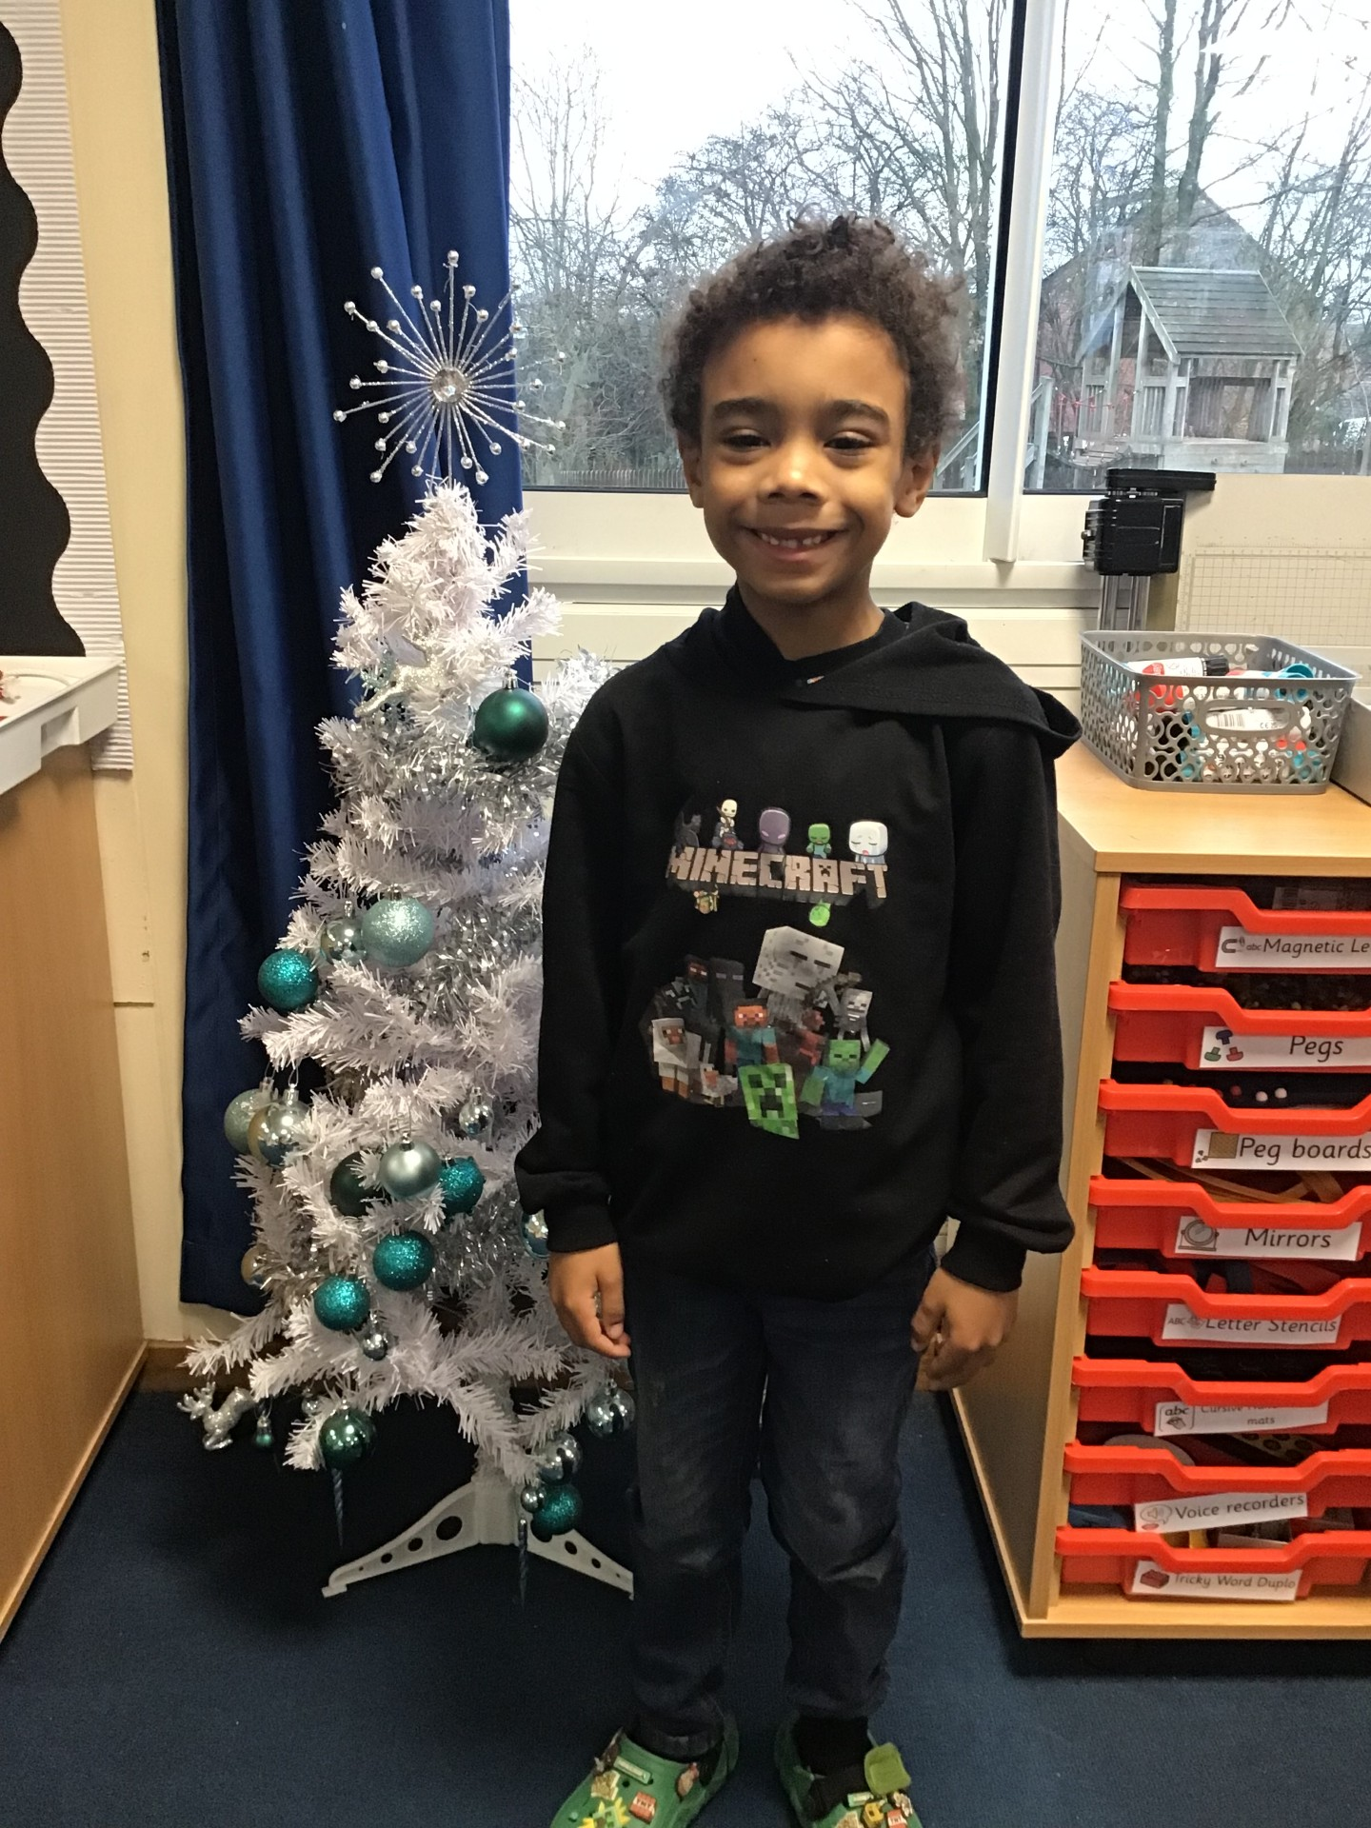
Our Wren Christmas Hero
Cruz has been amazing throughout Christmas week! He blew me away with his beautiful singing in our practices and especially our performances. He has been a true team player throughout party day and has been enjoying all the Christmas festivities. Merry Christmas Cruz!

Slide 6

Our Wren Christmas Hero
Ruby has also been a superstar Christmas Wren! She has enjoyed joining in with all the festivities and has been a team player throughout. She was even lucky enough to win our pass the parcel! She learned her lines beautifully for our performance and even added some actions to her sentence which was wonderful to see and share with everyone. Merry Christmas Ruby!
Thank you
Michaela Mee

Slide 7
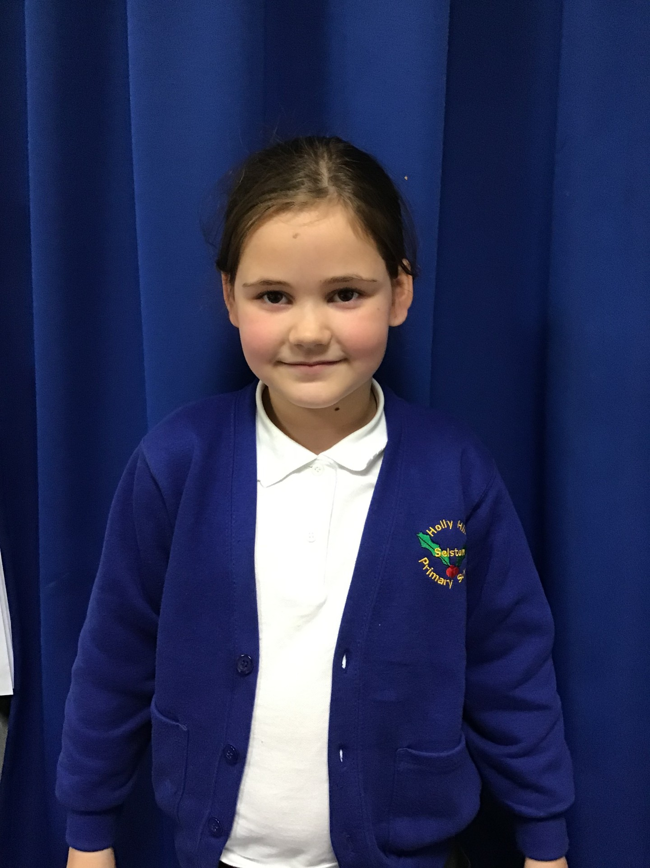
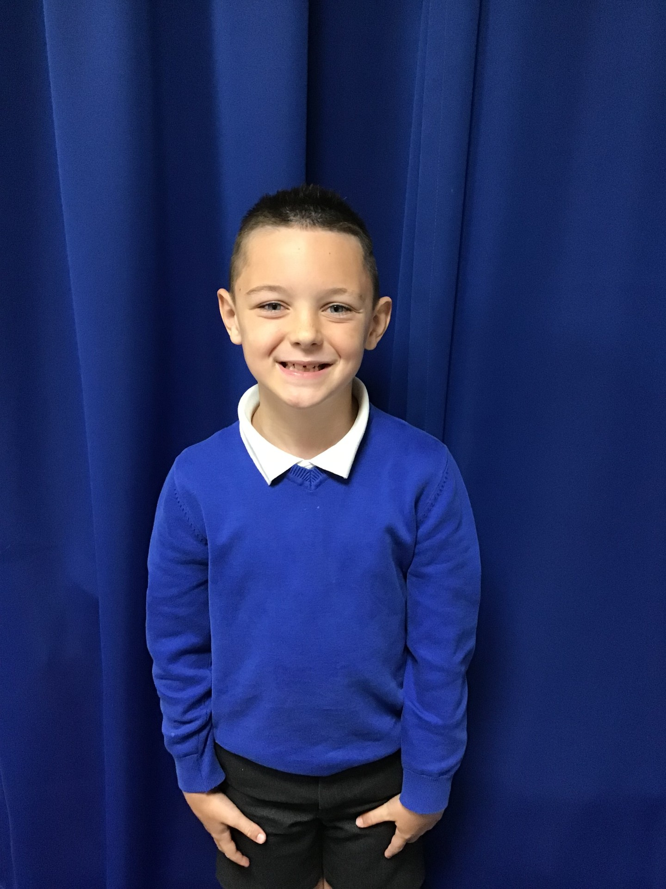
Our Woodpecker Christmas Hero
Our Woodpecker Christmas heroes are Larna and Noah. Without them, our KS1 performance wouldn't have been as amazing as it was.
On dress rehearsal day, our main character was absent and Larna stepped in and did a fabulous job. You could tell she had been watching carefully as she was able to act the part brilliantly and saved the day.
Noah was our main character in the play and was absolutely fabulous. He learnt all his lines and was a real acting super star.
Thank you both for making our performance so special.

Slide 8
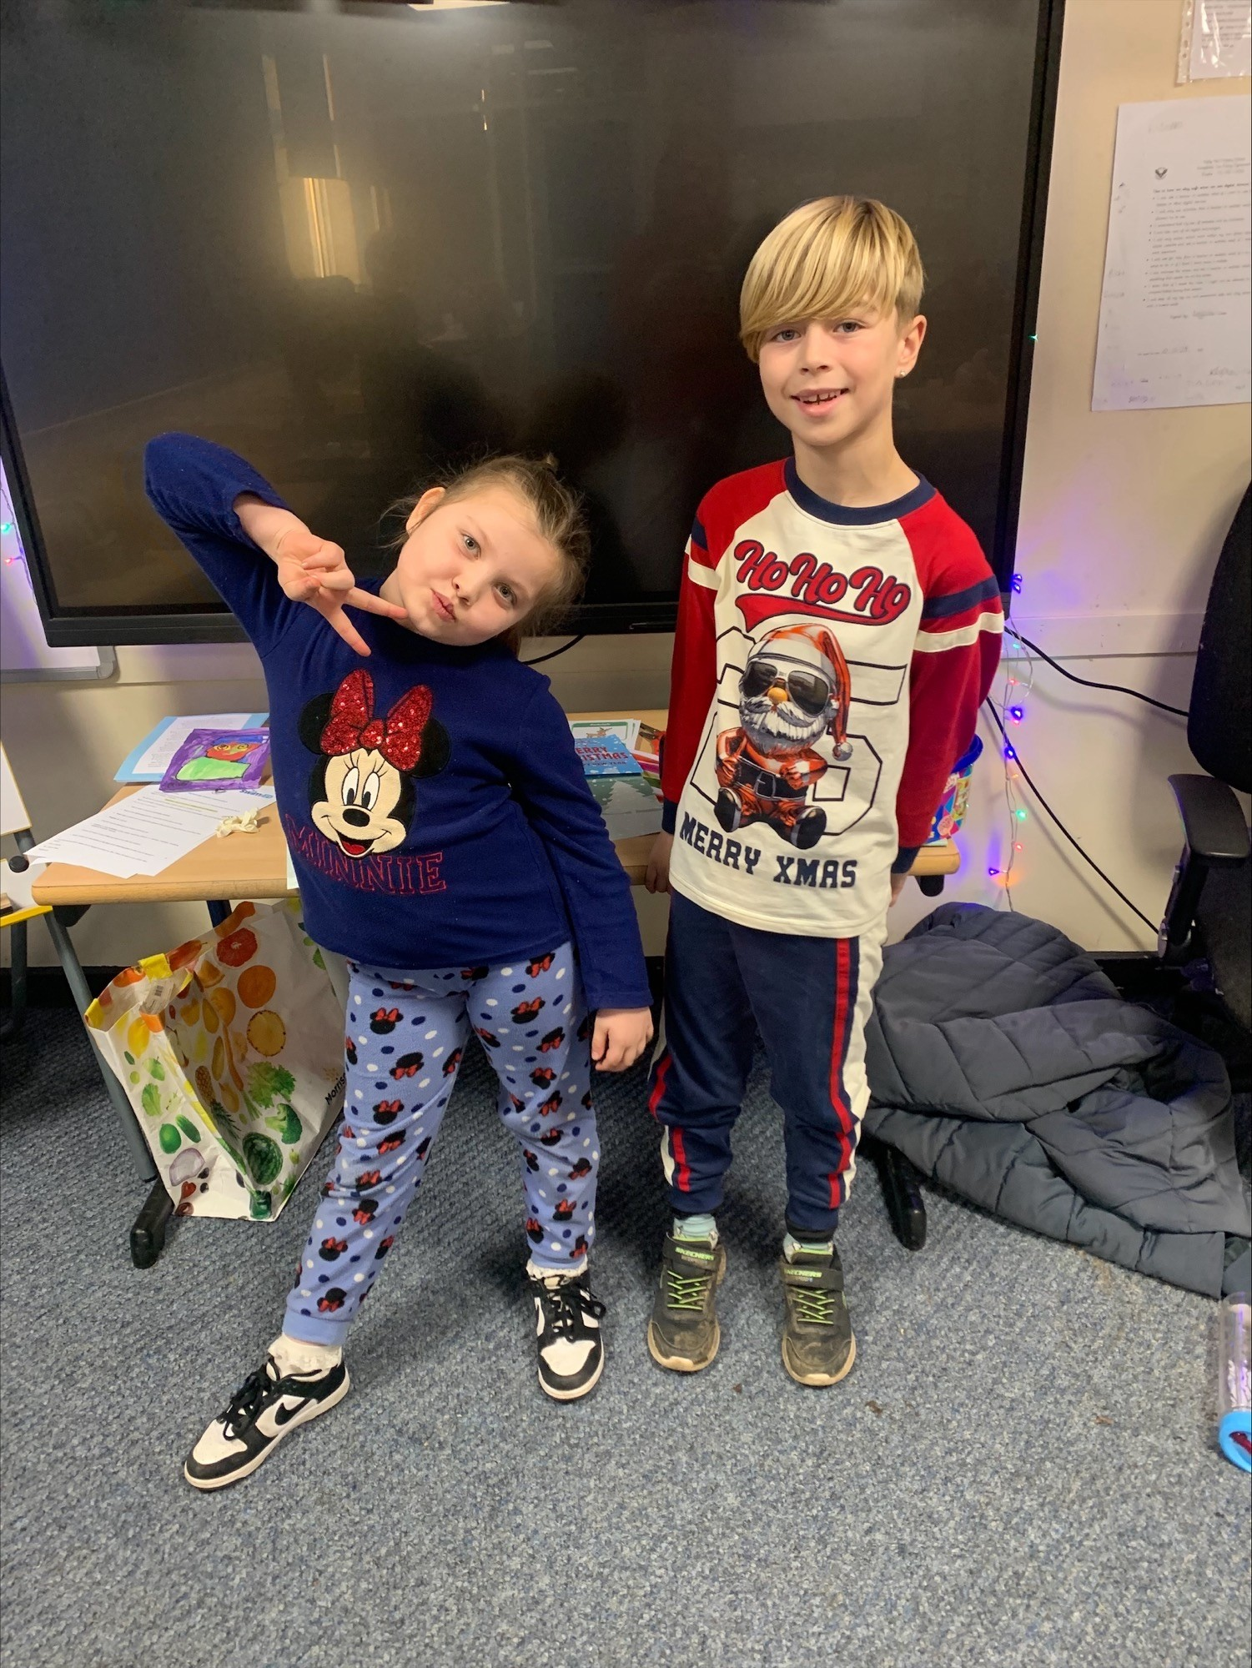
Our Kingfisher Christmas Hero
Kingfisher Christmas heroes are Olivia and Theo. Olivia has put all her sass and energy into our Christmas concert song and Theo has tried so hard to be amazing, joining in sensibly with all of our Christmas activities this week. Well done Olivia and Theo you really are deserving Christmas heroes 🎄🎄

Slide 9
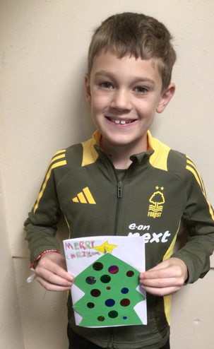
Our Dove Christmas Hero
The first Dove Christmas hero is Rowan.
Rowan is so deserving of this award because of his consistent effort and enthusiasm for learning. He is always ready to learn and can be relied upon to be impeccably behaved on every occasion. He is a perfect role model to others and an absolute pleasure to teach. Well done Rowan, you superstar!
﻿

Slide 10
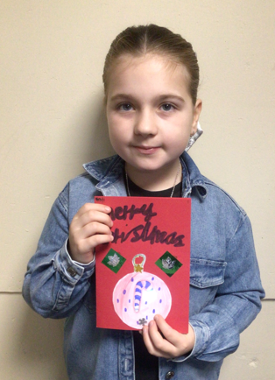
Our Dove Christmas Hero
Our next Dove Christmas hero is Esmee. Another wonderful member of the class who shows fantastic effort and a real maturity to her learning. She constantly tries hard and produces beautiful pieces of work every time. Esmee is exceptionally kind and always helps others in need. Another perfect role model who is a pleasure to have in Dove class. Well done Esmee!
﻿

Slide 11
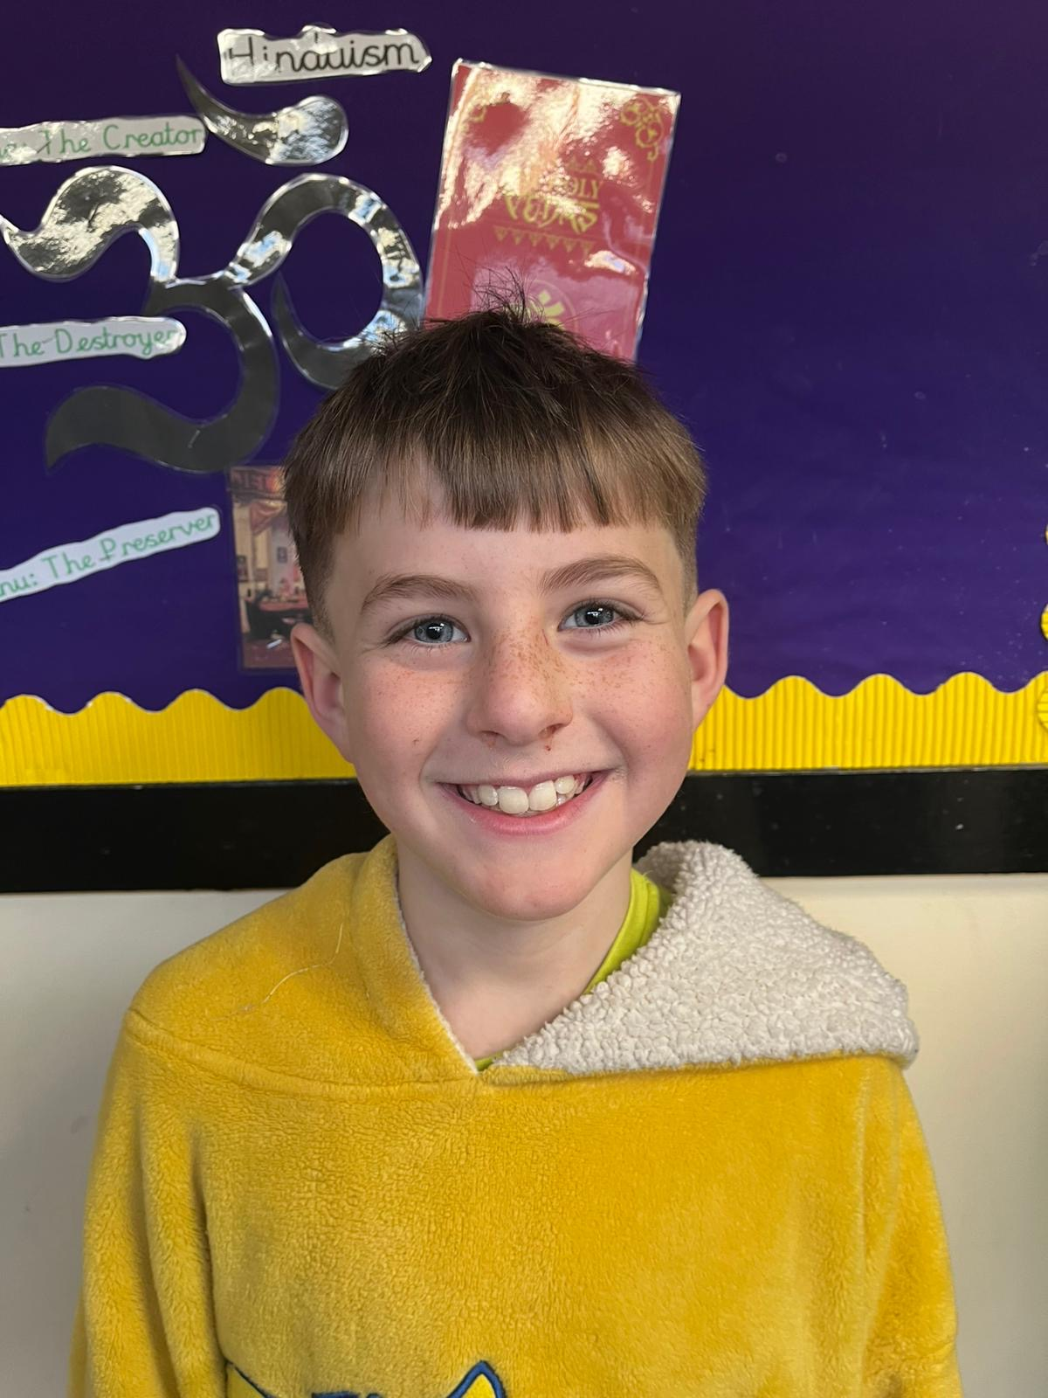
Our Swallow Christmas Hero
Mason has been an absolute delight to have in Swallow class over the last term. His perseverance and determination is amazing and he is just an all-round lovely person. Mason has caught my eye in every Christmas singing practise - always listening, ready and a credit to have in Swallow class. Keep it up Mason!

Slide 12
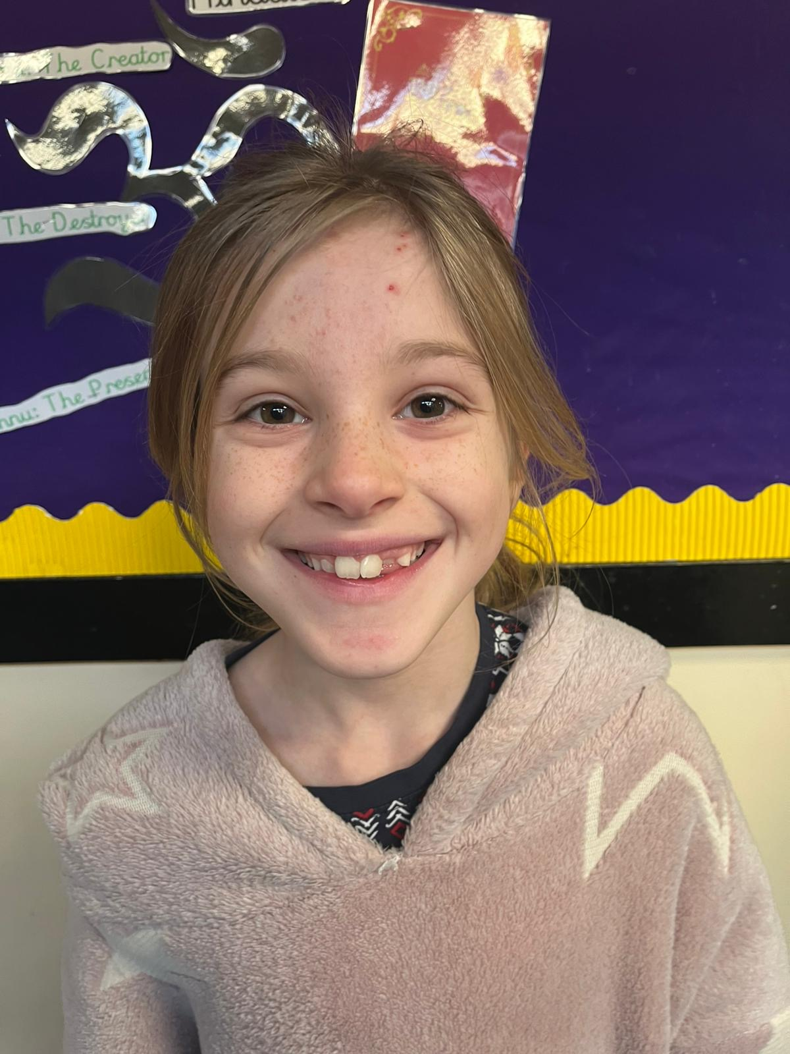
Our Swallow Christmas Hero
Dana is Swallow's 'unsung hero'. Quiet but incredibly conscientious, bubbly and a very kind friend. Dana has had a lovely Christmas week - especially enjoying the Christmas maths challenges!

Slide 13
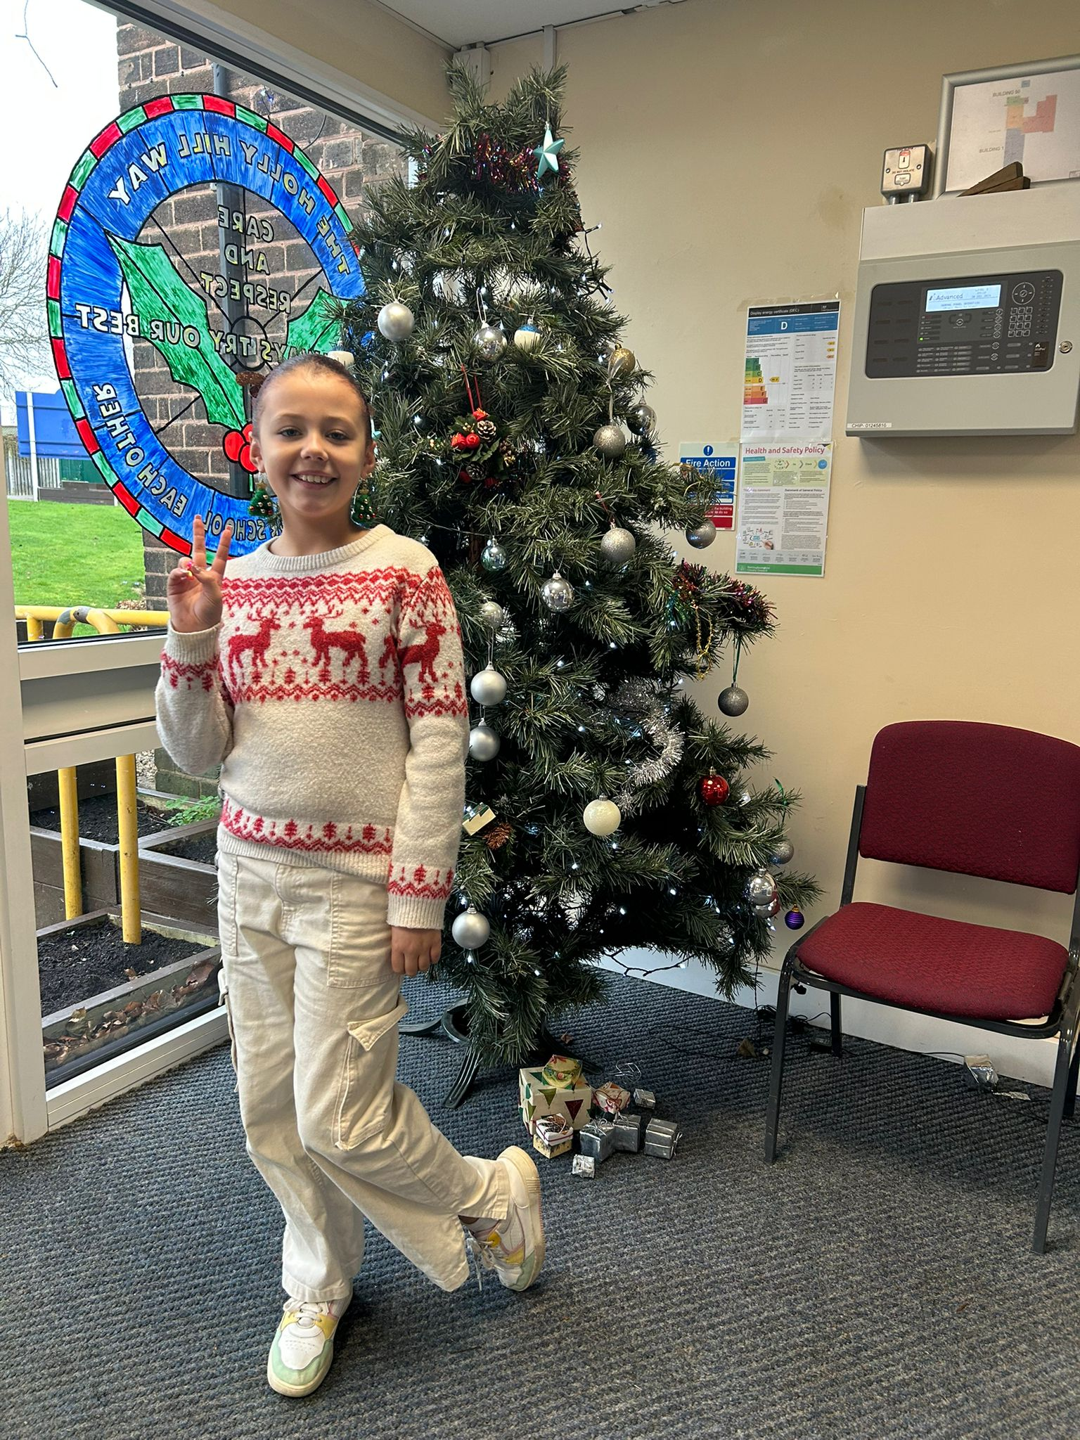
Our Owl Christmas Hero
Mila is my Owl hero for her kindness and for always doing the right thing. Mr. Close told me that during the pantomime, Mila shared her snacks with a younger child who didn’t have any. Mila showed the true spirit of Christmas and made a little boy extremely happy. Well done Mila!

Slide 14
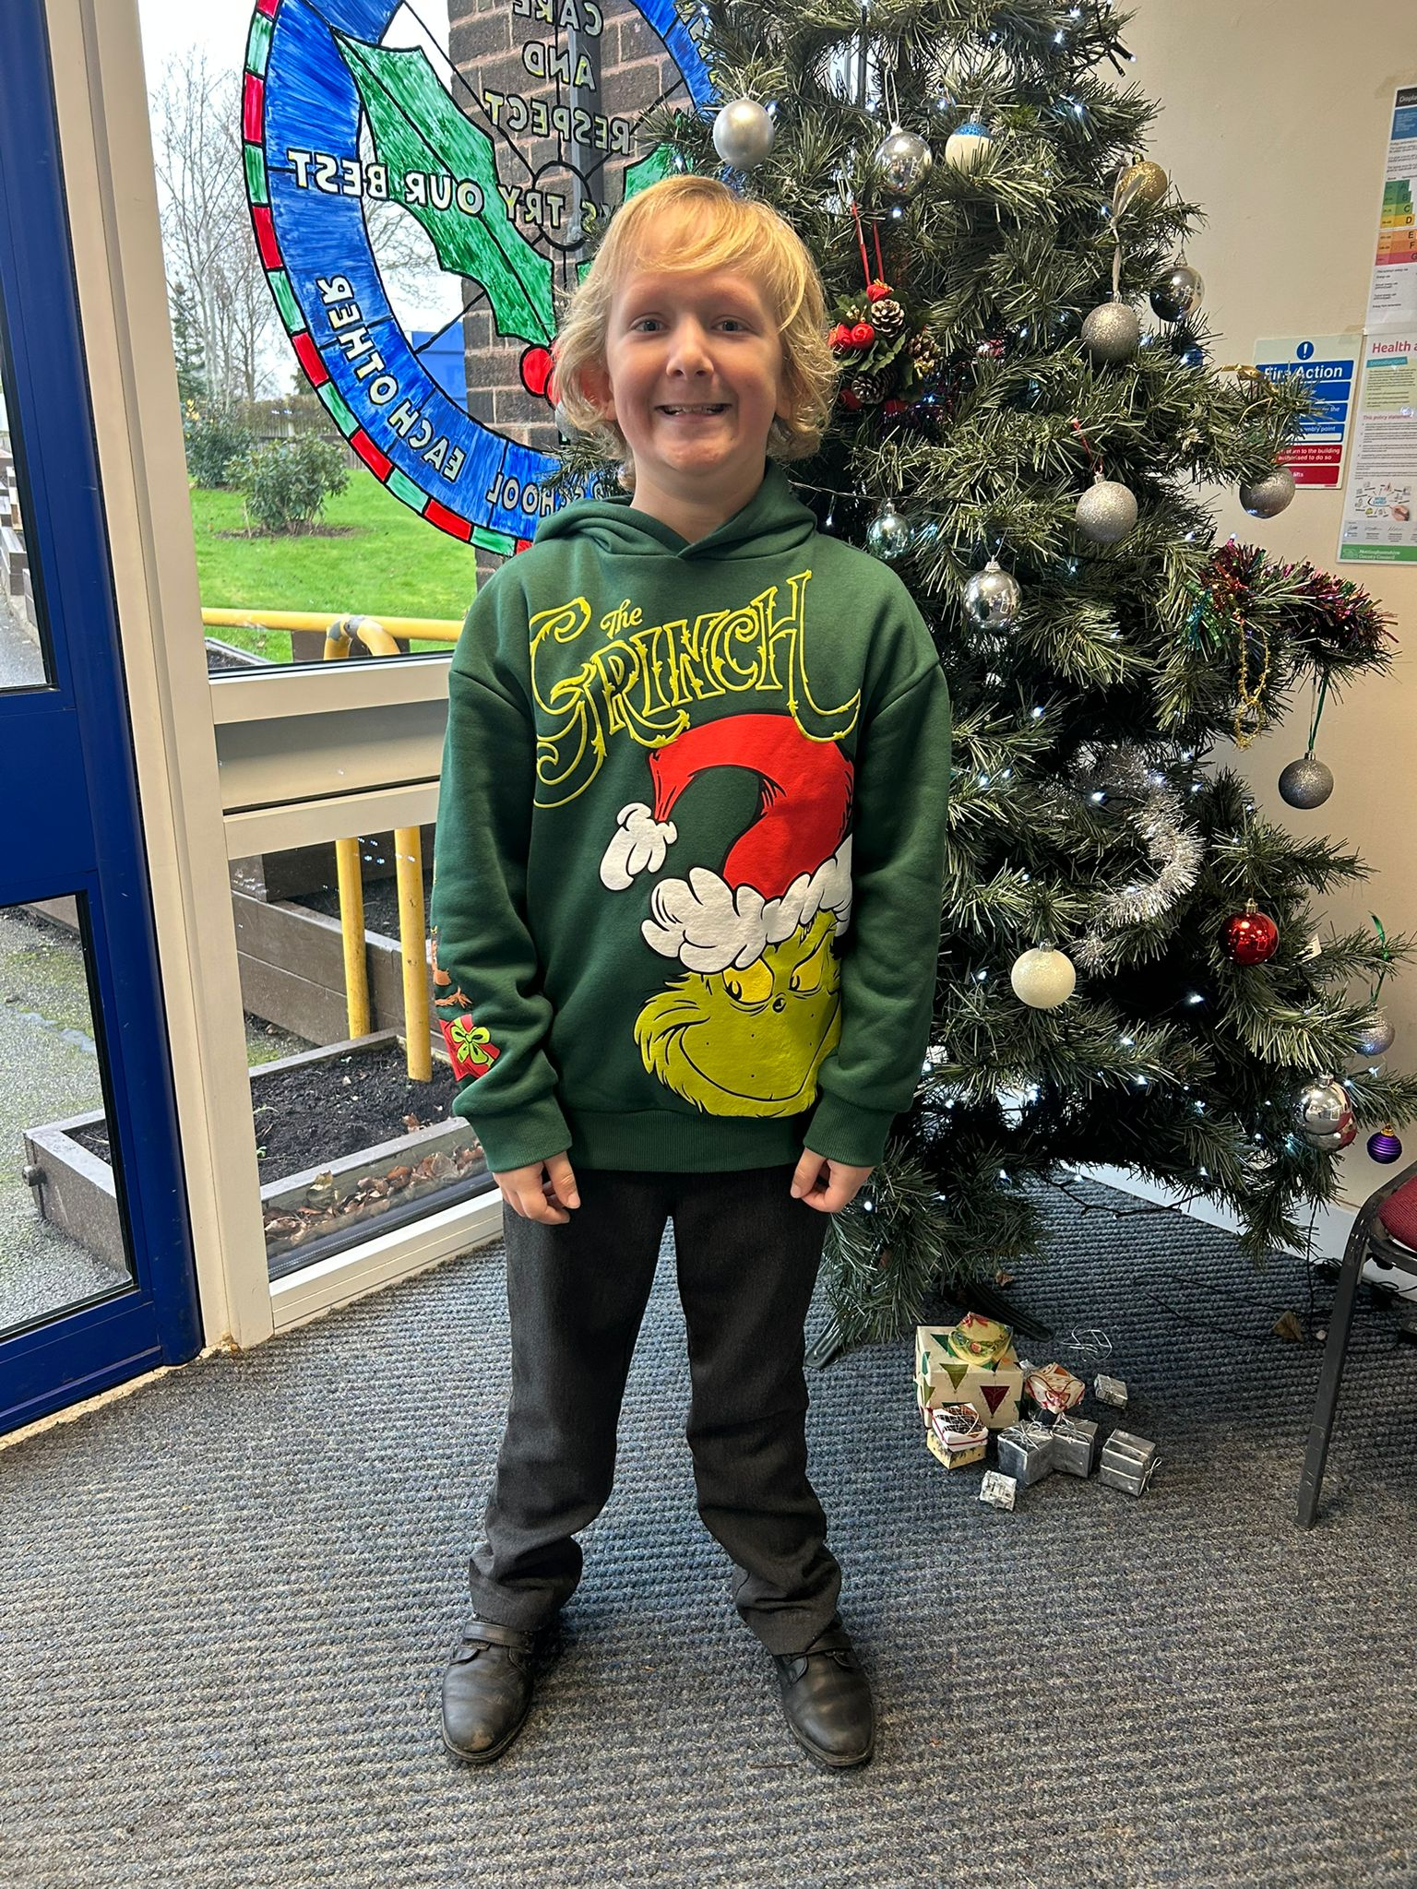
Our Owl Christmas Hero
Alex is my second Owl Christmas hero. I’m choosing Alex as he is always willing to help. Alex comes into school every morning with the biggest smile on his face and he make those around him happy too. He is a great friend and Owl class member.

Slide 15
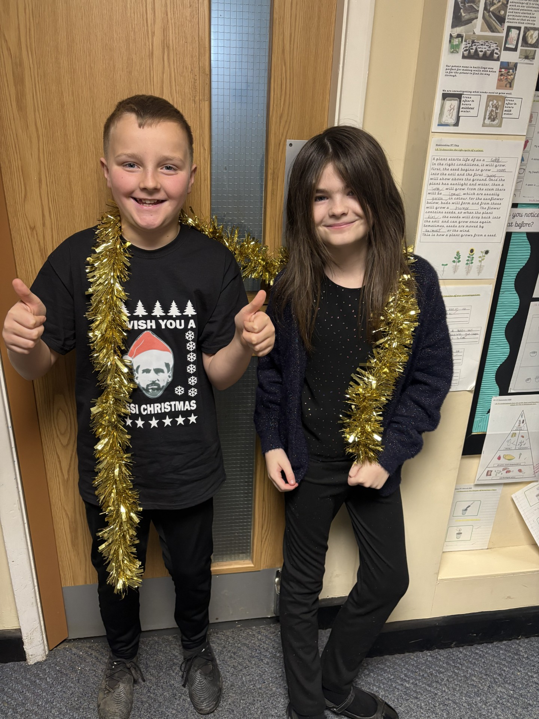
Our Falcon Christmas Hero
The Falcon Christmas Heroes are Avery and Jacob! These two have spread joy and light all week long, especially in preparation for the Carol Concert. Every song, whether its our class song or all of KS2, these two perform to the max and their enjoyment and energy has helped brighten the mood (especially when we're getting tired). I have loved watching them both. Keep shining in 2025! 🌟

Slide 16
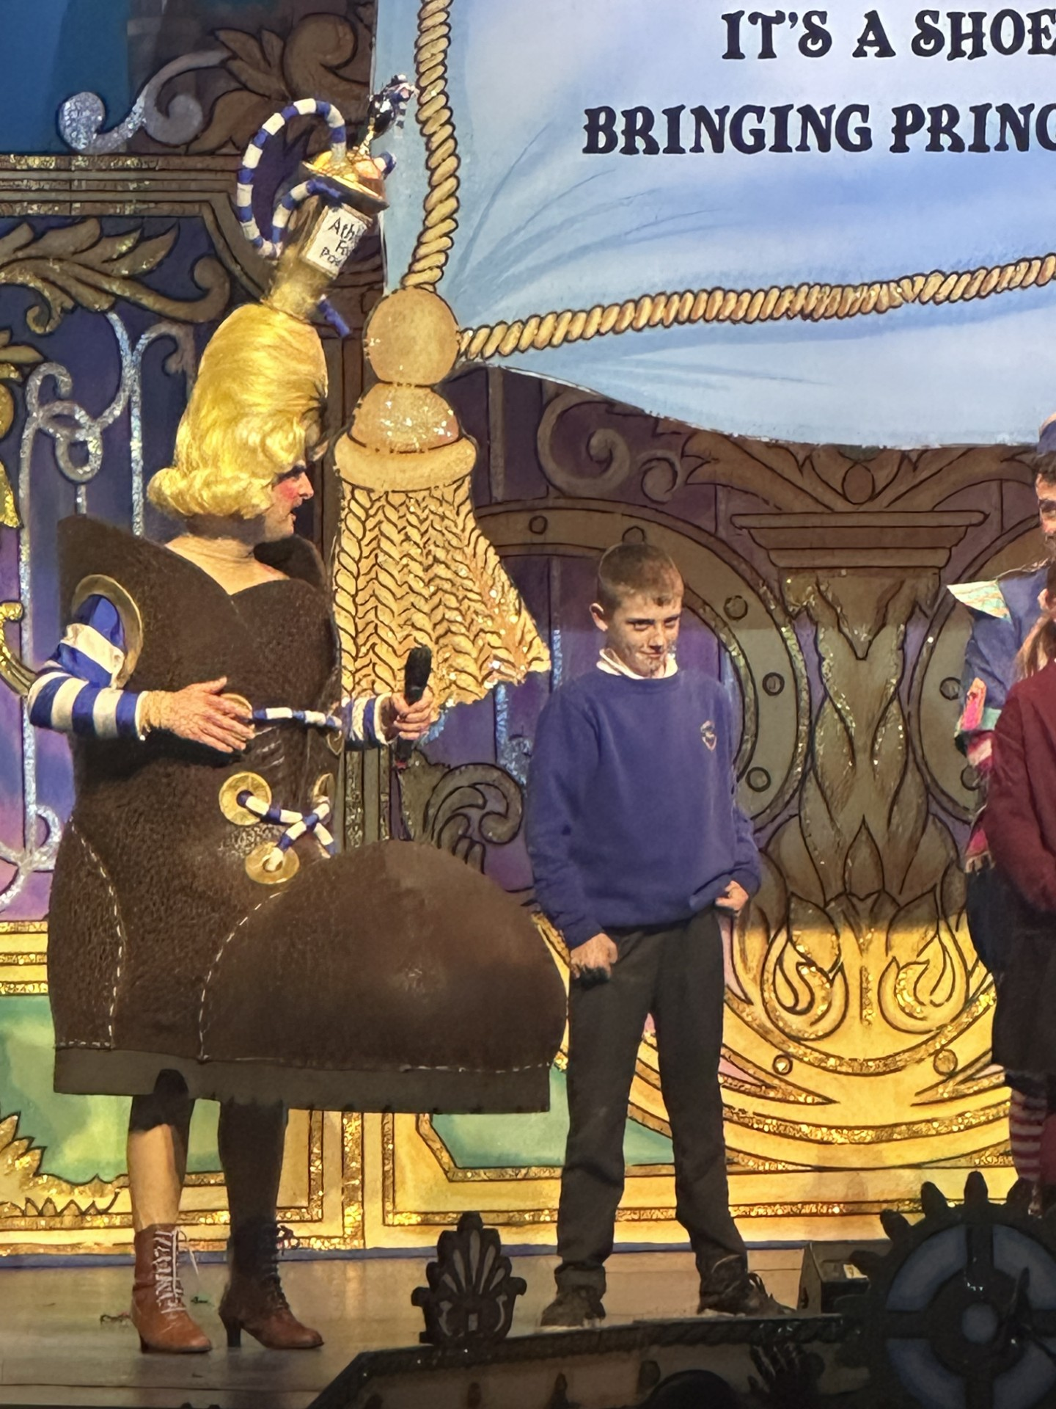
Our Swan Christmas Hero
Charlie and Kyle are my Christmas heroes this week!
Charlie was invited on the stage during our school trip to the pantomime and was such a good sport! He was up there singing and dancing and told the ugly step sister he wants a dirt bike for Christmas! He even received a goody bag at the end. Holly Hill were very proud to see you up there Charlie!

Slide 17
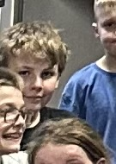
Our Swan Christmas Hero
Charlie and Kyle are my Christmas heroes this week!
Kyle is a hero this week for his behaviour and participation during our class party. Kyle joined in with everything, respected everybody else when it was their turn and had fabulous festive spirit. Well done Kyle - you make Swan class a lovely place to be.

Slide 18

Thank you for a wonderful Christmas week! We have had the most amazing time with you all.
Have a magical Christmas everyone!
Mrs. Steed xxx

