Slide 1

Holly Hill Heroes Assembly
HOLLY
HILL
SPRING TERM, 2025

Slide 2
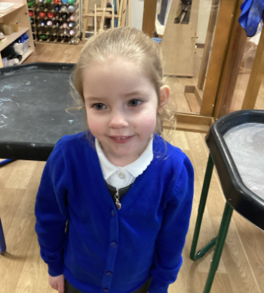
Our Cygnet Hero
Our Cygnet hero this week is Ava.
Ava has been so grown up coming into School this week, she has even been helping other children that were a little unsettled in the morning. What a superstar Ava!

Slide 3
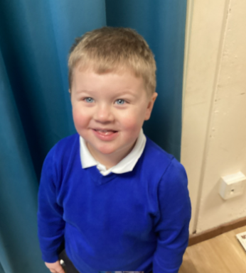
Our Cygnet Hero
Our Cygnet hero this week is Arthur.
Arthur is one of our youngest children but you would not know it this week. He has been listening and taking care to follow instructions. He has also been trying very hard in phonics and trying to blend sounds. Well done Arthur, we are all very proud.

Slide 4
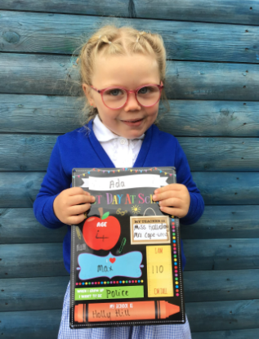
Our Cygnet Hero
Ada is one of our heroes this week! Ada has had an AMAZING week. She has really impressed me during phonics with her attention and her focus. She has often been the first person ready on the carpet for our learning time. She is always helping to tidy up after our busy time and we are super duper proud of her! Well done Ada!

Slide 5
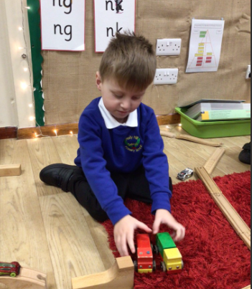
Our Cygnet Hero
Leo is our other hero this week! Leo has only just started with us at Holly Hill and he has made an excellent start! He is super knowledgeable and has so much to say. He has come to school without crying, and that is super brave. We can't wait to see how Leo grows with us at school. Well done Leo!

Slide 6
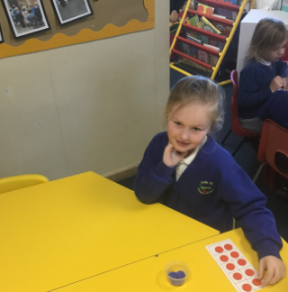
Our Puffin Hero
Matilda could be Puffin Class Hero every week. She has a fabulous attitude to everything we do and always tries hard. Most importantly though she is always kind and caring towards everyone in her class, always making sure her friends are OK. This is such a beautiful trait and she should be proud of herself. Well done Matilda you always are a PERFECT PUFFIN!

Slide 7
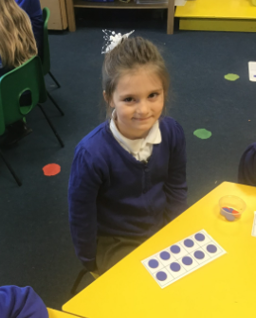
Our Puffin Hero
Lottie is a Puffin Class Hero this week because of the effort that she is putting into all her work. She has been trying particularly hard with her reading this term and has really impressed her teachers with her attitude. Most importantly Lottie is always happy and enjoys being with her friends which makes her a fabulous member of our class. Well done Lottie, you are working really hard and we know you will keep it up. You are a PERFECT PUFFIN!

Slide 8
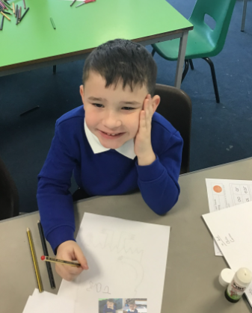
Our Wren Hero
Jase has been trying really hard with his phonics and has really impressed myself and Mrs Cottee with his attitude in his phonics lessons. He has been working hard to learn the new sounds, read words and write them, including sentences. Well done Jase, keep it up!

Slide 9
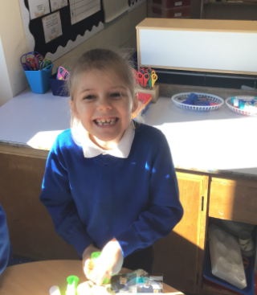
Our Wren Hero
Grace has also been trying really hard with her writing, she has been including new features we have learned in English and trying hard with her handwriting. I have been super impressed seeing the progress she has made since starting in F2 and is amazing me with her work now as a year 2. Fantastic Grace, keep it up!

Slide 10
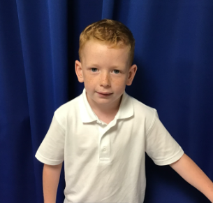
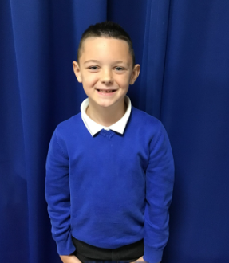
Our Woodpecker Hero
My heroes this week are Noah and Rupert. I have chosen both of them for the kind and thoughtful way they behave towards all the other children at school.
Yesterday, Noah could see that a child in Puffin had no one to play with and straight away he came and asked if they would like to play with him.
Rupert is always being helpful and making sure all our equipment is tidy, without being asked. He is always ready to help others with what they are doing, but does it in a really lovely way so that he is helping without being bossy.
It is lovely to have such kind and thoughtful children in Woodpecker Class.

Slide 11
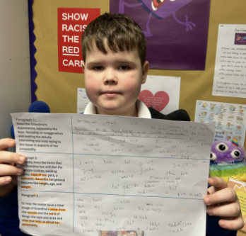
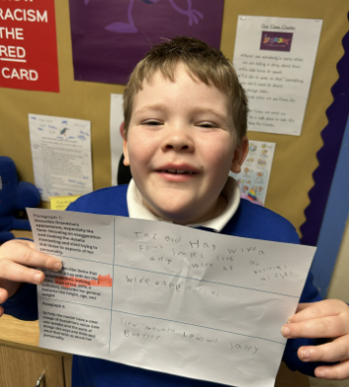
Our Kingfisher Hero
Kingfisher heroes this week are Zach and Cole.
We have been planning a character description of Grandma in George's Marvellous medicine and both boys have impressed me!
They worked hard to be independent and wrote some super ideas by themselves.
Well done boys, you have made me proud. 🌟

Slide 12
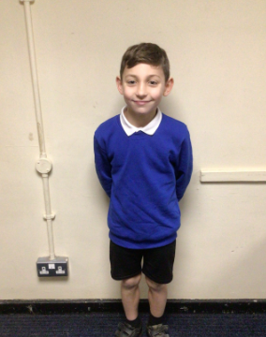
Our Dove Hero
The first Dove Hero this week is Teddie. Teddie has had a brilliant start to life at Holly Hill. He tries hard at everything he does, is a great friend and is doing brilliantly. What an asset to the school- well done Teddie.
﻿

Slide 13
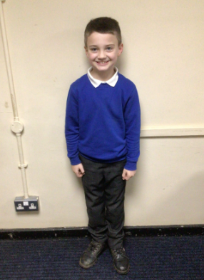
Our Dove Hero
The second Dove Hero this week is Corbyn. Corbyn could be Dove Hero every week for his fantastic hard work in class, but this week we have had to take note of the fantastic language he has used to describe the Grandma in George’s Marvellous Medicine. Corbyn has managed to make her sound absolutely disgusting! Great job!
﻿

Slide 14
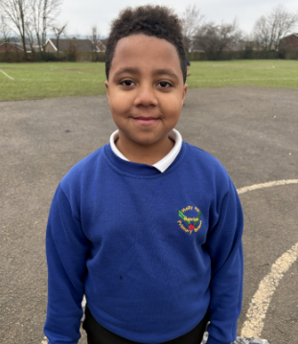
Our Swallow Hero
Our Swallow hero this week is Pelumi. Pelumi has really enjoyed our English focus this week and has loved writing descriptively about the characters in our class text. He has been very active on the carpet, answering lots of questions and has been very creative in his vocabulary and phrases.

Slide 15
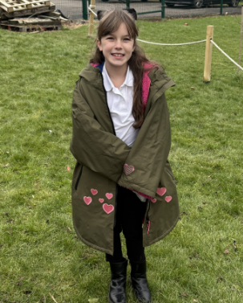
Our Swallow Hero
Our Swallow hero this week is Skyla. Skyla is an absolute superstar in everything she does. She tries 110% in all of her lessons. She is a super kind friend and a pleasure to have in Swallow class!

Slide 16
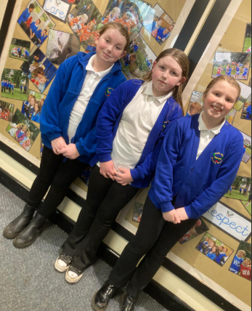
Our Owl Hero
My Owl Heroes this week are my 3 musketeers!
Amelia, Isla-Rose and Ella have been super helpful this week. They have all used their own initiative to help to make our room tidy. Ella tidied up other tables and not just her own. Amelia and Isla Rose thought that the sink needed sorting and cleaning - and they just did it!
Thank you girls for keeping our learning space lovely.

Slide 17
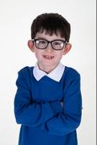
Our Falcon Hero
The first Falcon hero this week is Carson! Carson was an absolute superstar at Swimming on Monday: he overcame his nerves and even managed to enjoy himself! Not only that, but in the afternoon, Carson caught up with 2 maths lessons on decimals and absolutely smashed it! Carson always has such a positive, cheerful attitude , which makes him a truly FABULOUS FALCON! 🤩

Slide 18
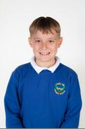
Our Falcon Hero
The next Falcon hero is Vinni! Vinni has had Mrs Cordon in his ear since Y4 about handwriting and in 2025 all her dreams have come true, because Vinni has worked really hard to improve his joined writing. Not only that, but Vinni is very hardworking in all subjects. He listens well and will always try to do the right thing. You are a wonderful member of Falcon Class Vinni- keep up the great work! 🤗

Slide 19
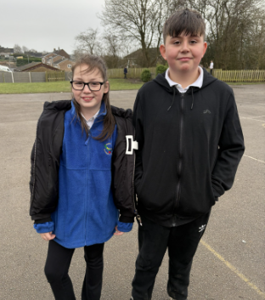
Our Lunchtime Hero
Our lunchtime heroes this week are Oliver and Sienna.
Oliver and Sienna are particularly helpful in the dining hall and always happy to help. They also give up their lunchtimes to play with the younger children on the KS1 playground and are noticed being kind and thoughtful at all times.
Well done Oliver and Sienna – you are everything we aim for in ‘the Holly Hill way’.

Slide 20
Our Attendance Heroes
This week’s winners with 98.4% are Woodpecker class! Well done!
CLASS | WIN 1 | WIN 2 | WIN 3
Cygnets 1
Cygnets 2
Puffin
Wren
Woodpecker
Kingfisher
Dove
Swallow
Owl
Falcon
Swan

Slide 21
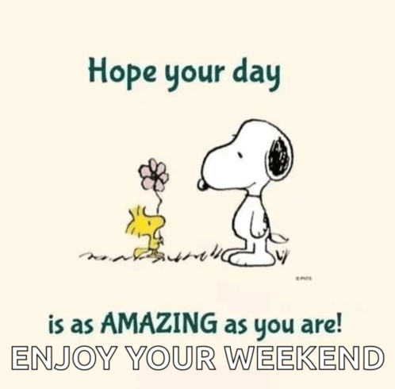
Have a lovely weekend everyone – you have been super stars this week!
Love,
Mrs. Steed xxx

