Slide 1

Holly Hill Heroes Assembly
HOLLY
HILL
SPRING TERM, 2025

Slide 2
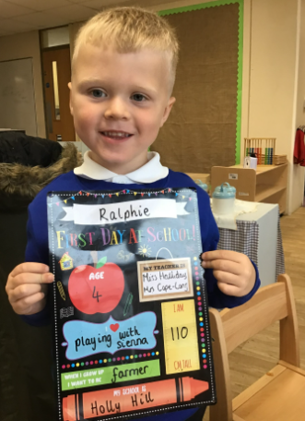
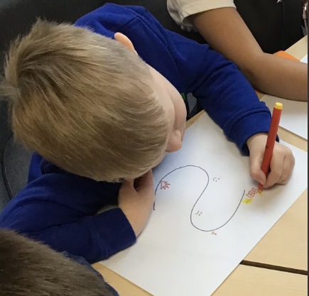
Our Cygnet Hero
Ralphie is our first hero this week! Ralphie is super hard working and when we set the challenge to create his own story, he did it with pride. He had some lovely ideas which he drew onto his story map, but he also had a go at writing some of the words too. Not only this, Ralphie has been working so hard in phonics and you can really tell when it comes to his writing! Well done Ralphie, you are a super Cygnet!!

Slide 3
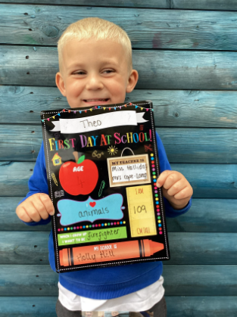
Our Cygnet Hero
Theo is our next hero! He has worked SO hard in phonics recently and Mrs G is super impressed with his knowledge. He impressed her by telling her what a digraph is - WOW! He is trying super hard with all his learning and giving everything a fabulous try. Well done Theo we are super proud of you!! Keep it up!!

Slide 4
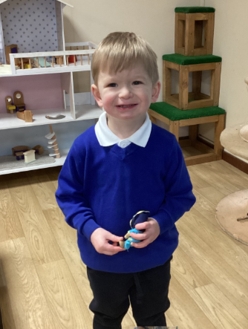
Our Cygnet Hero
Our Cygnet hero is Leo. Leo is one of our newer members of the class. He has tried so hard this week and been so brave coming into school. He has been making himself busy and always has lots of kind words to share. You are doing so well Leo - starting school can sometimes seem scary but you are doing amazing and we are all so proud!

Slide 5
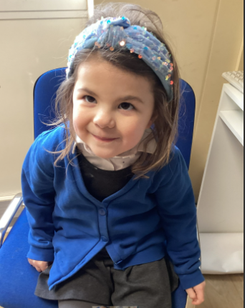
Our Cygnet Hero
Our Cygnet hero is Violet. Violet has been my assistant this week and has done so many tasks to help me. She has been handing things out and showing other children how to sit and listen on the carpet. I have loved some of her ideas she has shared during story time. Well done Violet, keep up the hard work.

Slide 6
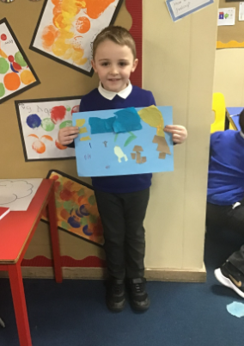
Our Puffin Hero
Chester has got to be a Puffin class hero this week due to his super helpfulness. He always takes it upon himself to check that all our whiteboard pens, boards and rubbers are put away and that our classroom equipment is looked after. He never needs to be asked to do this which is amazing. He was also extremely kind and helpful on Wednesday during our Computing lesson by going round helping other children who were struggling. Well done Chester you really are a PERFECT PUFFIN!

Slide 7
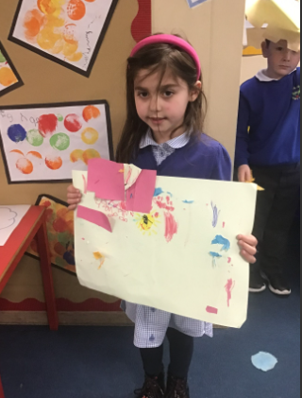
Our Puffin Hero
Ruby has got to be Puffin Class Hero this week. She has worked so hard in Maths each day. She has shown real determination to learn her numbers and be able to recognise them and match quantity to the numeral. Well done Ruby you really are a PERFECT PUFFIN!

Slide 8
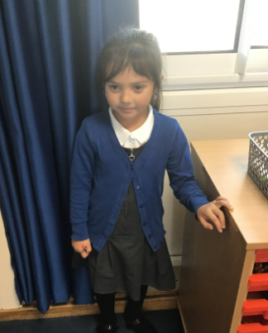
Our Wren Hero
Our Wren hero is Ivygrace. This is for working really hard with all of her learning, she has been trying her best in maths and working super hard in English with creating her sentences and writing them. Also putting her hand up during our topic sessions sharing her ideas. Keep it up Ivygrace, what a star!

Slide 9
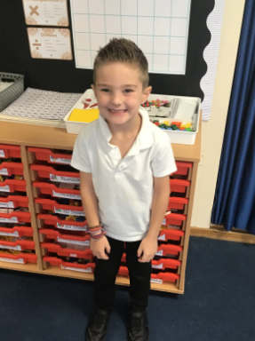
Our Wren Hero
Our Wren hero is Eddie. Eddie has also been working hard especially with our instruction writing this week. He has used imperative verbs and time adverbs within his instructions telling people how to create the most magnificent thing. Great job Eddie, keep it up!

Slide 10
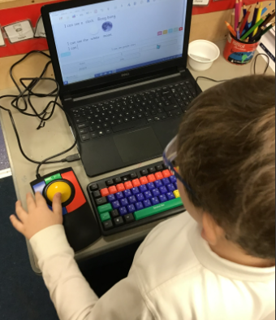
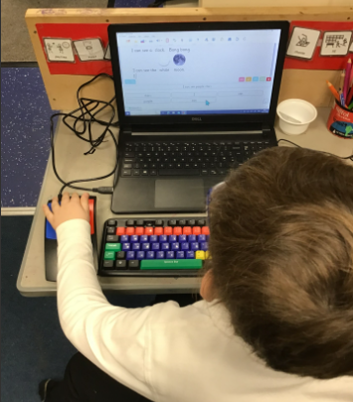
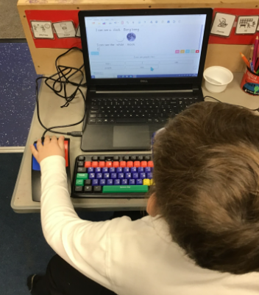
Our Woodpecker Hero
Our Woodpecker hero this week is Linus. Linus has been using a new tracker ball to write his sentences. He was reading the words independently and choosing the words to put in order to make his sentences. What a super effort Linus.

Slide 11
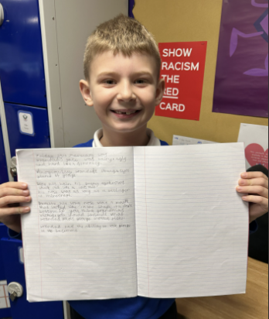
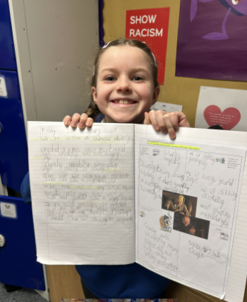
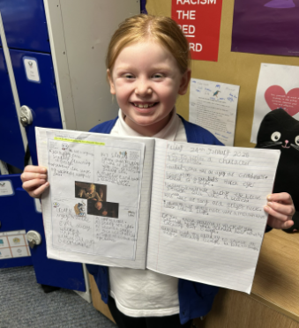
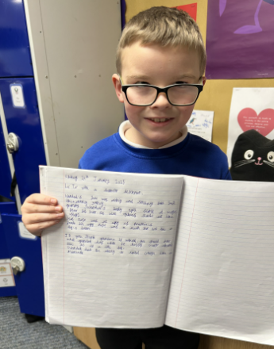
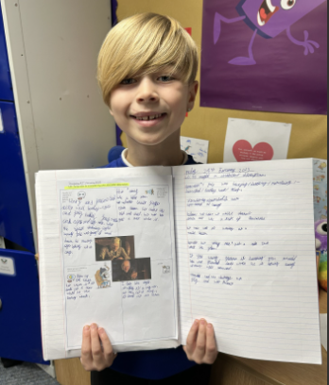
Our Kingfisher Hero
Wow, what a day for heroes.
When I set the task of creating a horrible grandad, to go with the horrid grandma in George's Marvellous Medicine, I didn't think we'd have such great descriptions! This lot definitely got to work to find the best (worst!) adverbs and adjectives and made us all smile.
What great writing, I have loved hearing your ideas.
Keep up the hard work Jason, Hanna, Evie, Finley and Theo! 🤩

Slide 12
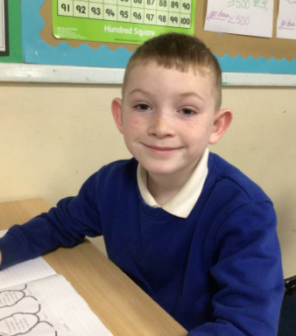
Our Dove Hero
Jaxson is a hero this week for fantastic enthusiasm in science. He produced a brilliant flyer about keeping your teeth healthy and could discuss what he had learnt so far in the topic. He has also been dazzling us in maths too! Well done Jaxson!
﻿

Slide 13
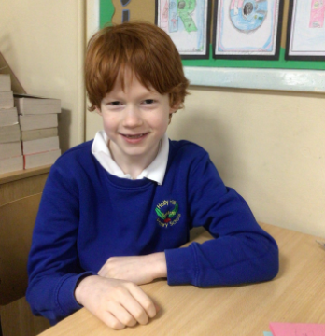
Our Dove Hero
Alastair has also impressed us this week. He has had some brilliant ideas to describe an imaginary grandad. He has come up with some fantastic similes and has managed to make him sound incredibly evil and creepy. Well done Alastair!
﻿

Slide 14
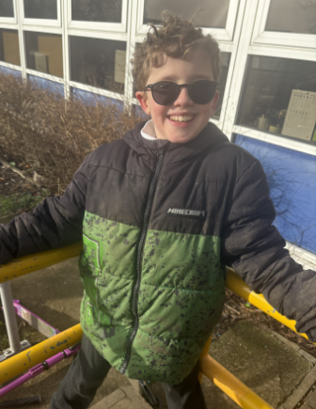
Our Swallow Hero
This week Albert has wowed Mr Close and I with his multiplying in maths. He found it tricky at the beginning and needed support but through his resilience and attitude, he has managed to multiply 3 digits by 1 digit.

Slide 15
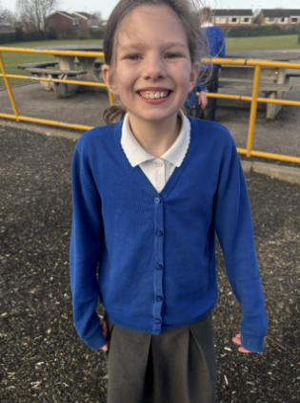
Our Swallow Hero
Isabella has taken on her TT rockstars challenge this week like a pro! In Swallow class we have all been completing the studio stage and trying to improve our 'Rock Status'. Isabella has managed to get to a Rock Legend!!

Slide 16
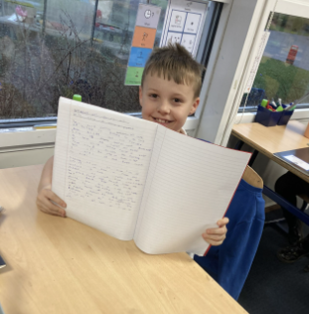
Our Owl Hero
Ethan is an Owl hero today for his sandstorm description writing this week. It was his best piece of writing yet and I was really impressed with it, some great descriptive sentences that were well punctuated. Well done Ethan!

Slide 17
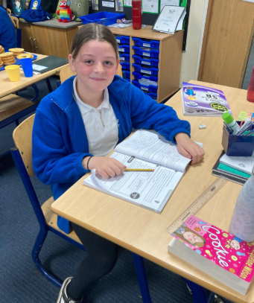
Our Owl Hero
Isla is an Owl hero this week for continually producing some great pieces of writing attempting to use new learning each time. Her presentation is always lovely too. Well done Isla.

Slide 18
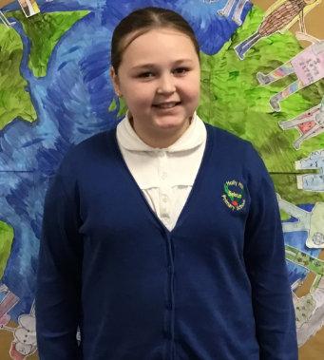
Our Falcon Hero
This week’s first Falcon hero is Lola! Lola is an absolute godsend when it comes to setting up the classroom in the morning: she is always eager to help make sure everyone’s resources are on the tables ready for a smooth beginning to the day. Lola is a particular hero this week because of her fantastic progress in French! During our lessons, Lola spoke in French with confidence and beautiful accent that really impressed. Lola, you’re a Fabulous Falcon!

Slide 19
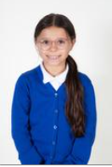
Our Falcon Hero
The next Falcon hero this week is Layla! Layla is also part of the morning dream-team, ensuring that the classroom is ready to go and organised each day. Layla is a particular hero this week for the excellent work she has been producing in English. She wrote a persuasive speech, taking care to include all the success criteria. She also wrote some of the most detailed inference answers in today’ English lesson that I read from the whole class! You just keep impressing me Layla- you’re a Fantastic Falcon!

Slide 20
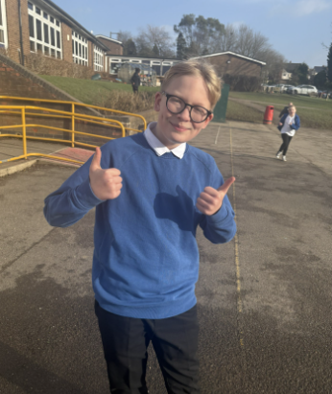
My Headteacher’s Hero
Blake is one of my heroes this week.
Blake is one of the kindest, most caring people you could ever wish to meet. He demonstrated it this week when a child in his class was upset. Blake bent down to his level, speaking to him a calm voice, asking if everything was ok and if there was anything he could do to help.
Blake’s act of kindness was spotted by many adults who all wanted to ensure that he was recognised for it.
Blake, kindness never goes unnoticed and we are so proud of the way you embrace the Holly Hill way in everything you do.

Slide 21
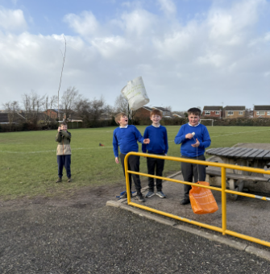
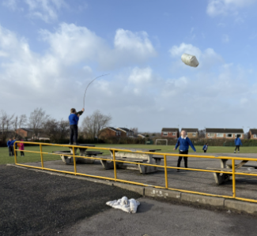
Our Lunchtime Heroes
Isaac, Jacob, Kai and Jack are my lunchtime heroes this week.
The boys wanted to make the most of a windy day and asked if I had a kite they could fly. When I told them that I hadn’t, they decided to make a couple themselves!
They worked so well as a team to create and perfect their kites and then had the best time flying them.
Well done boys – it was lovely to see you having such a great time together today.

Slide 22
Our Attendance Heroes
This week’s winners with 98.5% are Falcon class! Well done Falcons!
CLASS | WIN 1 | WIN 2 | WIN 3
Cygnets 1
Cygnets 2
Puffin
Wren
Woodpecker
Kingfisher
Dove
Swallow
Owl
Falcon
Swan

Slide 23
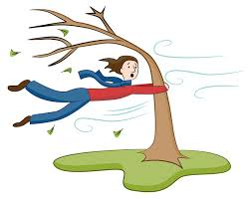
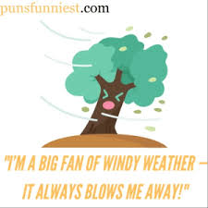
Well done for surviving a super windy day everyone!!!
I’m going home to brush my crazy hair!
Have a lovely weekend,
Love,
Mrs. Steed xxx

