Slide 1

Holly Hill Heroes Assembly
HOLLY
HILL
SPRING TERM, 2025

Slide 2
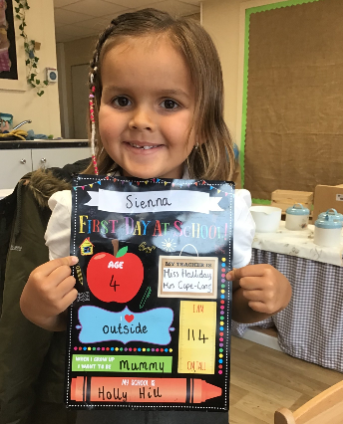
Our Cygnets Hero
Our first hero this week is Sienna!! Sienna has been such a treasure this week and every week to be honest. She has been so kind to our new little boy and really taken him under her wing. Sienna works so hard every single day… all day! Well done Sienna, you are an absolutely amazing young lady.

Slide 3
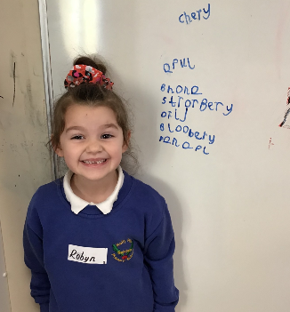
Our Cygnets Hero
Our next hero is Robyn! Robyn has been trying super duper hard in phonics recently and she recently wowed me with her writing of different fruits. You can really tell she is doing super listening. Robyn also loves to help her teachers with anything they need, she is also a really kind girl. Well done Robyn!

Slide 4
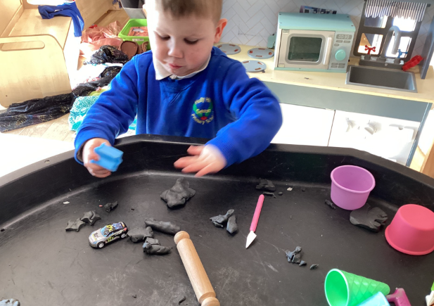
Our Cygnets Hero
Oakley has been working very hard this week to follow instructions. We had lots of fun with the dough, I was saying the instructions and he was carefully following. He is also, coming to speak to adults when he needs help. Well Done Oakley, we are so proud of you.

Slide 5
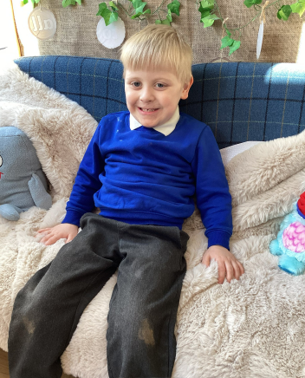
Our Cygnets Hero
Carter has such a jolly disposition and encourages others to see the wonders in life, getting so excited about his learning. He has been trying so hard this week to put on his coat by himself, he has stuck at it, even though he found it difficult. Thank you for making school such a happy place Carter.

Slide 6
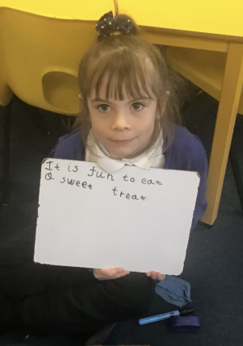
Our Puffin Hero
Oceana has made fantastic progress in Phonics this term and this is due to her amazing attitude and hard work. She is always attentive and listens carefully and is now able to apply her phonics skills. Well done Oceana - you truly are a PERFECT PUFFIN.

Slide 7
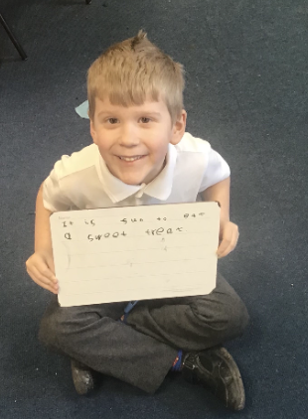
Our Puffin Hero
Seth has got to be a Puffin Class Hero this week as both myself and Mrs Cooper have noticed how amazing Seth’s attitude has been this term. He has tried particularly hard with his writing and Phonics, always trying to do his best to write independently showing pride in his achievements. Well done Seth - you truly are a PERFECT PUFFIN.

Slide 8
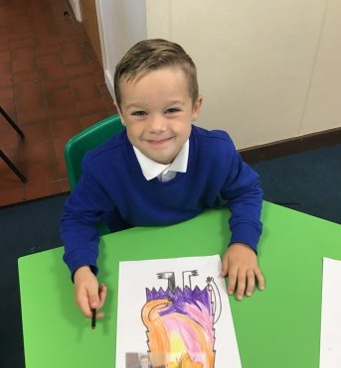
Our Wren Hero
Our Wren hero this week is Mason. This is for wowing me with his money knowledge this week in maths, after missing out on our first few lessons because he was poorly. He's come back and has whizzed through our money work, even solving problems needing up to 7 coins to make a set amount! Keep it up Mason!

Slide 9

Our Wren Hero
Anniyah is also a hero this week. Anniyah has been working hard every morning to match the letters of her name to her name card, and can now complete this independently. She is also working on having a go at forming the letters in her name too. Great work Anniyah!

Slide 10
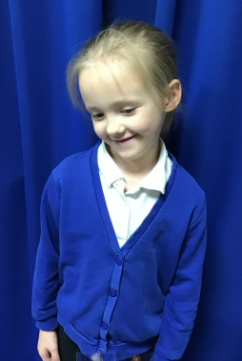
Our Woodpecker Hero
Our first Woodpecker hero is Abella. Abella is really impressing all the adults in Woodpecker with her hard work and effort in all lessons. She has become so much more confident and is really keen to put her hand up and answer questions. She always tries her best and is a real super star.

Slide 11
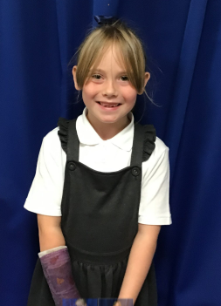
Our Woodpecker Hero
Our second hero this week is Cleo Renae. Cleo Renae has really impressed me over the last few weeks. She is always listening carefully and is always so keen to answer questions. She is always ready to learn and tries hard in everything she does and is always one of the first people ready, which is fantastic.

Slide 12
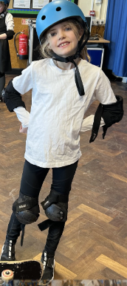
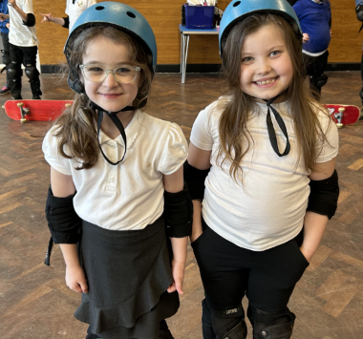
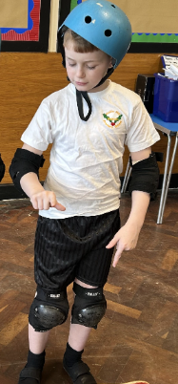
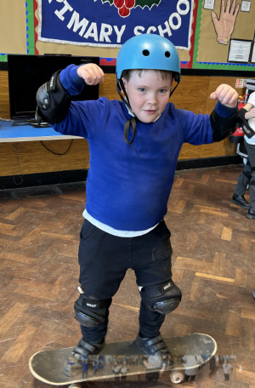
Our Kingfisher Hero
Kingfisher heroes this week are these skater dudes: Holly, Zach, Ava, Olivia, Killian and Bebe.
The resilience during their skateboard session was awesome. They fell, off, got back on, and repeated this several times over. There was a lot of giggling and cheering along the way!
You were brilliant! Well done this week’s heroes 🛹

Slide 13
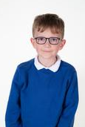
Our Dove Hero
Our first Dove Hero this week is Eric. Eric has been trying really hard with his presentation recently and has even tried to join some letters. During a group discussion recently, Eric was full of fabulous facts about history and wowed everyone. He showed such passion and enthusiasm for the subject which was wonderful to see. Well done Eric!
﻿
﻿

Slide 14
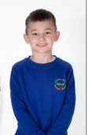
Our Dove Hero
Our next Hero is Max. Max sometimes finds writing a bit tricky but he is now showing much more perseverance during lessons and his handwriting has also really improved. It is now beautifully neat! He has also been trying really hard in Maths and has been joining in more confidently to class discussions which is brilliant. Great work Max!
﻿

Slide 15
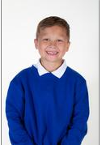
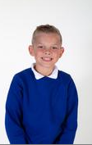
Our Swallow Hero
Our Swallow heroes this week are Morgan and Harrison S. Both of these boys have really excelled in maths this week, they have both tried really hard to overcome division and have supported other children.
Also, Harrison was the first to work out the correspondence problems that we did as a class and Morgan has shown a great attitude to his learning.

Slide 16

Have a lovely weekend everyone!
Mrs. Steed xxx

