Slide 1

Holly Hill Heroes Assembly
HOLLY
HILL
SPRING TERM, 2025

Slide 2
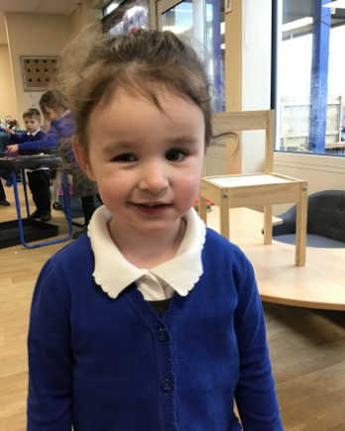
Our Cygnet Hero
Isla-Rose is our first hero! This young lady has grown SO much in confidence over this last half term. She has really shown us how gorgeous she is. Isla always helps her teachers, sits beautifully and is super duper kind to all her friends. For the first time this week she joined in with PE which is something she found a bit tricky before now. We are so proud of her! Well done Isla-Rose!

Slide 3
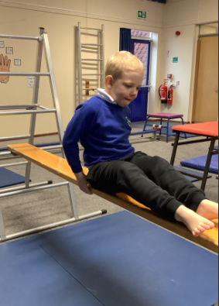
Our Cygnet Hero
Colby is our next hero! Colby has had a lovely week this week and he has also joined in with PE. He waited his turn and really enjoyed himself. Mr Ellis was super impressed with his gross motor skills. Well done Colby, we are super proud of you!

Slide 4
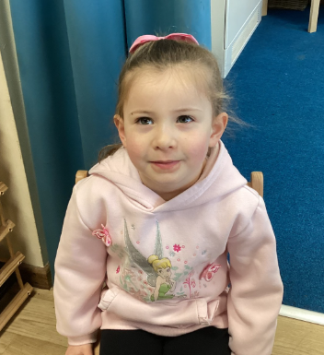
Our Cygnet Hero
Our hero this week is Ava. Ava is such an amazing member of our class - my list could be endless if I share all her wonderful traits. She sits beautifully and always has so many great ideas. Although only in Nursery, she is already trying to write sentences! Such a clever girl - keep up the hard work Ava you are amazing!

Slide 5
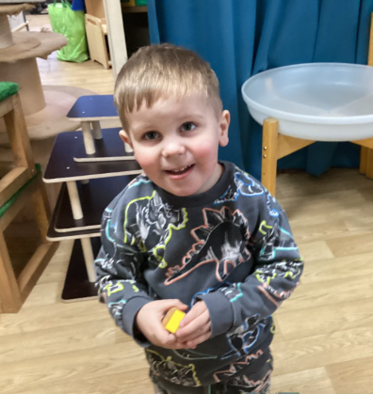
Our Cygnet Hero
Stewart is our hero this week. Stewart is working hard to follow instructions and make all the staff happy. He has been showing other children how he can look after his belongings and sit on the carpet when we ask, helping me to choose those children that can sit and listen. He has been expressing himself and made a beautiful picture of the Southern Lights - well done Stewart, we are really proud of you.

Slide 6
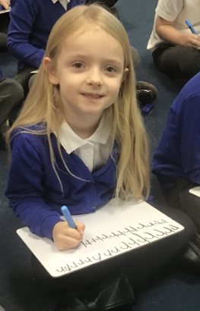
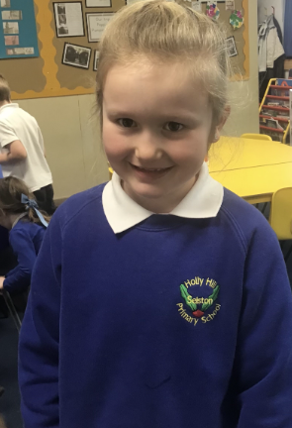
Our Puffin Hero
Our focus this week in Puffin Class has been showing kindness to others. Both Liliarna and Matilda have not only done this for a week but have shown kindness, respect and compassion to the other children in our class all term.
They are both the first ones to try and help others and always care for their fellow classmates. On top of this both Matilda and Liliarna have worked extremely hard all term with their writing and phonics and due to this effort have made incredible progress.
Well done Liliarna and Matilda - you are both truly PERFECT PUFFINS and we are all extremely proud of you both!

Slide 7

Our Wren Hero
Our Wren hero this week is Kolby. Kolby has been working really hard with his phonics and writing this term. He has really impressed us with the progress he has made in his phonics assessments and has been blowing me away every morning with his imaginative sentences based on a picture. Keep it up Kolby, what a star!

Slide 8
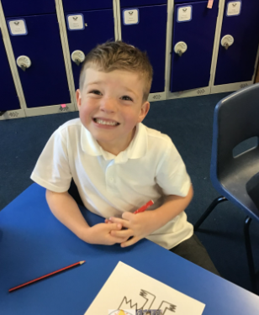
Our Wren Hero
Our Wren hero this week is Joseph. Joseph has been working hard with our money topic over the last few weeks. Although it's been very tricky, he hasn't given up and has tried his very best with every question. He has also helped his peers within class to solve different money problems. Great work Joseph!

Slide 9
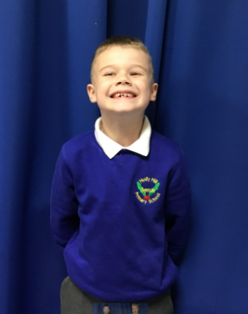
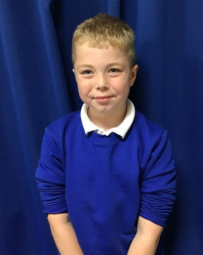
Our Woodpecker Hero
Our Woodpecker heroes this week are Mikee and Connor.
They have both really impressed me with their writing this week. We have been saying our sentences as a class before we go and write and these two boys have found this a big help with their writing. They have written some fantastic sentences everyday retelling the owl who was afraid of the dark and have really impressed me with the effort they have put in. Well done. I look forward to your next piece of writing being just as fantastic.

Slide 10
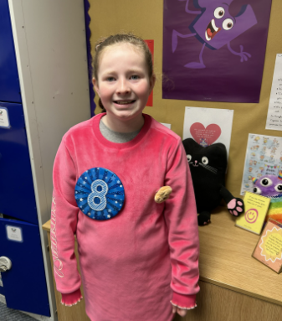
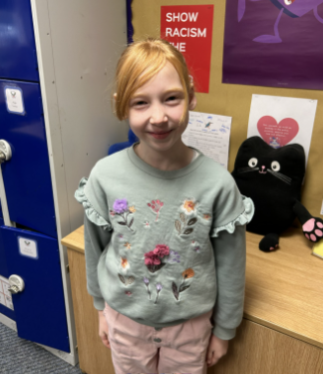
Our Kingfisher Hero
Kingfisher Heroes today are Eveleen and Rosanna.
These girls have been chosen as heroes for the same reason! They are always doing the right thing, always working hard and always kind.
Eveleen always brings a lovely calm atmosphere to our class and Rosanna is a friend to everyone.
Well done girls - keep being you! 🤩

Slide 11
Our Dove Hero
Our first Dove Hero this week is Ela. Ela has been trying really hard in Maths on dividing 3 digits by 1 digit. At times she has found this really tricky but she has continued to persevere and to ask for help where needed to try and master it. Well done Ela! Keep up the hard work.
﻿

Slide 12
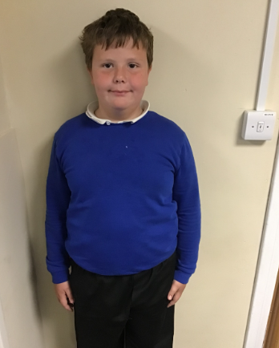
Our Dove Hero
Our next Dove Hero is Riley. In English this week we have been writing an explanation text for our own medicine, based on the book George’s Marvellous Medicine. Riley has contributed some fabulous ideas and had real enthusiasm for writing which has been lovely to see. Well done Riley!
﻿

Slide 13
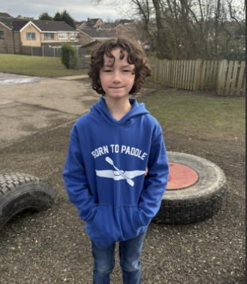
Our Swallow Hero
The first of our Swallow heroes this week is Elliot. Elliot has written a lovely explanation this week in English about his own marvellous medicine. He has thought carefully about all of the features that he needed to include and chosen some lovely vocabulary to include.

Slide 14
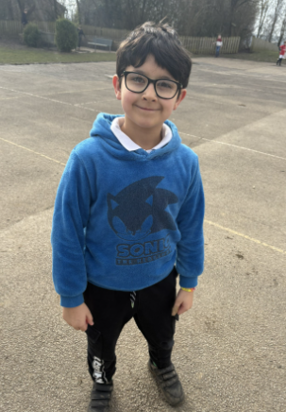
Our Swallow Hero
The second of our Swallow heroes is Jasper. Jasper has really worked hard with learning his times table this half term. He doesn't always find the times table check easy to complete but this week he managed to score his best score ever and was incredibly proud of himself. Well done Jasper!

Slide 15
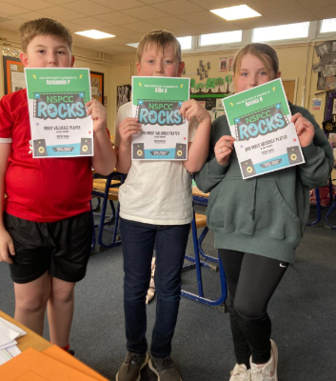
Our Owl Hero
We have three Owl heroes this week for being TT Rockstar stars on NSPCC number day.
Well done Ben, Amelia and Alfie for getting the classes highest scores and for improving your times tables.

Slide 16
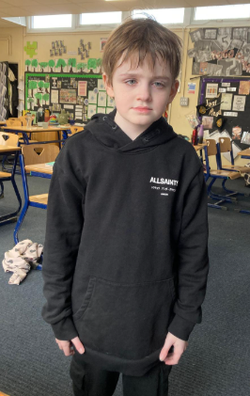
Our Owl Hero
Miller is also an Owl hero this week. Over the last few weeks, Miller has really impressed us all. He is really maturing and he is a thoughtful, caring and well behaved Year 5. We have been so proud of Miller lately as he comes into school smiling and he can better deal with issues that might happen throughout the day.
Well done Miller – we are so proud of you!

Slide 17
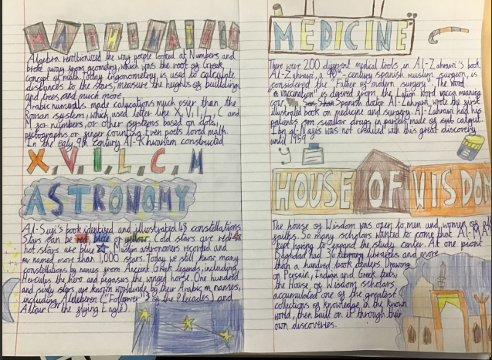
Our Falcon Hero
This first Falcon hero this week is Daisy! Daisy is such a hard worker and she always tries her best to make sure her work is beautifully presented, which makes marking her books a joy! In particular this week, Daisy has produced an excellent double page spread on the achievements of the Islamic Golden Age. Well done, Daisy you are a Fabulous Falcon 🤩

Slide 18
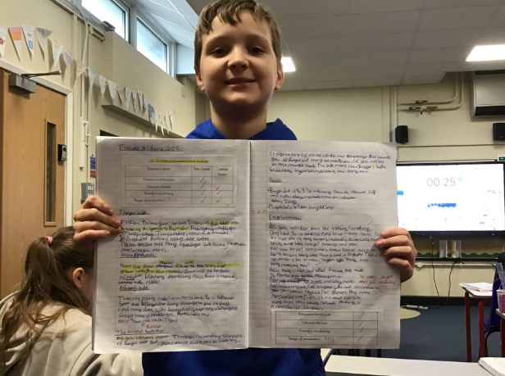
Our Falcon Hero
The second Falcon hero this week is Jack! Jack has made an English breakthrough, finding that an unorthodox, but comfortable writing position unlocked his potential for huge amounts of focus! He produced some of his best writing for his travel guide to Ancient Baghdad, impressing both Mrs Cordon and himself! Keep up the great work Jack! 🤓

Slide 19
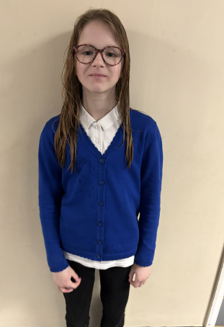
Our Swan Hero
My hero this week is Alexa.
Alexa has done some wonderful persuasive writing this week, creating a travel brochure to Ancient Baghdad. She’s used some fantastic persuasive vocabulary and techniques and I’m really proud of how hard she’s worked! ✍️

Slide 20
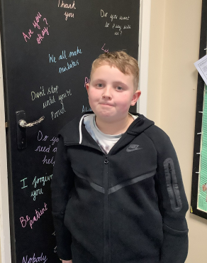
Our Swan Hero
My hero this week is Brandon.
Brandon is my swimming hero this week! Every week, Brandon asks me ‘When is it time for swimming?’ and I’ve loved how enthusiastic he’s been. He’s really given it his all and I’m so proud of his positive attitude! 🏊‍♂️

Slide 21
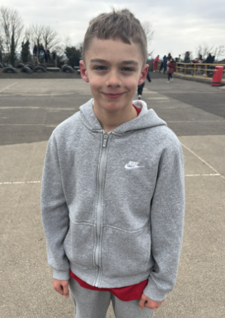
My Headteacher’s Hero
My Headteacher’s hero this week is Daniel.
On Tuesday, Daniel stepped up to play in goal for the Year 5/6 football team. Not only is he a Year 4, but he has also only just recovered from a nasty knee injury. Mrs. Fisher and I were worried about asking him but his Mum said she thought he’d love it.
She was right! Daniel was in his element and played amazingly well, making some brilliant saves. He also loved every minute of playing for the team and supported the rest of the players fabulously.
Mr. Close, Mrs. Fisher, Mr. Ellis, myself and the rest of Holly Hill are so proud of you Daniel. Watch your back Jordan Pickford – Daniel’s after your job!!!

Slide 22
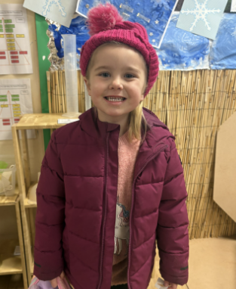
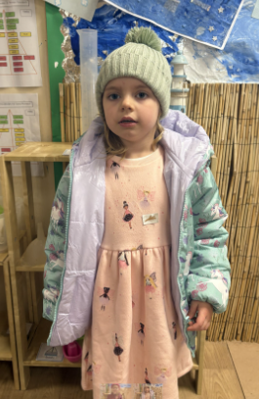
My Headteacher’s Heroes
I have also chosen Harper and Emily to be Headteacher’s heroes this week.
Yesterday, I showed some parents and their children around our Early Years Unit as they may want to come to our school in the future. Emily came straight over to say ‘Hi’ and offered to share her toy with the girls. Then, Harper came over with a picture that she had drawn for the girls and their Mummy.
Emily and Harper – your kindness and thoughtfulness made new children feel very welcome in our school yesterday. You showed everyone that Holly Hill is full of caring, loving children who demonstrate the Holly Hill way in everything they do. I’m extremely proud of you both and you made me, and our visitors, smile from ear to ear!

Slide 23
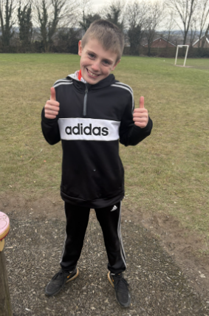
Our Lunchtime Heroes
Charlie has been chosen by the Midday Supervisors this week to be our lunchtime hero.
They have noticed that Charlie’s behaviour in the dining hall is excellent. He is well-mannered and always tidies his things away when he has finished – even if those around him don’t!
Jack has also been extremely impressed with Charlie during their group work. He has noticed that Charlie is focused, participating fully and happily supporting those around him who need it.
Well done Charlie – you are being noticed for all of the right reasons and that is something to be very proud of!

Slide 24
Our Attendance Heroes
This week’s winners with 98.5% are Woodpecker class!
Well done Woodpeckers – one more winning week and you’ve won the treat!
CLASS | WIN 1 | WIN 2 | WIN 3
Cygnets 1
Cygnets 2
Puffin
Wren
Woodpecker
Kingfisher
Dove
Swallow
Owl
Falcon
Swan

Slide 25
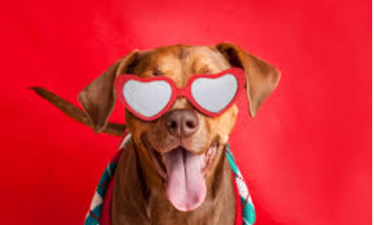

Happy Valentine’s Day!
Have a lovely half term!
See you in a weeks time!
Love,
Mrs. Steed xxx

