Slide 1

Holly Hill Hero of All Heroes Assembly
HOLLY
HILL
SUMMER TERM, 2026

Slide 2
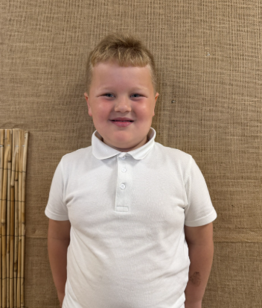
Our Cygnets Hero of all Heroes
Our first hero of all heroes is... ARTHUR! Words cannot describe how proud we are of Arthur and the progress he has made at Holly Hill so far. He is such a mature young man who is ALWAYS doing the right thing. He is such an ambitious little boy who wants to please his friends and the adults all of the time. He follows our rules and encourages others to do the right thing too which is such a wonderful quality to have. Any teacher will be lucky to have Arthur in their class and we wish him the best of luck moving to year one! We will miss you so much!

Slide 3
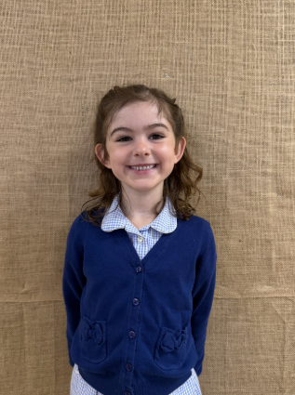
Our Cygnets Hero of all Heroes
Our next hero of all heroes is... BLAYKE! Blayke is such a gorgeous girl inside and out. She is such a wonderful role model to all of our children in EYFS. She has such a kind nature and embraces any challenges that she faces. She works so hard all of the time and we are so proud of her. Blayke is a very versatile young girl who can play and talk to a range of people/adults. She is super mature and can hold a conversation very well - Miss Halliday and Mrs Wilcockson will miss these chats so much. Blayke you are an absolute super star and we wish you the best of luck in year one!

Slide 4
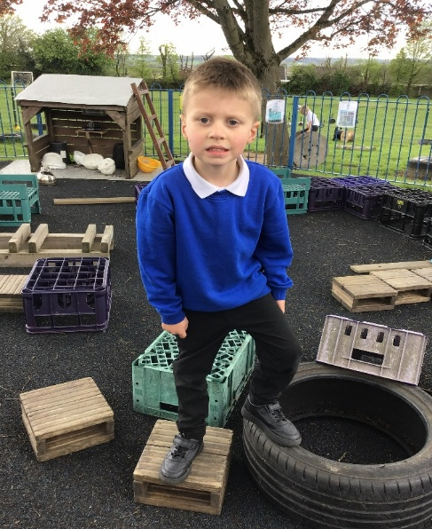
Our Cygnets Hero of all Heroes
Leo has been on the most incredible journey since starting with us in nursery. He has transformed from a quiet little boy into a confident, chatty young man. Without a doubt, he has made the most wonderful progress in every way. Not only that but he has also blown us away with his reading, phonics and number skills. He has absolutely blossomed in F2 and he is ready to embrace Year 1.
Mrs Fox is very lucky to have you next year, Leo!

Slide 5
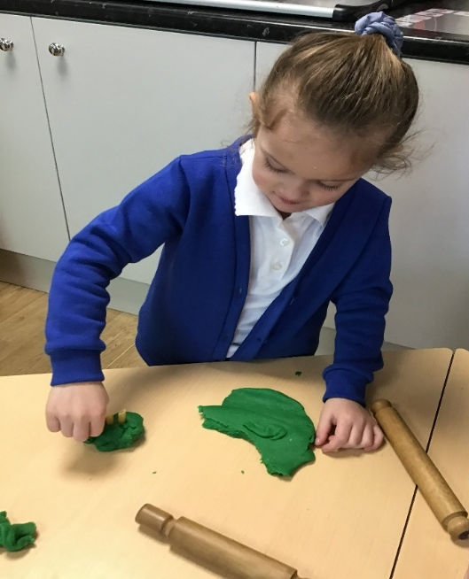
Our Cygnets Hero of all Heroes
What a super star Freya has been this year!
She is genuinely the most kind, caring and thoughtful girl who always thinks of others and is always there to lend a hand when needed. She is such a delightful girl with a brilliant personality. I love chatting to Freya and she always makes me giggle with her funny stories.
Freya has made a special effort to read regularly at home this year. Every week she is top of our reading chart! This has really helped her reading at school and she can now read sentences independently.

Slide 6
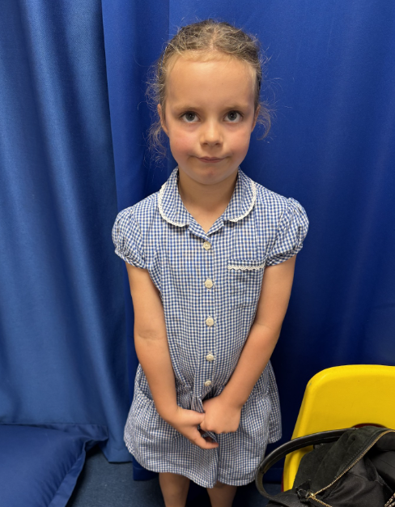
Our Puffin Hero of all Heroes
I could have chosen Harper as my Hero every single week – that girl is such a ray of sunshine who brings happiness, enthusiasm and energy to our classroom. I love her positivity and ‘have a go’ personality; nothing really fazes her. She has worked incredibly hard all year and made huge progress in all areas. My abiding memory of Harper really sums up her attitude, when she won the inter-school cross country competition. She totally ran her own race and stormed across the finish line. However, most importantly Harper is a genuinely kind and caring young lady who always puts others first. I am so proud of you Harper, you have been a PERFECT PUFFIN all year!

Slide 7
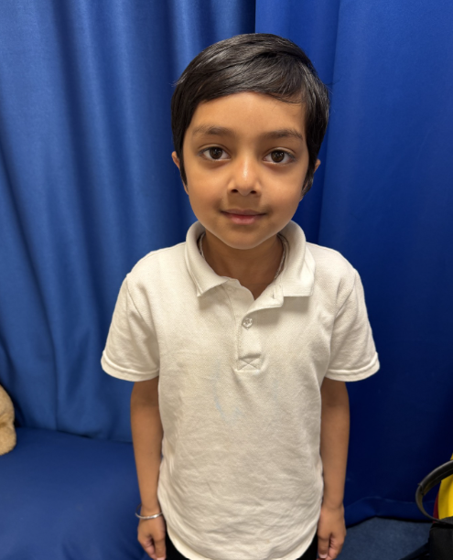
Our Puffin Hero of all Heroes
I could have also chosen Kavin to be a Hero every week, he has the most incredible attitude to school and life in general. He is a quiet but very conscientious young man who has worked hard all year and made amazing progress in all areas. It has been lovely to see Kavin grow in confidence so much and he now joins in with our discussions making very well thought out comments and suggestions. He has enjoyed so many things in school and tackles every new challenge with positivity. Although he is a quiet boy in the classroom – he most certainly isn’t when he is playing with his friends and it’s lovely to see him running around having fun. However, most importantly Kavin is a genuinely kind and who always puts others first. I am so proud of you Kavin, you have been a PERFECT PUFFIN all year!

Slide 8
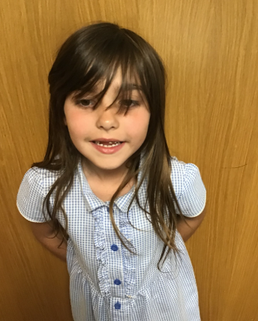
Our Wren Hero of all Heroes
Ruby is such a positive, happy girl and her joy for life and people around her is infectious. She tells me daily to have a great day and a good lunch. She is genuinely happy for anyone else's successes and happily will tell them. She works hard in all her lessons trying to push herself and achieve her outcomes all with a big smile on her face. I describe her as the glitter in my classroom, she just puts a shine and a sparkle into anything. We are so proud of you Ruby and know you will continue to thrive in Year 3. You are a wonderful Wren Ruby - keep up the positivity!

Slide 9
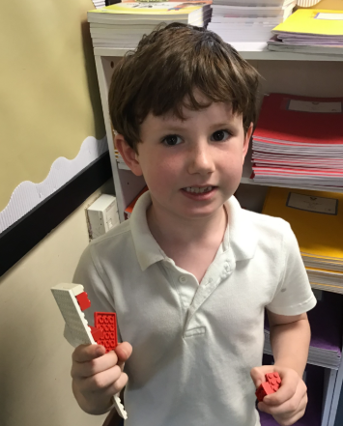
Our Wren Hero of all Heroes
Alfie has made such incredible progress this year in all areas of the curriculum! He is growing in confidence all the time and is working so hard. He goes and gets on straight away and loves to share his work. He is often so proud to show what he has done. He asks for help when he needs it and will always try to help others if he can. He is happy in chool and listens when we have feedback to share, often trying to act on that straight away. We are excited to see how much more you will progress in Year 3. You are a onderful Wren Alfie and we are all so proud of you - keep up the hard work!

Slide 10
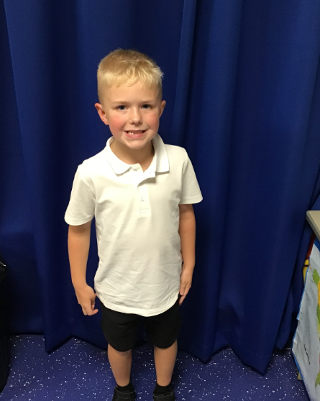
Our Woodpecker Hero of all Heroes
Our Woodpecker heroes of heroes are Harry and Gabriella.
Harry has been a super star all year in Woodpecker and is one of our ‘always’ children. Harry always works hard, always tries his best, always behaves and has had an amazing year in Woodpecker. He is so conscientious with his work and just puts so much effort into everything he does. Harry is definitely one of our 'go to' children in Woodpecker because he is so reliable and sets such an amazing example to everyone. He puts 100% effort into everything he does, whether it be an after school club or representing the school at cross country. You have a fantastic positive attitude Harry and we are super proud of the year you have had in Woodpecker Class.

Slide 11
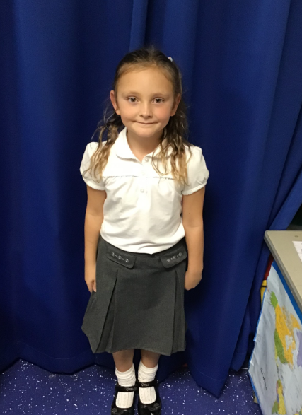
Our Woodpecker Hero of all Heroes
Bella has been chosen for the super effort she has put in to everything this year. At the start of the year Bella was very quiet and sometimes didn't feel very confident working independently. However, as the year has gone on, Bella's confidence has blossomed and she now will have a go at everything, always wants to answer questions and is so determined to do a good job. She will persevere and always wants to do her very best.
But it is not only in class that Bella shows how amazing she is. She is so sporty and she put this to good use a few weeks ago by taking part in the Muddy Runner race to raise money for charity. She raised over £1,000 which is an incredible amount. We are so proud of you Bella, for that and the amazing year you have had in Woodpecker Class.

Slide 12

Our Nest Hero of all Heroes
Miriam is the Nest hero of all heroes. She has settled into Nest life so beautifully and has become a loving, smiling and much-loved member of the Nest family. She is always happy and joins in with the daily routine as if she’s been part of the Nest forever. She is an absolute joy and we love having her with us in the Nest. We’re excited for next year with you already Miriam!

Slide 13
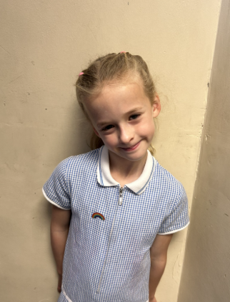
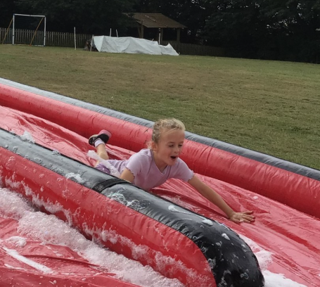
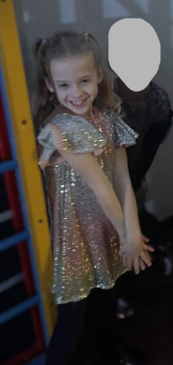
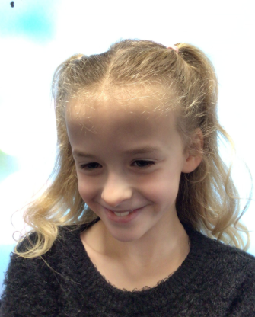
Our Kingfisher Hero of all Heroes
Amelia is our hero of heroes this year because she is such a kind and caring member of the class. She puts care into everything she does and gives 110% into all of her work. Her bright smile has a way of making everyone feel happy - always on hand to help.
Thank you for being a fabulous Kingfisher Amelia.

Slide 14
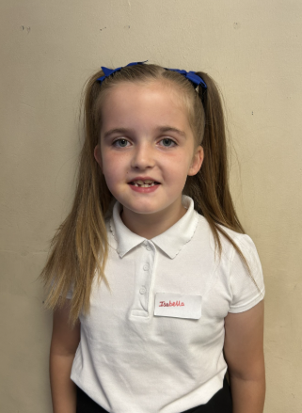
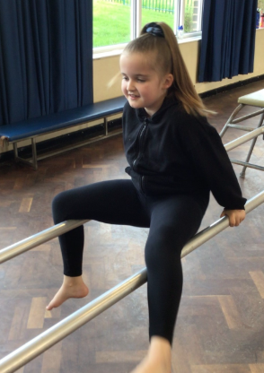
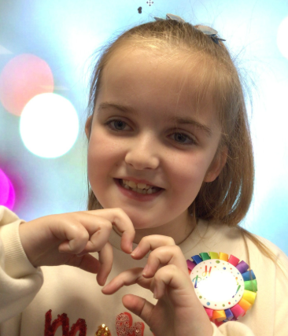
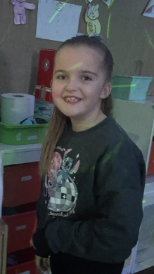
Our Kingfisher Hero of all Heroes
Isabella is our hero of heroes this year. She is an incredibly happy and smiley member of the class who brings a positive energy. Isabella is respectful and considerate and treats everyone with kindness. She is always willing to lend a helping hand, whether supporting her friends or assisting her teacher.
Thank you for being a fabulous Kingfisher this year Isabella.

Slide 15
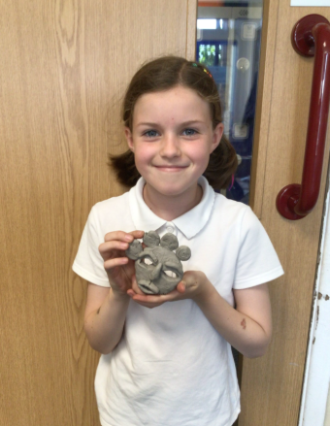
Our Dove Hero of all Heroes
Hanna has been an absolute super star all year. She has been a motivated, enthusiastic and kind member of Dove Class. She has worked hard all year especially with her writing and timetables, doing extra work at home, which has really paid off. Hanna has been a role model to the younger children in the class and a much sought after friend. She is always the first to offer encouragement and support to others and makes the classroom a lovely place to be. Hanna truly is a Hero of Heroes.

Slide 16
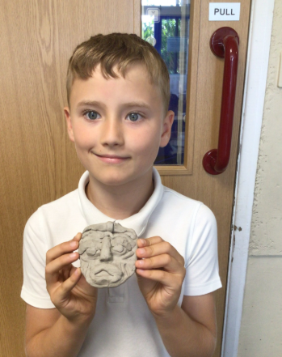
Our Dove Hero of all Heroes
Liam has blown us away this year with his enthusiasm, motivation and desire to learn. His probing questions in class have led to deeper understanding both for him and the rest of the children, whilst his insightful comments often encourage others to look at things differently. Liam has been a good friend to all and can always be relied upon to care for others. He always has a kind word, or encouraging comment to give, which makes him such a valuable member of Holly Hill. He truly is a Hero of Heroes.

Slide 17
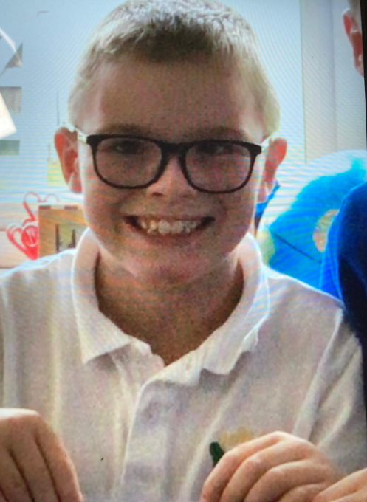
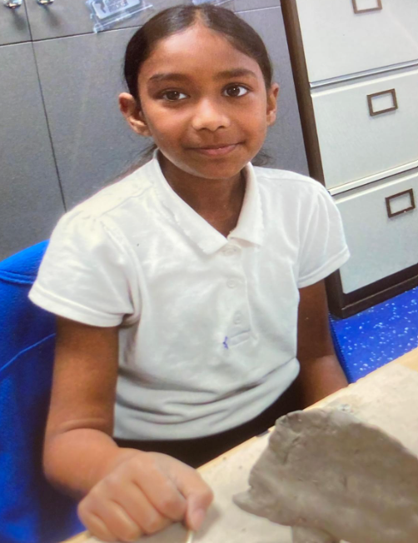
Our Swallow Hero of all Heroes
Our Swallow heroes of all heroes are Adona and Finley.
I have chosen these two wonderful young people for exactly the same reason. They have been true Holly Hill Heroes every month, every week, every single day. They have worked so hard and have always strived for better. They have shown 100 percent respect at all times towards their peers and adults. Their behaviour and attitude to learning is exceptional. Well done Adona and Finley – I am so proud of you both.

Slide 18
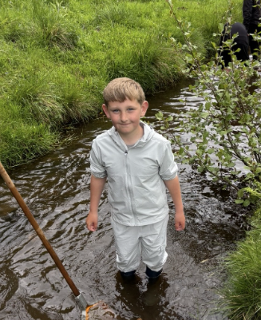
Our Owl Hero of all Heroes
Owl Class hero of all heroes is Charlie. Throughout the year, Charlie has consistently tried his best in every area of learning. He has a genuine love of learning that shines through every day. He has made amazing progress throughout the year, and he should be incredibly proud of everything he has achieved. Charlie comes to school each day with a big smile on his face and a positive attitude that brightens our classroom. He is always eager to learn and loves sharing interesting facts with the class, making every day a little more exciting! Well done, Charlie. Keep being curious, hardworking, and sharing your wonderful enthusiasm for learning. We are so proud of you!

Slide 19
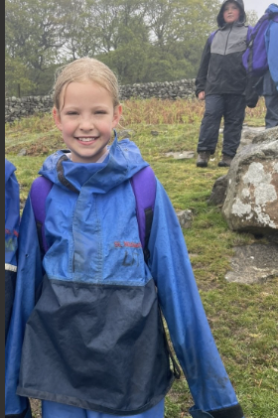
Our Owl Hero of all Heroes
Paisley is a hero of all heroes. Paisley tries her very best every single day and approaches everything she does with determination and a positive attitude. She is kind, caring, and treats everyone with respect, making her a wonderful friend and role model in our class. Paisley is always willing to help others, whether it's supporting a classmate or lending a hand whenever it's needed. Her thoughtful nature and caring attitude make our classroom a happier place to be. Well done, Paisley! You should be so proud of everything you have achieved this year. Keep being the kind, hardworking, and thoughtful person you are. We are all so proud of you!

Slide 20
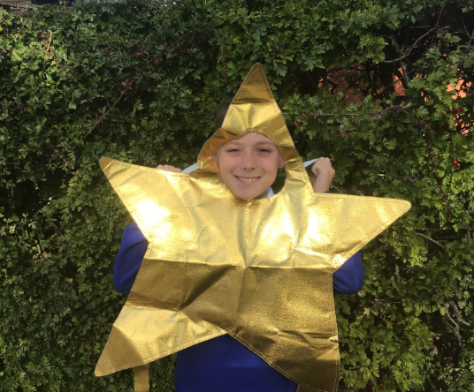
Our Falcon Hero of all Heroes
My first Hero of all Heroes has to be George. All year, he has been such a kind, caring soul who will help anybody and everybody. He always has such a bright smile on his face, and his calming presence definitely has a positive impact on everyone else in the classroom, myself included. Whilst he came into Year 5 very strong academically, I believe his knowledge has strengthened even more throughout the year, getting some really high marks on his summer assessments. There is no doubt in my mind that he is Y6 ready - I can't wait to see what he does next!

Slide 21
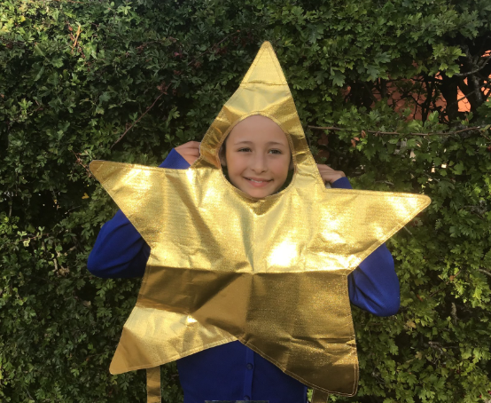
Our Falcon Hero of all Heroes
My next Hero of all Heroes is Sophie. Sophie is such a determined, headstrong young lady who has not let anything defeat her all year. Time after time, she has given it her all when representing the school in many sporting events. She is also a girl after my own heart when it comes to reading . She always has her head stuck in a book - even when she should be listening to lessons sometimes! The hard work she put into SATs as well was inspiring - she absolutely smashed them all and should be immensely proud of herself. I know she will go on to do amazing things at Selston High and I will miss her very much!

Slide 22
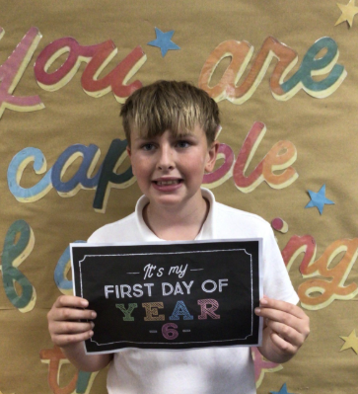
Our Swan Hero of all Heroes
My first hero of all heroes is Ralph. Ralph is one of the kindest children I have ever had the pleasure of teaching. Some children stand out because of what they achieve, but true heroes stand out because of who they are. Your kindness brightens the days of everyone around you Ralph, and your hard work shows that with determination and a positive attitude, anything is possible. You are always the first to offer a helping hand, whether it be to younger children, friends or adults around school. You can always be relied upon to be doing the right thing and embody our Holly Hill value of kindness. Well done for having the most wonderful year Ralph - you truly are a hero or all heroes!

Slide 23
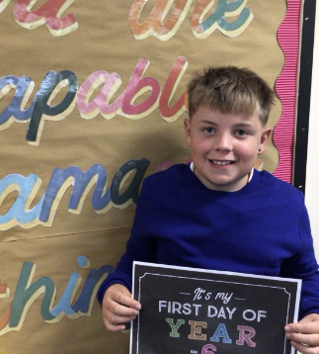
Our Swan Hero of all Heroes
My next hero of all heroes is Theo. This year Theo, you have shown determination, resilience and always had a positive attitude. Your fabulous behaviour sets a wonderful example for everyone around you. You are respectful, thoughtful, and always ready to try your best. Your kindness, enthusiasm, and willingness to learn make you such a valued member of our class, and I know that you will always have your hand up to offer something interesting and insightful to tell the class. You have achieved so much this year, and this is only the beginning of all the wonderful things you are capable of. Well done—you are an absolute superstar!

Slide 24
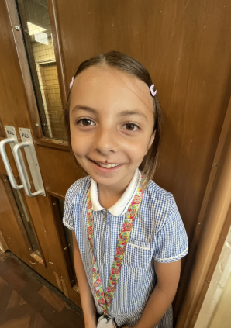
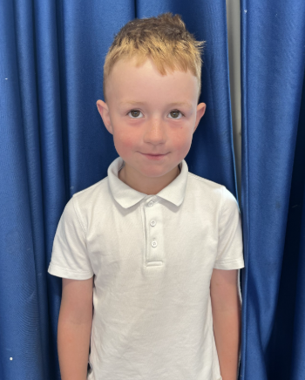
Our Wraparound Hero of all Heroes
Our wraparound hero of all heroes are:
Ronnie! Ronnie is always doing the right thing in wraparound care. He is always kind and helpful and it’s always lovely to spend time with him. Thank you for being a super star Ronnie.
Evie! Evie is always so kind to everyone in breakfast club. She helps to look after the other children and will do anything for the staff to give them a helping hand. We love having you in breakfast club Evie.
You are both a joy and we love having you in wraparound care.

Slide 25
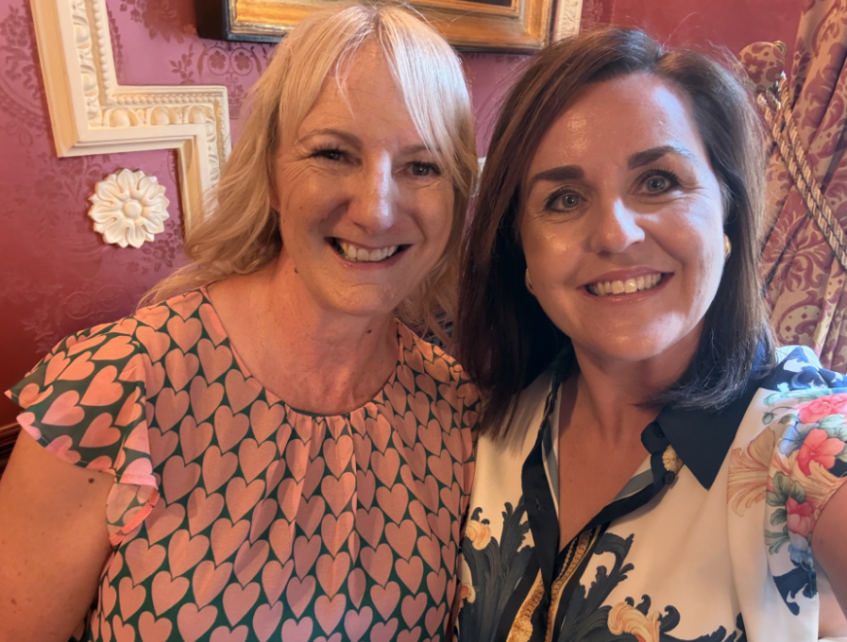
My Headteacher’s Hero of all Heroes
My Headteacher’s hero of all heroes this year is Mrs. Cottee!
Mrs. Cottee has taught at Holly Hill for an incredible 28 years! During that time, she has taught and cared for 100s of Selston children. She taught some of you in Nursery and even more of you in Year 1 and she has made sure that all of the children at Holly Hill have a great start with their phonics. She is kind and caring and will do everything she can to make a difference.
I will miss her more than I can possibly put into words. Enjoy a happy and relaxing retirement – no one deserves it more.
Team Holly Hill forever x

Slide 26

What a wonderful year it has been at Holly Hill.
We are so proud of you all and everything you achieve. I hope that you have lots of wonderful primary school memories from this year and look forward to making lots more together next year.
Year 6 – we will miss you beyond words. Wishing you lots of luck at your new schools.
Turn and give your teachers the biggest clap and cheer for being the all time, best ever, in the history of the world, greatest, most amazing people!
Have a wonderful summer – see you in September!
Mrs. Steed xxx

