Slide 1

Holly Hill Heroes Assembly
HOLLY
HILL
SUMMER TERM, 2026

Slide 2
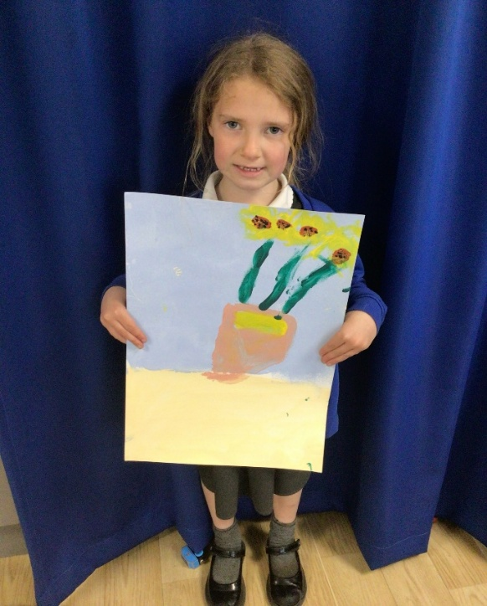
Our Cygnets Hero
Lola continues to shine in the Cygnets!
She has really matured this term and is really starting to show some grown up, Year 1 qualities.
She is playing very nicely with her friends now and involving everyone in her games.
Her handwriting is AMAZING!! Her letters are beautifully formed and they are so small and neat.
Lola has been impressing Miss Halliday too in her phonics group as she has been working so hard.

Slide 3

Our Cygnets Hero
Finn has made brilliant progress in only a short time!
He is trying so hard to listen carefully to instructions and follow our routines. He now joins us for the register and joins in with singing times. He listens beautifully during story time.
Finn loves playing outdoors and he is very good at building in our building site. He is very good at whizzing on the balance bikes too! He loves our times down in Whisper’s wood and he loves to explore. We are so proud of you Finn!

Slide 4
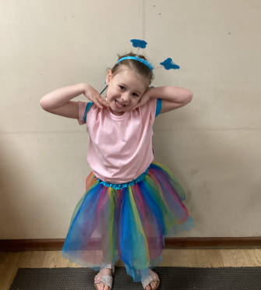
Our Cygnets Hero
Our first hero is… Ava!! Ava is such a wonderful little girl who is ALWAYS doing the right thing. She always helps around the classroom without being asked. She also follows our class rules and encourages others to do the same. She is such a good friend to all our Cygnets. I am so glad we get to keep Ava for another year. Ava we are so proud to have you in Cygnets class, well done!

Slide 5
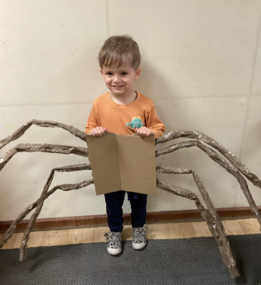
Our Cygnets Hero
Max is our next hero! Max has really grown in confidence recently and we are really starting to see his cheeky personality shine. He is very good at listening and he loves joining in with singing, his voice is wonderful! Max is one of our youngest nursery children but he has already made some fabulous progress and we can’t wait to spend more time with him in September.

Slide 6
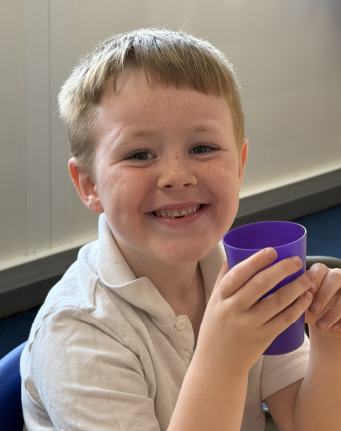
Our Puffin Hero
Our first Puffin hero is Lucas.
Lucas is a Hero this week as he has been a super star, coping so well with Transition Day and all the changes in our routines. He has shown great resilience and we are all incredibly proud of him.
Well done Lucas - you truly are a PERFECT PUFFIN!

Slide 7
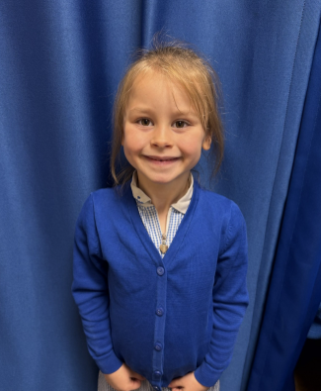
Our Puffin Hero
Halley has got to be our other Hero this week! She has been trying incredibly hard to listen carefully and has been working really hard in everything she does. Her determination, effort, and positive attitude have really stood out. Well done, Halley—keep up the fantastic work! You truly are a Perfect Puffin!

Slide 8
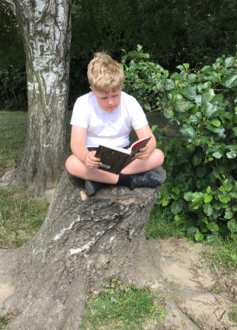
Our Wren Hero
We have had such a fantastic week in Wrens and so many children have stood out as amazing this week, some children are just wonderful every week and I wish I could choose more Wrens, as so many have impressed me!
Oscar is my first hero. Oscar always has so many interesting things to share with us in Wrens, we have particularly enjoyed hearing all about Vietnam this week and loved seeing him is his Vietnam football kit. He really threw himself into the 'Tough Runner' this week, I absolutely loved that he really helped his friends under the nets and just smiled the whole way through. He has also been working so hard in all his work and his artwork is particularly impressive! His enthusiasm and ideas, make me smile daily! You are a wonderful wren Oscar, keep up the hard work!

Slide 9
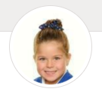
Our Wren Hero
My second hero is Ella.
Ella is one of many children in our class who could be a hero every week. She is kind and hardworking and always tries her best. She has been working so hard to work a little quicker recently and is producing some fantastic work. She is always one of the first children to offer to help and is always there for all her friends. She makes me proud on a daily basis and just gets on without ever making a fuss. Ella you really are a wonderful wren, keep making everyone proud!

Slide 10
Our Woodpecker Hero
Our heroes this week are Arlo, Chester and Eddie.
Arlo is our first hero for the super way he has settled into Woodpecker Class. He has made a super start and made lots of friends already. It is almost as if Arlo has always been here! We feel so lucky you came to Woodpecker class Arlo.

Slide 11
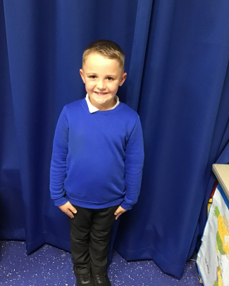
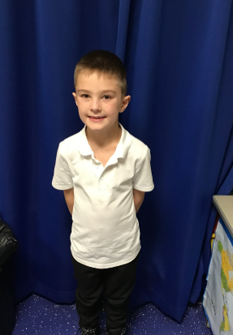
Our Woodpecker Hero
Our other heroes are Chester and Eddie for the way they have looked after Arlo to help him settle in. They have been taking it in turns to be at the front of the line with Arlo and have helped him at dinnertimes and playtimes. Well done boys – you are everything we like Holly Hill children to be.

Slide 12
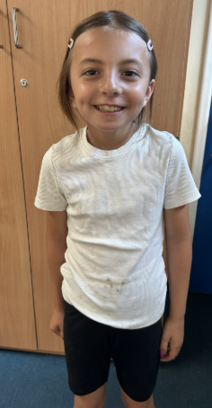
Our Kingfisher Hero
Our hero this week is Evie.
I don't have enough words to say how kind and helpful Evie is every single day. She is always ready to do jobs in class, even before we have started school. Evie's class teacher next year, is going to be very lucky! 😀
Well done Evie, you are brilliant! 🤩

Slide 13
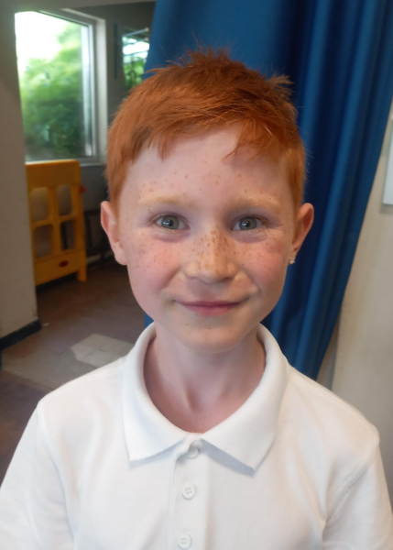
Our Dove Heroes
Dove's first hero this week is Kayne. He has only been with us a few days but has shown himself to be a sensible, kind and valuable member of Dove Class already - we know he will be a real asset to our school. We are so happy to have you here Kayne!
.

Slide 14
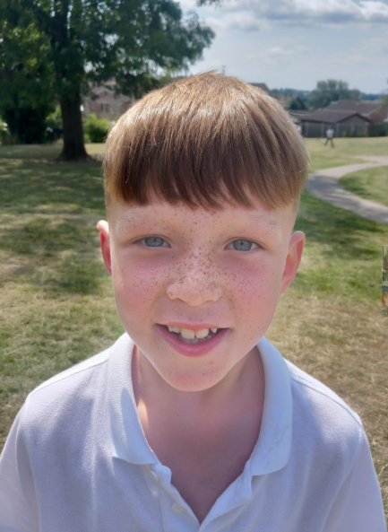
Our Dove Heroes
Dove's second hero this week is Rory. All year Rory has tried his very best and been an outstanding member of our school who is kind to others, supportive and highly motivated. This shows every day in class with the work Rory does and his attitude to learning. Rory definitely is a Holly Hill Hero!

Slide 15
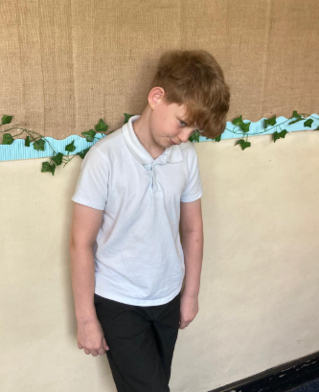
Our Swallow Heroes
Killian is a Swallow hero today. He has been amazing in all of our Jigsaw lessons but especially in the session today. Killian was so sensible and thoughtful. He talked about how bodies change when we get older and how emotions change and how that affects us. He was able to share with the class lots of great ideas. I am so proud of you Killian – you listened all the way through to other people’s ideas too. Well done!

Slide 16
Our Swallow Heroes
.
All of Swallows are heroes for their participation, enthusiasm, love and laughter throughout our Tough Runner. I love to see how a bit of water and a big inflatable thingy can bring so much joy to our afternoon! Swallows, your faces were a picture and I laughed so much! My heroes!

Slide 17
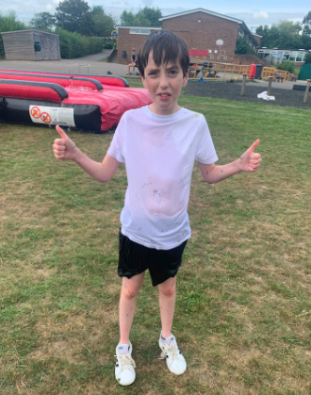
Our Owl Heroes
.
Owl Heroes this week are Stanley and Blake. They absolutely threw themselves into tough runner. By the end of it they were covered in bubbles and had the biggest smiles on their faces. Well done boys!

Slide 18
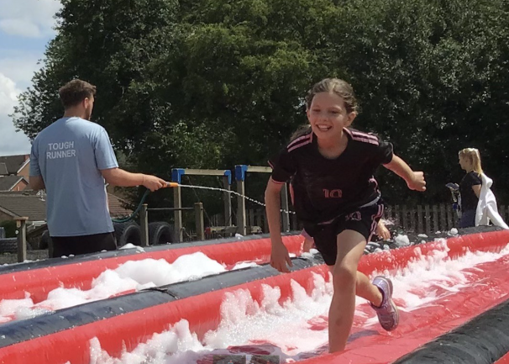
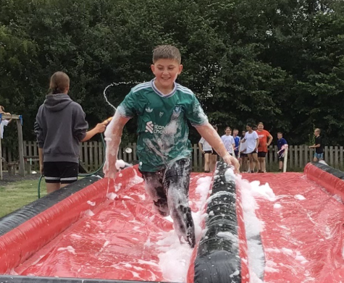
Our Falcon Hero
My heroes this week are Ben and Bella. They both got stuck into tough runner, completing the circuits properly and finishing with some pretty impressive amount of laps. As you can see, they had a whale of a time completing it as well! Well done to you both 🌟💦😅

Slide 19
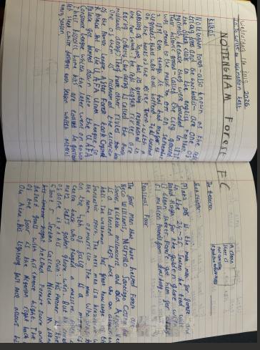
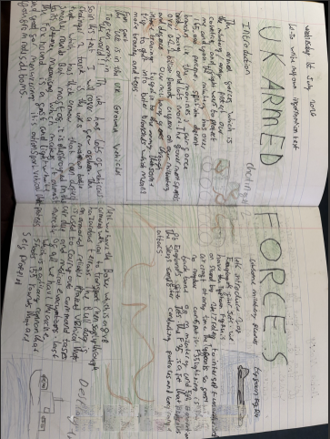
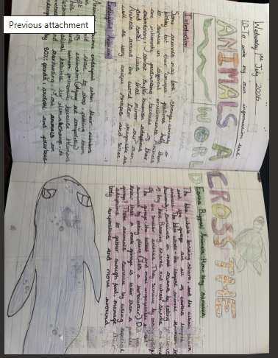
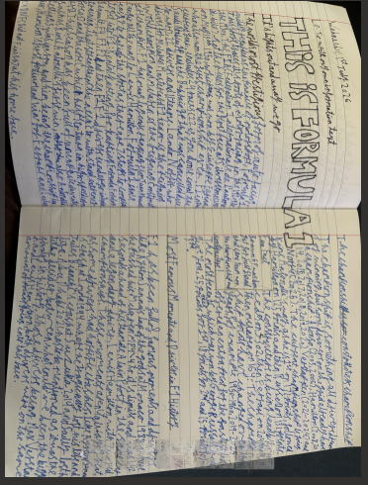
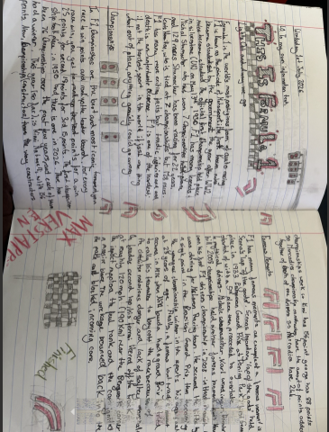
Our Swan Heroes
I've got 5 amazing writing heroes this week - Theo T, Seb, Alan, Lilly and Ralph! We have been writing our own information texts, researching about the topic of our choice and writing our final piece completely independently. This was a project that we all enjoyed and everybody worked so hard - we have writing about the armed forces, foods around the world, record-breaking roller coasters and so much more! Everybody's writing was amazing, but these 5 were selected to be our heroes this week. Well done fabulous writers 💫💫💫💫

Slide 20
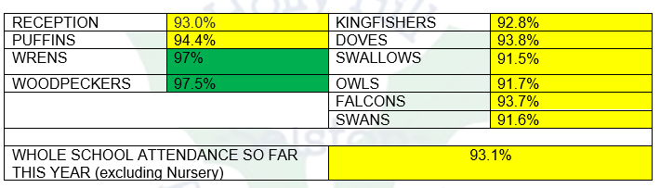
Class Attendance winners
CLASS | WIN 1 | WIN 2 | WIN 3
Cygnets 1
Cygnets 2
Puffin
Wren
Woodpecker
Kingfisher
Dove
Swallow
Owl
Falcon
Swan
Well done Woodpeckers! This week’s winners with 97.5% attendance!!
Remember, when you reach 3 wins, your class will get £25 to spend on books and 15 minutes extra play! Try to come to school every day to help your class be the winners!

Slide 21

Have a fabulous weekend everyone!
Mrs. Steed
xxx

