Slide 1

Holly Hill Heroes Assembly
HOLLY
HILL
SPRING TERM, 2025

Slide 2
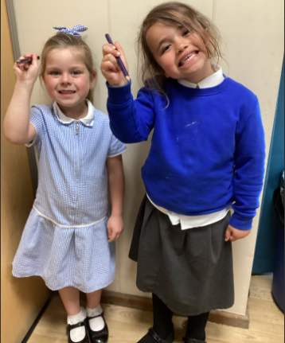
Our Cygnet Hero
Our class have really enjoyed innovating Jack and the Beanstalk this week. They changed the setting at the top of the beanstalk to Elsa's Castle. It invoked some amazing shared talking and we had some wonderful sentences and vocabulary. Our favourites are our heroes this week:
Ella came up with 'The door creaks slowly open to Elsa's Castle.’
Zayla came up with 'The frozen spires are sharp and pointy.'
Well Done Ella and Zayla what fantastic sentences. They both are also very kind and hard working and could be heroes every week!

Slide 3

Our Cygnet Hero
Our first hero is Amir! Amir has had a really good week this week, especially over dinner times. He is working hard to use kind hands all of the time and we can really tell he is working hard. Amir has also impressed us with his reading! He is segmenting and blending beautifully, well done Amir!

Slide 4
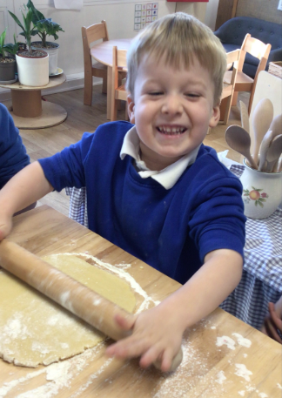
Our Cygnet Hero
Our next hero is Max! Max is such a bubbly young man who loves to learn new things. He is super passionate about making new creations and showing them off to his friends. Max loves to help the adults with any jobs that they are doing. Max we are super proud of you! Well done!

Slide 5
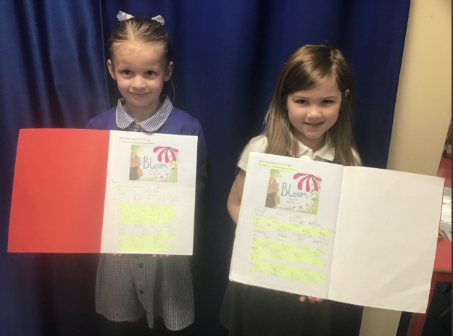
Our Puffin Hero
Our Puffin Class Easter Heroes are May and Ottilie. Both girls have worked so hard ALL term to improve their writing including writing at greater length, using punctuation, making sure their handwriting is beautiful whilst still using their phonic and tricky word knowledge to write words independently. They have shown maturity by taking on suggestions to improve their work - what an amazing attitude to have in Year 1. Well done, Ottilie and May, Mrs Cottee is so proud of you both - you are both absolutely PERFECT PUFFINS!

Slide 6
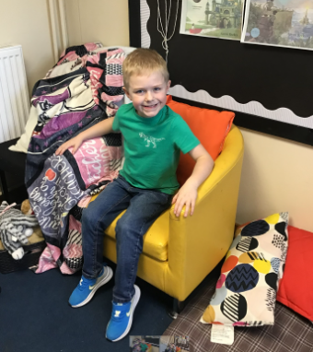
Our Wren Hero
Our Wren hero this week is Harry. This is for his attitude towards our computing work with the bee bots this half term and showing great perseverance when working with algorithms! He has worked hard to plan, program and debug his algorithms. Fabulous work Harry!

Slide 7
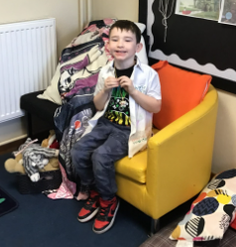
Our Wren Hero
Our second Wren hero is Jase. This is for amazing me with his attitude towards his writing. He's trying so hard to write more independently and has been a super star at it. I have really enjoyed seeing his fabulous writing and his confidence grow, showing great pride in his work. Keep it up Jase!

Slide 8
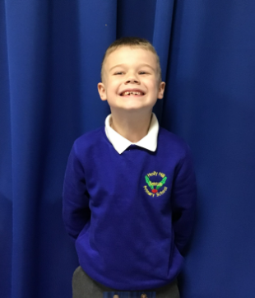
Our Woodpecker Hero
Our Woodpecker heroes this week are Connor and Cleo-Renae.
They are both heroes as they have been working so hard all half term.
Connor has made super progress with his writing and he has been so proud of the work he is producing. He is also trying really hard to answer lots of questions and listen really carefully. Well done Connor.

Slide 9
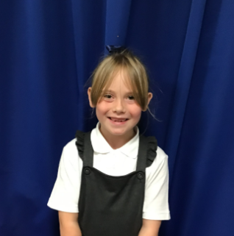
Our Woodpecker Hero
Cleo-Renae is always a super star and could be a hero every week. She is always ready to learn and is really trying to make her work better and better all the time. Well done and keep up the fabulous work Cleo-Renae.

Slide 10
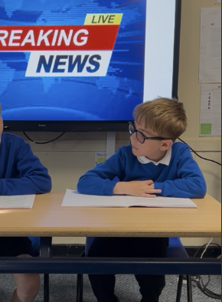
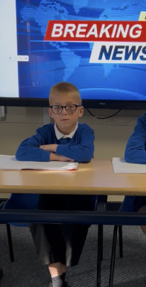
Our Kingfisher Hero
Kingfisher heroes this week are Finley and Oliver. They have written a great news report this week about the tragedy in Pompei.
I have chosen Oliver because he wasn't sure about being recorded, but he persevered in practising and came out as a shining news presenter, looking very professional.
Finley also did a fantastic job of sorting out his news report and his fellow reporters job too. He was a great news anchor!
Well done boys for being fabulous in the news studio. 🌟

Slide 11
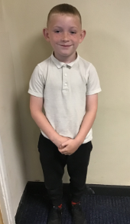
Our Dove Hero
Our first Dove Hero this week is Jaxson. Jaxson has really impressed us recently with his enthusiasm and dedication in lessons. We have noticed a real change in his attitude and he now is the first to listen, is showing a love of learning and is trying really hard with his presentation. He has also worked brilliantly in a team during English, ensuring he takes a role, and has been supportive to others in his group. Well done Jaxson! You are a superstar Dove!
﻿
﻿
﻿

Slide 12
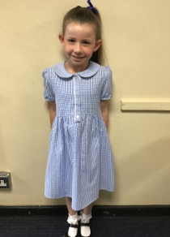
Our Dove Hero
Our next Dove Hero is Amelia. What a difference we have seen this term in English! Amelia has shown such enthusiasm for the texts that we have looked at and has even been reading one of the books at home. She has tried exceptionally hard with her writing and has produced some fabulous work. Amelia has also been a wonderful team member whilst producing our news report script and has worked with her team in a supportive and helpful manner, taking on a key role as scribe. Well done Amelia! You are amazing!
﻿
﻿

Slide 13
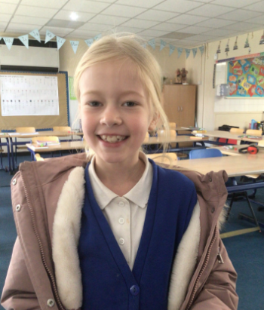
Our Swallow Hero
Our first Swallow hero is Olivia. Olivia has been working really hard in class and doing her best to stay super focused and on task. We are really impressed with her efforts in reading and spelling and last week she got full marks on her spelling test! Well done Olivia. Keep it up!

Slide 14
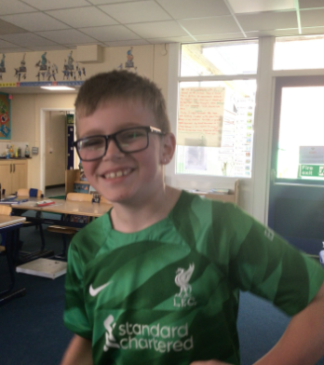
Our Swallow Hero
Our second Swallow hero is Braiden. Braiden always has impeccable manners. He is very thoughtful and sets the example for speaking politely and kindly to others and he is always patient and being supportive of other children. I have also noticed how he is doing his best to stay focused and it is reflected in his work, as he has a must clearer idea of what he needs to do now! Well done Braiden!

Slide 15
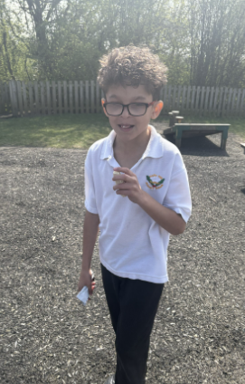
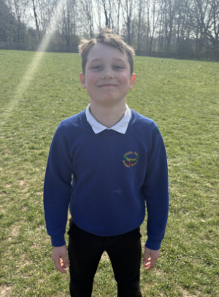
Our Swallow Hero
Mrs. Fisher has also chosen two Swallow heroes – Harrison and Lockie. This is for creating a great end of unit sequence using all of the gymnastics movement that they have learnt. The boys worked together to create rolls and balances that transitioned through a sequence. Mr Ellis was really impressed.
Well done boys!

Slide 16
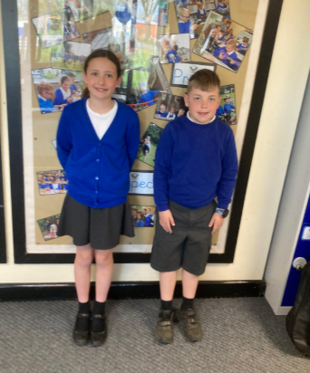
Our Owl Hero
Our Owl heroes this week are two people who are just the best and who are great role models for the rest of Owl class. Theo and Sophie give their best every single day. They work hard and have a fabulous attitude to school and their learning.
Well done for being so amazing Sophie and Theo!

Slide 17
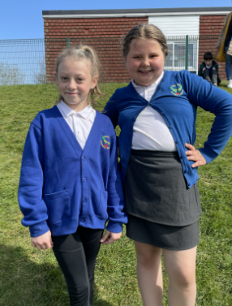
Our Falcon Hero
This week’s Falcon Hero is Ellie-Mae! Ellie has been with us for just two weeks and she has already shown herself to be someone who can follow the Holly Hill Way. It can be scary starting a new school, but Ellie has chatted to lots of different people and can be seen here with her lovely new friend Lilly! I look forward to the rest of the year with you in Falcon Class!

Slide 18
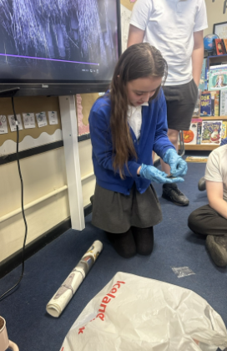
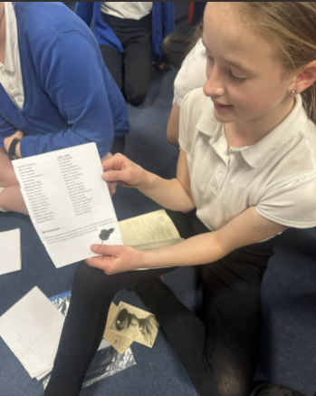
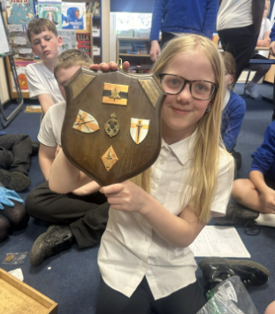
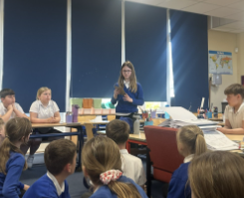
Our Swan Hero
My special heroes this week are Alice, Heidi, Alexa, Alaina and Phoebe. The children were challenged to find out whether they had any relatives who were alive during WW2 and had some questions to research. These girls went above and beyond, bringing incredible artefacts and family photos to share with us all. Thank you so much girls for engaging in our WW2 topic and speaking so knowledgably to Swan class about what you had to show them. You’re amazing historians!

Slide 19
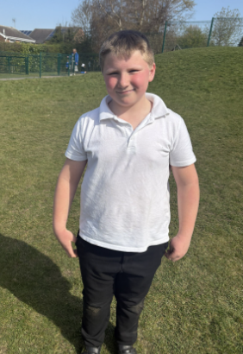
Our Office Hero
This week, Mrs. Binder asked if she could choose a hero as she had spotted someone who she felt really deserved it.
Mrs. Binder has chosen George to be the office hero this week. When she was in the dining hall yesterday, she saw that George was helping a friend who was upset. George was trying to help his friend to stay and ensuring that he didn’t get into any trouble by approaching a problem with a mature attitude.
Well done George. How wonderful to know that you are doing the right thing all of the time, even when you might not realise that someone is watching you.

Slide 20
Our Wraparound Hero
Our wrapround hero this week is Ela.
Ela is an absolute angel when she is in wraparound care and is absolutely perfect every day. She plays nicely, is kind to everyone, has beautiful manners, listens to the grown ups, looks after the little ones and all done with that beautiful smile of hers!
You are a delight to be around Ela – keep being amazing!

Slide 21

Tweak of the week
Don’t forget that left is still best!
We are working hard to keep our school litter free on the inside and the outside.
Keep it up everyone!

Slide 22
Our Attendance Heroes
CLASS | WIN 1 | WIN 2 | WIN 3
Cygnets 1
Cygnets 2
Puffin
Wren
Woodpecker
Kingfisher
Dove
Swallow
Owl
Falcon
Swan
This week’s winners with 97.6% are Dove class!
Well done Doves!

Slide 23
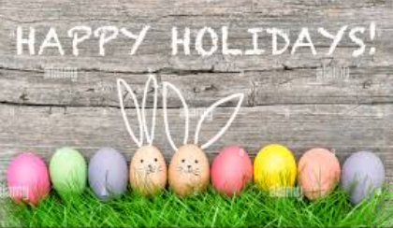
Have a fabulous Easter break everyone!
Love,
Mrs. Steed xxx

