Slide 1

Holly Hill Heroes Assembly
HOLLY
HILL
SPRING TERM, 2025

Slide 2
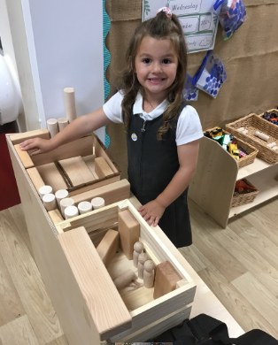
Our Cygnet Hero
Our first hero is… Robyn!! Robyn is such a wonderful little girl who always brings such joy to the room. She is always there to help her friends and the adults. Robyn has been working really hard independently with her writing and her story maps! She recently told me a story about a silly sausage dog who was doing yoga! Very creative! Well done Robyn!

Slide 3
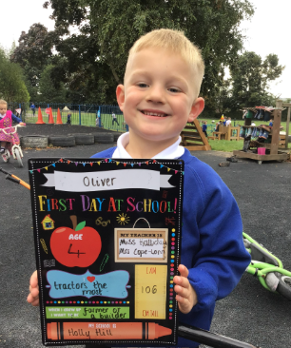
Our Cygnet Hero
Oliver is our next hero! Oliver is such a gorgeous young man who is working SO hard at the moment. He always listens and shows us how super he is. Oliver really wowed me with his writing this week which he completed independently. Oliver you are such a wonderful person to have in Cygnets, well done!!

Slide 4
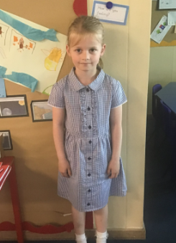
Our Puffin Hero
May is a Puffin Hero this week. She consistently works independently, always doing her best at whatever she does. Her writing is absolutely fabulous, with beautiful handwriting, punctuation and lovely ideas. This week in particular she has become confident enough to offer ideas during class discussions. Well done May, you really are a PERFECT PUFFIN!

Slide 5
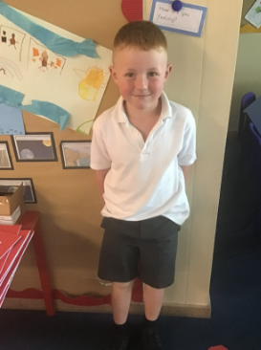
Our Puffin Hero
Ronnie is Puffin Class Hero, He has developed the most fabulous attitude to his learning and enjoys a challenge especially in Maths. He also has great ideas which he can articulate clearly. PE is also one of his favourite lessons and it is lovely to see him so enthusiastic and enjoying himself. Well done Ronnie, you really are a PERFECT PUFFIN!

Slide 6
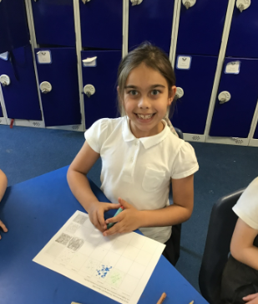
Our Wren Hero
Lilly has joined us recently and has settled straight into the Holly Hill life. She is a wonderful addition to Wren class and has already made lots of new friends, been impressing the teachers and showing her knowledge off with answering lots of questions in all of our lessons. Keep it up Lilly – we are delighted that you have joined us!

Slide 7
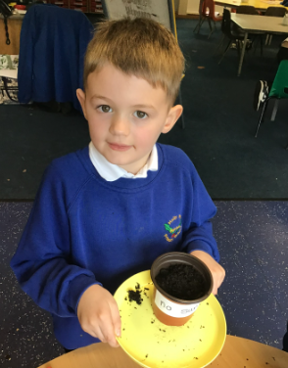
Our Wren Hero
David has been trying really hard this week with his writing and has been including extra grammatical features into his writing which has been wonderful to read. Keep it up!
He has also been a superstar at helping to work on our tweak of the week by picking up litter he spotted on the playground and helping to keep our classroom tidy. Great work David!

Slide 8
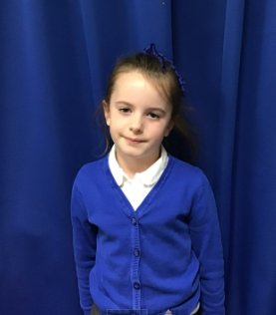
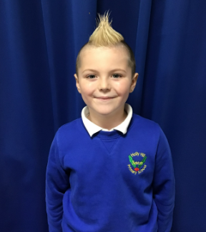
Our Woodpecker Hero
This weeks Woodpecker heroes are Bonnie and Lucian.
Bonnie could be a hero every week but I have chosen her this week as she has really impressed me in maths this week with her detailed answers to our problem. Not only did she use good mathematical language in her answer, she also drew her working out and wrote a calculation to prove it. Well done Bonnie. That was amazing Maths.
Lucian has also been amazing in Maths this week. He is really listening hard in activities and his hand is up all the time to answer questions. Well done Lucian. It is fabulous to see all the effort you are putting into your Maths.
.

Slide 9
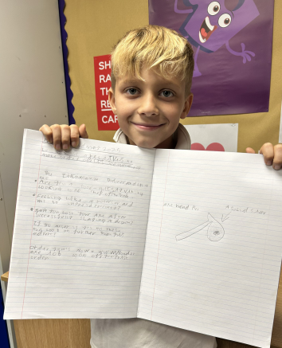
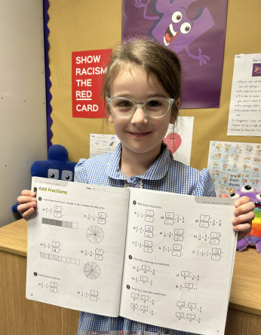
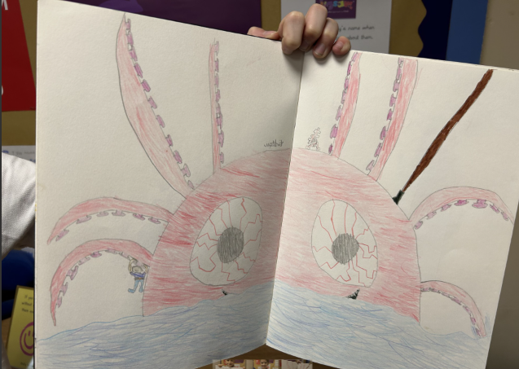
Our Kingfisher Hero
Kingfisher Heroes this week are: Reuben, Ava and Killian.
Reuben is a English hero this week - his pencil and his writing hand have been on fire! He’s read out some amazing work based on How to Train Your Dragon and some of the vocabulary he has used has amazed me.
Ava has blown my socks off this week with her work about fractions. She was a pro at adding and subtracting the numerator, always remembering the the denominator stays the same.
Killian is a hero, because his art work amazes me. I’ve loved looking through his art portfolio and picking out my favourites. I expect to see his work in the state Gallery one day!
Well done to my heroes this week, you’ve all amazed me for different reasons. 🌟

Slide 10
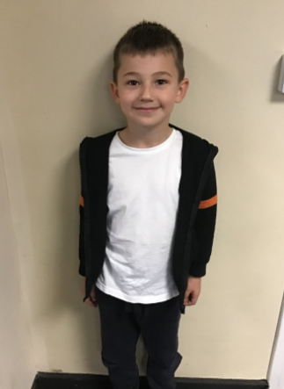
Our Dove Hero
Our first Dove hero this week is Max. Over the course of the year, Max has really grown in confidence and is now showing much more independence, especially when writing, which is where he used to struggle. He has been trying really hard these last few weeks to improve his handwriting and has got his pen licence this week! Well done Max! Keep up the hard work.
﻿
﻿

Slide 11
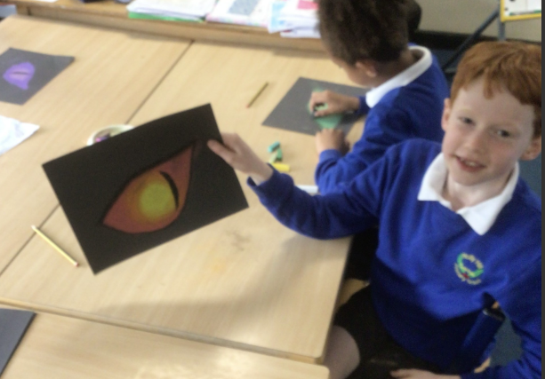
Our Dove Hero
Our next Dove hero is Alastair. Alastair is always such a fantastic contributor during class discussions and has so many fabulous ideas. He has also really impressed us this week in p.e, taking a lead when working in teams and being supportive and helpful to others. Great orienteering qualities. Well done Alastair. What a wonderful Dove you are!
﻿

Slide 12
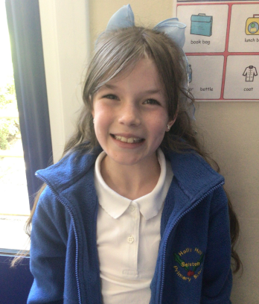
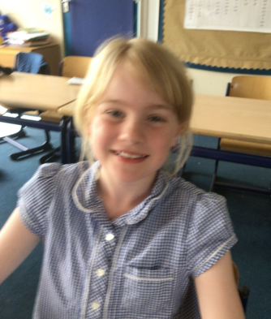
Our Swallow Hero
From Swallow this week, our heroes will be Megan and Skyla.
Both girls did a fantastic job on using inverted commas in the English work this week. Speech marks are really tricky to get write, so it just goes to show how hard both of them work at their writing and how focused they are at checking for the correct punctuation. On top of this, Skyla and Megan are both role models for kindness, focus and behaviour in general across very school day.
Well done both of you!
.

Slide 13
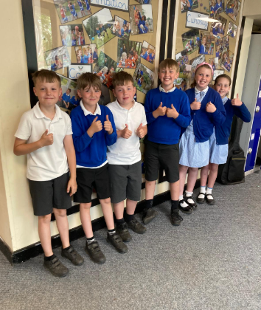
Our Owl Hero
Owl heroes this week are our Bikeability crew who have spent 2 days mastering the biking proficiency. Well done for persevering in the heat – I’ve loved hearing how much you have enjoyed it. Well done Owls!

Slide 14
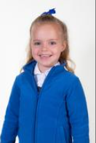
Our Wraparound Hero
Our wrapround hero this week is Harper.
Harper has been chosen because she is always kind and always helpful. She is a delight to have in after school club.
It has been a fabulous week for Harper as yesterday, she came to show me her amazing writing about a bumble bee. She had sounded out beautifully, included her finger spaces and had even remembered a capital letter and a full stop!
You are an absolute super star Harper and we are very proud of you!

Slide 15
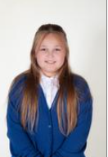
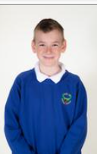
My Headteacher’s Hero
My Headteacher’s heroes this week are Elliot and Lola.
At lunchtime, they spotted me thinking about our tweak of the week and decided to help me. They picked up loads of rubbish from the field and around the edges which was so helpful and considerate.
Thank you for helping to make sure our school is a lovely place to be Elliot and Lola.

Slide 16

Tweak of the week
Don’t forget that left is still best!
We are working hard to keep our school litter free on the inside and the outside.
Keep it up everyone!

Slide 17
Our Attendance Heroes
CLASS | WIN 1 | WIN 2 | WIN 3
Cygnets 1
Cygnets 2
Puffin
Wren
Woodpecker
Kingfisher
Dove
Swallow
Owl
Falcon
Swan
This week’s winners with 98% are Owl class!
Well done Owls – at last!

Slide 18
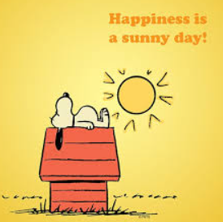
Enjoy a sunny weekend and an extra day off for the bank holiday.
See you on Tuesday next week!
Love,
Mrs. Steed xxx

