Slide 1

Holly Hill Heroes Assembly
HOLLY
HILL
SPRING TERM, 2025

Slide 2
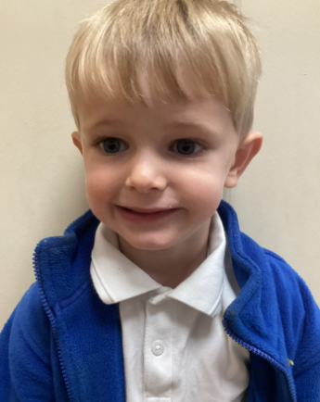
Our Cygnet Hero
Our first hero this week is Jasper. Jasper has had a very busy week, accessing all areas of the setting. He did amazing phonics and was able to segment and write the words easily. He has also shared some brilliant facts about ladybirds. Well Done, we are proud of you.

Slide 3
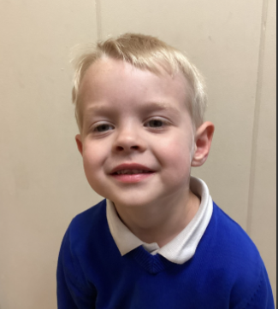
Our Cygnet Hero
Our second hero this week is Noah. Noah has really engaged in our topic this term. He has been search for mini beasts and showing all his friends how to treat them very carefully as not to hurt them and fetches water and leaves to look after them.

Slide 4
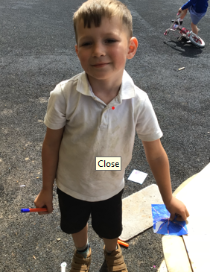
Our Cygnet Hero
Oakley has been a shining star in Cygnets this week. He has been making us so proud with his super listening and his ability to focus and concentrate on the task in hand!
Oakley has a brilliant attitude to learning and he tries his best in all that he does. He is really starting to believe in himself and believe that he can do it! Oakley always plays really well with his friends and often uses his imagination to create some super games. Oakley has wowed us so much with his phonic knowledge and he has showed us some brilliant blending this week.

Slide 5
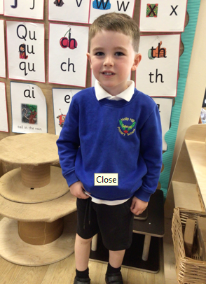
Our Cygnet Hero
Kai is a pleasure to have in the Cygnets and he really is a lovely boy. It has been lovely to see him grow in confidence to try and do things independently. He is becoming more confident to talk in class discussions and share his thoughts and ideas.
Kai blows us away with his amazing number skills and it is lovely to see how he applies this in his play. He loves to practise writing his numbers in the correct order. Kai is also a super reader! His blending is very speedy and he beginning to read automatically recognise words too. We are very proud of Kai and the amazing progress he is making.

Slide 6
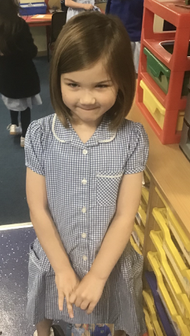
Our Puffin Hero
Ottilie is the most fabulous young lady. She loves to read and write even doing both at home.
This week she has thrown herself into our new core book Vlad and the Great Fire of London. In our drama session she not only took on various roles adapting her voice for each character but also showed maturity by helping others in her group. Well done, Ottilie you really are a PERFECT PUFFIN!

Slide 7
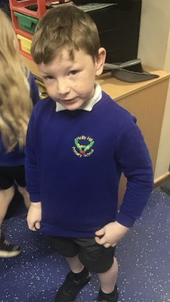
Our Puffin Hero
Oscar has developed the most fabulous attitude to his learning. He has worked particularly hard with his writing recently, improving not only his handwriting but also what he writes. This week he has been super helpful by tidying the classroom without being asked. Well done, Oscar you really are a PERFECT PUFFIN!

Slide 8

Our Wren Hero
Ruby has blown us all away these past few weeks, she has been working extremely hard and has made huge progress with her phonics and writing. We have been so impressed with her attitude towards her learning and blowing our socks off with her phonics scores. Keep up the fantastic work Ruby!

Slide 9
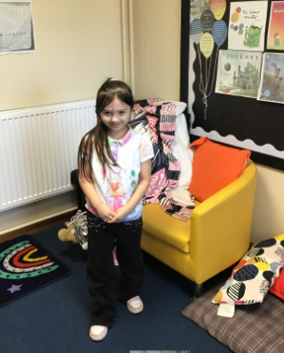
Our Wren Hero
Ivygrace has been an absolute star this week and has amazed us with her attitude towards her phonics and reading. She's also been a whizz with her maths this week and has blown me away everyday in maths, some days finishing her work in record time! Keep up the fantastic work Ivygrace!

Slide 10
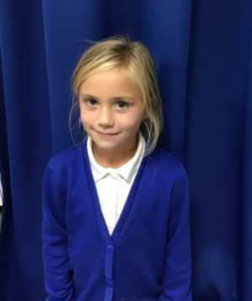
Our Woodpecker Hero
Our first Woodpecker hero this week is Elsie.
Elsie is hero this week for all the effort she is putting into all her work. She is really trying hard and was an absolute superstar in art this week with her shading. Well done Elsie. Keep it up.

Slide 11
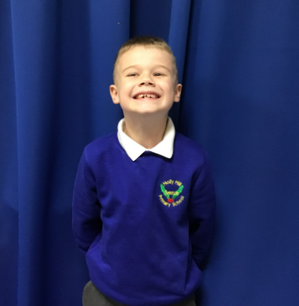
Our Woodpecker Hero
Our second Woodpecker hero this
week is Connor.
Connor is my other hero this week. He has really impressed me by always being sat on the carpet ready to learn. He is also making super effort in English and we have all been really impressed with his writing. Well done Connor. Keep up the hard work.

Slide 12
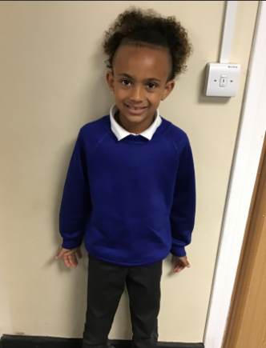
Our Dove Hero
Our first Dove hero this week is Karson. Karson has been working so hard on his writing over the last few weeks. He is trying to come up with more of his own ideas and has worked exceptionally hard on his handwriting which this week has gained him his pen. He is now writing all joined and it is beautifully neat. Well done Karson!
﻿
﻿

Slide 13
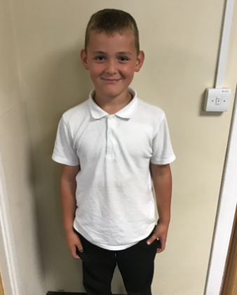
Our Dove Hero
Our next Dove hero is Ronnie. Over the course of this year Ronnie has worked exceptionally hard on his times table knowledge and is now over doubling his score to get nearly full marks! This is a massive achievement and we have every faith he is now going to smash his times table check! Well done Ronnie! Proof that practise makes all the difference!
﻿

Slide 14
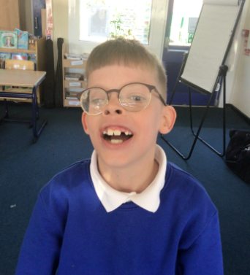
Our Swallow Hero
George is new to our class and has done really well settling in this week. Not only has he had to get used to being one of 4 children called George in the same class ( I think that's a record) but he has had to adapt to a new school, and that is not always easy. It has been great to see how he has focused and contributed to lessons, along with making lots of new friends. It already feels like he has been at Holly Hill for years, such is the excellent Holly Hill values that he has shown. Well done!

Slide 15
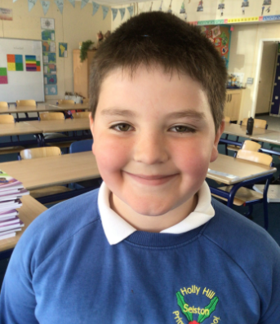
Our Swallow Hero
Another George! But then again, we have a lot of them! George is a superstar with his effort and attitude each week. He is always polite and kind and helpful and tries his best every day. We also want to celebrate the fact that George is a Rock God! That is a new level on TT Rockstars we have had to specially create because George is so, so fast at answering his times tables. He can do over 120 in a minute. That is two every second! Incredible work and shows real perseverance.

Slide 16
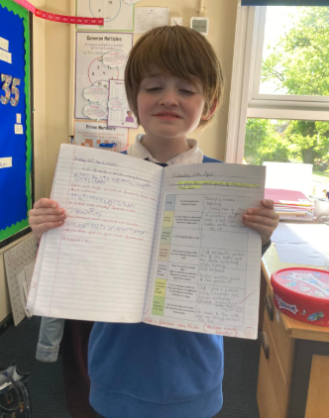
Our Owl Hero
Miller is Owl hero today for a plan that he has produced for our Letter from the Lighthouse ‘Next Clue’. The idea he had was such a good one and Miller was able to give detailed information for his plan. Well done Miller - a super piece of work!

Slide 17
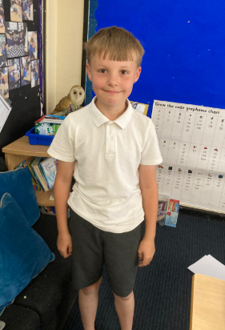
Our Owl Hero
Ethan is an Owl hero today for a random act of kindness that he showed during our VE Day celebrations. Ethan you made me very proud as you showed true Holly Hill care and values. We always talk about the phrase ‘Be Kind’ and on that day, you were so kind! Well Done Ethan!

Slide 18
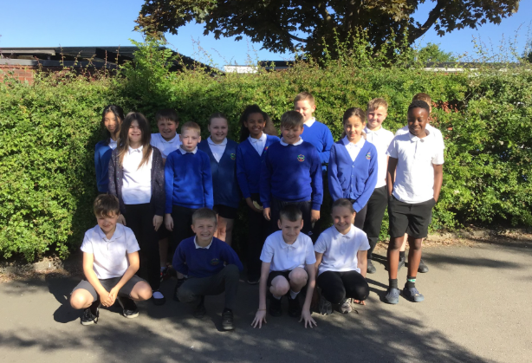
Our Falcon Hero
The first hero for Falcon class this week is ALL OF YEAR 6! They have worked so unbelievably hard this week on their SATs tests, keeping concentration and positivity through a long and busy week. They have genuinely all tried their best and I am absolutely bursting with pride when I think of how much progress they have made and how they have maintained such great attitudes. I look forward to this last half term with these wonderful, mature, GENIUS CHILDREN! 🤩

Slide 19
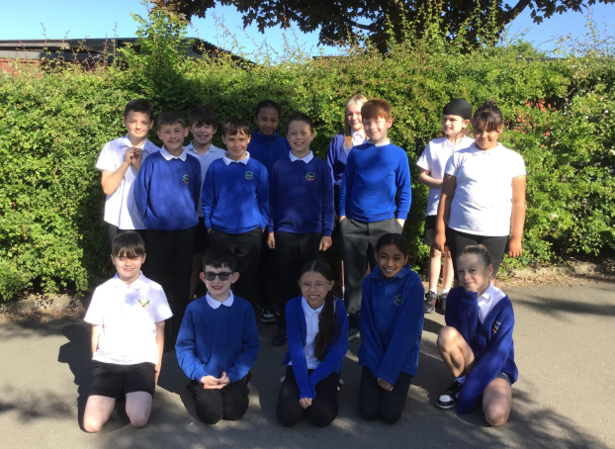
Our Falcon Hero
The second Falcon hero is ALL OF YEAR 5! These absolute superstars have had to work in the bird box, the infant hall, all over the place to accommodate their Y6 classmates. They have handled all the changes with grace and maturity and it was so lovely to hear the way they cheered for their classmates once the tests were over! I am very proud of their brilliant attitudes- you are all amazing! 🤩

Slide 20
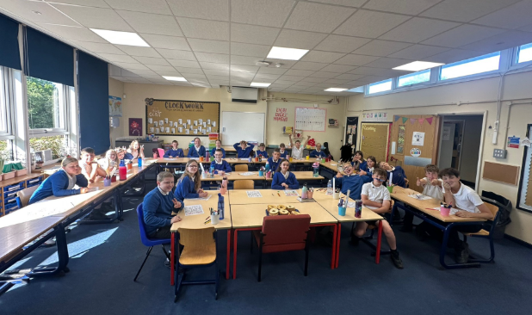
Our Swan Hero
All of Swan class are heroes this week. They have completely astounded all the adults this week during SATs. They were mature, hard-working and so calm throughout the whole week and I couldn’t be any prouder of every single one of them. Well done Y6 - you’ve been superstars 🌟 🌟 🌟🌟

Slide 21
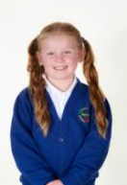
Our Wraparound Hero
Evie is our wraparound hero today. Evie is an ‘always’ child – she is always so kind, she is always doing the right thing and she always helps to tidy up. It is a pleasure to spend time with Evie in wraparound care – well done Evie!

Slide 22

Tweak of the week
Don’t forget that left is still best!
We are working hard to keep our school litter free on the inside and the outside.
Keep it up everyone!

Slide 23
Our Attendance Heroes
CLASS | WIN 1 | WIN 2 | WIN 3
Cygnets 1
Cygnets 2
Puffin
Wren
Woodpecker
Kingfisher
Dove
Swallow
Owl
Falcon
Swan
This week’s winners with 98% are Falcon class!
Well done Falcons – you’ve won your treat!

Slide 24
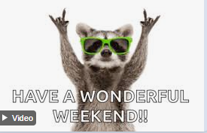
Have a fabulous weekend everyone!
Love,
Mrs. Steed xxx

