Slide 1

Holly Hill Heroes Assembly
HOLLY
HILL
SPRING TERM, 2025

Slide 2
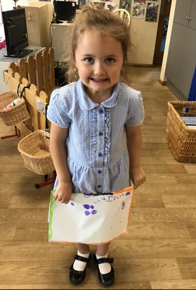
Our Cygnet Hero
Isabella is a phonics whizz kid! She blows us away with her amazing phonic knowledge. She is getting very confident at automatically recognising words and no longer needs to blend the sounds. Isabella is getting really good at listening carefully in our group times and she is remembering to put her hand up if she wants to share her thoughts and ideas. Isabella is very creative and loves to paint, cut and stick! She particularly loves to draw and creates the most detailed pictures.

Slide 3
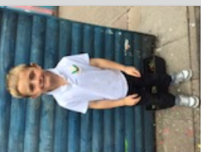
Our Cygnet Hero
What a super week for Benjamin! He has really impressed us with his learning in phonics and reading groups this week. Benjamin has shown brilliant concentration and he is taking in all of our super learning. Benjamin has been very motivated in his play and he knows exactly what activities he wants to do. He spends a long time engrossed in one activity. Well done Benjamin, we are very proud of you!

Slide 4
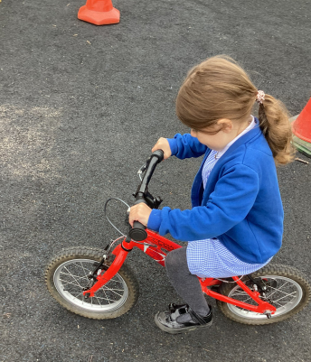
Our Cygnet Hero
Our first hero this week is Violet. Violet has worked so hard this week, she was immensely proud that she has conquered riding the bike using the pedals and no stabilisers. Not only this, but in phonics she has been practising really hard and is doing fantastic oral blending and segmenting. We are really proud of you Violet - keep up the hard work.

Slide 5
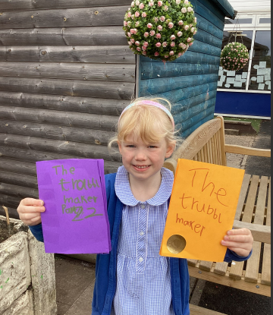
Our Cygnet Hero
Our second hero this week is Ivy. Ivy is a budding author and has not only produced 1 but 2 books this week. She loved sharing her story of the super villain and acted as an inspiration to lots of the children in Reception, who also wanted to write their own stories.

Slide 6
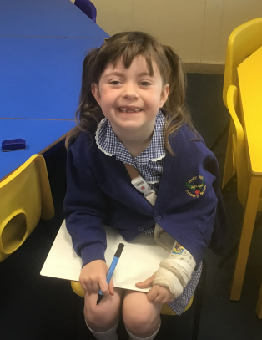
Our Puffin Hero
Georgia has shown great resilience this term. She broke her arm a few weeks ago but came back to school immediately. She has never complained and just got on with her work and school life. She has also made excellent progress with her writing this term. Well done, Georgia you really are a PERFECT PUFFIN!

Slide 7
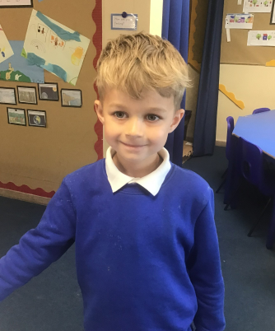
Our Puffin Hero
Hunter has had the most amazing half term and we are so pleased that he joined Puffin Class. Mr Ellis, our sports coach says that he always listens carefully in PE, can follow instructions and work well with other children, he was certainly enjoying our tennis and cricket sessions recently. Hunter has also loved our Great Fire of London topic and has been able to remember lots of facts and can speak clearly using great language. Well done, Hunter, you really are a PERFECT PUFFIN!

Slide 8
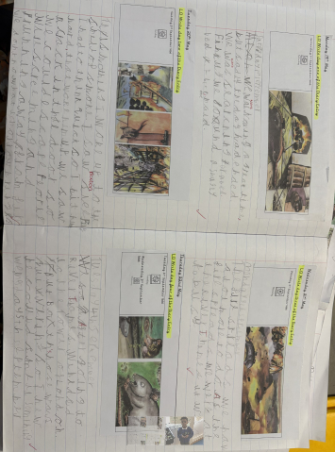
Our Wren Hero
Mason has written a fabulous diary entry this week as Vlad the flea in our Grear Fire of London topic. He has been trying out his cursive handwriting and has included lots of subordinating conjunctions within his entries. Fabulous work this week Mason - keep it up!

Slide 9
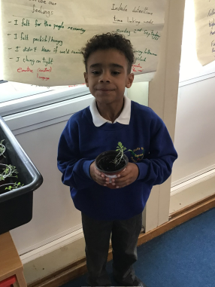
Our Wren Hero
Cruz has really enjoyed our Great Fire of London topic and has thrown himself into all our learning including our workshop. He has shown week in, week out how much knowledge he has gained about the Great Fire of London and is always putting his hand up to share his ideas within our lessons. Great work Cruz, Historian in the making🙂

Slide 10
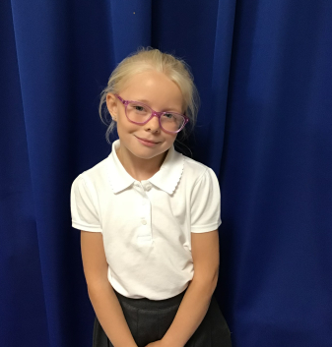
Our Woodpecker Hero
Our first hero this week is Jasmine.
Jasmine is our hero for 2 reasons. She really impressed Mrs Warsop on Monday with her photography skills. She has also been really kind and shared some of her plants we grew from seeds with other children whose plants had not grown very well so they could take some home. She is always so kind and thoughtful to other children and really shows the care part of the Holly Hill way.
Well done Jasmine!

Slide 11
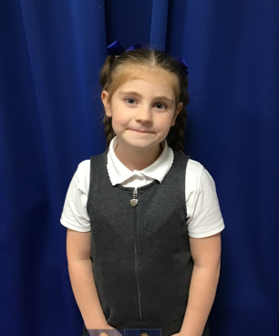
Our Woodpecker Hero
Our second hero this week is Ayda. Ayda is a hero for all the time and effort she spends on Numbots. She has been on the most minutes in the past month out of Woodpecker Class and it really shows with her understanding of her maths work in school.
Well done Ayda.

Slide 12
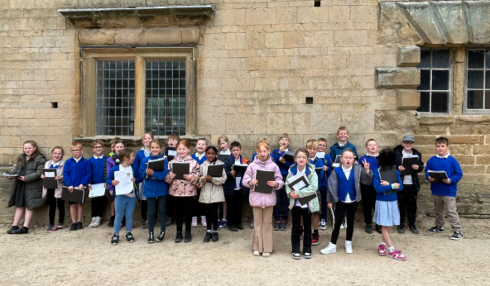
Our Kingfisher Hero
Kingfisher are all heroes this week for making our trip to Bolsover castle enjoyable and memorable. We all had a great time exploring the inside and the grounds 🏰
Thank you Kingfisher for being superstars 🌟
﻿
﻿

Slide 13
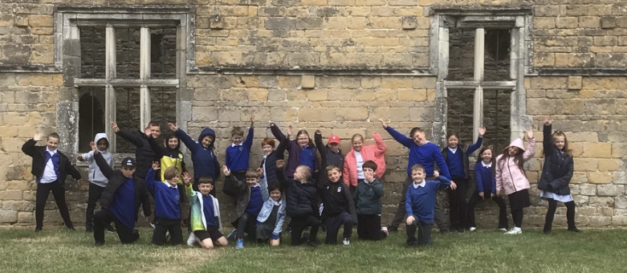
Our Dove Hero
Dove heroes this week are the whole class. They were absolutely brilliant on our trip to Bolsover Castle. The whole class were enthusiastic and asked fantastic questions to deepen their understanding. All of the adults were so proud of them and everyone had a wonderful day. Well done everyone!
﻿

Slide 14

Our Swallow Hero
I would like to choose all of Swallows this week. Even though they have ALL worked incredibly hard with their times tables over the last year, this week they have really stepped up their game! The Times Tables check is straight after half term and each and every one of them has tried so hard this week to keep up their high scores.
Keep up the great work over half term!!

Slide 15
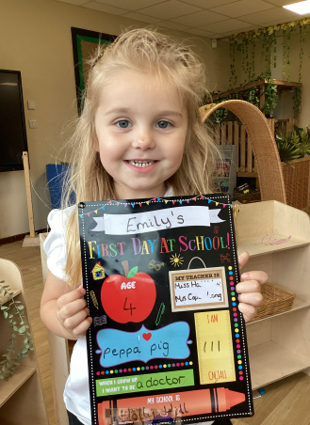
Our Wraparound Hero
Our wrapround care hero this week is Emily. Emily has only just started coming to breakfast club but has settled in beautifully. She follows the routine, listens carefully and is a joy to be around in the morning.
Well done Emily!

Slide 16
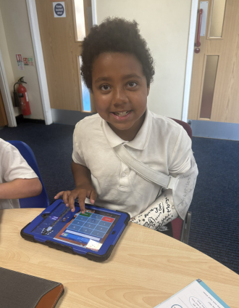
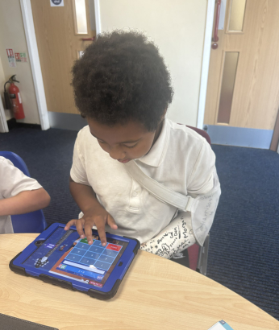
My Headteacher’s Hero
My Headteacher’s hero this week is Pelumi.
Pelumi had a terrible accident at the skatepark last week which resulted in him needing an operation. He now has a cast on his arm from shoulder to wrist! But, he’s come back to school this week with the biggest smile on his face and demonstrated endless resilience. He came along on the school trip and is coping brilliantly with no complaining. He also took great delight in telling me the gory details of his injury!!!
We were very worried about you Pelumi and are absolutely delighted to see you back in school! You’ll be back out on that football pitch before you know it!

Slide 17

Tweak of the week
Don’t forget that left is still best!
We are working hard to keep our school litter free on the inside and the outside.
Keep it up everyone!

Slide 18
Our Attendance Heroes
CLASS | WIN 1 | WIN 2 | WIN 3
Cygnets 1
Cygnets 2
Puffin
Wren
Woodpecker
Kingfisher
Dove
Swallow
Owl
Falcon
Swan
This week’s winners with 96.8% are Cygnets 2!!!
At last Cygnets – well done!! xx

Slide 19

Have a fabulous half term everyone!
Let’s hope it doesn’t rain every single day!
See you all in a weeks time.
Love,
Mrs. Steed xxx

