Slide 1

Holly Hill Heroes Assembly
HOLLY
HILL
SUMMER TERM, 2025

Slide 2
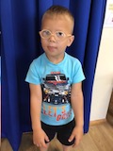
Our Cygnet Hero
Emetas has made us so proud this week! He is really growing in confidence and is becoming more independent in everything, We are really pleased with his communication and he using some English words now! He has really wowed Mrs Clay in Maths and he can recognise all numbers 1-5. He is trying really hard with his writing and he is trying to copy letters from a sound mat. He can form the ‘E’ for Emetas beautifully.

Slide 3
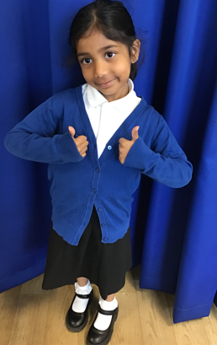
Our Cygnet Hero
Jesona is a Cygnets superstar! She is amazing us with her fantastic phonics skills and she is writing some super sentences all by herself! She takes herself off to the writing area and makes her own books. We loved her information book all about sea creatures.
Jesona has been trying hard to focus and listen carefully during carpet times and she is a brilliant role model to others. She has amazed us with cycling skills this week. She has shown great determination to pedal the bike independently. Well done Jesona!

Slide 4
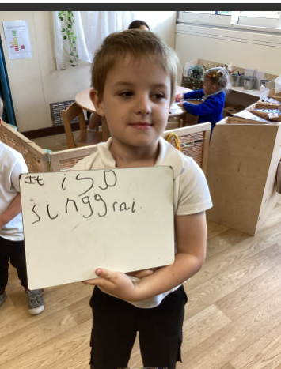
Our Cygnet Hero
Finnley has been showing everyone how he is ready to move to Year One. He has been coming in every morning and been writing me a wonderful sentence, as well as sitting beautifully and being so sensible! Well Done Finnley, we are all very proud of you.

Slide 5
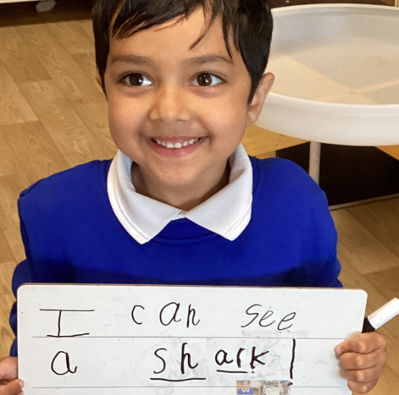
Our Cygnet Hero
We want to celebrate Kavin's new found confidence this week. He happily shares his ideas with the class and no longer has his head down on the carpet. He is always so well behaved and asks if there is anything he is unsure of. It is a joy watching him happily playing with his friends at choosing time. Well done Kavin, you were really brave and took a step out of your comfort zone and now you are flying.

Slide 6
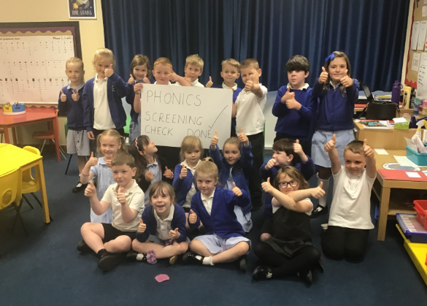
Our Puffin Hero
Everyone in Puffin Class is a hero this week. It has been our Y1 Phonics Screening Check week and everyone has worked their socks off over the last few months. This week every single child has not only tried their best with the check but also been incredibly sensible whilst our week has been different to usual. Well done PERFECT PUFFINS I am incredibly proud of all of you!

Slide 7
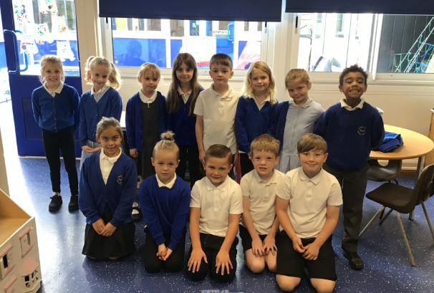
Our Wren Hero
I have to choose all of Wren year 2's for trying their best during their SATs and showing great resilience as we moved into the hall every morning for a week! I am so proud of them all and how hard they have tried this year. Well done Year 2!

Slide 8
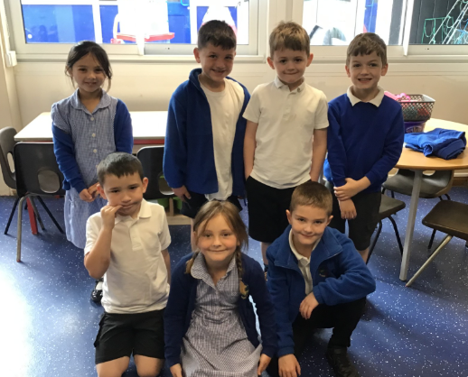
Our Wren Hero
And of course I also have to choose all of my year 1s for being absolute superstars and smashing their phonics screening check. They have blown all of the KS1 staff away and we could not be prouder of them all and the progress they have made! They have worked so hard and it has really shown. Great work Year 1!

Slide 9
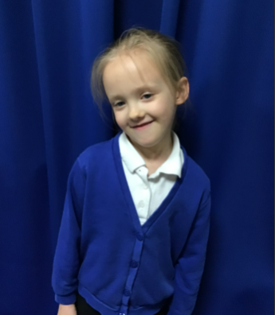
Our Woodpecker Hero
Our first hero this week is Abella.
Abella could be my hero every week as she is always a superstar. Whenever we are sat on the carpet, Abella is always sat beautifully and ready to learn. No matter what we do I know that she will do her best and try really hard. Well done Abella.

Slide 10
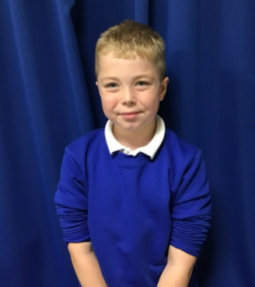
Our Woodpecker Hero
Our second hero is Mikee.
Mikee has broken his toe and is having to wear a special boot. It also means that he can’t run around and he has been so sensible and hasn't moaned at all about not being able to play and run around. Hopefully it will heal quickly so you can get back to normal.

Slide 11
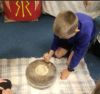
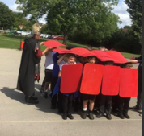
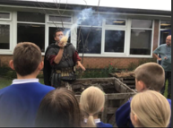
Our Dove Hero
Dove Heroes this week are the whole class for how brilliant they were when we had the Roman Visitor. They were fantastically behaved, asked some wonderful questions and all had an amazing time while learning about Roman life! A special shout out to the Year 4’s too for how well they all did with their Multiplication Checks. What an awesome class Dove is!
﻿

Slide 12
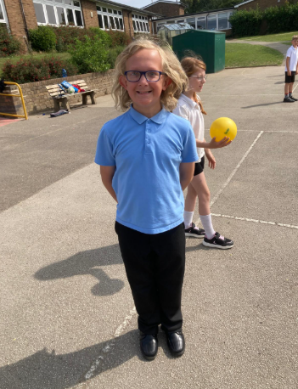
Our Owl Hero
Alex is an Owl hero today for his volley ball skills. He is developing great skills in sending and receiving the ball. He particularly impressed me with coaching his friend – demonstrating how to send the ball and then watching them have a go. Lovely to see Alex – well done!

Slide 13
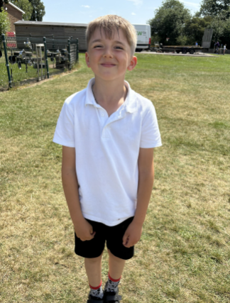
Our Owl Hero
Issac is an Owl hero this for being so much more settled in class. He has been trying to be ready for lessons, showing good listening and working hard. Well done Issac – what a fab week you have had!

Slide 14
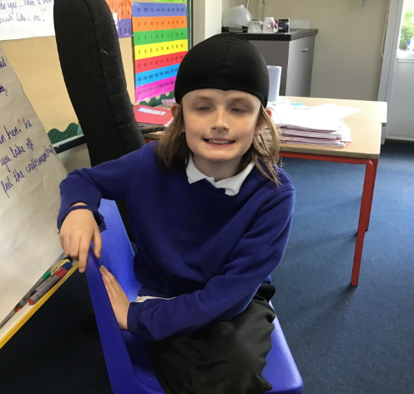
Our Falcon Hero
The first Falcon hero this week is Julian! This week Julian was a fabulous example during a game of dodgeball. He kept positive when he was out, stuck to the rules and remained positive about his teammates. He just proved that day how it is so much more fun when you stay positive and remember that it’s only a game and have fun together! 🤩

Slide 15
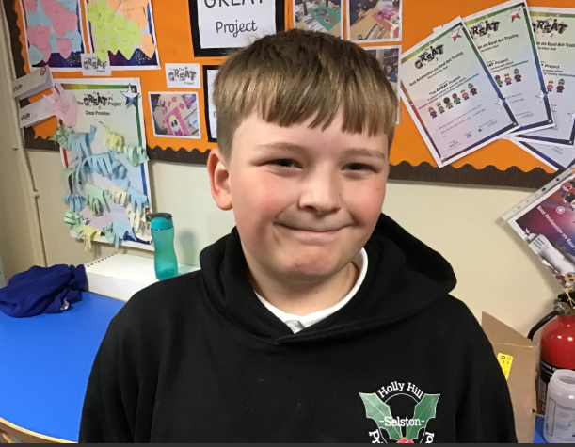
Our Falcon Hero
The second Falcon hero this week is Kai! Kai wrote a fabulous opening narrative based on the short film ‘Alma’. He used powerful vocabulary in a way that created an eerie atmosphere and really set the scene for a spine-tingling tale! Not only that, but Kai had clearly taken pride in his work and ensured his presentation was to a high standard. Keep up the great work Kai! 🤗

Slide 16
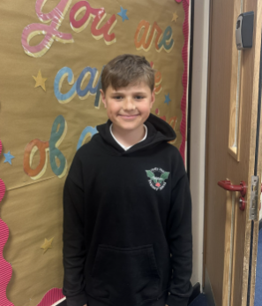
Our Swan Hero
Charlie is a hero this week for astounding us all in our geography lessons recently. I have never known somebody with as incredible map knowledge as Charlie has! I love discovering hidden talents, and I'm fully expecting to see Charlie exploring the world one day with an Atlas as his guide! Well done, Charlie! 🗺️📍

Slide 17
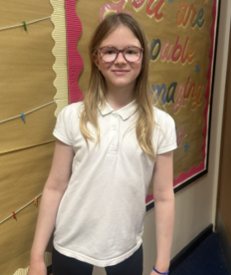
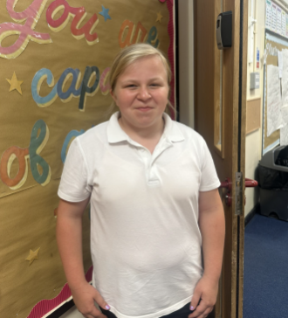
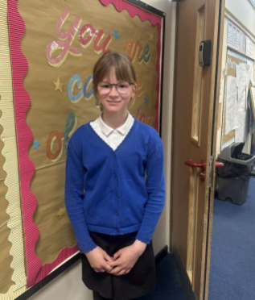
Our Swan Hero
I’ve also got three writing heroes this week: Alaina, Shayla and Alexa. We've been writing a suspense story about a spooky doll named Alma, and these three girls did some incredible writing! Well done superstars 🌟🌟🌟

Slide 18
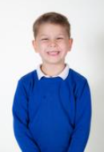
Our Wraparound Hero
Our wrapround care hero this week is Toby. Toby is trying so hard to always make good choices. He is doing so well and he is being kind to his friends all of the time.
Well done Toby!

Slide 19

Tweak of the week
Don’t forget that left is still best!
We are working hard to keep our school litter free on the inside and the outside.
Keep it up everyone!

Slide 20
Our Attendance Heroes
CLASS | WIN 1 | WIN 2 | WIN 3
Cygnets 1
Cygnets 2
Puffin
Wren
Woodpecker
Kingfisher
Dove
Swallow
Owl
Falcon
Swan
This week’s winners with 98.8% are Woodpeckers!!!
Well done Woodies xx

Slide 21
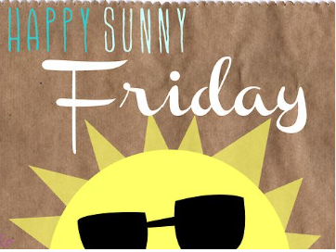
Have a lovely sunny weekend everyone.
Don’t forget to spoil your Dads and Grandads on Sunday!
Love,
Mrs. Steed xxx

