Slide 1

Holly Hill Heroes Assembly
HOLLY
HILL
SUMMER TERM, 2025

Slide 2
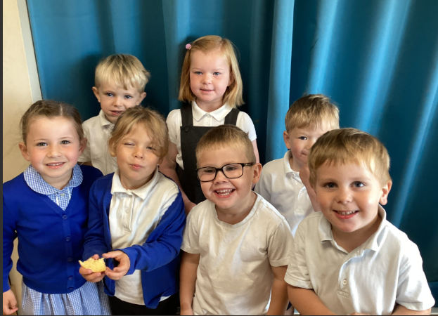
Our Cygnet Hero
All the Foundation 1 children are heroes this week for being so welcoming to the new children that visited our school for the first time. They showed the new children all the areas of the class and set a great example of how we follow our class rules. When the bells were rung, they explained how we stop and listen. The classroom did not need much tidying as they ensured everyone was choosing, using and putting away! Some of the new children were a little nervous but not for long it was great to see some amazing interactions- we are so proud of you.

Slide 3
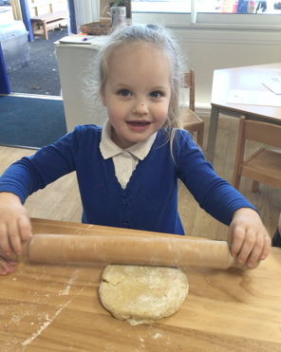
Our Cygnet Hero
Summer is a delightful little girl and she is always full of positivity and energy. She always greets us with a cheerful
“Good morning” with a huge smile on her face.
Summer has a super imagination and she plays so creatively with her friends. She is becoming more confident to share her ideas and communicate with her friends when playing.
We are so proud of Summer’s progress in managing her emotions and she has been trying hard to use her words when she is feeling upset.
Keep shining bright Summer, you really are a super Cygnet!

Slide 4
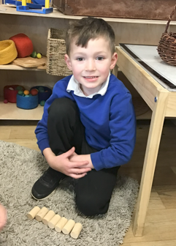
Our Cygnet Hero
Oakley is a lovely character and he makes us laugh every day with his cheeky sense of humour!
Oakley has been trying hard to focus his attention by concentrating and listening carefully during our group times.
He has really wowed us in maths this week when learning about 3D shapes. He can name many shapes and talk about their properties.
Oakley takes great care when forming his letters and his handwriting is beautiful! His phonic knowledge is growing every day and he is showing signs of being year 1 ready!
Well done Oakley, we are all so proud of you!

Slide 5
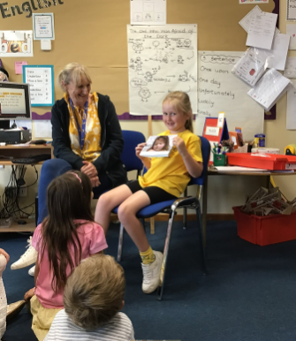
Our Puffin Hero
Our two Heroes this week are Matilda and Hunter, both of whom have had the most terrific weeks.
Yesterday on our ‘Wear Yellow for Hydrocephalus Day’, Matilda shared a very personal book of photos about her sister Aleyna who has the condition. Matilda spoke very articulately about Aleyna and things that her and their family have been through.
Thank you so much for sharing this with us Matilda, you are most definitely a PERFECT PUFFIN!

Slide 6
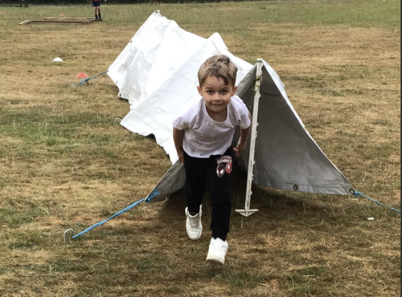
Our Puffin Hero
Hunter has had a brilliant week too and he absolutely loved our Tough Runner event. He was so enthusiastic and totally threw himself into each challenge - it was lovely to see the pure enjoyment on his face. He has also continued to work really hard in every other area of the curriculum too despite a rather unusual week with transition mornings and things not being quite the same as usual. Well done Hunter, you are a PERFECT PUFFIN!

Slide 7
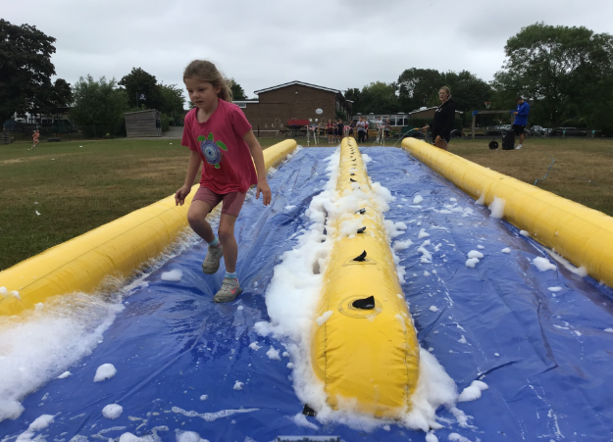
Our Wren Hero
Lucy wasn't sure at first about our tough runner and was reluctant to have a go on the water slide at first, but after her first go around the course, she jumped on and had a go. Well done for not giving up and trying something new! Lucy loved it in the end and had a fab time!

Slide 8
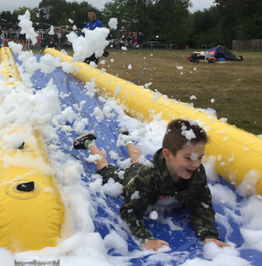
Our Wren Hero
Eddie has been a superstar with his fabulous attitude within the classroom. He has been super helpful and always offers to tidy up, help hand things out and helps his peers when they need it. All round a great role model within Wren class! Keep it up Eddie, you'll make a fabulous year 2!

Slide 9


Our Woodpecker Hero
Woodpecker heroes are Joe and Linus. Both boys smashed their timetables assessment today and the whole of Woodpeckers are so very proud of them. They answered every question correctly.
A huge well done!

Slide 10
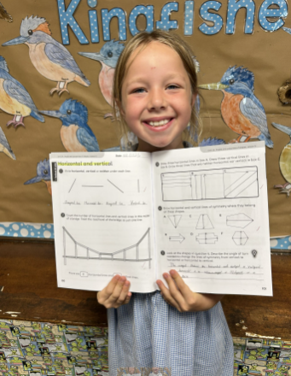
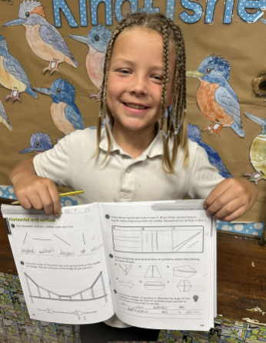
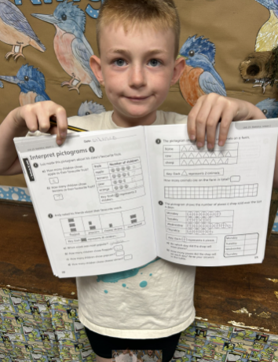
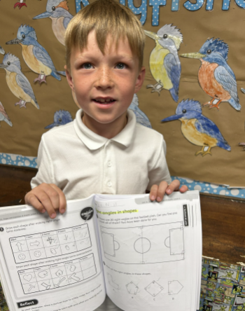
Our Kingfisher Hero
This week I have chosen Killian, Joshua, Rory and Connie. They are my fabulous maths heroes.
During our unit about time and angles, they have shown hard work, perseverance, and resilience. Some of the work hasn't been easy, but they have joined in with class work and showed that they can do the tricky challenges when they keep trying.
Well done maths heroes, keep shining in your maths work! 🌟
﻿

Slide 11
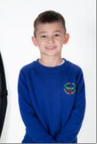
Our Dove Hero
The first Dove hero this week is Max. Max has been working super hard in class all year and has really impressed this week with his ideas and language when we planned our diary entries. We can’t wait to write them and read Max’s. Miss Morrison is pretty sure she will cry!
﻿

Slide 12
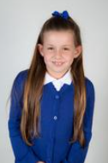
Our Dove Hero
Dove’s second hero is Amelia. She also came up with some fantastic ideas for our diary entries and used some brilliant similes to get the emotions across. Well done Amelia! Get the tissues ready for Miss Morrison.
﻿

Slide 13
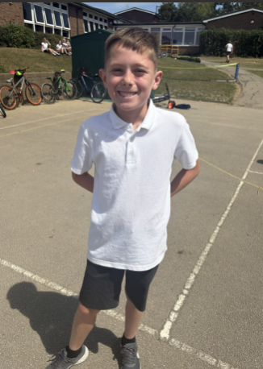
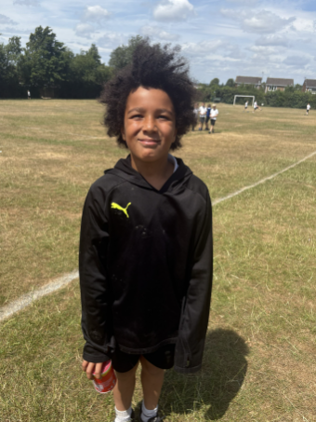
Our Swallow Heroes
This week my heroes are Jackson L and George H.
Jackson has been incredibly helpful throughout his time in Swallow class. Every morning, he helps to set up the classroom and is always happy to help in other ways too.
George has consistently shown a great attitude towards his learning all the way through the year. He has produced some fantastic pieces and he should be incredibly proud of himself.
﻿

Slide 14
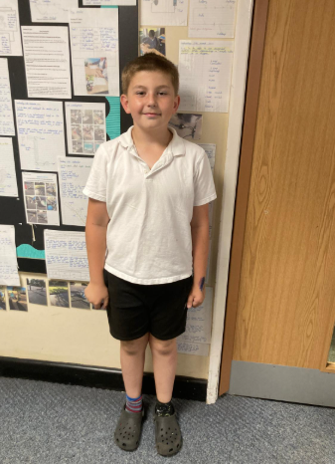
Our Owl Hero
I’m proud to say that Ben is Owl hero this week. He has been trying hard for a few weeks to improve his classroom behaviour and his attitude and he really has achieved that this week. He also had a great week last week when some of the class were in Hathersage. Well done Ben, keep being this better version of you!!!

Slide 15
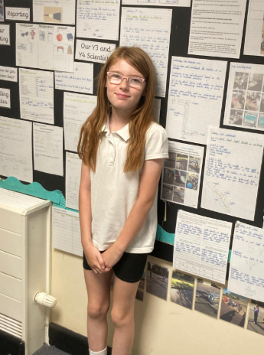
Our Owl Hero
Amber is hero this week for being amazing all of the time. Amber continues to try hard with everything that she does. Her manners are exceptional and every night she says bye to me and tells me to enjoy my evening/ weekend. Amber, you are a lovely individual - keep being you!

Slide 16
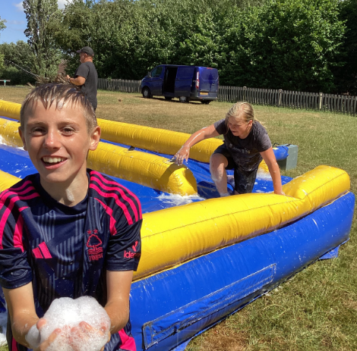
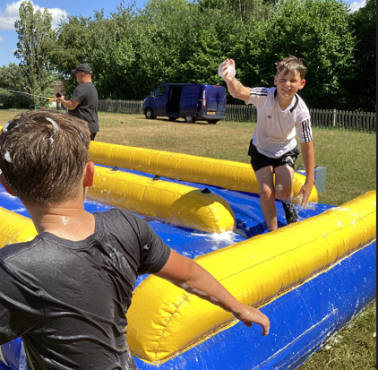
Our Swan Hero
Charlie and Haydn are heroes this week for their great behaviour. Both boys have shown how much they have matured this year and have made so much progress making the right choices, even when it’s the hard thing to do in the moment. I feel proud of the people they have become and know they’re going to start high school with their best foot forward.

Slide 17
Our Swan Hero
Logan is a hero for his sensible but fun-loving behaviour during the Tough Runner water slide afternoon on Wednesday. Logan threw himself into every activity and I loved seeing the smile on his face as he threw himself down the slide! I loved seeing you having an amazing time Logan with all of your friends!

Slide 18
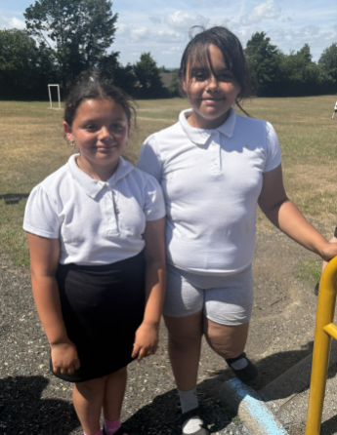
Our Attendance Heroes
Mrs. Leal has nominated Aaliyah and Kailah for a noticeable improvement in their attendance over the last couple of weeks.
Keep it up girls – we love seeing your gorgeous faces in school!

Slide 19
Our Attendance Heroes
CLASS | WIN 1 | WIN 2 | WIN 3
Cygnets 1
Cygnets 2
Puffin
Wren
Woodpecker
Kingfisher
Dove
Swallow
Owl
Falcon
Swan
This week’s winners with 98% are Falcons!!!
Well done Falcons xx

Slide 20
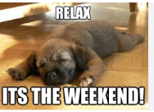
Have a lovely weekend everyone.
Love,
Mrs. Steed xxx

