Slide 1

Welcome to year 3 and 4

Slide 2
Meet the adults…
Teachers:
Kingfisher (Year 3) Mrs Ward
Dove (Year 3 and 4) Miss Quarmby/Miss Morrison
Swallow (Year 4) Mrs Fisher & Mr Beckett
Teaching Assistants:
Mrs Brooks
Mr Close
Mrs Smedley

Slide 3
year 3 and 4 Organisation
Kingfisher is a straight Year 3 class, made up of the youngest year 3 children.
Dove is a mixed class, made up of the oldest year 3 children and the youngest year 4 children.
Swallow is a straight year 4 class made up the oldest year 4 children.
All classes are a mixture of ability, therefore there will be no fixed groupings in class.
All classes across the phase will share the lesson planning, so every class with cover the same content.

Slide 4

Organisation and timetables
8.50am: Doors open and children come up themselves.
Dove classroom door for Dove,
Main door for Kingfisher and Swallow classes.
10.25am: Breaktime for 15 minutes.
11:45 – 12.45 pm Playtime and lunch.
Active 15 in the afternoon
3.30pm collection from the KS2 playground.

Slide 5
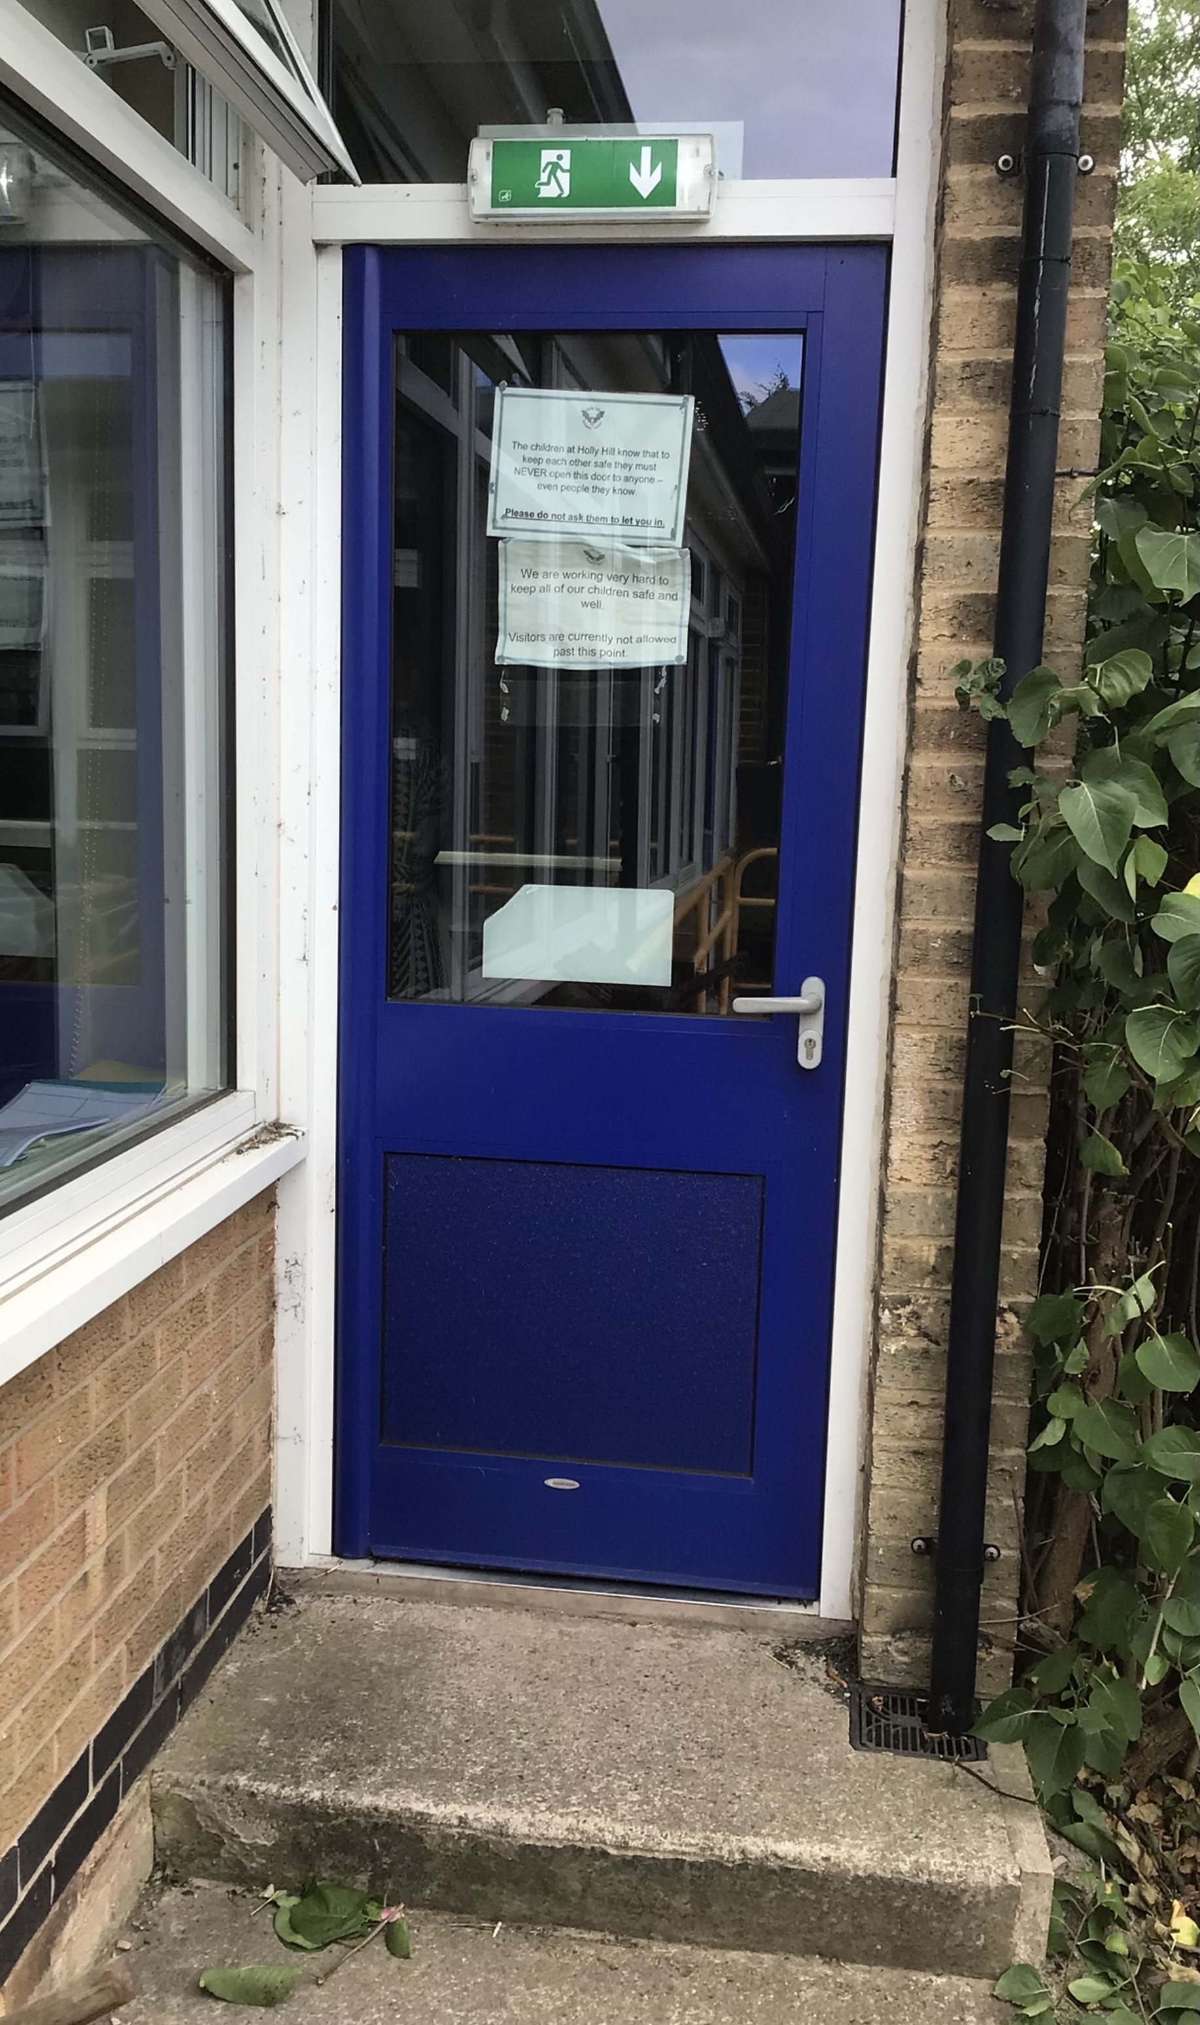
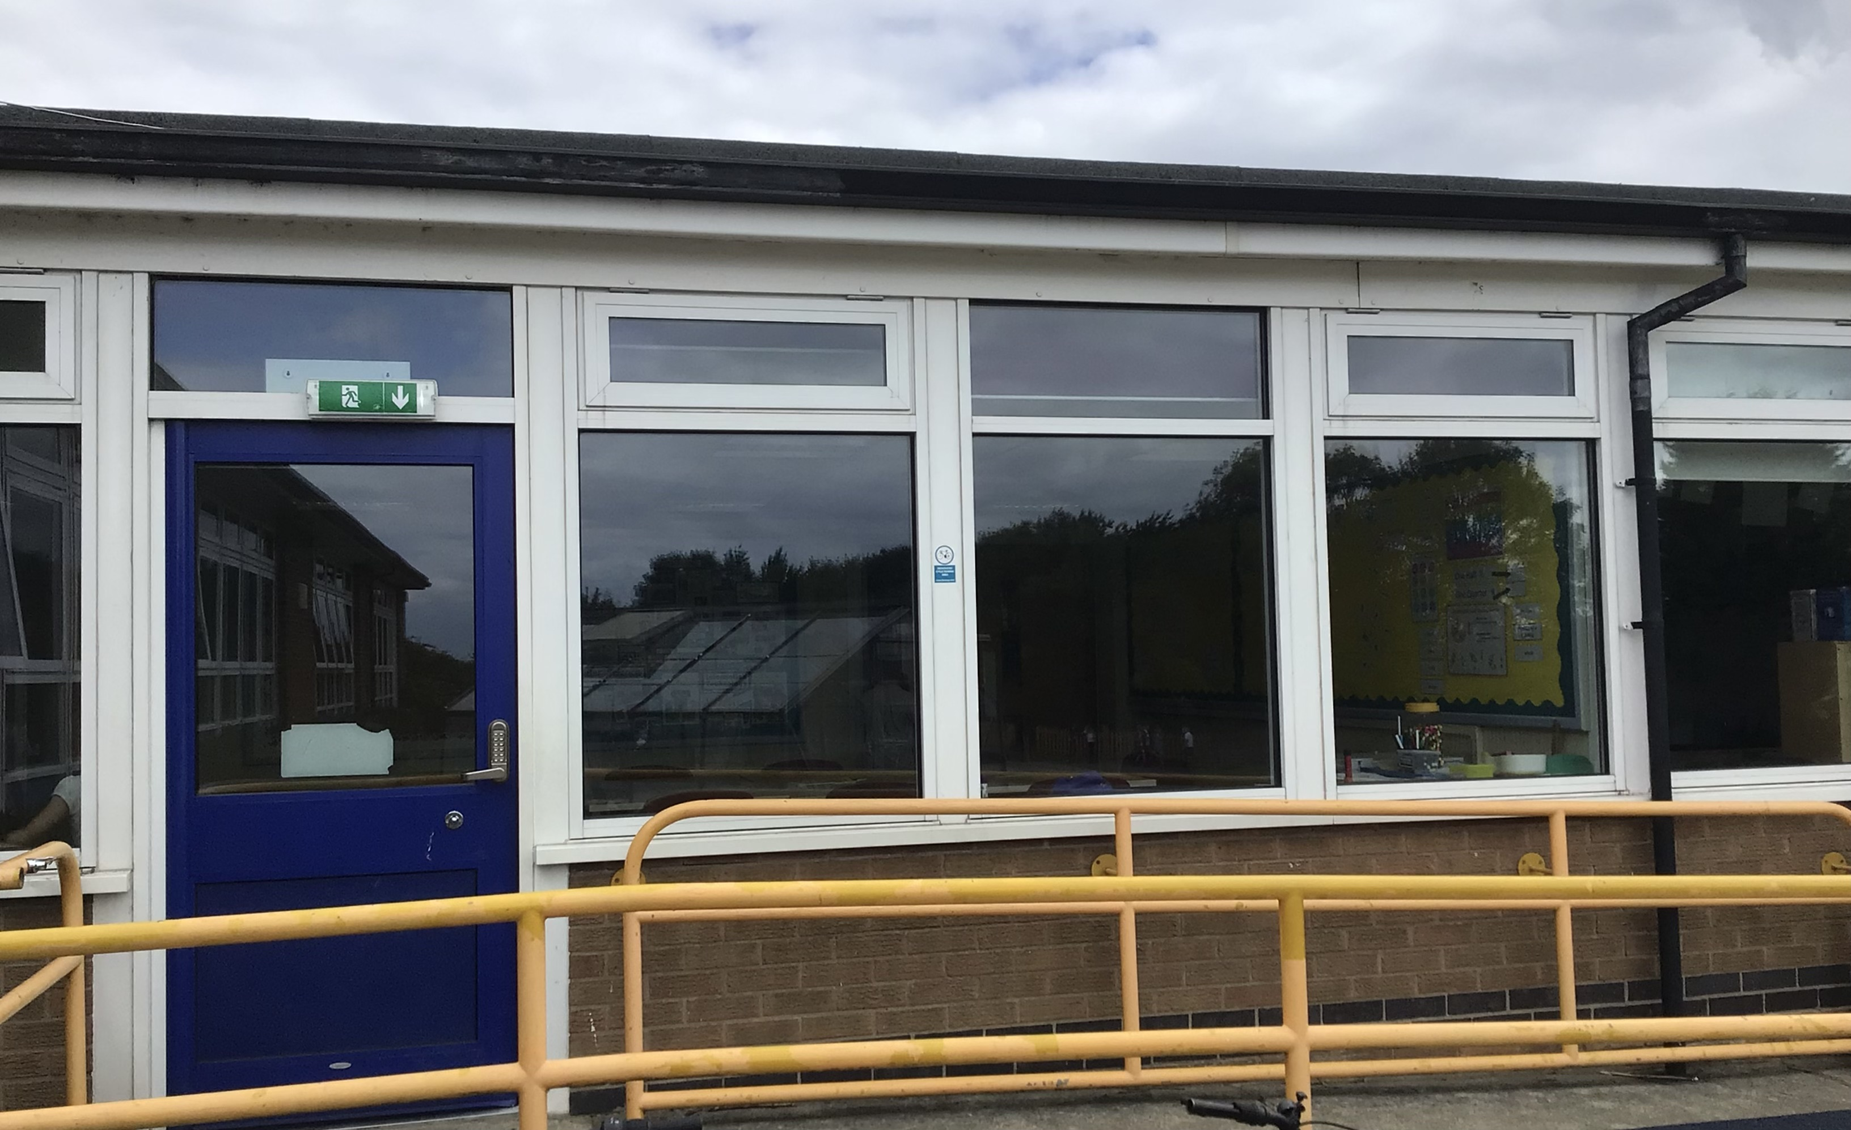
Entrances
These are the two entrances your child will go through.
Dove Class door.
Kingfisher and Swallow

Slide 6

There will be some variation in the weekly timetable between the different classes. ​
​
Each morning at school, the class teacher will display a timetable for the day. ​
​
P.E. kits should be brought to school on Mondays, kept in lockers and taken home on Fridays.
Kingfisher will have PPA on Monday afternoons

Slide 7
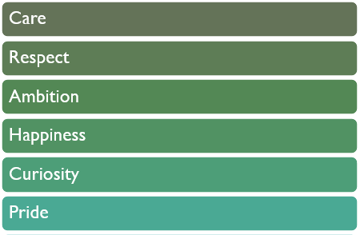
Our values
“Choose to be the best.”

Slide 8

Behaviour Expectations...
We love spotting the positive behaviour of our pupils!
When we see children following the Holly Hill Way we will do some of the following...​
- Tell you we're pleased​
- Send a text to tell your parents​
- Send a note or postcard home to show off​
- Make you a Holly Hill Hero in assembly​
When we notice pupils not following the Holly Hill Way, we will always give you a reminder and some time to make a better choice- we don't want anyone to get in trouble!​
For pupils that continue to make bad choices, they may need to miss some, or all of their breaktime in order to think about what needs to happen to 'make it right' and talk it through with their teacher. A full behaviour policy is on the school website.

Slide 9
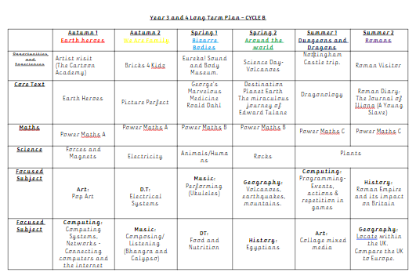
Curriculum Part 1
This plan shows the subjects we plan to study in the next academic year.
Though there may be odd changes to individual areas, this plan is the first in a 2-year rolling plan to ensure that by the time children leave Y4, they have covered all aspects of the National Curriculum.
Focused subjects will be taught in more detail over a series of lessons.

Slide 10
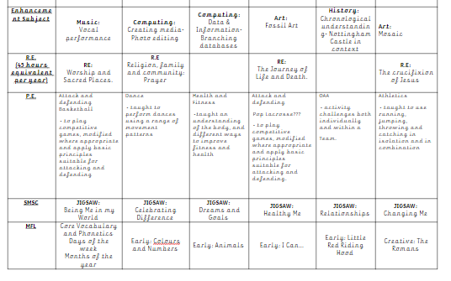
Curriculum Part 2
.
MFL will be taught using the Language Angels scheme for French.
Enhancement subjects are one-off lessons that help to deepen understanding of a topic or theme.
SMSC continues to be taught using the Jigsaw scheme.

Slide 11



Maths
Maths:
This year, we will be continuing our Power Maths journey! The children will be familiar with this style of Maths lesson, as it is the same across the whole school.
Power Maths encourages practical Maths work with lots of problem solving practise.
Dove class will follow the Power Maths for their own year groups.
Times Table Rockstars and Mathletics will be used to enhance pupil’s learning and can be accessed at home!

Slide 12

Times tables
Multiplication Check:
The Year 4s are expected to carry out the National Multiplication Check at the end of Year 4.
25 questions- 6 seconds each – up to 12X12
We will practise the timetables from Year 3 upwards, daily.
2 weeks in June
A parents’ information meeting will be held next year.

Slide 13

English
You will see on our long term plan that we have detailed the books that we will be studying in class. These are carefully chosen to develop reading for enjoyment and understanding, as well as being the focus of our written work in English.​
The first text that we will be using in our English lessons will be Earth Heroes.​
If your child does have their own copy, please do not read them before school starts! This won't give much of a head start, but it will definitely spoil some of the suspense and excitement as we find out what happens!​

Slide 14

Reading
In Year 3/4 we love of reading!
Book Bands accessible in classrooms and can be taken home
To support our developing readers, we have invested in some phonics books for older pupils- leave in school
Access to the library
Book corners in each classroom
High-quality class texts for daily story time.
See our recommended read lists!

Slide 15

Homework
10 spellings (National Curriculum/ topic vocabulary) tested weekly - to be practised at home.
Times tables tested weekly - to be practised at home.
Read as much as you can!
Mathletics and TT Rockstars logins will be given out / stuck into diaries in September.

Slide 16
Special things that may happen:
Swimming for Year 3 and 4!
The year 4 children will be invited to attend a residential in Hathersage, Peak District, in December.
At Christmas, we hope to run a performance and we celebrate with week dedicated to Christmas treats and surprises.
An experience or trip each term, linked to the topic.

Slide 17

OTHER INFORMATION
We do take photographs and videos to put on the school website. This is to celebrate the children’s achievements. Please make sure you have signed the consent forms.
A text message service is used to keep you updated.
Attendance - please remember to notify school if your child is poorly or absent for the day.

Slide 18

OTHER INFORMATION
School uniform is to be worn every day – a uniform list can be found on the website.
School P.E kit must be kept in school from Monday to Friday - no jewellery for PE lessons. This is very important. Please ensure your child has a PE kit for inside and outside.
Jewellery in school must be kept small – studs etc.
We ask that the children don’t have painted nails etc.
Children are provided with everything they need in class so they will not need to bring pencil cases etc.

Slide 19
How to contact us
We will happily talk to you. You can always catch us on the playground at the end of the day.
Other communication can be made via phone call, message in Reading Diary or an appointment.
If something happens in school (illness or injury) we will phone you.
If there is no answer, we will leave a message and endeavour to call again.

Slide 20

Any questions?
Please ask us if you have any other questions.
We will be available after the meeting.
We are always happy to answer any queries.

