Slide 1

Notes:
Title page – text only

Slide 2
What is a charity?
An organisation set up to provide help and raise money for those in need.
The NSPCC is a charity who want to help every child to have a safe and happy childhood.
Notes:
Title page – text only

Slide 3



Notes:
Explain that your school will be joining hundreds of other schools across the UK to take part in Number Day and to raise money for the NSPCC
Ask if anyone has heard of the NSPCC ? Does anyone know what the initials NSPCC stand for?

Slide 4

Notes:
For example National = The NSPCC works all over the country,

Slide 5

Notes:
Society = is like a group of people who have come together, some pupils may be members of their local scouts or brownies. A society is another word for a group of people,

Slide 6

Notes:
Prevention = another word for prevention is ‘stop’,

Slide 7

Notes:
Cruelty = another word for cruelty could be mean, nasty, horrible (to expand on this section you could run through the different types of harm in the appendix)

Slide 8

Notes:
Children = ask the pupils what age do you stop being a child? The answer is 18

Slide 9
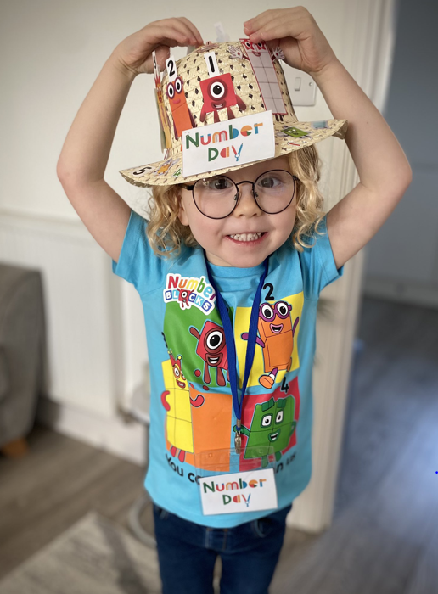
Keeping children safe is why the NSPCC is here:
When a child needs a helping hand, they’ll be there.
When parents are finding it tough, they’ll help.
When laws need to change, or governments need to do more, they won’t give up.
Notes:
Keeping children safe is why the NSPCC is here. That’s what drives their work, and that’s why – as long as children need support – they will fight for every childhood.
So when a child needs a helping hand, they’ll be there.
When parents are finding it tough, they’ll help.
When laws need to change, or governments need to do more, they won’t give up.

Slide 10


Childline gives children
and young people a voice
Online, on the phone, anytime
0800 1111
childline.org.uk
Notes:
Childline
It is really important to speak out to a safe adult or grown up if you are ever worried, upset or need to talk.
Childline, a service provided by NSPCC is also there to listen to children and young people, whatever their worry, whenever they need help.
On average, a child contacts Childline every 45 seconds – they can talk about anything, and often it’s a problem they feel they can’t talk to anyone else about. A child or young person can contact Childline, they can do this by calling 0800 1111 or visiting childline.org.uk
Childline is open 24 hours a day, 365 days a year, it’s never closed.
The fundraising we are doing in school is helping to pay for the NSPCC’s services that include the Speak out Stay safe programme and Childline.
Use this slide as required.

Slide 11

^{Our Number Day Event}
^{Friday 6th February 2026}
Dress up for Digits
Play time games
Fun classroom activities
Notes:
The NSPCC has many other services across the UK that you will be helping to raise money for. Make the link between maths / numbers and helping children raise money for other children
It takes a lot of time and a lot of money to ensure that Childline and NSPCC’s other services are there every day for children and young people. Our school is joining hundreds of others to take part in NSPCC Number Day and help raise money for children.
Please insert the details of your schools Number Day event:-
What activity you are doing (Teacher: Have a look at our fun new Buddy’s Key Challenge sponsored event – find out more at www.nspcc.org.uk/numberdayresources)
The amount of time your class is dedicating to Number Day (a lesson or a whole digit day!)
Who will be taking part – teachers and parents can join in too
Why not ask the School or Pupil Council to help organise the event and make a display
You could send a covering letter to parents (template available to download) to explain about the purpose of NSPCC Number Day and to generate their support.
You can also use the posters and press releases from the Number Day website to promote your event.
Raise money and donate using the details in your welcome letter or using GiftT QR code, ParentPay or JustGiving

Slide 12
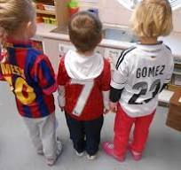
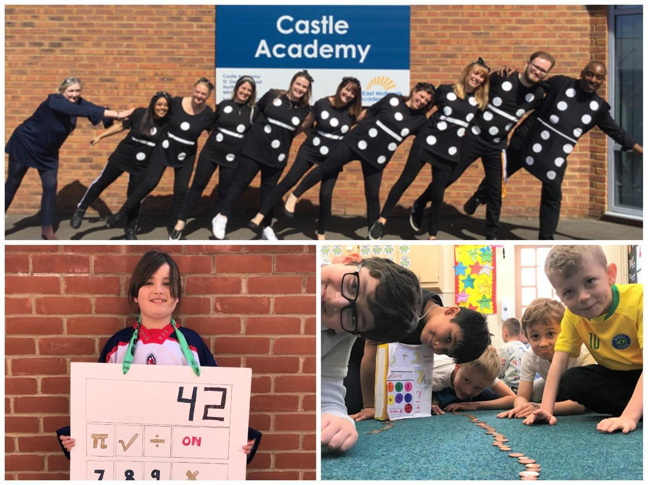
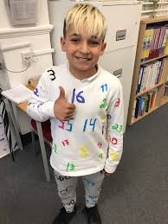
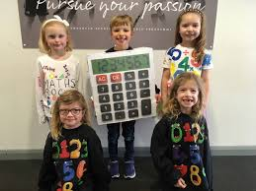

Slide 13
^{Play time competitions- 50p}
How many sweets in the jar?
How much does the treat bag weigh?
Choose your favorite number- will it be one of 5 winners?
Throw the beanbags in the hoops
Scoring goals against children in Y6
How long is the snake?
Notes:
The NSPCC has many other services across the UK that you will be helping to raise money for. Make the link between maths / numbers and helping children raise money for other children
It takes a lot of time and a lot of money to ensure that Childline and NSPCC’s other services are there every day for children and young people. Our school is joining hundreds of others to take part in NSPCC Number Day and help raise money for children.
Please insert the details of your schools Number Day event:-
What activity you are doing (Teacher: Have a look at our fun new Buddy’s Key Challenge sponsored event – find out more at www.nspcc.org.uk/numberdayresources)
The amount of time your class is dedicating to Number Day (a lesson or a whole digit day!)
Who will be taking part – teachers and parents can join in too
Why not ask the School or Pupil Council to help organise the event and make a display
You could send a covering letter to parents (template available to download) to explain about the purpose of NSPCC Number Day and to generate their support.
You can also use the posters and press releases from the Number Day website to promote your event.
Raise money and donate using the details in your welcome letter or using GiftT QR code, ParentPay or JustGiving

Slide 14


Notes:
Explain what your number crunching, digit day event is and how the children will be raising money by either collecting sponsors or asking for donations
In your fundraising pack there is a sample sponsor form which can be photocopied. The sponsor form can also be downloaded from the Number Day website.
£4 could pay for one of our trained volunteer counsellors to answer a child's call for help to Childline.
£400 could pay for one of our trained volunteer counsellors to answer 100 calls to Childline.
£4 could pay for one of our trained volunteer counsellors to answer 300 calls to Childline.

Slide 15

Raise money
and have fun!
Notes:
We will receive a certificate showing how much sponsorship the whole school has raised doing Buddy’s Key Challenge, and what the money will be spent on.

Slide 16

Notes:
Key Messages:
Hands up - who enjoys playing board games or cards? Or watching, “Countdown”, “Pointless”, “Catchphrase”, “Tipping Point” or “The Cube”.
Ask the children if they enjoy watching and playing Number based games and quizzes and to explain why they enjoy these games and programmes. They may offer answers such as “They are fun/interesting”. “I like watching them with my friends and family” or you can learn from them.
Take a variety of responses and use their answers to draw out what they can learn from playing such number games.
The children may offer answers like: “You can learn about counting, adding, subtracting, taking turns, strategy etc..”
Try to establish the link between the ideas of number games and the enjoyment and learning about maths. Once you feel you have established a context for introducing the subject of the assembly, tell them that on Friday 2 February (or on another day that suits) everyone in school will have the chance to enjoy some number games and maths activities to celebrate Number Day and that “All over the Country’ other schools will be doing the same: celebrating how much fun maths can be”.
Once the children are interested and motivated to take part in Number Day, explain to them that there is another reason why taking part is so important to them – they will “have the opportunity to raise money for thousands of children all over the country who are being helped by a charity called the NSPCC”.

Slide 17

©NSPCC 2023. National Society for the Prevention of Cruelty to Children. Registered charity England and Wales 216401,
Scotland SC037717 and Jersey 384. Photography by Tom Hull, Harry George Hall, and Adrian James White. Children and adults
pictured are models and volunteers. Photography includes a real-life NSPCC Childline counsellor, Sarah Murphy. J2023009.
Notes:
End slide option 1

