Slide 1


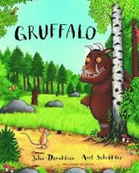


Reading at
Holly Hill
Mrs Watson
Wednesday 5th October

Slide 2
What do we do at Holly Hill?
Phonics daily (Foundation and KS1)
3 x Group Reads per week (Foundation/ KS1)
Story time daily
Story assembly weekly
English lessons with lots of reading
Whole class reading KS2

Slide 3
We spend lots of money on books!!
We have spent thousands on books for Early Reading
Please encourage the children to look after the books and send them back to school daily

Slide 4
Whole Class Reading
One text per class
Challenging texts
Teacher reading to the class – modelling fluency and expression
Children take over the reading out loud
Children have time to read independently
Questions related to the text
The benefits are huge. All children read 5 times a week instead of once.
Children still need decoding receive intervention support

Slide 5
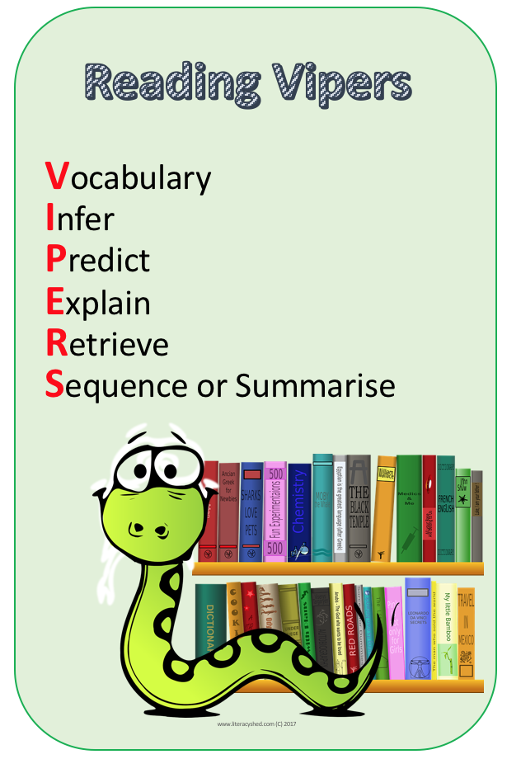
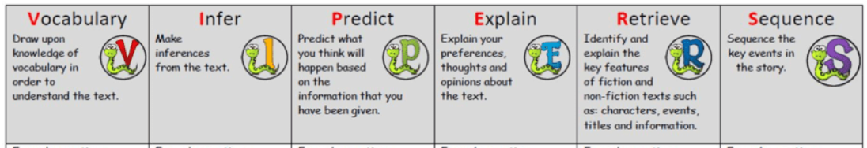

Slide 6
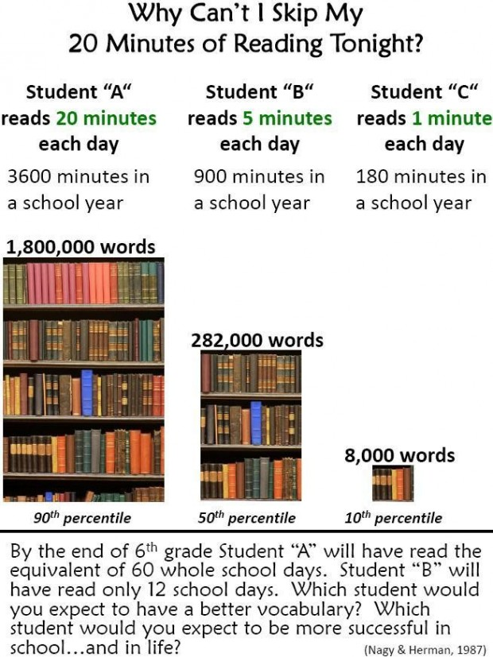
Why do we need to read to our children and hear them read?

Slide 7
What can you do at home?
  Read to them as much as you can
  Talk to the children lots! Drown the children in language. IT IS SOOOOOO IMPORTANT!
  Get the children to tell you lots of stories.
  Use phonics and play lots of language games
  Listen to the children read. Encourage the children to read well and model good reading for them.
  Ask lots of questions about the books they bring home.
  Get them to predict what could happen next,
  Discuss the characters.
  Ask them to summarise what the book was all about.

Slide 8
How to Read with your child
https://www.youtube.com/watch?v=-OG2Q6pPQYw

Slide 9
Reading Really is Fundamental
No one is going to debate the importance of being able to read in order to learn and navigate through life. But reading provides many surprising and important additional benefits
Reading makes kids better at maths. A British study found that students who frequently read for pleasure not only had better vocabulary and spelling—which is to be expected—but that those students were also more proficient at maths. The theory is that reading exposes students to new ideas, which may make new maths concepts easier to comprehend.
Reading fiction helps children be more empathetic. Research has shown that students who read books could put themselves into other people’s situations more easily, and had increased compassion.
Reading can boost self-esteem and communication skills- students who read usually have an enhanced vocabulary, they can often find the words to express themselves and do not feel as frustrated and angry.
Reading changes the structure of the brain. In a six-month daily reading program, scientists found that the amount of white matter in the area of the brain associated with language actually increased. Another study found that reading helps the brain exercise cognitive function.

Slide 10
Reading impacts on:
• overall literacy ability including writing ability and reading related skills such as text comprehension
• attainment across the curriculum in subjects such as maths and science
• higher level comprehension skills necessary for educational success
• the likelihood of completing education
the likelihood of employment

Slide 11
Vocabulary is soooooo important!!
The “30 million word gap” refers to a research study conducted by psychologists Betty Hart and Todd Risley.
Their study showed that children from some families had a staggering 30 million fewer words than children from families where speech and language is rich and varied by the time they are 4 years old
Children from a language rich family hear, on average, 2,153 words per hour compared to 616 words per hour

Slide 12
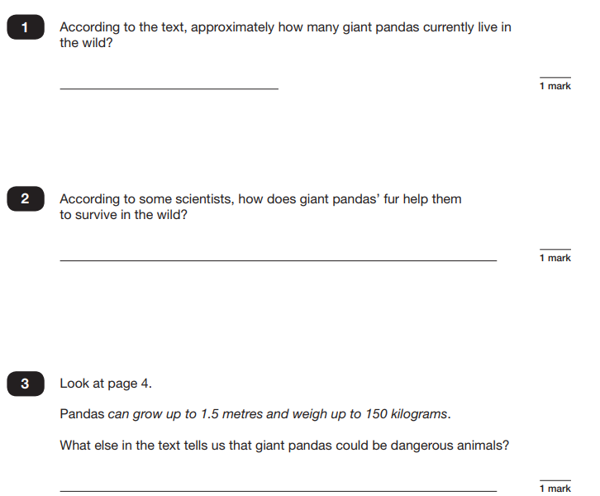
SATs Reading

Slide 13
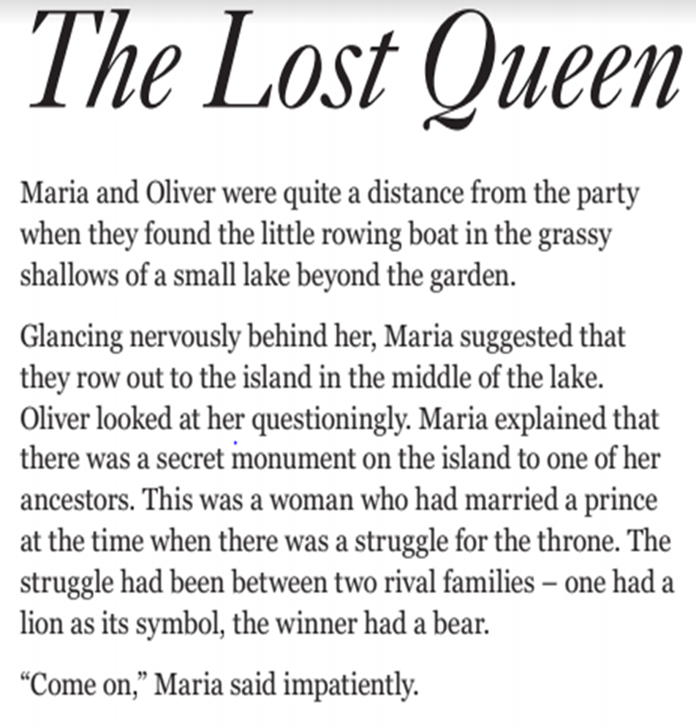
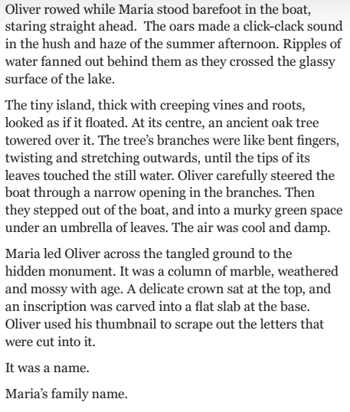

Slide 14
Finally… Why is it important to listen to our children read and promote a love of reading?
https://www.youtube.com/watch?v=kul-g_30HuU

Slide 15
Thank you so much for listening.

