Slide 1





Reading at
School and
Home
Mrs Watson
Wednesday 20th September

Slide 2
What do we do at Holly Hill?
Phonics daily (Foundation and KS1)
3 x Group Reads per week (Foundation/ KS1)
Story time daily
Story assembly weekly
English lessons with lots of reading
Whole class reading KS2

Slide 3
Whole Class Reading (KS2)
One text per class
Challenging texts
Teacher reading to the class – modelling fluency and expression
Children take over the reading out loud
Children have time to read independently
Questions related to the text
The benefits are huge. All children read 5 times a week instead of once.
Some children require Little Wandle intervention

Slide 4
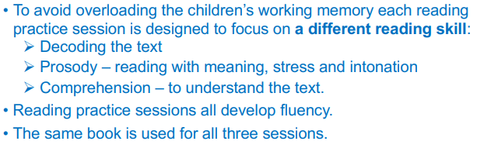
Reception and KS1 Reading Groups

Slide 5
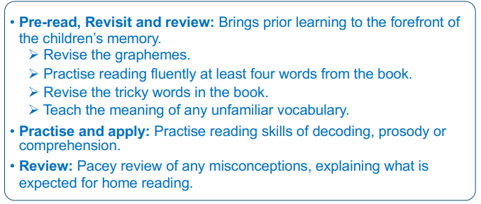
The structure of each reading session..

Slide 6
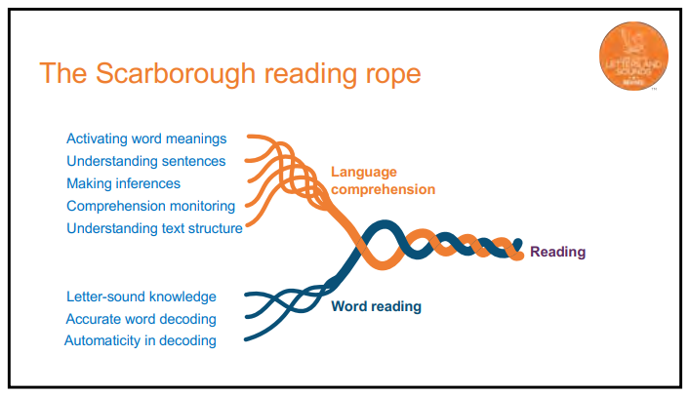

Slide 7
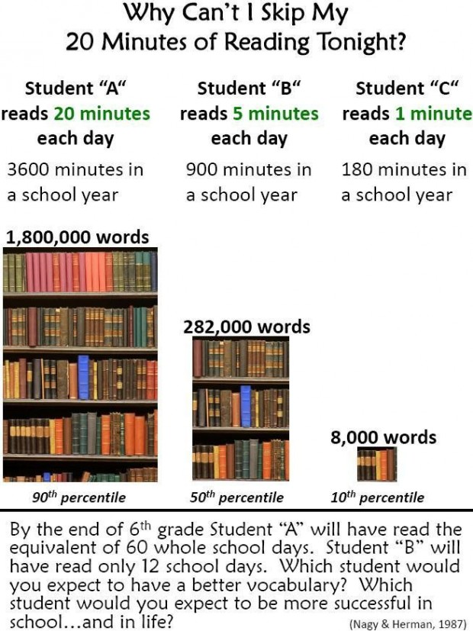
Why do we need to read to our children and hear them read?

Slide 8
Supporting your child at home
Although your child will be taught to read at school, you can have a huge impact on their reading journey by continuing their practice at home.
There are two types of reading book that your child may bring home:
A reading practice book. This will be at the correct phonic stage for your child. They should be able to read this fluently and independently.
A Reading for Pleasure Book. Your child will not be able to read this on their own. This book is for you both to read and enjoy together.

Slide 9
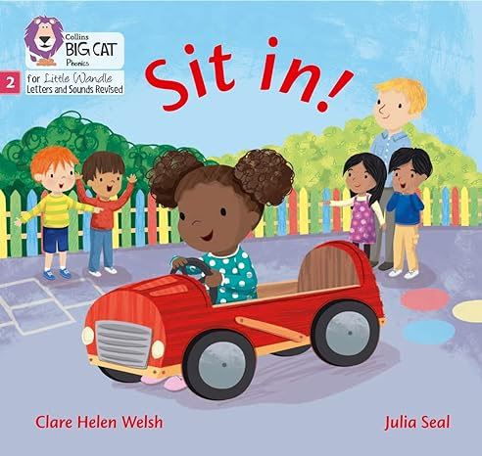

Reading practice book
Reading for Pleasure book

Slide 10
Reading Practice Book
This book has been carefully matched to your child’s current reading level.
If your child is reading it with little help, please don’t worry that it’s too easy – your child needs to develop fluency and confidence in reading.
Listen to them read the book.
Remember to give them lots of praise – celebrate their success!
If they can’t read a word, read it to them.
After they have finished, talk about the book together.
We aim for our children to read 5 times a week in total.

Slide 11
Reading for Pleasure Book (Sharing Book)
In order to encourage your child to become a lifelong reader, it is important that they learn to read for pleasure.
The Reading for Pleasure Book is a book they have chosen for you to enjoy together.
Please remember that you shouldn’t expect your child to read this alone.
Read it to or with them.
Discuss the pictures although avoid any over-reliance on these
Enjoy the story together and get comfy!
Stop the children at points throughout the read and model predicting what might happen next. Get the children to do this.
Use different voices for the characters.
Explore the facts in a non-fiction book.
Discuss new vocabualry
Ask questions at the end.
The main thing is that you have fun!

Slide 12
Pure Sounds
https://www.littlewandlelettersandsounds.org.uk/resources/for-parents/

Slide 13
Finally… Why is it important to listen to our children read and promote a love of reading?
https://www.youtube.com/watch?v=kul-g_30HuU

Slide 14
Thank you so much for listening.

