Slide 1







Reading at Home with KS2 children
Mrs Watson
Wednesday 27th September

Slide 2
What do we do at Holly Hill?
Phonics daily (Foundation and KS1)
3 x Group Reads per week (Foundation/ KS1)
Story time daily
Story assembly weekly
English lessons with lots of reading
Whole class reading KS2
Keep up and catch-up interventions

Slide 3
Whole Class Reading (KS2)
One text per class
Challenging texts
Teacher reading to the class – modelling fluency and expression
Children take over the reading out loud
Children have time to read independently
Questions related to the text
The benefits are huge. All children read 5 times a week instead of once.
Some children require Little Wandle intervention

Slide 4
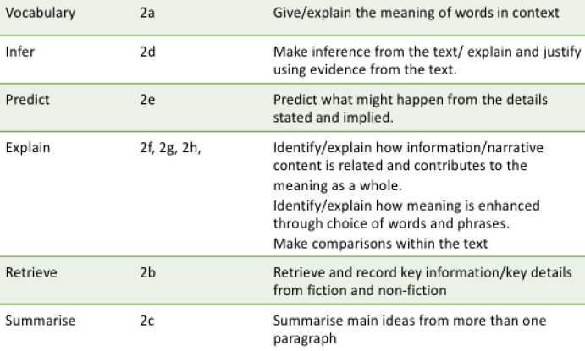
Reading Skills development in School

Slide 5
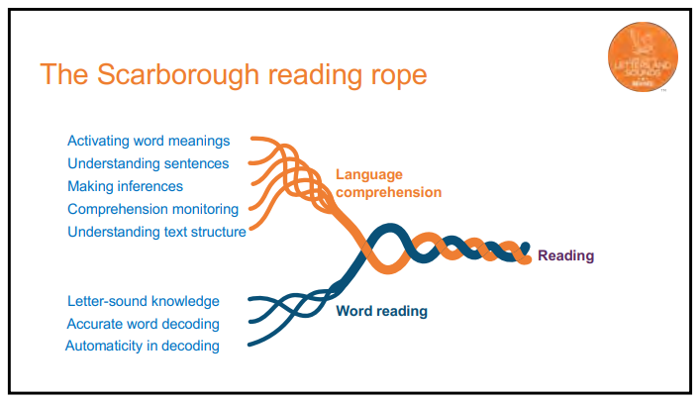

Slide 6
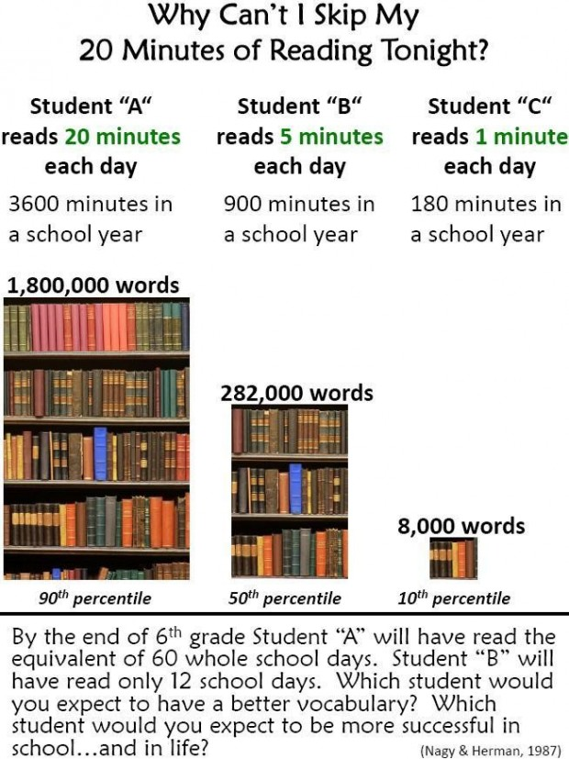
Why do we need to read to our children and hear them read?

Slide 7
KS2 Expectations
Children read at school every day
Read at home 5 times a week
Children can choose anything to read
Enjoy reading together
Be relaxed
Make reading common practice

Slide 8
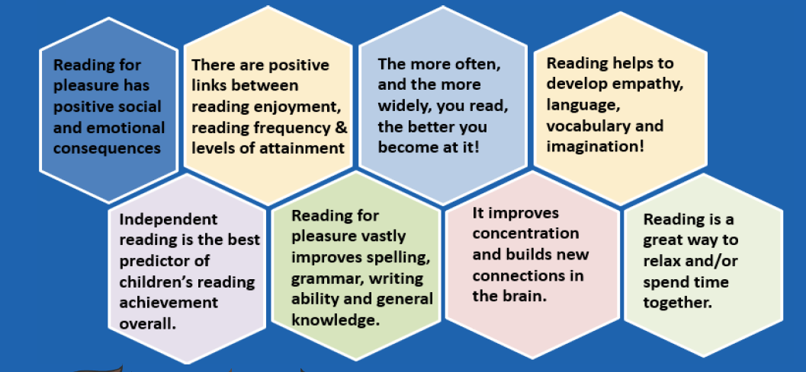
Why should KS2 children continue to reading journey?

Slide 9
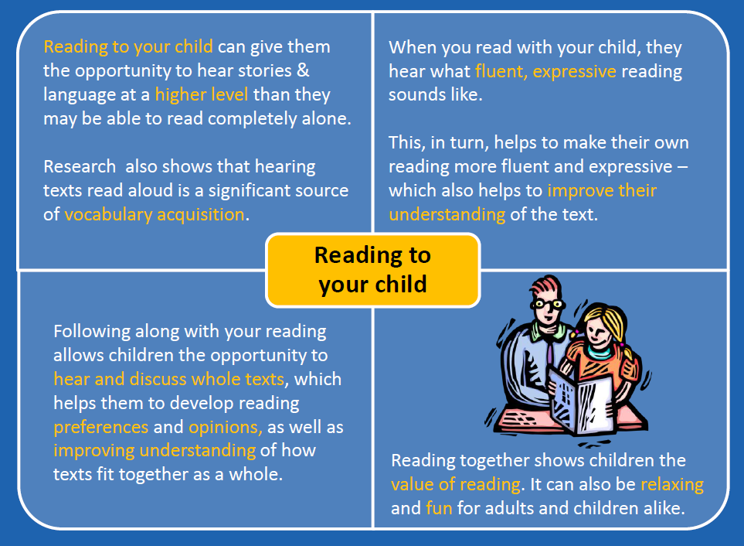
Reading to and with your child

Slide 10
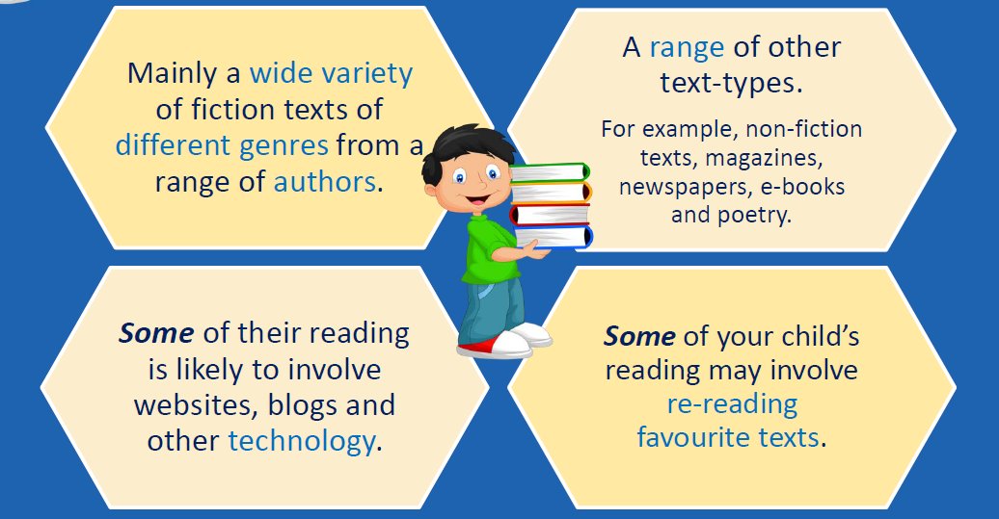
What can children read at home?

Slide 11
Reading for Pleasure Book (Sharing Book)
In order to encourage your child to become a lifelong reader, it is important that they learn to read for pleasure.
The Reading for Pleasure Book is a book they have chosen for you to enjoy together.
Please remember that you shouldn’t expect your child to read this alone.
Read it to or with them.
Discuss the pictures although avoid any over-reliance on these
Enjoy the story together and get comfy!
Stop the children at points throughout the read and model predicting what might happen next. Get the children to do this.
Use different voices for the characters.
Explore the facts in a non-fiction book.
Discuss new vocabualry
Ask questions at the end.
The main thing is that you have fun!

Slide 12
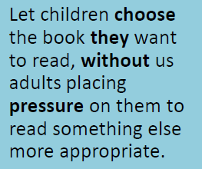
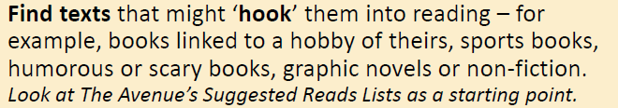
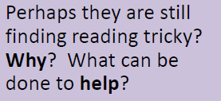
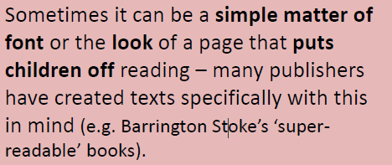
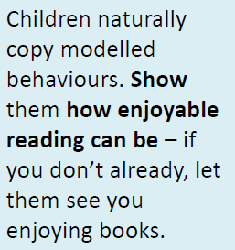

Reluctant Readers

Slide 13
Thank you so much for listening.

