Slide 1




Reading at
Holly Hill and
Home
Mrs Watson
Wednesday 1st October

Slide 2
Are you a reader?

Slide 3
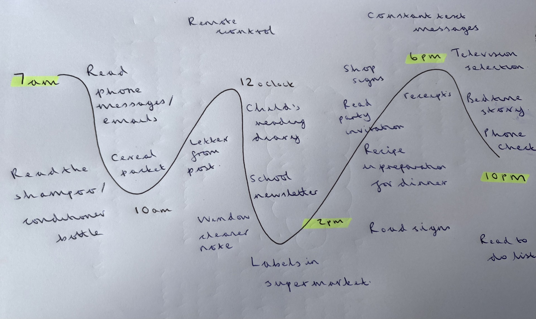
Reading Journey

Slide 4

What do we do in KS1 and Foundation Stage?
Phonics daily Little Wandle
Younger children- Little Wandle Foundations for Phonics
3 x Group Reads per week (Foundation/ KS1)
Story time daily
English with core books
New Writing Sequence

Slide 5
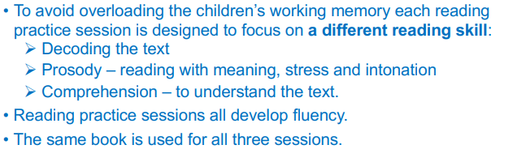
Reception and KS1 Reading Groups

Slide 6
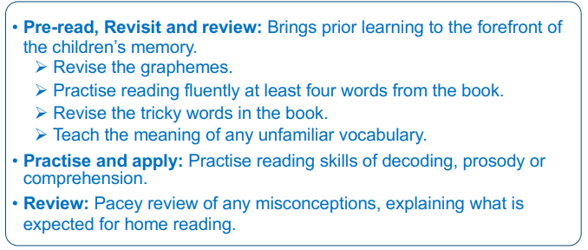
The structure of each reading session..

Slide 7
KS2
Story time daily
Story assembly weekly
English lessons with lots of reading
Whole class reading KS2
Phonics catch up interventions for those who need it

Slide 8
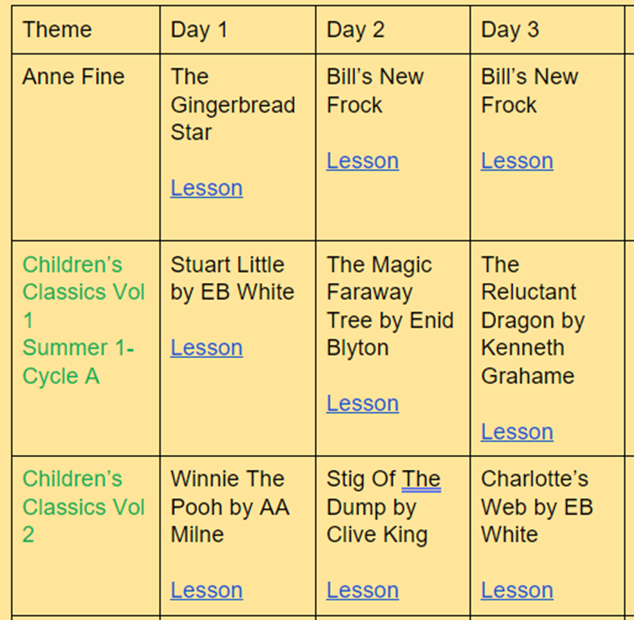
KS2 Whole Class Reading Lesson
Whole class novel
Whole class reading at the same time
Vocabulary check
Quick start quiz
Partnered talk
Individual thinking
Solo work
Class novel sessions

Slide 9

Our aim:
Learn to e

Slide 10
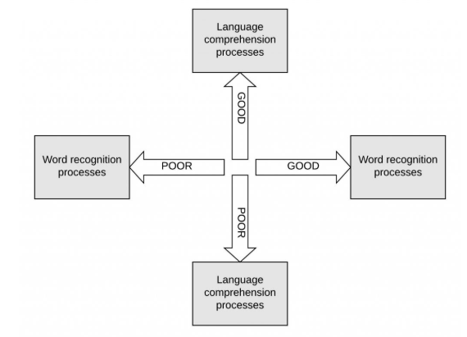
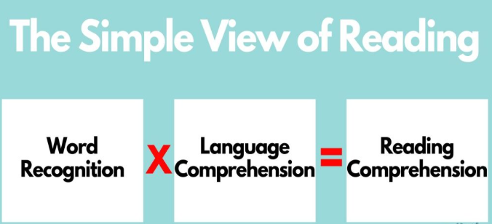
The Simple View of Reading

Slide 11
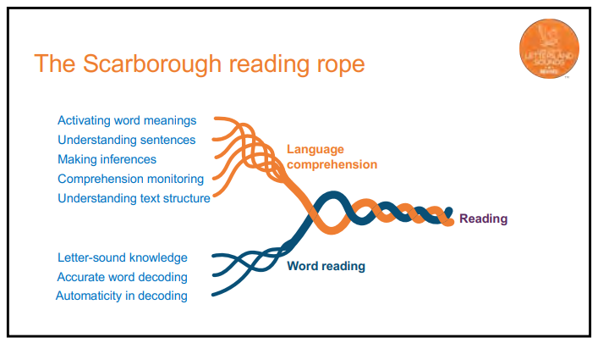

Slide 12
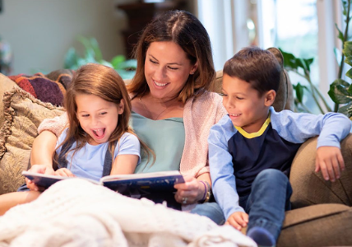
Why read at home?

Slide 13
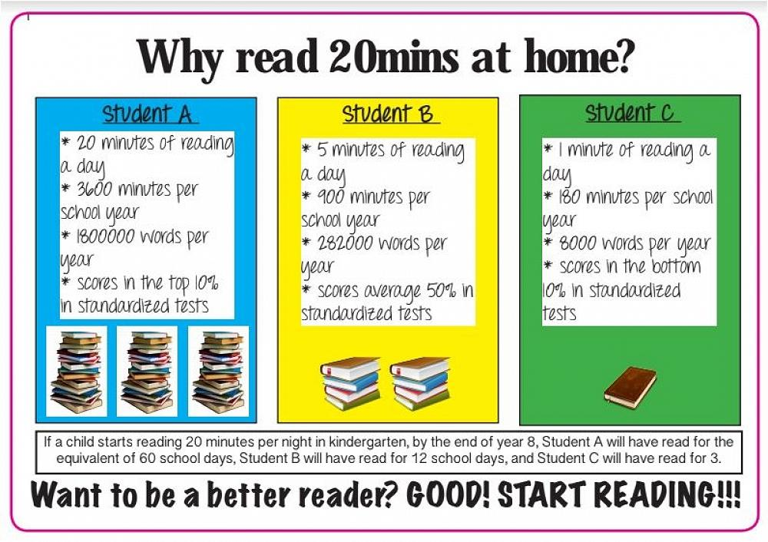
Why do we need to read to our children and hear them read?

Slide 14
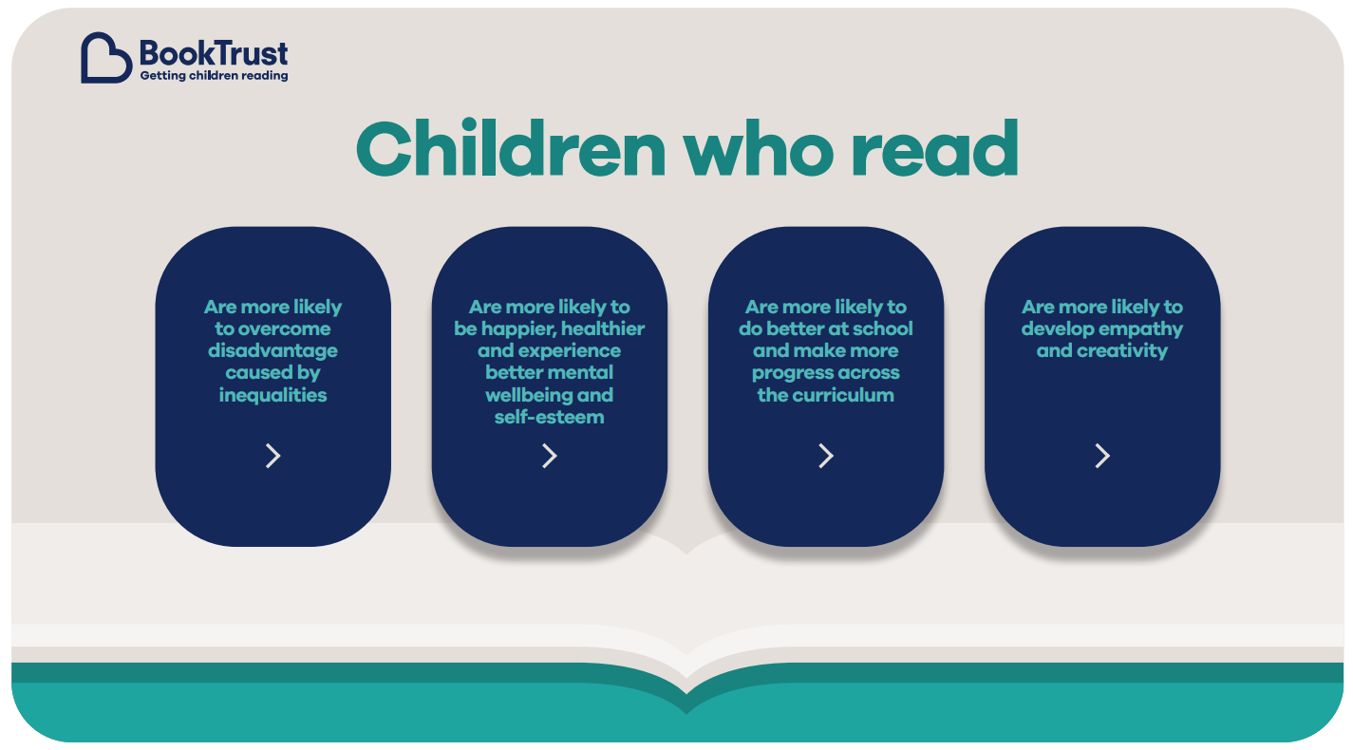

Slide 15
Supporting your child with reading at home
Although your child will be taught to read at school, you can have a huge impact on their reading journey by continuing their practice at home.
There are two types of reading book that your child may bring home:
A reading practice book. This will be at the correct phonic stage for your child. Some children will have a wordless book. Some Key Stage Two children will be reading book banded books. Some KS2 children will be Free Readers and at a point where they can select from age appropriate books.
A Reading for Pleasure Book. Your child will not be able to read this on their own. This book is for you both to read and enjoy together.

Slide 16
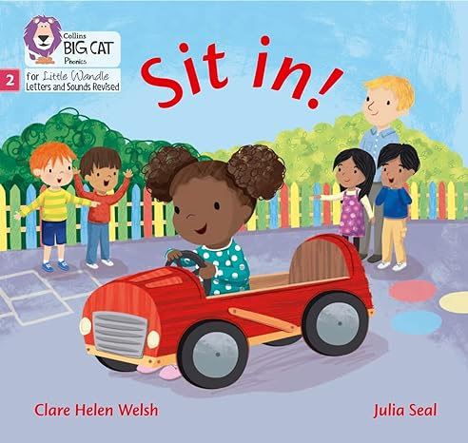

Reading practice book
Reading for Pleasure book

Slide 17
Reading Practice Book
This book has been carefully matched to your child’s current reading level.
If your child is reading it with little help, please don’t worry that it’s too easy – your child needs to develop fluency and confidence in reading.
We are aiming for 95% fluency (this means children can decode familiar words without effort allowing them to concentrate on comprehension and prosody)
Listen to them read the book.
Remember to give them lots of praise – celebrate their success!
If they can’t read a word, read it to them.
After they have finished, talk about the book together.
We aim for our children to read 5 times a week in total.
Children will get a treat for reading 5 times.

Slide 18
Reading for Pleasure Book (Sharing Book)
In order to encourage your child to become a lifelong reader, it is important that they learn to read for pleasure.
The Reading for Pleasure Book is a book they have chosen for you to enjoy together.
Please remember that you shouldn’t expect your child to read this alone.
Read it to or with them.
Discuss the pictures although avoid any over-reliance on these.
Enjoy the story together and get comfy!
Stop the children at points throughout the read and model predicting what might happen next. Get the children to do this.
Use different voices for the characters.
Explore the facts in a non-fiction book.
Discuss new vocabulary
Ask questions at the end.
The main thing is that you have fun!

Slide 19
Thank you so much for listening.

