Slide 1

Welcome to Holly Hill
Foundation Unit!

Slide 2
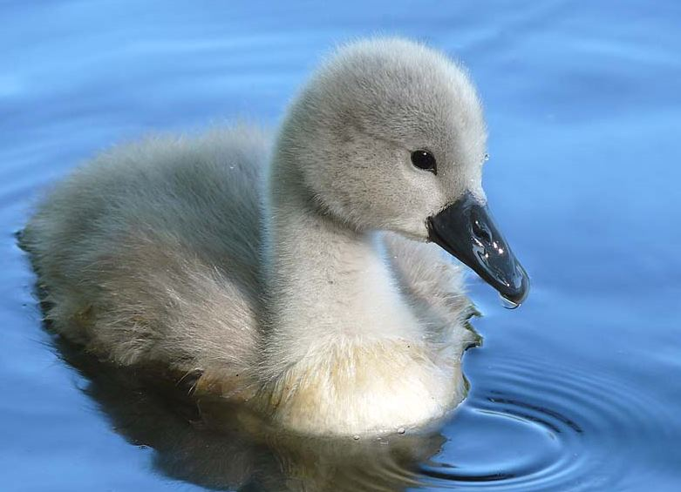
We are called the
Cygnets!

Slide 3
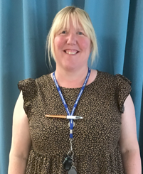
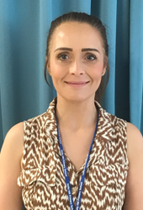
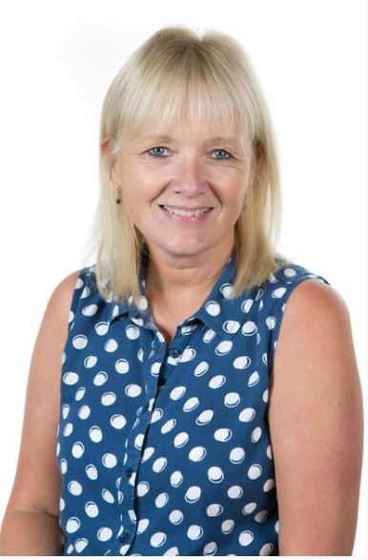
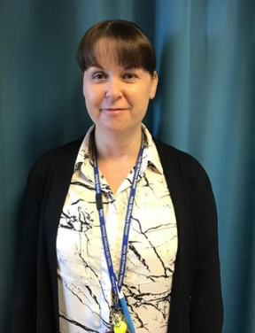
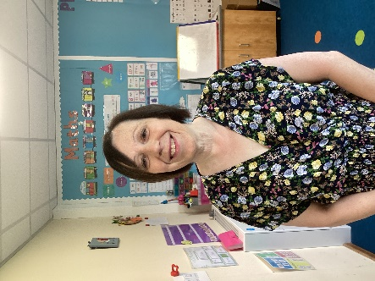
Meet the Team
Mrs Fox
Class 1 Teacher
Mrs Jeffery
Class 2 Teacher
Mrs Clay
Learning Support
Mrs Gorewoda
Learning Support
Mrs Wilcoxson
Learning Support

Slide 4
Transition Visits
Monday 30th June at 9-11am-Parent to stay and play.
Tuesday 1st July at 9-11am-Child to stay without parent.
Start Dates
Wednesday 3rd September
If your child is starting full time with us, you are welcome to collect them at 1.30pm during the first full week. Please just let us know.

Slide 5
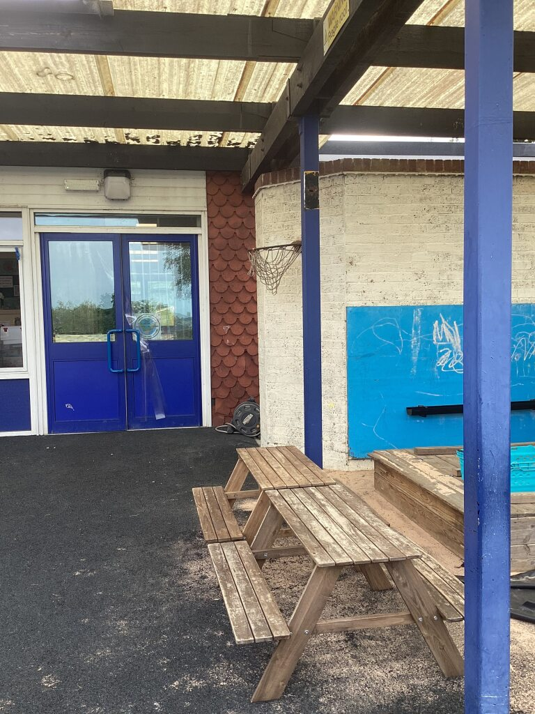
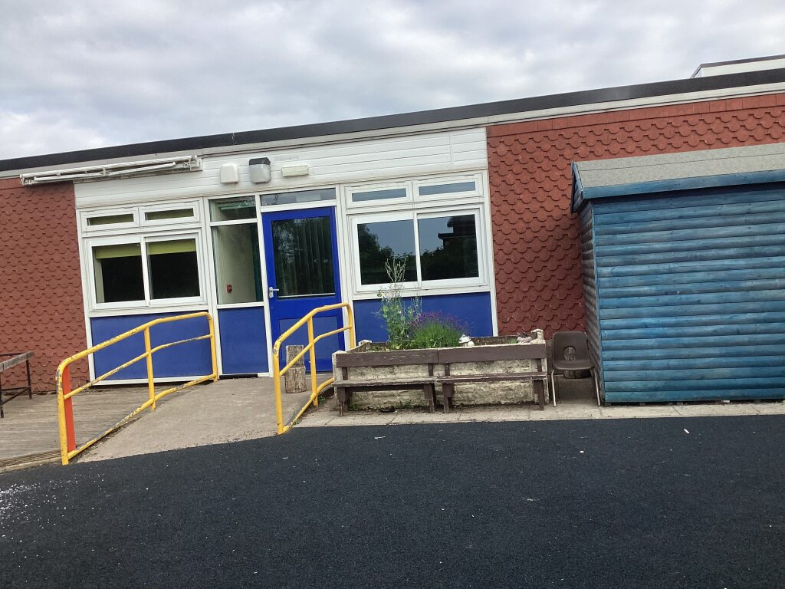
Entrances/Exits
This is the entrance and exit for children who are in Class 2
with Mrs Jeffery.
This is the entrance and exit for children who are in Class 1 with Mrs Fox.
If you need to pass on any messages before the session, this is absolutely fine but if you need to talk to us in more detail then please arrange a time with us.

Slide 6
The Curriculum
Children in the Early Years learn through play.
Teachers plan activities through our half termly topics, based on children’s interests to motivate, engage and inspire them.
Teachers will support learning through play by modelling, questioning, extending and challenging your child to think independently. Teachers observe the children very closely to see what they know and can do!
Teachers also plan more structured activities that support the learning taking place in the setting each week. This is usually a writing, reading or number activity. We make good use of our outdoor learning environment too and go outside all year round and in all weathers!

Slide 7
The Areas of Learning within the EYFS:
​
​
Personal, Social and Emotional Development Literacy​
Building Relationships Comprehension​
Managing Self Word Reading​
Self-Regulation Writing​
​
Communication and Language Mathematics​
Listening, Attention and Understanding Number​
Speaking Numerical Patterns​
​
Physical Development Understanding the World​
Gross Motor Skills People, Culture and Communities​
Fine Motor Skills The Natural World​
Past and Present​
Expressive Art and Design​
Creating with Materials​
Being Imaginative and Expressive​

Slide 8
A typical day in the Cygnets!
8.30 | Doors open for F1 children only Children come in and play
8.50 | Doors open for F2 children
9.00-9.30 | Phonics
9.30-11,00 | Indoor & Outdoor Play Reading Groups
11.00-11.30 | Maths/Literacy for morning F1 children Literacy for F2 children
11.30 | Morning F1 children go home
11,30-12.30 | Lunch time F2 children/30 hours
12.30 | Register
12.40-1.00 | Maths
1.00-3,00 | Indoor & Outdoor Play
3.00 | Topic Time
3.15 | Story
3.30 | Home Time

Slide 9
Lunch Time Arrangements
School dinners are free of charge for F2 pupils.
F1 children can have a school dinner at a cost of £2.55 per day.
Our kitchen staff serve lunch in the school hall.
The teachers stay and support children for a little while when they are eating their lunch.
Children can bring a packed lunch if they prefer and they eat with all the other children in the hall.

Slide 10
Children can decide daily whether they would like a hot dinner or a packed lunch. Children are encouraged to put their name on the dinner/packed lunch chart as they come in each morning. A member of staff will usually ask parents on the door. A dinner register is done by the teacher each morning.
School meal menus are available on the school website. These change termly. There is a vegetarian option daily also.
If your child has an allergy or intolerance please make us aware so we can notify the kitchen accordingly.

Slide 11


Snack
All children are offered a piece of seasonal fruit and carton of milk each day.
Milk is free of charge until the child’s 5th birthday. Afterwards it can be supplied at a small charge through the Cool Milk website.
Please register your child for milk on the Cool Milk website: https://www.coolmilk.com/

Slide 12



School Uniform
For boys
Black shoes
Black/grey shorts or trousers
A white shirt or polo shirt
A royal blue jumper (with or without the Holly Hill logo)
For girls
Black shoes
Black/grey skirt, trousers, dress or tights
A blue dress or grey pinafore may be worn in the summer
A white shirt or polo shirt
A royal blue jumper or cardigan
Please make sure that every item of uniform is clearly labelled with your child’s name!

Slide 13

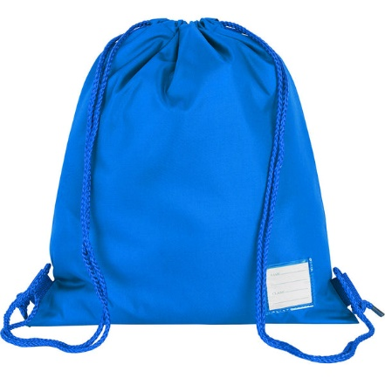


Things your child will also need
Water Bottle-containing water
Your child will be free to drink their water throughout the day.
PE Kit-In a named PE bag which can stay in school for the half term.
White T Shirt and black shorts for all indoor PE
A tracksuit and trainers for outdoor PE
Skirts are much easier than pinafores on PE day!
Don’t forget socks if your daughter wears tights!
Earrings should be taken out on PE days. (Tuesday)
Book Bag-all contents to be kept in the folder and brought to school every day.
All F2 children will be provided with a school book bag.
F1 children are able to purchase these from the School Office if they so wish.
Also, please check your child’s book bag each day for any letters.
Coat-Please bring a coat as we are outside a lot of the time!
Wellies-These are to be kept on our outdoor welly stands.

Slide 14
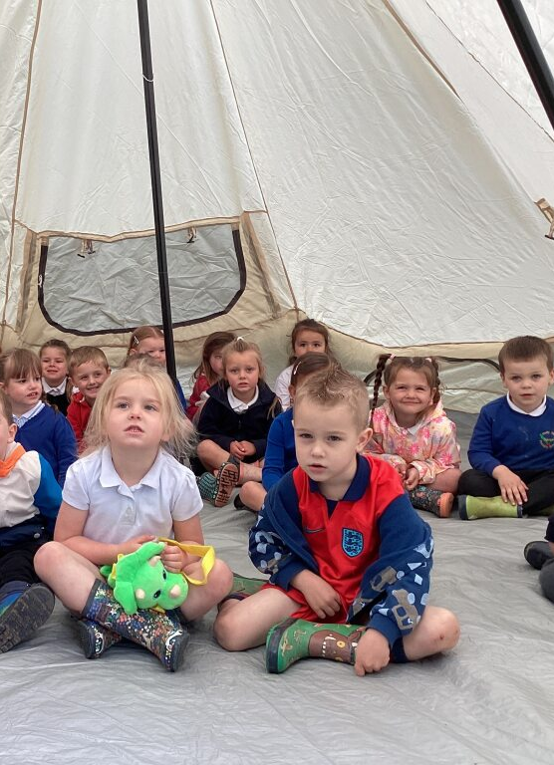
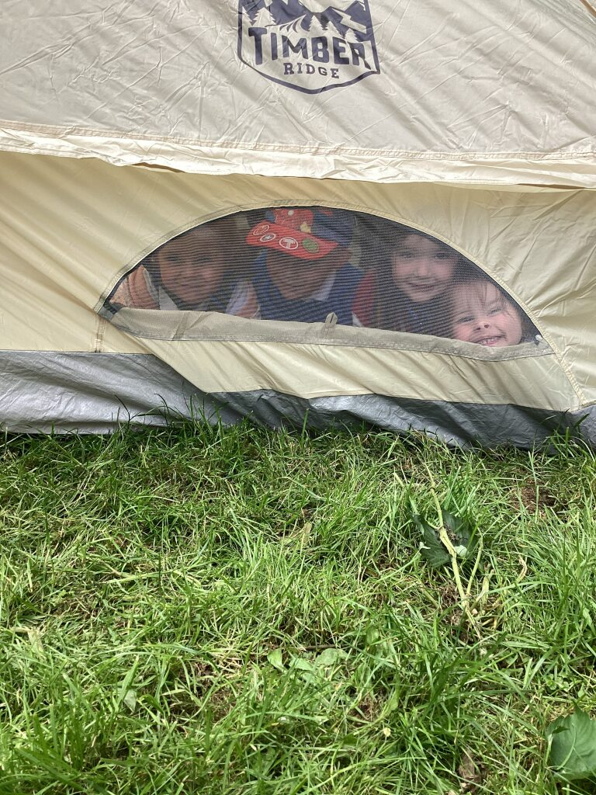
We take a trip every week on
Friday to Whisper’s Woodland
Outdoor learning is in all weathers!
Waterproof clothing and fleeces are provided.
Children need to wear their own wellies and suitable uniform, hats and gloves in the winter time.

Slide 15
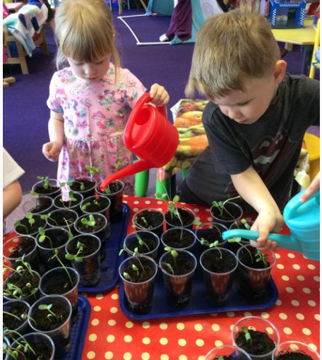
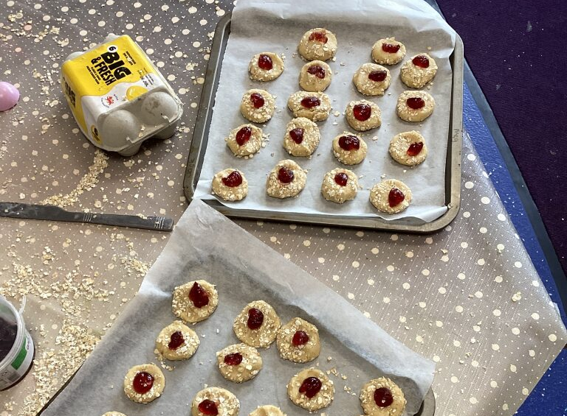
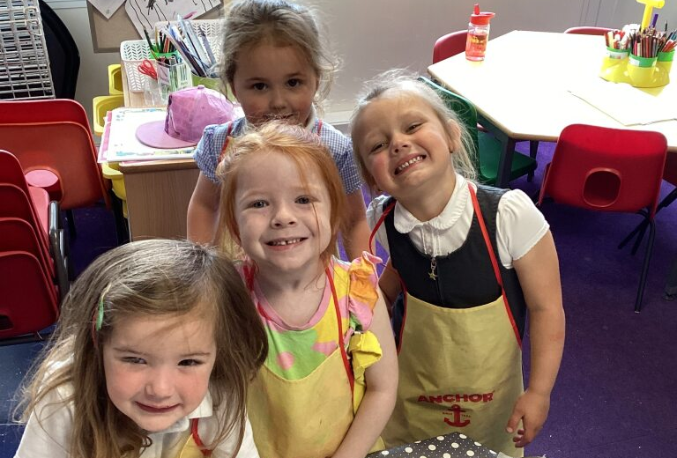
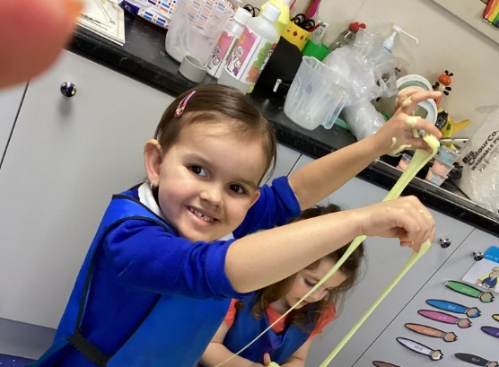
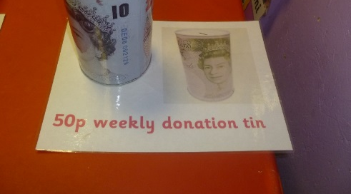
Baking and
extra special activities
Each half term we have a Holly Hill bake off!
This is usually linked to our learning each half term.
For example, we might make gingerbread men when learning about traditional tales.
We kindly ask parents/carers for 50p a week or £3 for a 6 week half term to help towards the cost of these lovely activities.

Slide 16
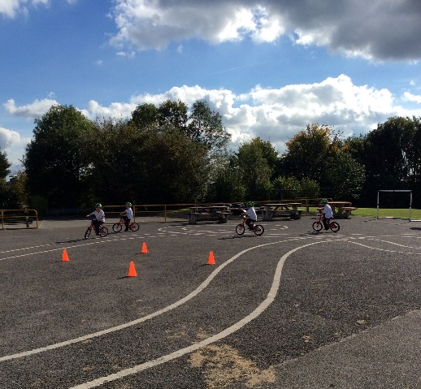
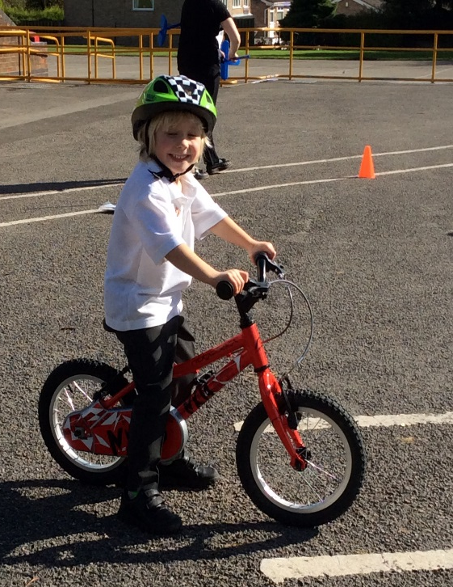
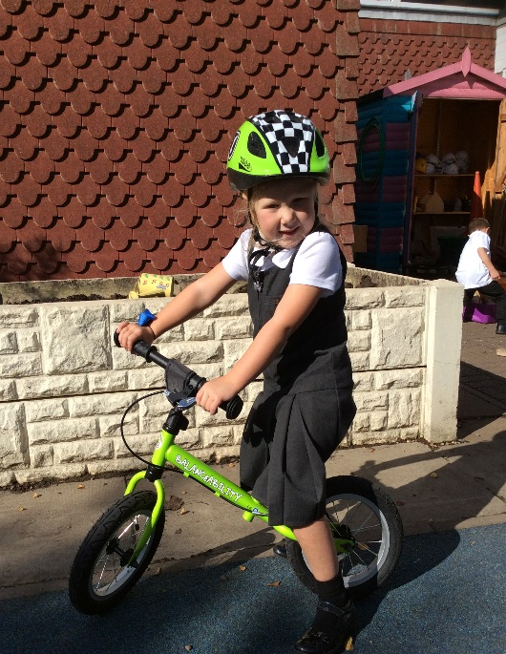
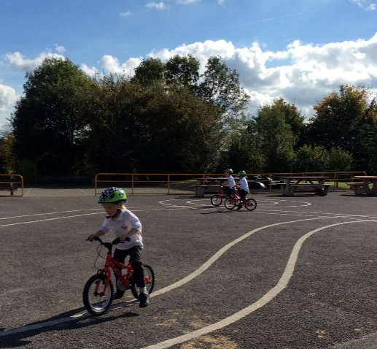
Balance Ability
Your child will take part in balance ability bike sessions. Staff have been trained to deliver a planned course to teach your child the skills they need to ride a pedal bike safely.

Slide 17

Little Wandle
Little Wandle is a complete systematic synthetic phonics programme.​​
The children will have a phonics session every day.​​
They will start on Foundations for Phonics (usually in F1) and Phase 2 (usually in F2) and build on this daily, introducing Phase 3 and finally Phase 4 in the summer term.​
Once they have been taught all of Phase 2 and have started Phase 3 (around October half term); we will complete some Little Wandle assessments which will give them a reading level.
After half term; we will start to send Little Wandle reading books home.​
​To find out more:​
https://www.littlewandlelettersandsounds.org.uk/resources/for-parents/​
We will also be holding a Little Wandle meeting in the Autumn.
More information to follow​.

Slide 18

Reading at home
We want every child to have a love of books!
Every week each child (F1 and F2) chooses a reading for pleasure book to take home and share with their grown ups.
F2 children will also have a Little Wandle reading book to bring home based on their phonic knowledge.
Please record your child’s reading in their Reading Diary. We recommend 5 times a week!
Children will win prizes on our reading track for reading at home and school.
We intend to provide each child with their own reading dog to encourage children to read with you at home,

Slide 19
A few things to help prepare your child for school …
Put on their own coat and take it off for when we get ready to play outside and come back inside.
Take off their own shoes and put on their wellies for Whisper’s Woodland and playing outside.
Begin to recognise their own name to help find their own belongings e.g. water bottle.
Open a zip on a bag to put letters and pictures inside.
Peel a satsuma/ banana to help them be more independent at snack time.
Undo straw wrappers and pierce carton with a straw if they like to drink milk.
Read lots of bed time stories together, sing Nursery rhymes and play!

Slide 20
30 hours children
30 Hours F1 children will need to be collected at 11.30 on Fridays.
If they wish to remain at school until 3.30 a payment of £10 needs to be made to the School Office in cash or via ParentPay for the additional hours.
If you are eligible for 30 hour funding, please let the office know your code as soon as possible.

Slide 21

Keeping you updated!
We aim to send home an EYFS newsletter each week that
will inform you about what we will be learning each week.
From time to time, we may send home some dates for your diary.
We will be posting photographs of our amazing learning each week to our class page on our school website. Please take a look at http://hollyhillschool.co.uk/-Children-class pages-cygnets
We often send text messages with reminders!

Slide 22

Medication
Should your child require prescribed medication 4 times a day, please complete a medication form from the office. We can only administer medicines that have been prescribed by a doctor.
If your child is asthmatic, please complete a form and hand named inhalers to the teacher. Please keep a check on the ‘use by’ date. These will be kept in school.
If your child has an Epipen, please ensure that we have one that we can keep in school in a labelled box.

Slide 23
Attendance
Every day counts!
Your child is able to keep up with their learning. - Children who are late or absent from school frequently develop large gaps in their learning which will impact on their progress, their ability to develop at the same rate as their peers and meet expectations for their age. Being at school every day helps develop friendships and social skills.
We support parents to achieve a minimum of 97% attendance for all children.
Each child’s attendance is carefully monitored by school and the local authority.

Slide 24
Attendance
Reporting a child’s absence - please contact the school office on 01773 783909 on the first morning of absence and leave a message.
Recommended period to be kept away from school for diarrhoea and /or vomiting illness is 48 hours from the last episode of illness.
If your child has a slight cold, please bring them to school. We will monitor them carefully and call you if they become too poorly to be at school.

Slide 25
Before and After School Provision
Our Holly Hill wrap around clubs provide high quality care and provide a range of activities before and after school.
It is very popular with many of our Holly Hill families!
Morning Breakfast Club
7.30am –8.50am
(a non-cooked breakfast i.e. cereals and toast is provided)
Costs £4.00 per session
After School Club
3.30pm – 5.30pm
(a snack is provided)
Costs £7.00 per session
If you are interested in reserving a place at our Breakfast or After School Club, please contact the school on 01773 783909.

Slide 26
Pupil Premium Funding
Pupil Premium is an additional grant given to schools to help encourage the attainment of children.
You can apply at www.nottinghamshire.gov.uk or F1 parents can complete the form in your pack.
For every child who qualifies we receive £1300.
We can use it for intervention and targeted support.
Extra-curricular activities, trips, clubs, workshops, projects and enrichment activities etc.

Slide 27
Thank you for choosing Holly Hill.
We are always here to help!
If you have any questions at all then please do not hesitate to ask.

