Slide 1

Year 2 Residential
July 14th – 15th 2025

Slide 2
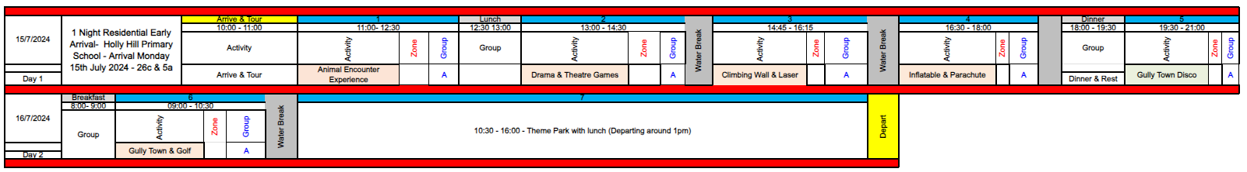
Events
Monday | Tuesday
Arrive 10am Tour of the park Animal encounter Lunch Drama and theatre games Laser Tag Inflatable and Parachute Dinner and Rest Gully Town Disco | Breakfast Gully Town and Golf Theme Park Lunch Home by 2pm ish

Slide 3
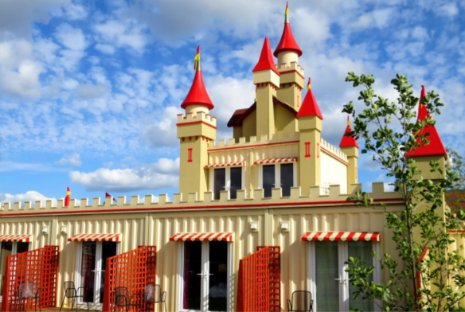
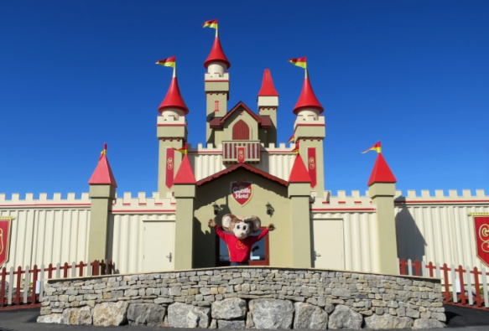
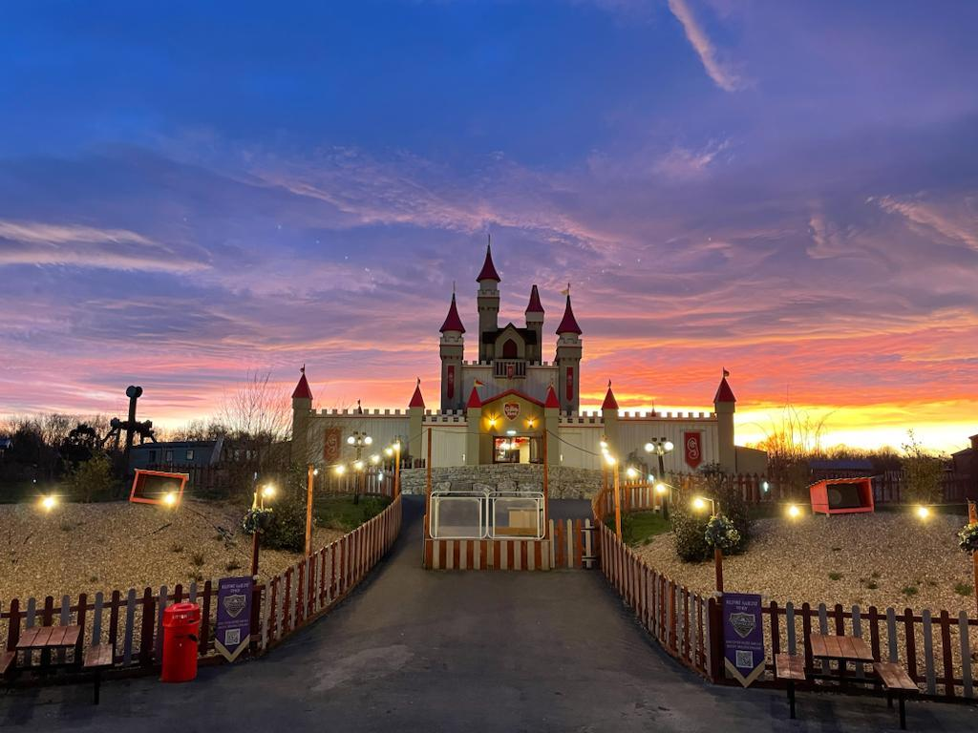
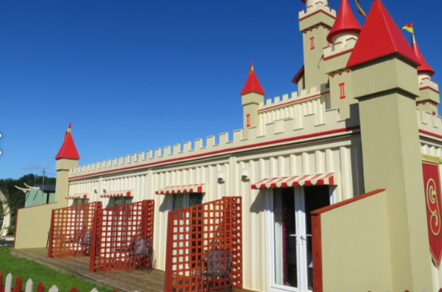
OUR HOME

Slide 4
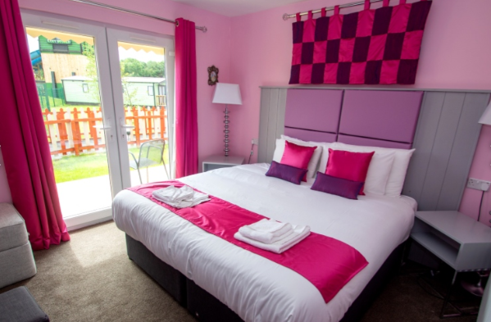
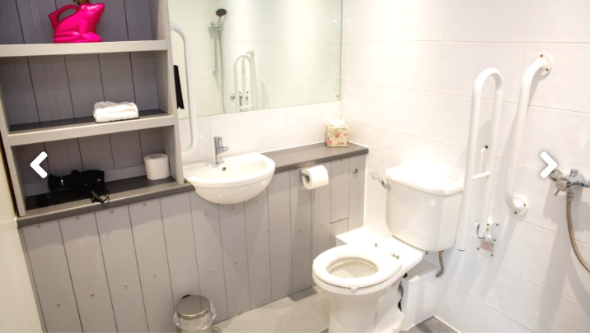
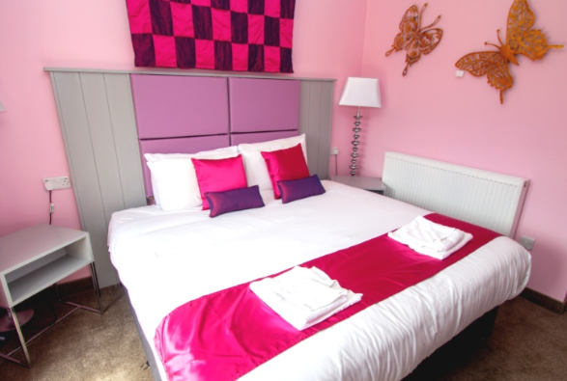
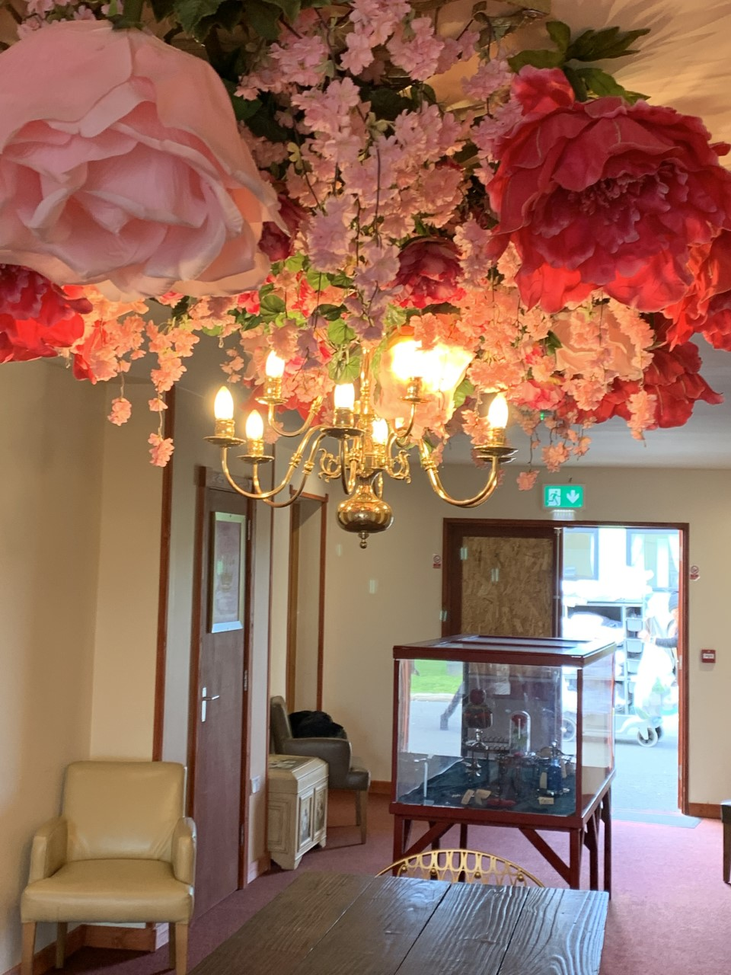

Slide 5
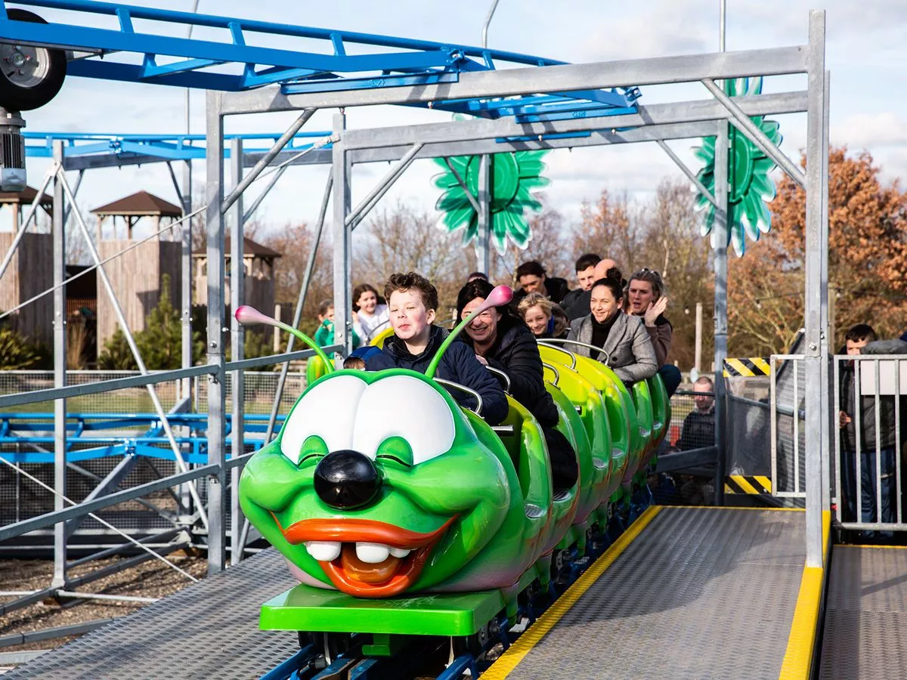
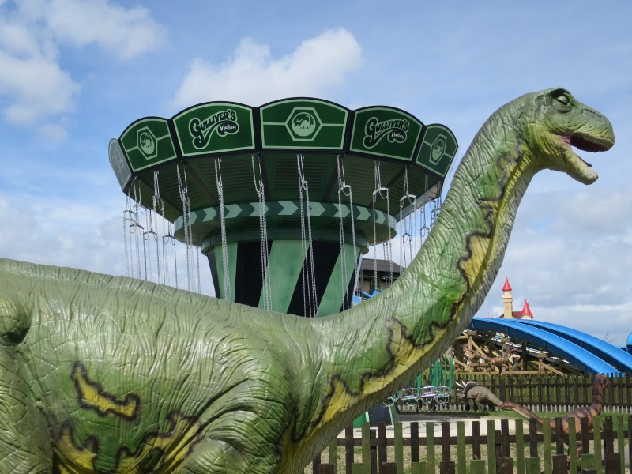
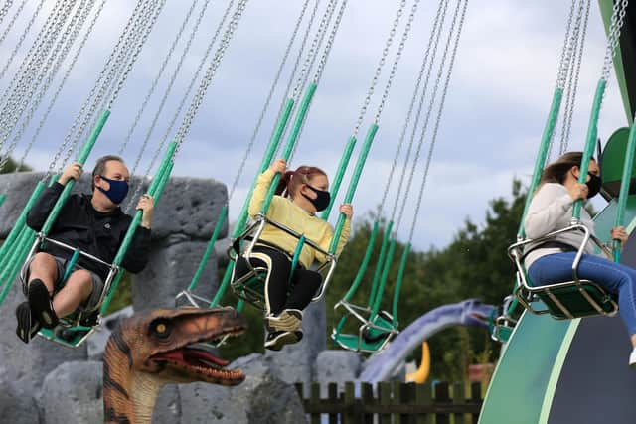
So much fun!!!

Slide 6
Kit List
Towel
Toiletries (toothpaste/ brush/ flannel/ shower gel/ hairbush)
Sun cream
Cap or Sun Hat
Rain Jacket (lightweight)
Old Shoes/ Trainers
Suitable clothes for July
A change of clothes and shoes for the disco (they like to dress up!)
Clothes for bedtime, PJs, Onesie, etc.
Water Bottle (Maybe a spare too)
Medication – If Required (clearly labelled with your name) – to Mrs Cooper
NO SPENDING MONEY!!
Packed lunch and snacks for day 1 (clearly labelled)
Drinks for day 1

Slide 7
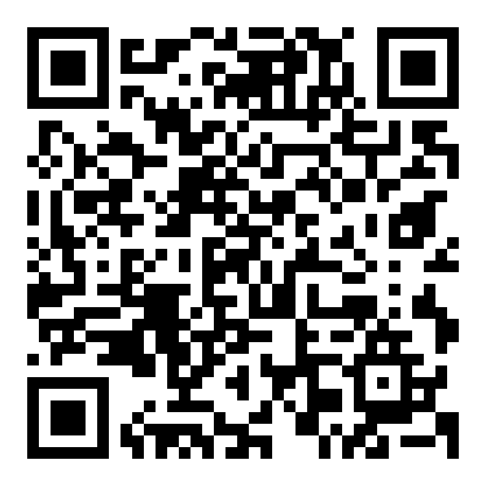
Payments and Medical Forms
Medical forms today please. Children are unable to travel without these!!
Please fill in the waiver
https://www.questionpro.com/a/TakeSurvey?tt=8b0bt9RWNuU%3D
Payments to the office/ parent pay

Slide 8

Any Questions?

