Slide 1

Holly Hill Heroes Assembly
HOLLY
HILL
AUTUMN TERM, 2025

Slide 2
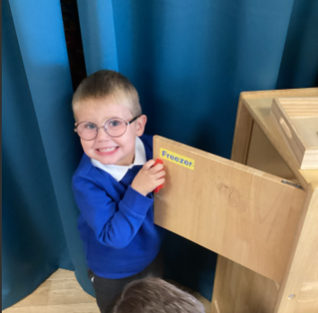
Our Cygnets Hero
This week it is so tricky to choose a hero, as all the children have been amazing and settled so well.
Standing out is Oakley. He has come back with such a grown up attitude. He is sitting on the carpet and remembering all our carpet rules. Most of all, he is starting to show more resilience and not getting frustrated when he is finding things difficult. Keep up the hard work Oakley, we are so proud of you.

Slide 3
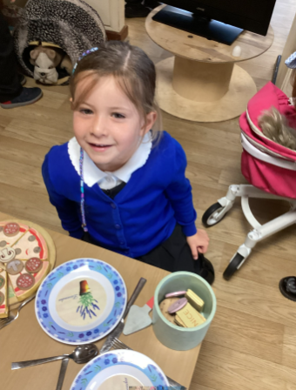
Our Cygnets Hero
Our second hero is Ava. Although lots of her friends moved onto Year One, she has carried on and formed new friendships and been very helpful and nurturing to all the new children. She has taken her new found responsibility in her stride and is loving helping the children learn all our class rules.

Slide 4
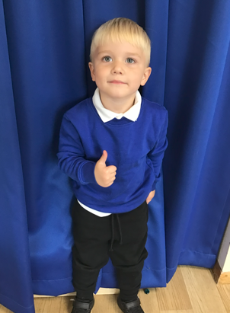
Our Cygnets Hero
We are so proud of Ollie and how amazing he has settled into school. He now leaves his Mummy and Daddy nicely each morning and comes into school with a big smile on his face! We are so proud of Ollie’s talking at school. He is talking confidently to all of the teachers and his friends when playing. Ollie is a good listener and he can sit so nicely during our carpet times, showing good concentration. We feel so lucky to have Ollie join us at Holly Hill and he really is a great addition to the Cygnets!

Slide 5
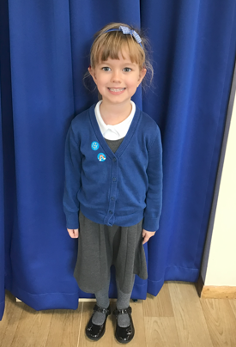
Our Cygnets Hero
Nancy has made an amazing start to her Holly Hill journey and even though she’s only been in school for eight days, it feels like she’s been a Cygnet for years! She has taken all changes in her stride! Nancy loves to learn and she always has her brain switched on. She has loved our phonics sessions this week and she has remembered all our new sounds. We love the way Nancy spends a long time in the writing area, usually creating a very detailed picture or practicing her letter formation. We are so excited to see how Nancy progresses this year, we know she is going to fly!

Slide 6
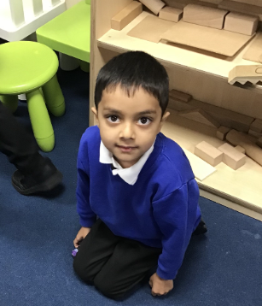
Our Puffin Hero
What an amazing start Kavin has made! From the first day he settled straight away. He is always one of the first to be sat on the carpet ready to learn. He concentrates and listens carefully and plays really well with his friends. Well done Kavin, you really are a PERFECT PUFFIN!

Slide 7
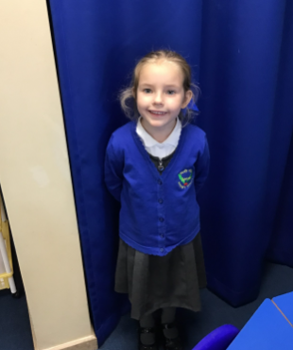
Our Puffin Hero
Wow! What a brilliant start to Year One Ava has had. She comes into school each day with a smile on her face and even after only a few days, she knows and follows our class rules. She listens carefully and most importantly is incredibly kind to any child who is upset or struggling. Well done Ava - you really are a PERFECT PUFFIN!

Slide 8

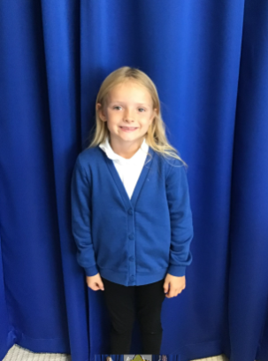
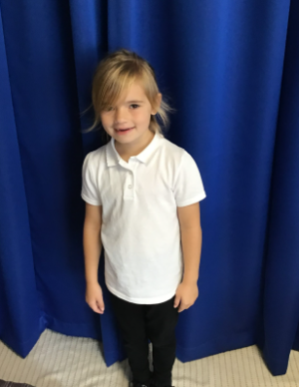
Our Wren Hero
I couldn't choose just 2 for my first heroes of the year, as these three girls have used their own initiative since coming into Wren class to respect and care for our environment everyday. Thank you Lilyann, Lilliarna and Nancie-Jane, for helping to keep our classroom and tables tidy. They all work together to tidy up any mess which has been left over or just giving the tables an extra tidy helping to keep them looking fabulous! What a great start to the year and showing a great example of our Holly Hill Way!
Nancie-Jane is also new to our HH family and has settled in beautifully, making some lovely friends too!

Slide 9
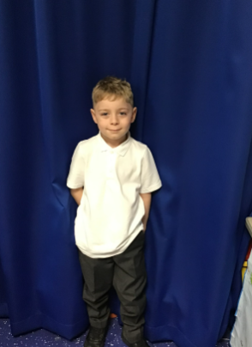
Our Woodpecker Hero
This weeks Woodpecker heroes are Xavier and May.
Xavier has only just joined Holly Hill but you wouldn't know it! He has settled in and made friends so quickly - it is as if he has been here ages. He has made a fantastic start. Well done and welcome to Woodpeckers Xavier.

Slide 10
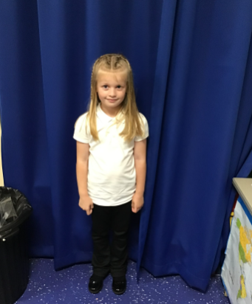
Our Woodpecker Hero
Our second hero is May. May has settled in brilliantly and is one of those children who is always doing the right thing. She is a perfect role model to everyone. She is always ready to listen and does her best in everything.
Well done May – it’s a delight to have you in Woodpeckers.

Slide 11
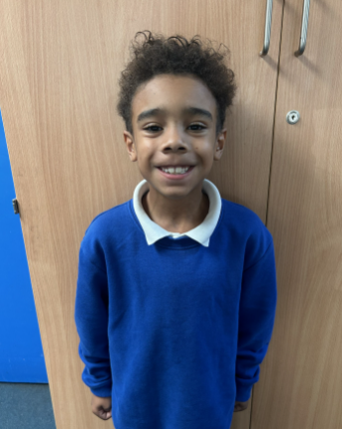
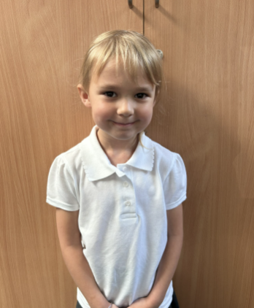
Our Kingfisher Heroes
Our Kingfisher Heroes this week are Olivia and Cruz.
Olivia is always following the Holly Hill way and has settled into Kingfisher brilliantly! I can always rely on Olivia to be listening , doing the right thing and working hard.
Cruz is a hero for being a fabulous Kingfisher! He has settled into Year 3 like he's been here for ages. We are so impressed with the way he answers questions and joins in with class discussion.
Olivia and Cruz, we are so proud of you! What a fabulous start to Year 3 🌟

Slide 12
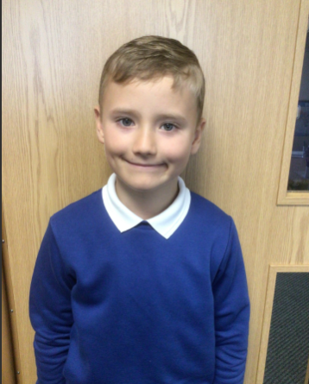
Our Dove Hero
The first hero for Dove Class this week is Liam. Liam is new to our school but has settled in brilliantly. He is making lots of new friends and really impressing his teachers with his enthusiasm and attitudes to learning. He is already a great asset to Holly Hill. Well done Liam!

Slide 13
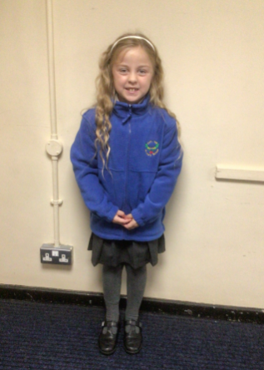
Our Dove Hero
Our second hero is Anastacia. Anastacia is another new person to our school. She has settled in wonderfully and has made lots of new friends, even being voted one of the class school councillors. Another great asset to our school. Well done Anastacia!

Slide 14
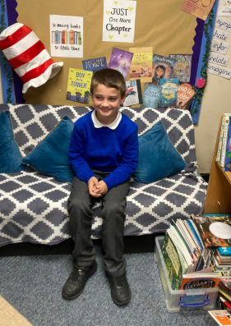
Our Swallow Hero
Corbyn is a Swallow hero this week. Corbyn scored 25/25 on his times tables assessment this week. Wow - top marks already!!! Well done Corbyn, what a great start for you.. We are super proud!

Slide 15
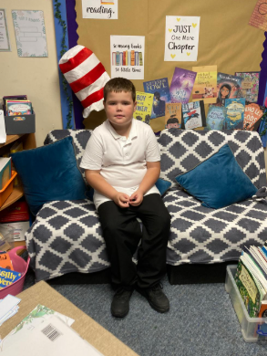
Our Swallow Hero
Cole has been amazing since starting back. He has really settled in to Year 4. He has tried hard with his work, put his hand up often and been very kind. Well done Cole – we’re very proud of you!

Slide 16
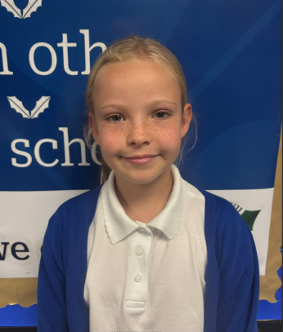
Our Owl Hero
My hero this week is Paisley. Paisley has made an amazing start to year 5. She always gets straight on with work and sets a brilliant example for all of Owl Class. Well done, Paisley!

Slide 17
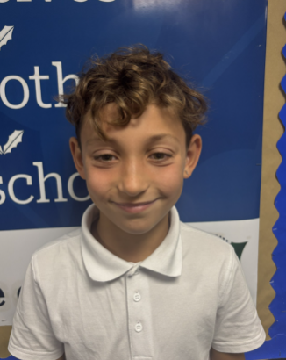
Our Owl Hero
My hero this week is Teddie. Teddie has been working hard and trying his best in all lessons. His dedication and strong work ethic is paying off. I am very proud!

Slide 18
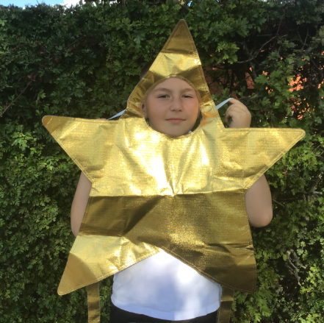
Our Falcon Hero
Ben - I have chosen you as one of my heroes this week for your impeccable attitude and work ethic. You have truly embodied being a Year 6 role model in the class, working hard and efficiently to complete your work then striving to challenge yourself further with extra work when you have finished! I love how every time I look over at you, you are always finding ways to better your understanding, whether it's getting lost in Shakespeare, exploring the fact pages in your reading diary or practicing your times tables. You have set an impeccably high standard for yourself starting out in Y6 Ben, and I have no doubt that it will continue throughout the year. Keep up the amazing work!

Slide 19
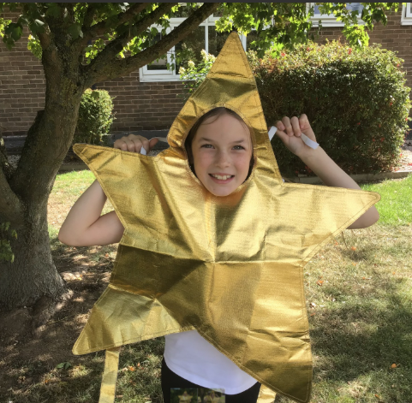
Our Falcon Hero
Skyla - you were an easy choice to be one of my heroes this week for all of the kindness and care that you have shown! You have truly made me feel so welcome, through helping out in the classroom, always checking in and having a wonderful smile on your face. Your work ethic as well is absolutely faultless - you willingly partake in class discussions, always want to share your ideas and get stuck in with whatever piece of work I give you with no issues at all. You have transitioned into Y5 so well and I do not doubt for a second that you will let this standard slip. Keep on being the absolute superstar that you are!

Slide 20
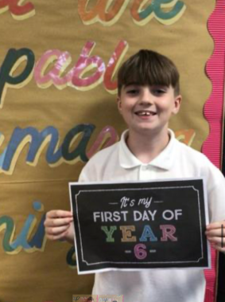
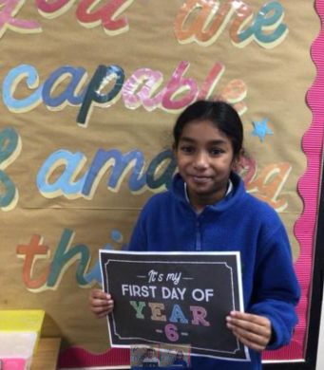
Our Swan Hero
My two superstar heroes this week are Shevona and Tyler. These two fabulous swans are always the first to be ready to learn, are so polite and try so hard every single lesson. I am so happy that they are part of team swan: they are already mature and reliable Year 6’s. Well done super heroes! 🌟

Slide 21
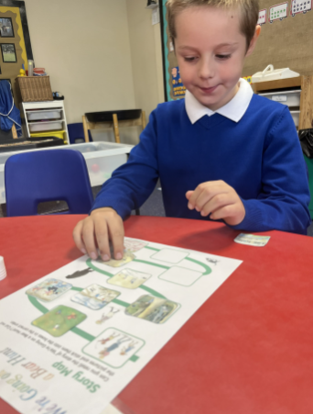
Our Nest Heroes
Kenley and Sebastian are our Nest heroes this week.
Kenley has been so happy this week in the nest. He has joined in all group activities, joined in with phonics and singing time and has been choosing his own songs and saying single words to us. We are so proud of him!

Slide 22
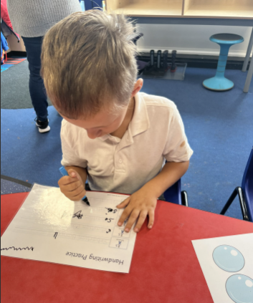
Our Nest Heroes
Sebastian has come back with a ready to work and learn attitude. He has been doing all of his work and helping all the staff in the nest to tidy up after activities. We are so proud of him - keep up the good work!

Slide 23
Class Attendance winners
This week’s winners with 99.3% are Dove class! Well done Doves!
Remember, when you reach 3 wins, your class will get £25 to spend on books and 15 minutes extra play! Try to come to school every day to help your class be the winners!
CLASS | WIN 1 | WIN 2 | WIN 3
Cygnets 1
Cygnets 2
Puffin
Wren
Woodpecker
Kingfisher
Dove
Swallow
Owl
Falcon
Swan

Slide 24

What a fabulous first full week back Holly Hill! You have all settled beautifully and are working super hard already. Looking forward to a fabulous year head.
Have a great weekend!
Mrs. Steed xxx

