Slide 1

Holly Hill Heroes Assembly
HOLLY
HILL
AUTUMN TERM, 2025

Slide 2
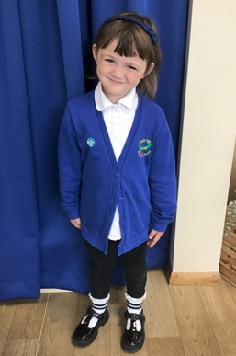
Our Cygnets Hero
We are so lucky to have Laila in the Cygnet class with us. We have really seen her step up as a big F2 since starting back to school. She is a brilliant role model to our new children. Laila follows all of our listening rules and amazes us during our carpet times. Laila has particularly made us proud in our phonics sessions this week. She has remembered all the phonemes we have learnt so far and her oral blending is brilliant.
Laila always holds her pencil correctly and forms the most beautiful letters. You are a Cygnet super star Laila!

Slide 3
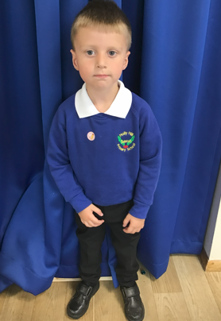
Our Cygnets Hero
Leo has blown us away since starting back in F2! What a grown up young man he is now! He seems very happy and settled at school and this shows in his learning and play. He has grown in confidence, talking more and becoming more independent. He is confidently showing the F1 children what to do.
Leo is a very good friend to others and he is very good at sharing his ideas. He is a very helpful boy and loves the responsibility of carrying out a little job. Thank you, Leo, for being you, you are such a lovely boy.

Slide 4
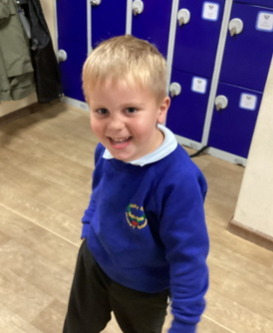
Our Cygnets Hero
Stewart has been amazing this week in phonics. He has sat and listened carefully and has remembered some of the sounds and is able to repeat them back to me. He knows to come in and where to sit and is now trying really hard to cross his legs. He has started to make sounds to say 'Good Morning' and what he is eating. We are so proud of you Stewart, you are working so hard.

Slide 5
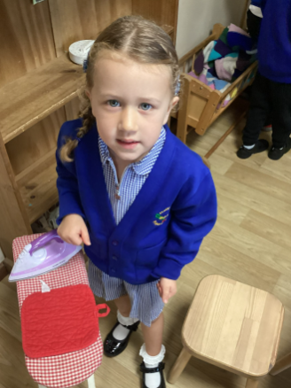
Our Cygnets Hero
Ivy is new to our school, but you would not know this as she has settled so well. She follows all our rules and is especially good at 'Choosing, Using and Putting Away'. She has already made lots of friends and sets a fantastic example to how well to sit and listen at carpet time. We love having you in our class Ivy and we are so proud of you - keep being so amazing Ivy!

Slide 6
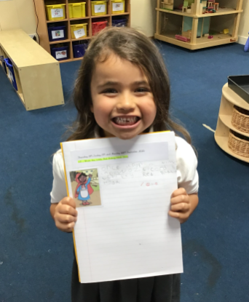
Our Puffin Hero
Zayla has had an amazing start to Year 1. She always tries her best and this week has completed a lovely piece of writing about the story Little Red Riding Hood. She tried really hard to make the first piece of writing in her new book so wonderful. Well done Zayla, you are a Perfect Puffin and I am really proud of you!

Slide 7
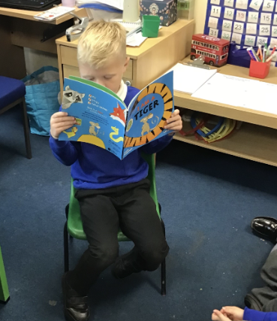
Our Puffin Hero
Ralphie has had a brilliant start to Year 1 and made himself at home in Puffin Class. He literally bounds in each day ready to get stuck in – what a fabulous attitude. This week he had the confidence to read a book to the rest of the class which he had brought from home. He read it in a fabulous readers voice. Well done Ralphie, you are a Perfect Puffin and I am really proud of you!

Slide 8
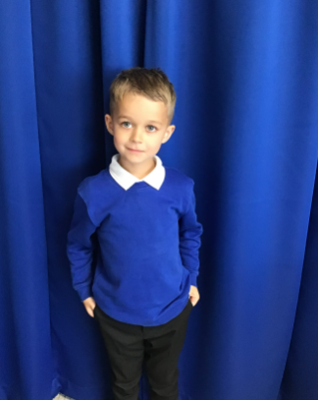
Our Wren Hero
I have chosen Hunter this week for being an absolute pleasure to have in Wren class. He is a delightful boy, who is always offering a helping hand to myself and his peers. He is well mannered, tries hard and is a fabulous role model within Wren class. What a fabulous start to the year! Keep it up Hunter!

Slide 9
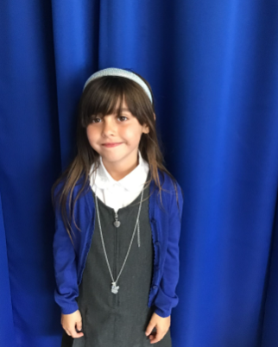
Our Wren Hero
Ruby has had a great start in Wren class, sharing lots of her ideas within our English lessons and always trying hard with her work even when she finds it a bit tricky. Her handwriting is wonderful, and I can see how hard she has been practising. She has even been offering a helping hand to those around her too. Keep it up Ruby!

Slide 10
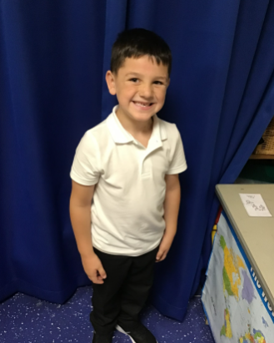
Our Woodpecker Hero
This weeks heroes are Jase and Frankie.
Frankie has been a super star in lessons and is trying to answer lots of questions. He is working really hard and this is really showing in the work he is producing. Well done Frankie.

Slide 11
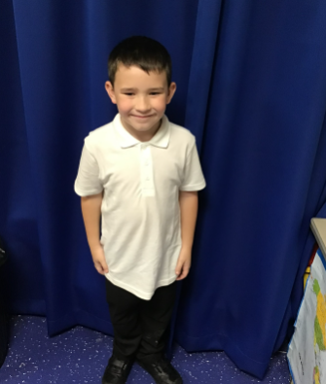
Our Woodpecker Hero
Our other hero is Jase.
Jase has been working really hard in his maths and was a superstar when he was working with me. He could tell me all the answers and what he had to do to work them out. He has also been a fab helper and made sure all our maths equipment was put away tidily.
Well done both of you.

Slide 12
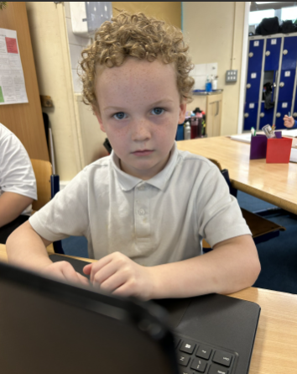
Our Kingfisher Heroes
Kingfisher Heroes this week are Cayden, Carson and Joseph.
Cayden is a hero this week for working so hard. He has joined in with all our maths learning in Year 3 and even assisted the teacher in working out a tricky answer! Cayden is definitely a maths whizz and we are so proud of how well he has worked!

Slide 13
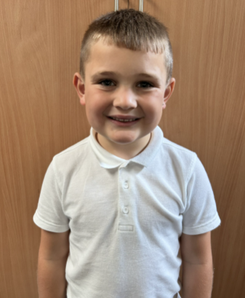
Our Kingfisher Heroes
Carson is a hero this week for his learning in Year 3. Carson is always working hard with his head down and focusing on the teas. His handwriting is beautiful and has blown our socks off with his lovely joining.

Slide 14
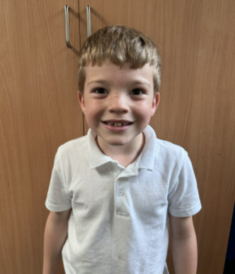
Our Kingfisher Heroes
Joseph is a hero for settling into Year 3 brilliantly! He is very mature and is always ready to learn. We love Joseph's contributions to class discussions, as he always has something interesting to say!
Well done heroes - keep shining! 🌟

Slide 15
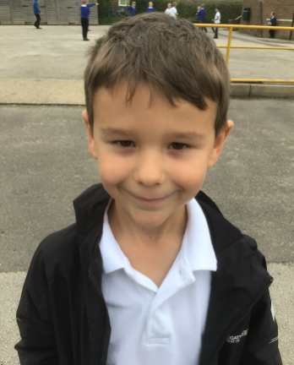
Our Dove Hero
Our first Dove hero this week is Noah. What a fantastic start to year 3 Noah has had. He has really impressed us with how eager he is to learn and how well he participates during every lesson. His behaviour is impeccable and he is a wonderful role model to others in his class. Well done Noah, you Superstar!

Slide 16
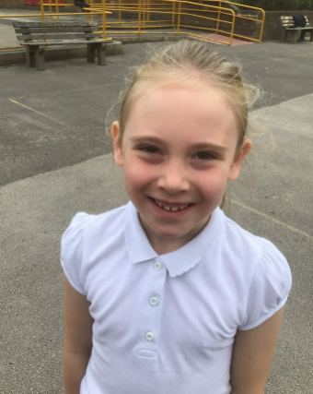
Our Dove Hero
Our next Dove hero is Cleo-Renae. Wow! You have started the year with such enthusiasm and blown our socks off with some of your fabulous writing ideas and answers during class. Every lesson Cleo-Renae has given it her all and we can see she’s going to be such a positive member of the class this year! Well done Cleo on a wonderful start to the year! Another Dove Superstar!

Slide 17
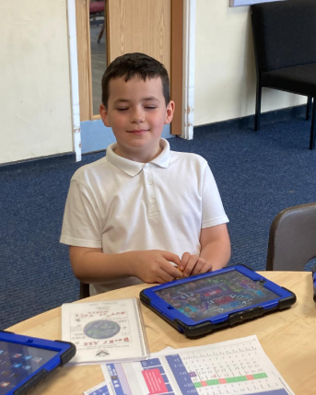
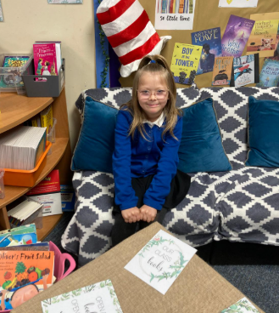
Our Swallow Hero
​Elsie and Harry are Swallow heroes this week. They both started at Holly Hill this year and they have both had an excellent start and are already part of our school family. We are very happy to have you hero - our new Swallows!

Slide 18
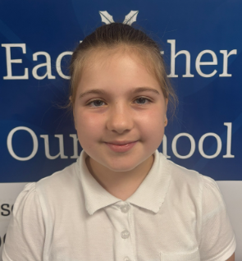
Our Owl Hero
Esmee is Owl’s hero this week because of her outstanding attitude to learning. This week Esmee has amazed me in her English lessons. She has been able to confidently use subordinate AND relative clauses in her sentences. Her books have even been used as a model to the whole class! I am so proud Esmee, keep up the good work!

Slide 19
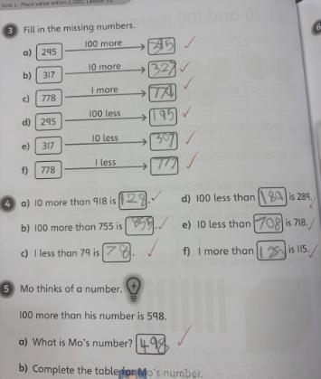
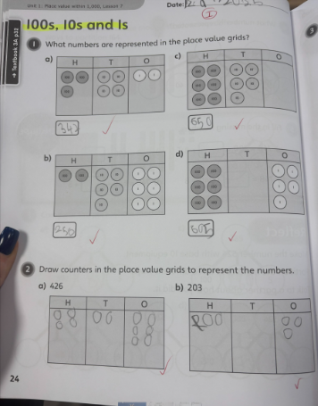
Our Owl Hero
James is our Owl hero because of his amazing maths work. James has tried his hardest in every lesson and always wants to challenge himself. He is giving maths his all and we are all enjoying watching his confidence improve every day. I am so proud of you!

Slide 20
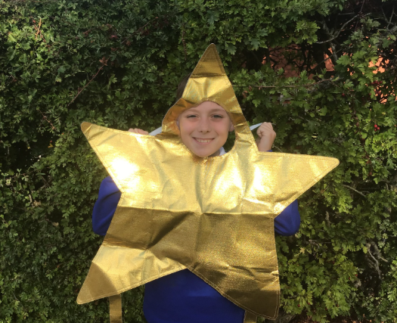
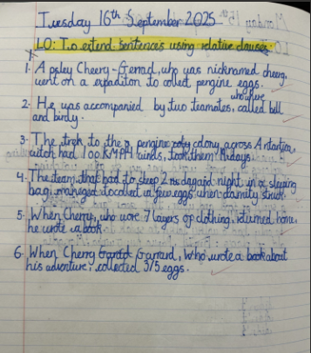
Our Falcon Hero
My first hero is George. No matter what piece of work I ask him to do, he always gets stuck straight in without a fuss and presents it so beautifully! He really sets the standard very high for handwriting in my class. This is a brilliant start to Year 5, George. Long may it continue!

Slide 21
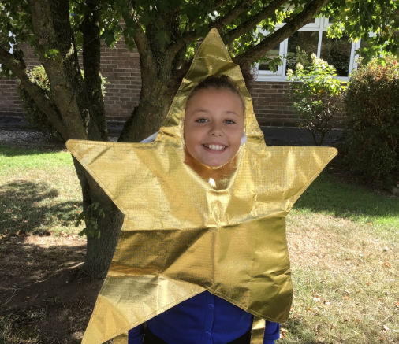
Our Falcon Hero
My second hero for this week is Mila. I feel Mila has really settled into Year 6 well. She tries her hardest with all of her work and will go above and beyond to help me and others in the class too. She is a true delight to have in my class and I hope her positivity and drive carries on throughout her final year at Holly Hill!

Slide 22
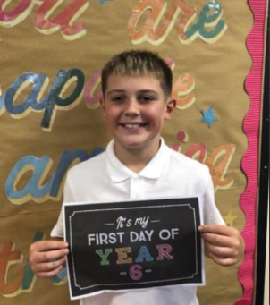
Our Swan Hero
My first hero this week is Jaxon. Jaxon has been working so hard in his lessons, but this week he has particularly impressed me with his maths. I gave everybody a brain break in maths to recharge, and when I walked past Jaxon, he said 'You said to have a break, I've just answered two more questions!' I love to see you settling into the role of being a Year 6 Jaxon - you're making me really proud 🌟🦢

Slide 23
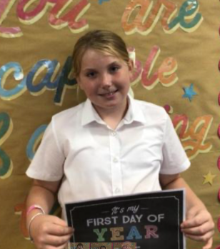
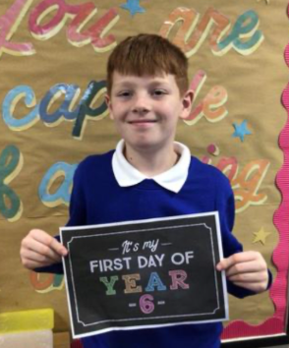
Our Swan Hero
My next heroes are Amelia and Jacob. These two super stars are just so kind and helpful around the classroom - they love to help me with a job and keep me organised and I know I can rely on them to help me if I need it. Amelia noticed that the chairs needed putting out in assembly and whipped up a team straight away, and Jacob is Mrs Steed's number one clicker in Picture News assembly! Guys, you are already becoming such fantastic role models and you've made a fabulous start to Year 6 🌟🦢

Slide 24
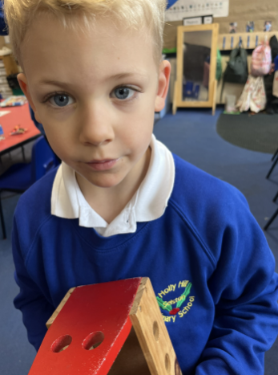
Our Nest Hero
Our Nest hero this week is Colby. Colby has settled into the nest beautifully. He has joining in with all group learning activities and is so happy. He also gives the best cuddles ever!

Slide 25

Our Wraparound Heroes
Our Wraparound heroes this week are Flynn, Hale, Sebastian and Ollie.
They have only just started school but have settled into breakfast and after school club beautifully. They are settled, they follow the rules, they play nicely and they are always happy to come in.
We are so proud of you all and are so glad you that you came to join us at Holly Hill!

Slide 26
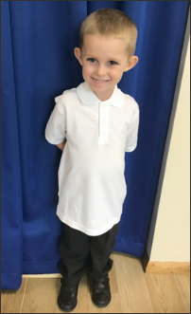
Our Lunchtime Heroes
Wow Sebastian! You are absolutely smashing ‘big school’ life! Not only did Wraparound care nominate you for heroes assembly, but the Midday Supervisors nominated you too!
They have spotted that you have settled in really well, you eat all of your dinner, you sit beautifully in the hall, you always have a gorgeous smile on your face, you’re always doing the right thing AND you have amazing manners!!
Goodness me Sebastian – you really have got off to a flying start! We are extremely proud of you and are absolutely delighted that you are part of our Holly Hill family.

Slide 27
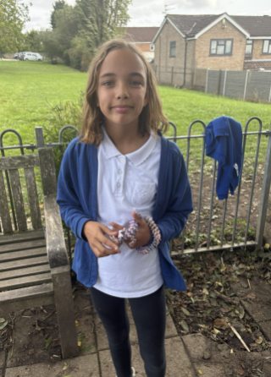
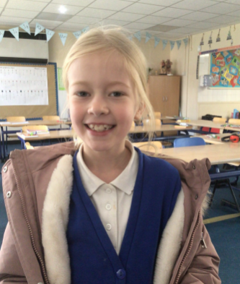
My Headteacher’s Hero nominated by Riley
My Headteacher’s heroes this week are Olivia and Skyla. The girls were nominated by Riley in Year 6 who was blown away by the girls kindness and friendship this week.
Riley had an accident at the skatepark which resulted in a deep cut to his hand. He came to tell me that he thought Olivia and Skyla should be celebrated for helping him, getting him some tissue, checking that he was ok and being lovely people when he needed some help.
I couldn’t agree more Riley! Olivia and Skyla, we are extremely proud to hear that you are just as kind and caring outside of school as you are in school. Well done girls and thank you to Riley for wanting to celebrate kindness!

Slide 28
Class Attendance winners
This week’s winners with 99.2% are Puffin class! Well done Puffins!
Remember, when you reach 3 wins, your class will get £25 to spend on books and 15 minutes extra play! Try to come to school every day to help your class be the winners!
CLASS | WIN 1 | WIN 2 | WIN 3
Cygnets 1
Cygnets 2
Puffin
Wren
Woodpecker
Kingfisher
Dove
Swallow
Owl
Falcon
Swan

Slide 29
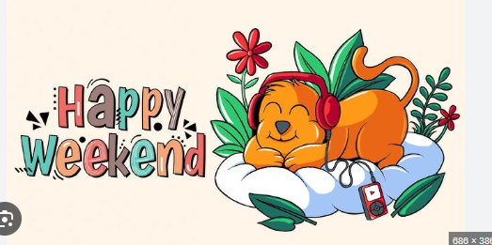
Happy weekend Holly Hill!
See you on Monday,
Mrs. Steed xxx

