Slide 1

Holly Hill Heroes Assembly
HOLLY
HILL
AUTUMN TERM, 2025

Slide 2
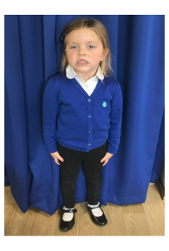
Our Cygnets Hero
Hallie is a shining star and we can’t believe the progress she is making already! Her attitude to learning is great and she is certainly ready for F2! She has really impressed us in phonics this week as she trying hard to listen and concentrate carefully. Hallie is the loveliest friend to others and she is so caring. She always uses kind words and is a big comfort to her friends. We are so lucky to have you in our class Hallie!

Slide 3
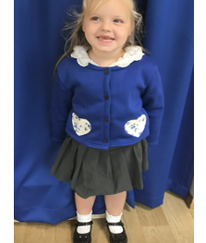
Cygnets hero
Summer is a little ray of sunshine and she lights up our classroom when she walks in each morning. She is always so cheerful and greets everyone with a big smile!
Summer is listening well during our carpet times and she is developing a positive ‘can do’ attitude. She has been trying so hard to hold her pencil correctly and write letters.
Summer has really impressed us with her number skills. She can confidently recognise, order and count quantities to 10.
Well done Summer, you make us so proud every day!

Slide 4
Our Cygnets Hero
Blayke Simpson
Blayke has so many positive attributes we could fill a page with them. She just sits and listens attentively and always wants to add to our conversations positively. She already knows and follows our class rules and is such an eager learner, participating fully. She has taken to phonics and is already orally blending and segmenting. We love having you in our class Blayke - you make us so proud!
Cygnets have all settled so well, they have made us all so proud.

Slide 5

Our Cygnets Hero
Flynn Smith-Bowater
Flynn is a very big character in our class and has already made lots of friends. He is very caring and likes to give out hugs and will make his friends laugh. When walking around School you can hear other children talking to him and saying hello, which just illustrates how much of an impact he has had. He loves to play creative games and always asks people to play with him, he makes us all smile so much on a daily basis. We are so glad you are in our class and make us so proud.

Slide 6
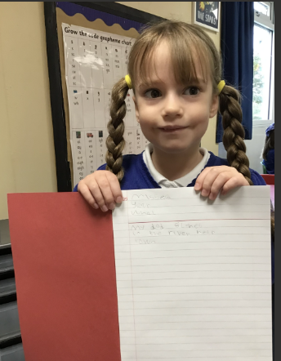
Our Puffin Hero
Wow, what a super start Agnes has had in Year One. She always sits beautifully on the carpet and listens carefully. She tries really hard at everything she does and has really embraced the new challenges of the change in curriculum. This week Agnes has worked particularly hard to write the Little Red Riding story over several days and has produced a fabulous piece of work. Well done, Agnes, you are a PERFECT PUFFIN!

Slide 7
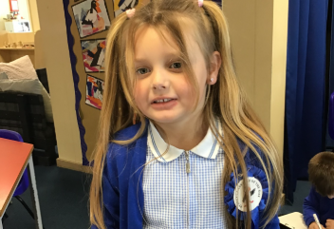
Our Puffin Hero
Wow, Freya has had an amazing start to Year One. She always comes into school with a big smile on her face ready to take on a new day. She is so enthusiastic and eager to learn which is a fabulous attitude to have. This week she has made some excellent contributions to our discussions and was able to explain the concept of comparing groups to the other children, speaking clearly and confidently. Well done, Freya, you bring so much life and positivity to our class. You really are a PERFECT PUFFIN!

Slide 8
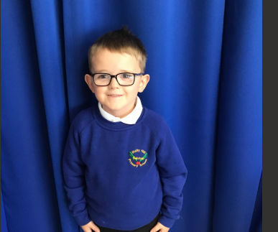
Our Wren Hero
Seth has a superstar attitude towards his learning! No matter what we are doing he always tries his best and wants to work hard to impress the adult he is working with. He has such a fabulous attitude and lovely smile, I love having him in Wren class. Keep it up Seth!

Slide 9
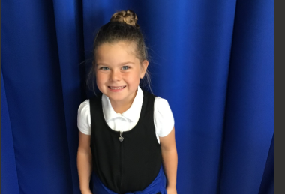
Our Wren Hero
Ella is an absolute delight to teach. She is a fabulous role model and always tries her best. She has a fantastic attitude towards her learning and always wants to do her best! It is a pleasure having such a kind, hard-working and loving girl like Ella in Wren class. She also gives the best cuddles!

Slide 10
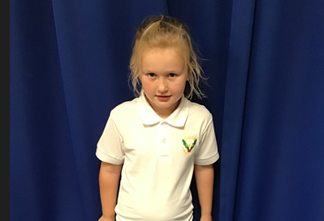
Our Woodpecker Hero
Matilda has been an absolute dream since starting Woodies and we simply could not ask for any more from her. You are on the recognition board daily and we are so proud of everything that you do in our class. We were so lucky that you became a Woodpecker! Well done Matilda!

Slide 11
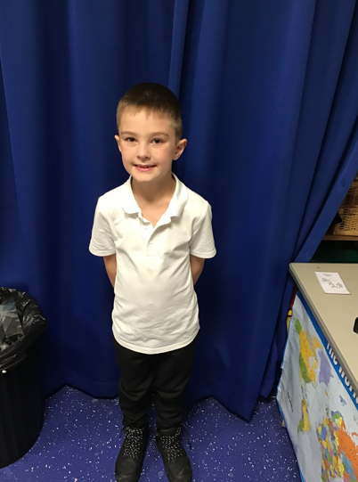
Our Woodpecker Hero
Eddie has been an absolute superstar since starting Woodpecker Class. He has immediately risen to the challenge of being a Year 2 and is so mature! Well done Eddie!
It is also your birthday today Eddie and we want you to remember turning 7 and being our Woodpecker Hero forever.
Happy Birthday from Mrs Watson, Mrs Hutchinson and all your Woodies friends.

Slide 12
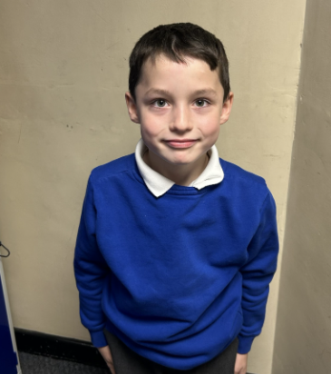
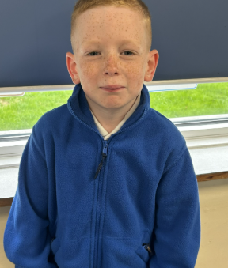
Kingfisher Heroes
Our Kingfisher Heroes this week are Finley and Rupert!
Finley is new to our school and has settled brilliantly. He is a kind friend to the other children on his table, very helpful in the classroom and works hard in everything we do. We're so glad you joined us at Holly Hill Finley.
Rupert is a hero for his brilliant writing this week. We have been writing based on the text of The Lost Thing and Rupert has thought of some good ideas. We were very impressed at the lovely vocabulary he used.
Well done Finley and Rupert - we are very proud of you 🌟

Slide 13
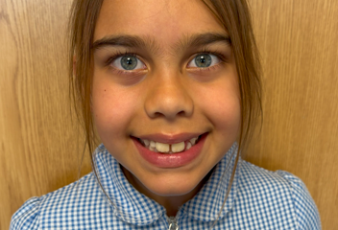
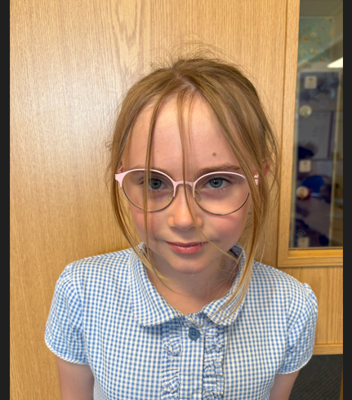
Our Dove Heroes
Dove heroes this week are Sienna and Lilly. Both girls have been working super hard in class, particularly with their writing. This week they have produced some fantastic pieces including lots of brilliant features and language. Well done girls – great work!

Slide 14
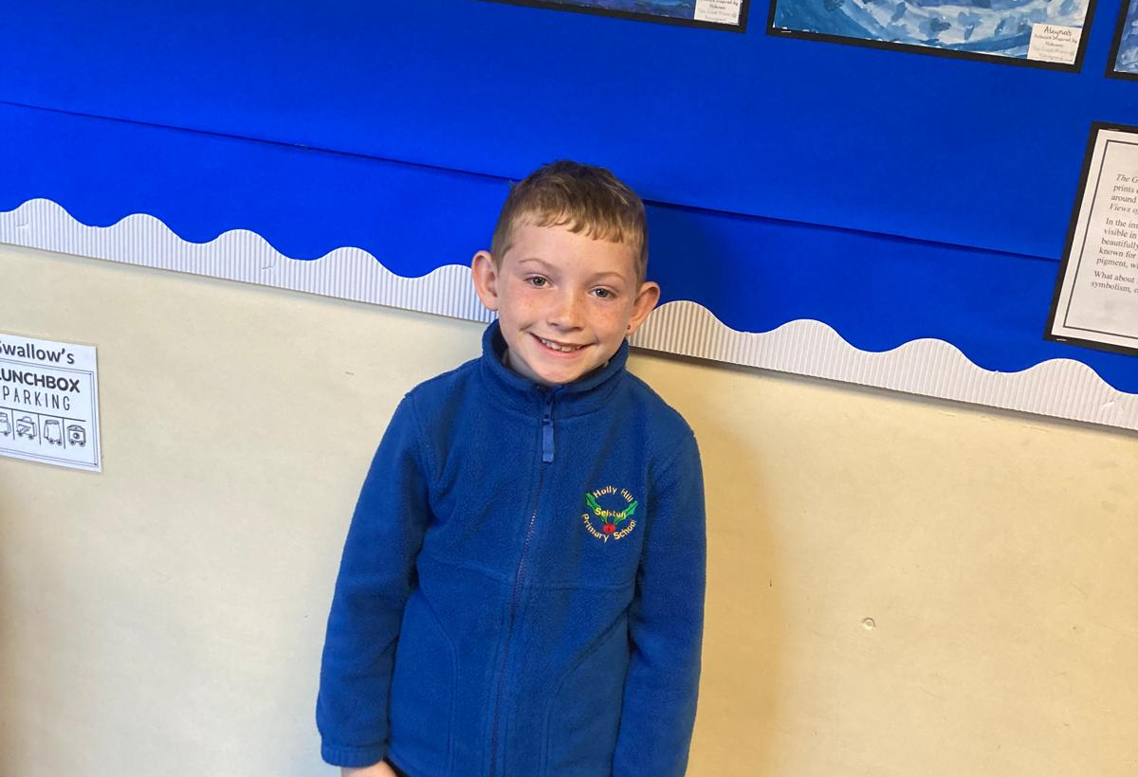
Our Swallow Hero
Jackson is a Swallow hero this week. I am really impressed with his attitude to learning, his kindness and support towards his peers. Also for his classroom behaviour. He has made such a positive start to Year 4. Well done Jaxon, I’m very proud of you!

Slide 15
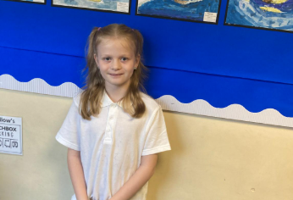
Our Swallow Hero
Holly is a hero in Swallow for just being the most fabulous, caring, hardworking individual. Holly’s behaviour is impeccable, she tries hard with her work too. I’m so impressed with how Holly has taken it upon herself to look after and befriend our new pupil. Holly is a true Holly Hill star.

Slide 16
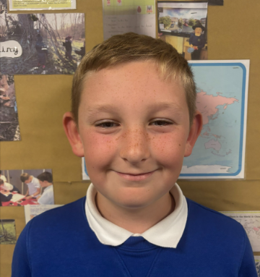
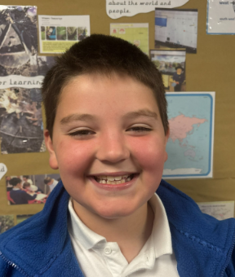
Owl Heroes
Charlie is Owl’s hero. Charlie is always the first with his hand up ready to share his amazing ideas. He tries his hardest in all lessons and is always ready to help his friends if they are struggling! Well done, Charlie. I am so proud!
Another Owl hero is George. George has a brilliant attitude to learning and is always ready to learn and set the standards for the rest of the class. George has been absolutely amazing in maths and is getting better and better every day. I am so impressed with you. Well done, George!

Slide 17
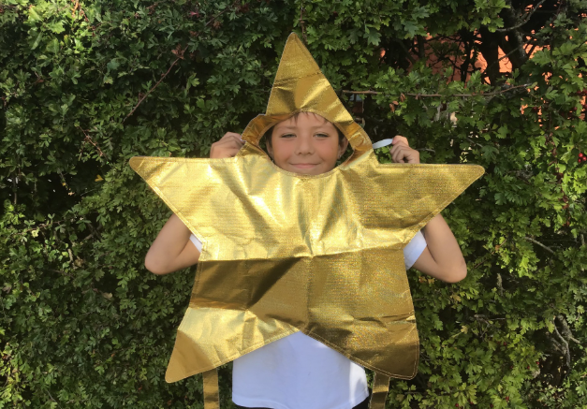
Our Falcon Hero
I have seen such a shift in Sonny’s attitude towards school. He is always smiley, always ready to have a joke and has been getting stuck in with his work with no problem at all. I am especially loving his enthusiasm in Maths now that we have moved on to the four operations! I am very proud of the turn around you have shown, Sonny. Well done!

Slide 18
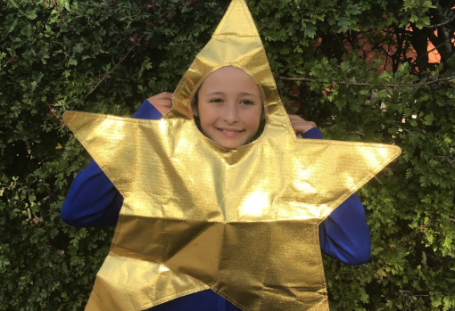
Our Falcon Hero
Sophie is such a happy, smiley girl that radiates a positive energy within my classroom. She has been blowing me away with some of the amazing, higher-level vocabulary she comes up with in our English lessons, which I think she gains from her passion of reading. I know I can always rely on her to help me uplevel my modelled sentence, as well as inspire other children to do the same in their own work! Amazing job, Sophie. You truly are a Fantastic Falcon!

Slide 19
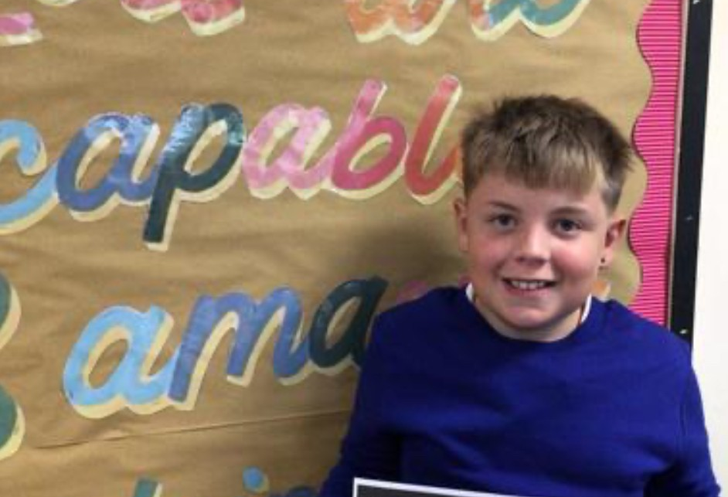
Our Swan Heroes
Cory and Theo are heroes this week for their hard-working ethic and commitment to their learning. These boys are always putting their hand up to contribute ideas in class and have produced some wonderful work because of this. They are also such lovely boys to chat to, and they love giving updates about what’s going on in the gaming world during morning check-in. Boys, I’m so lucky you’re part of team swan this year - you’re both fabulous!

Slide 20
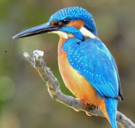
Class Attendance winners
This week’s winners with 97.7% are Kingfisher class! Well done Kingfishers!

Slide 21
Well done to our fabulous heroes.
You make us so proud everyday.
Have the best weekend everyone!

