Slide 1

Holly Hill Heroes Assembly
HOLLY
HILL
AUTUMN TERM, 2025

Slide 2
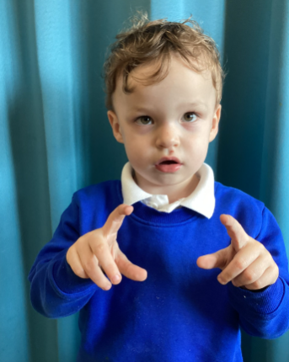
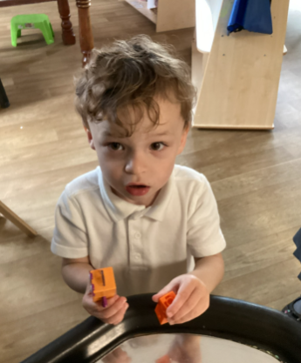
Our Cygnets Hero
Ozzy is our first hero this week!
Ozzy he has adapted to leaving Mummy at the door and waving goodbye like such a big boy. He independently puts his bag and drink away and already knows to come and sit on the carpet when we ring the bell. He is getting more and more confident and loves to listen to all the other children in our class.

Slide 3
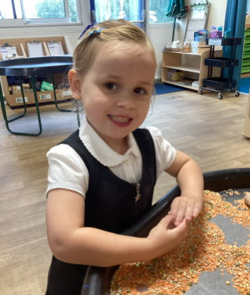
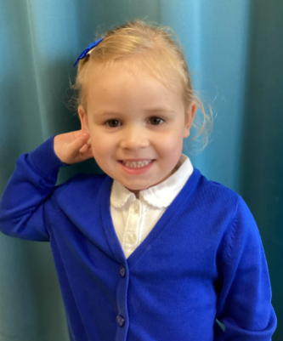
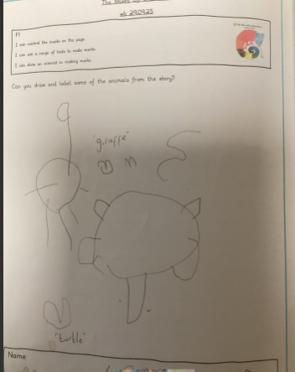
Our Cygnets Hero
Madison is our second hero this week.
Madison is a quieter member of our class but that has not stopped her from making some beautiful friendships. She plays nicely with her friends and does fantastic listening. She has done some beautiful mark making this week from our story.

Slide 4

Our Cygnets Hero
Poppy-Leigh is a super star and she is impressing us so much with her amazing learning. Her phonic knowledge is brilliant and we know she is listening carefully as she can remember all of the phonemes we have learnt so far!
Poppy-Leigh has really impressed Mrs G in reading groups this week! She can hear the sounds and is starting to blend the sounds together.
She has also blown us a way with our new Talk for Writing story, She can independently retell The Mixed up Chameleon story using all the vocabulary and actions. A huge well done Poppy-Leigh!

Slide 5
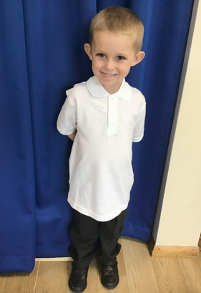
Our Cygnets Hero
Sebastian is an amazing addition to our Cygnet class!
He is growing in confidence every day and he now has a positive attitude towards new activities and routines. He has made some lovely new friends at school too! He absolutely loves stories and he can retell lots of his favourites.
Sebastian has made us so proud this week, when talking about his ‘Family Box.’ He could confidently explain all his chosen items in great detail. Keep up the good work Sebastian!

Slide 6

Our Puffin Hero
Freya M is an absolute super star. Every day she comes into school with a smile on her face and is one of the first to be ready on the carpet, listening carefully and ready to learn. She always works hard and this week she has tried particularly hard with her writing and has written some lovely sentences about Robin Hood. Well done Freya, you are a PERFECT PUFFIN and I am really proud of you!

Slide 7
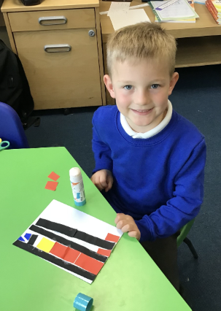
Our Puffin Hero
Oliver settled straight away into Year One. I absolutely love how Oliver eagerly comes into school each morning. He has a great sense of humour and bags of enthusiasm. He always has great ideas to contribute and a fabulous willingness to have a go. Well done Oliver, you bring so much positivity to our class, you are a PERFECT PUFFIN and I am so proud of you!

Slide 8
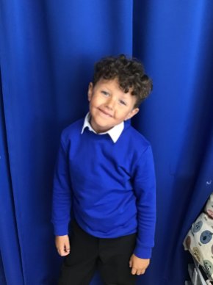
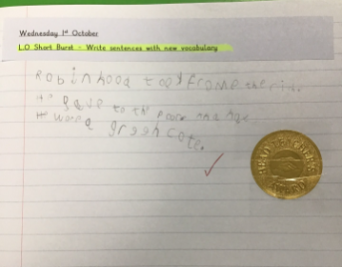
Our Wren Hero
Kruize has amazed me with his writing this week about Robin Hood. We wrote some sentences about him and he has worked so hard on his formation and presentation, I was blown away. So much so we even went and shared his writing piece with Mrs Steed and Cygnets. I am so proud of him and he was very proud of himself too! Keep up the fabulous writing Kruize!

Slide 9
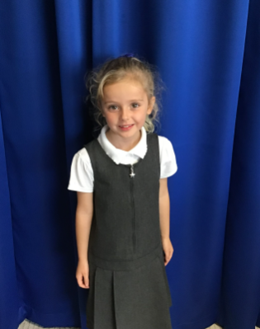
Our Wren Hero
Isla is an all round super star within Wren class. She always works hard and she loves to help her peers and myself. She loves keeping our tidy classroom and she uses her own initiative to tidy up the tables and provision area when it's left in a bit of a mess. I appreciate all of your help Isla! Thank you!

Slide 10
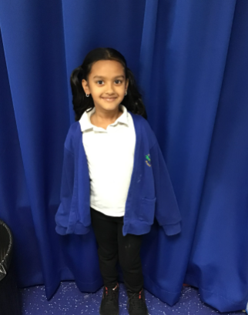
Our Woodpecker Hero
Our heroes this week are Bisviya and Gabriella.
Bisviya is one of Woodpecker ‘always’ children as no matter what we are doing, she puts in 100% effort. She always listens and is ready to answer questions and start her learning. It is fantastic to have you in Woodpecker Class.

Slide 11
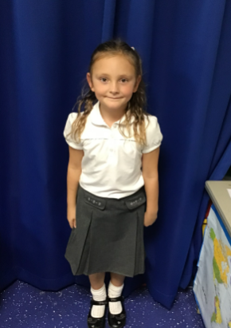
Our Woodpecker Hero
Gabriella has made a super start in Woodpecker Class and she has been a Maths superstar this week. She is doing super listening and has her hand up for every single question. It is great to see how confident you are becoming Gabriella. Well done.

Slide 12
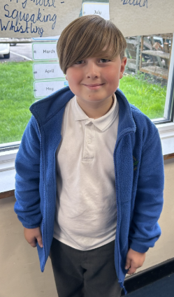
Our Kingfisher Heroes
Our Kingfisher Heroes this week are Finley and Abella 🌟
Finley is a hero this week for working hard, contributing some good ideas 💡 during whole class work, and answering lots of questions. He's had a spark about him this week which has been brilliant to see.

Slide 13
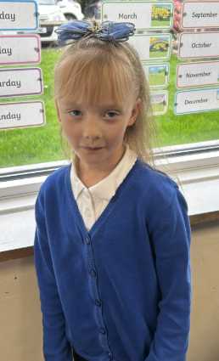
Our Kingfisher Heroes
Abella is a hero for always doing the right thing. She is always ready to listen, ready to work hard and is a kind friend to everyone. It's great having such a sensible Kingfisher.
Both Finley and Abella have demonstrated the Holly Hill Way this week.
Keep shining 🤩

Slide 14
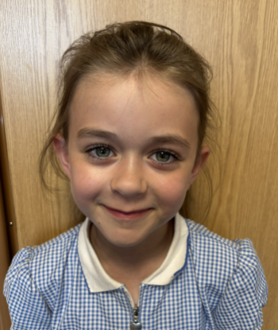
Our Dove Hero
Our first Dove Hero this week is Lilly. What a fabulous member of Dove Class you are. Lilly always tries her very best, even when finding something hard, and has shown great resilience so far this year. She is always the first to be ready to learn and can always be relied upon to be super sensible and perfectly behaved! Well done Lilly, you superstar!

Slide 15
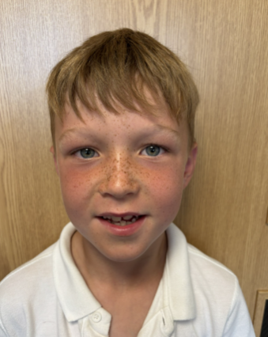
Our Dove Hero
Our next Dove Hero is Rory. Rory has really impressed us this week with his maths skills on number lines and ordering numbers to 10,000. He has also tried really hard with his description about his own ‘Lost Thing’ in English. Rory is a shining example of perfect behaviour in class and is a real role model to his peers. Well done Rory, you are a fantastic Dove!

Slide 16
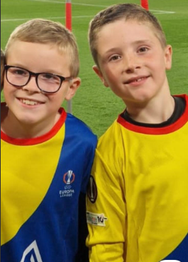
Our Swallow Hero
Thomas and Finley are our Swallow heroes this week. They were Nottingham Forest mascots this week and I know that they will have been representing Holly Hill impeccably while doing so. What a fabulous experience for two fabulous boys – Swallow class are extremely proud of you both!

Slide 17
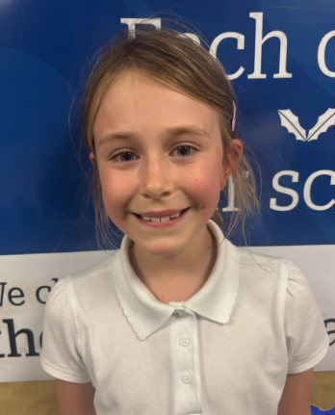
Our Owl Hero
Olivia is Owl hero this week. This week Olivia has amazed us with her creative ideas during lessons. She has used her imagination and asked great questions. Olivia has managed to incorporate everything we have learnt over the last four weeks into her English writing. I am so proud Olivia, keep up the good work!

Slide 18

Our Owl Hero
The second Owl hero is Blake. Blake always comes in every morning ready to learn, listening carefully and trying his best in every activity. Your positive attitude towards learning is inspiring for the rest of the class. Well done Blake, I am so proud of you!

Slide 19
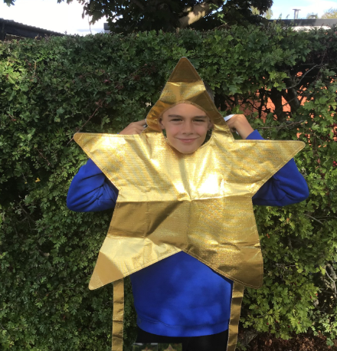
Our Falcon Hero
I have chosen Daniel and Dana this week.
I want to celebrate Daniel for being extremely brave this week after receiving some sad family news. He has shown such resilience and strength at school and has still managed to put a smile on my face, as well as making his friends smile too. You're a superstar Daniel, never forget that!

Slide 20
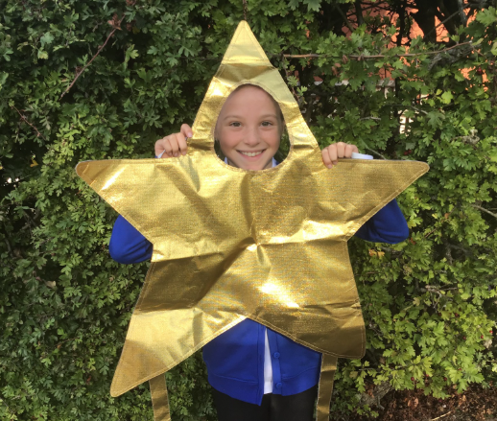
Our Falcon Hero
I also want to celebrate Dana for being a model student. She presents her work beautifully, always wants to help out and is such a kind and caring friend to all. She has taken to Year 5 so well and is already showing me Year 6 standards in lots of the things that she does! Keep up the amazing work, Dana.

Slide 21
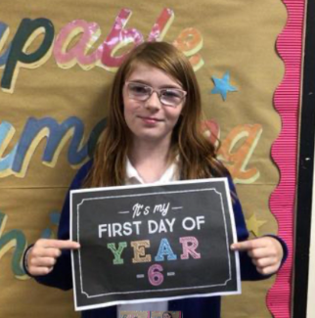
Our Swan Hero
Amber is a hero this week, for facing her fears and speaking in front of the class! Amber, like lots of children, can sometimes find it daunting to share her ideas and thoughts with everybody, but she has been trying so so hard and I'm so proud of her. Well done Amber - you are a super star!!

Slide 22
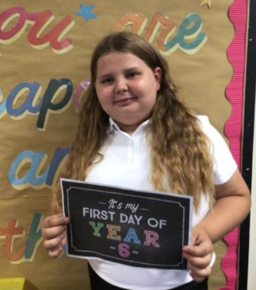
Our Swan Hero
Lilly is a hero for her amazing attitude, kindness and behaviour. Lilly shows integrity in everything that she does - doing the right thing, because it is the right thing to do. Lilly is so kind to everybody and always leads people to doing the right thing. Lilly, Holly Hill is very lucky to have role models like you. You make Swan class a kinder place to be <3

Slide 23
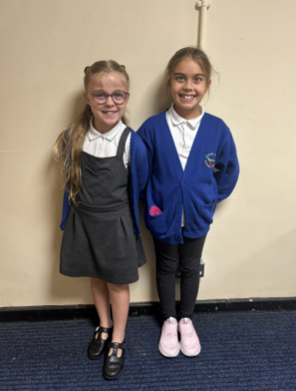
Our Lunchtime Heroes
Anastasia and Lilly have been chosen to be lunchtime heroes this week.
The girls have taken it upon themselves to keep our field and playground looking beautiful by litter picking during their break times. They are very passionate about caring for our school and looking after the environment.
Thank you girls – we are very grateful for your hard work!

Slide 24
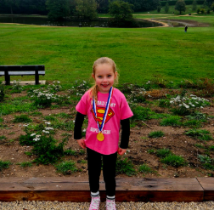
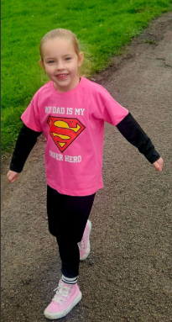
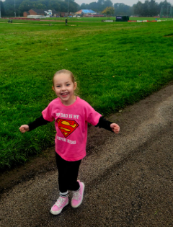
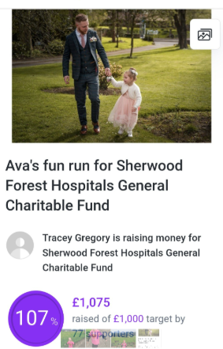
My Headteacher’s Hero
Ava is my Headteacher’s hero this week.
Last Sunday, Ava did a 2k park run and raised over £1000 for Sherwood Forest Hospitals Trust. The doctors and nurses here have helped to make her Daddy better and she wanted to say a big thank you and make sure that they can keep helping other people.
We are all extremely proud of you Ava and think that your determination to give something back to the hospital who helped your Daddy is inspirational.
The world is a better place because of people as kind and caring as you Ava.

Slide 25

My Headteacher’s Hero
Mrs. Cottee is my Headteacher’s hero this week.
Mrs. Cottee has ran two half marathons in a month to raise money for the Richard Whitehead Foundation. She completed the Great North Run in September and then the Robin Hood half marathon last weekend and has raised over £600 for charity!
We are so proud of her – teaching is a super tough job and while the rest of us spent our weekends sitting on the sofa eating chocolate, Mrs. Cottee is training and then running 13 miles!!! She also has an injured foot and she just kept on going even when it was really hurting and she would liked to have stopped.
We think she is an inspiration and we hope she’ll be having a nice relaxing couple of days this weekend!

Slide 26
Class Attendance winners
This week’s winners with 99.2% are Woodpecker class! Well done Woodies!
Remember, when you reach 3 wins, your class will get £25 to spend on books and 15 minutes extra play! Try to come to school every day to help your class be the winners!
CLASS | WIN 1 | WIN 2 | WIN 3
Cygnets 1
Cygnets 2
Puffin
Wren
Woodpecker
Kingfisher
Dove
Swallow
Owl
Falcon
Swan

Slide 27
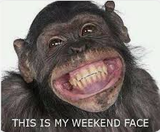
Have a lovely weekend everyone!
Mrs. Steed xxx

