Slide 1

Holly Hill Heroes Assembly
HOLLY
HILL
AUTUMN TERM, 2025

Slide 2
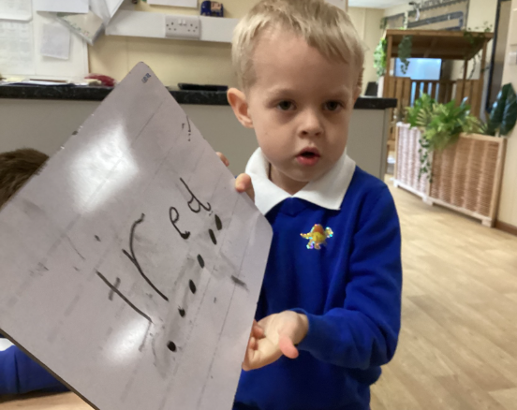
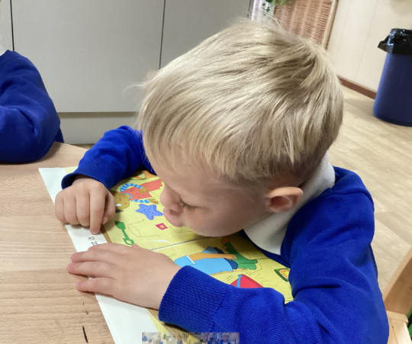
Our Cygnets Hero
We are all amazing in Early Years and it is always so difficult to just select 2 children - so many children do amazing things, so well done to you all!
Two children that have stood out this week are:
Noah has such a great personality and has some fabulous ideas when he is exploring, he really has such a creative imagination! He has been so sensible since coming back in September and particularly this week where he is seeing the connections with letters and sounds. He is so proud that he is starting to read and write and we are incredibly proud too, well done Noah!

Slide 3
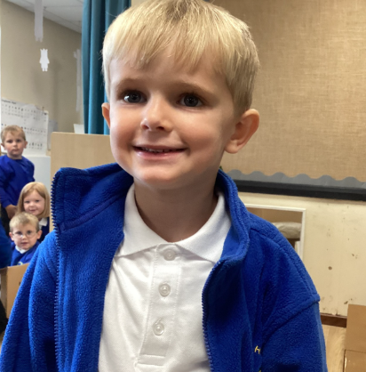
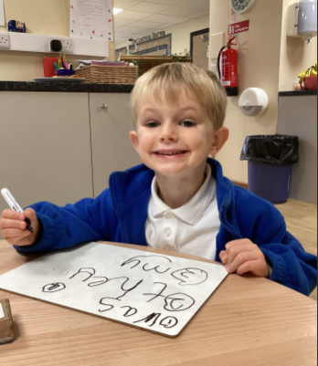
Our Cygnets Hero
Jasper is extremely caring. He always makes sure everyone is happy and is very helpful, always asking for jobs to help. He is very bright and we cannot believe some of the things he knows. He is very good at maths and even knows his times tables! He has been doing amazing writing and loves to write tricky words, which blows us away! We are so proud of you Jasper, keep up the fantastic learning.

Slide 4
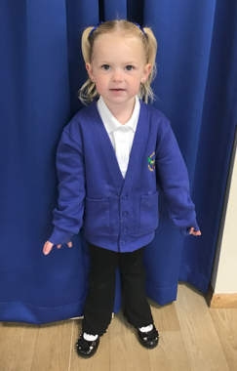
Our Cygnets Hero
What an amazing week for Miley!
No tears at school this week and she is leaving her Mummy so brilliantly every morning! Miley is much happier at school and has been showing us a big smile this week, Miley is more willing to join in, sit on the carpet and play independently with her friends. Mrs Clay and Mrs G are so impressed with Miley’s enthusiasm during phonics. She is so keen to join in with every activity. Well done Miley, we are all so proud of you!

Slide 5
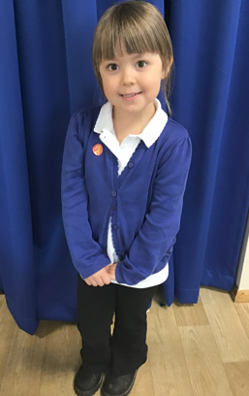
Our Cygnets Hero
Autumn is an ‘always’ child and she is such a pleasure to have in our Cygnet class, She ALWAYS tries her best, ALWAYS has a positive attitude and challenges herself with a smile on her face,
Autumn loves to learn and she is so enthusiastic in our phonics and maths lessons. She listens very carefully and soaks up all the knew learning! She has really impressed us this week with her blending in phonics and she can now independently sound talk and blend the sounds to read CVC words. She always looks so pleased with herself when she reads a word by herself!
Autumn is a lovely, kind and nurturing girl who has made some lovely friendships in our class. Autumn, you are a super star!

Slide 6
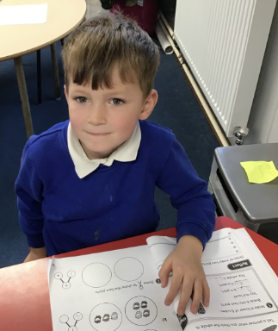
Our Puffin Hero
Wow, what an amazing start to Year 1 Oakley has made. This week in particular I am so proud of the effort he has put into ALL his work. He has tried so hard to complete his writing independently and to remember to use his phonics to write words. He has also been so well behaved and helpful around the classroom. Well done, Oakley, you really are a PERFECT PUFFIN!

Slide 7
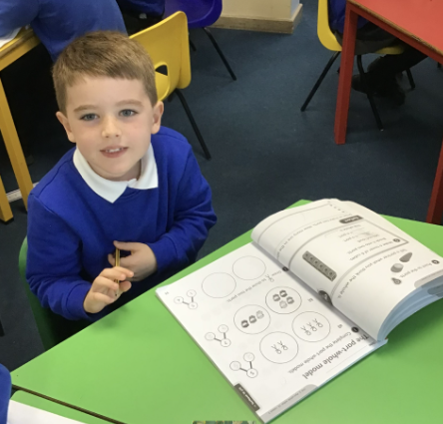
Our Puffin Hero
Wow, Kai has made a brilliant start to Year 1. He was certainly not a keen writer when he started in Puffin Class but has tried super hard over the last few weeks and has made great progress already. Most importantly he is always well behaved and kind to other children. He is a quiet little boy but it was absolutely lovely to see him enjoying himself so much in the Free Style Football session we had this week. He showed great determination to achieve each of the skills the coach taught the children. Well done Kai, you really are a PERFECT PUFFIN and I am so proud of you!

Slide 8
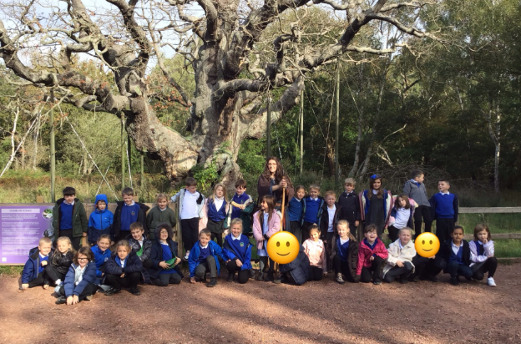
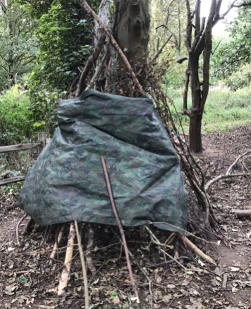
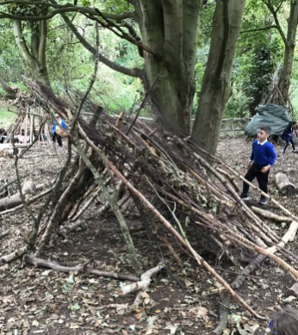
Our Wren Hero
Year 2 were absolute superstars for our trip to Sherwood Forest. They were polite, sensible and had an amazing time finding out lots of interesting facts about Robin Hood, his Merry Men and the Sheriff of Nottingham. We also learned lots about the different oak trees within the forest. They had an absolute blast at den building too and created some fabulous dens! We were all so proud of you!
Also a shout out to the year 1s for a fabulous day at school with Mrs Cooper, super excited for their turn on Tuesday!

Slide 9
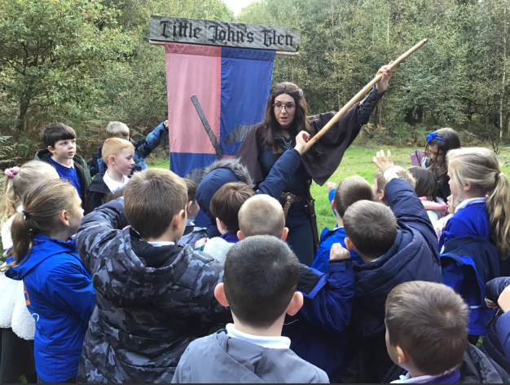
Our Woodpecker Hero
This weeks Woodpecker Heroes are the whole of Woodpecker Class. We went on our trip to Sherwood Forest yesterday and all the adults were so proud. Everyone had a fabulous day and were so well behaved and polite at all times. They listened well to Maid Marion and joined in with everything we did. They were a real credit to Holly Hill and they made it a really enjoyable and super day for everyone.

Slide 10
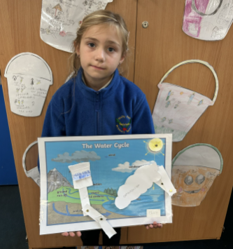
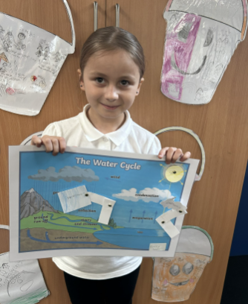
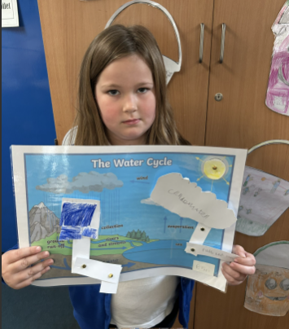
Our Kingfisher Heroes
Our Kingfisher heroes this week are Elsie, Bobbi and Bexley 🤩
We have been busy working on our design technology project which has been quite challenging. Year 3 have been making different types of levers to make different parts of the water cycle move.
Not only did these girls finish their levers with resilience and perseverance, but they also then went to help others with their levers.
I am impressed with their hard work and determination.
Well done heroes! 🌟

Slide 11
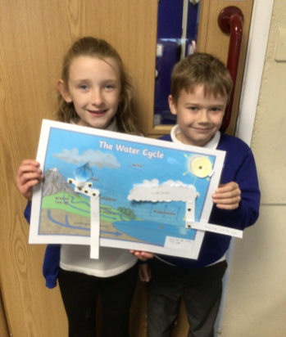
Our Dove Hero
Dove heroes this week are Lilah and Connor. They worked brilliantly together to create a moving model of the water cycle. They solved problems, took turns and created a wonderful end product. What a great team!

Slide 12
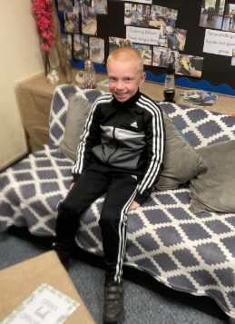
Our Swallow Hero
Jack is our hero today. I am so happy with Jack. He has been an amazing Swallow so far this year and he is always ready to learn in class. He has shown a good attitude and tries hard with his work. Well done Jack - a fabulous start to Year 4.

Slide 13
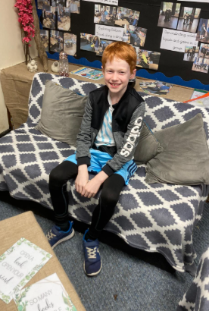
Our Swallow Hero
Alastair is a hero every day. He is Swallow’s fountain of all knowledge and every day his contributions to our learning are amazing. He is always quick to join in and he will support others with their learning. Well done Alastair - you are amazing.

Slide 14

Our Owl Hero
Owl’s hero is Ela. Ela has impressed us this week by making brilliant links to what we have learnt in previous lessons. This shows you’re really thinking deeply, remembering key ideas, and making great connections in your learning. You are an outstanding role model to the class, I am so proud of you!

Slide 15
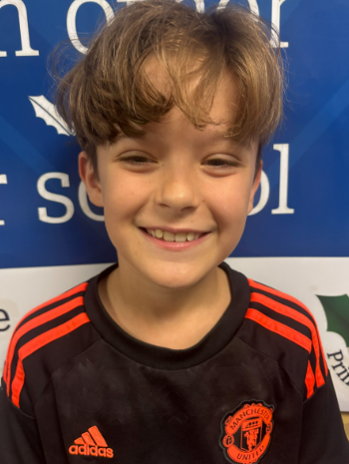
Our Owl Hero
Owl’s hero is Cruiz. Cruiz works so hard to complete his work to the highest standards, whilst being kind and helpful to others in the classroom. His hand is always up ready to share his brilliant ideas. Your positive attitude towards learning and willingness to help your friends makes you an Outstanding Owl. Well done Cruiz, I am so proud!

Slide 16
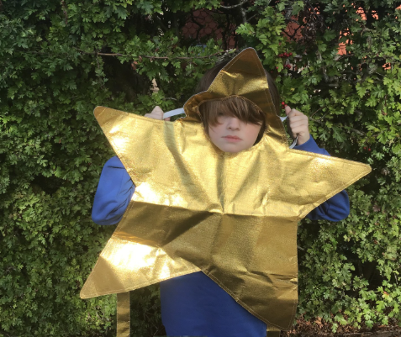
Our Falcon Hero
My first hero this week is Miller. Both myself and Miss Hill have been really impressed with his work ethic this week. He's given every task we have put in front of him a really good go and not given up, even if he has found it tricky. We are so excited to see this positive attitude towards school Miller - keep it up - you are truly turning into a Fantastic Falcon!

Slide 17
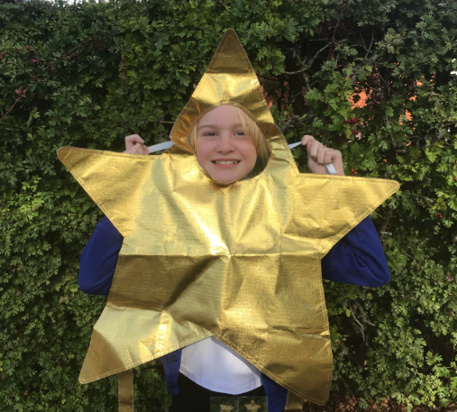
Our Falcon Hero
My second hero this week is Megan. Without fail, Megan puts 100% effort into every piece of work and presents it so beautifully. She has such a vast bank of knowledge in her brain which she imparts into every lesson, both during input and completing her tasks. You have kicked off Year 5 extremely well Megan - a Fantastic Falcon indeed!

Slide 18
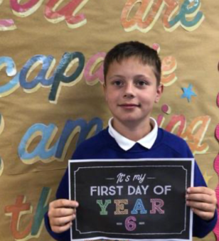
Our Swan Hero
Alan is a hero this week for his so many reasons, the first being for his contributions to our RE lesson this week. Alan had some really mature and interesting opinions about forgiveness and always puts his ideas forward so clearly. Alan also deserved to be recognised this week for the hard work he has put into Year 6 so far. Alan works so hard every single day and 100% shows what a positive attitude to learning looks like. He is such a kind coach to his partners and a calming influence on our class. Alan, you bring so much wisdom to Team Swan and I think you’re amazing! 🌟

Slide 19
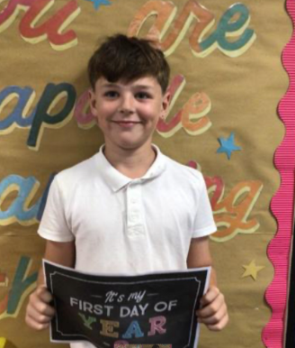
Our Swan Hero
Seb is a hero this week for lots of reasons. This past week or so, Seb has really found his stride in Year 6 - he works hard every single day and has produced some fabulous work, particularly his information text about an explorer in English and anything geography related (if you ever need to identify a flag, Seb is your guy!) Seb brings a smile to my face every day too: he always has a funny story to tell us and has such a bright personality - Seb, I think you are completely wonderful and Swan class are lucky to have you around! 🌟

Slide 20
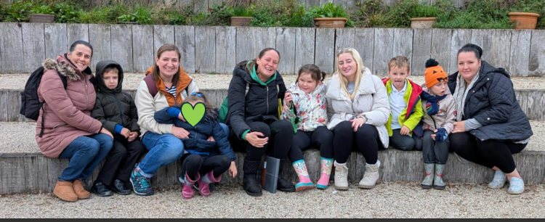
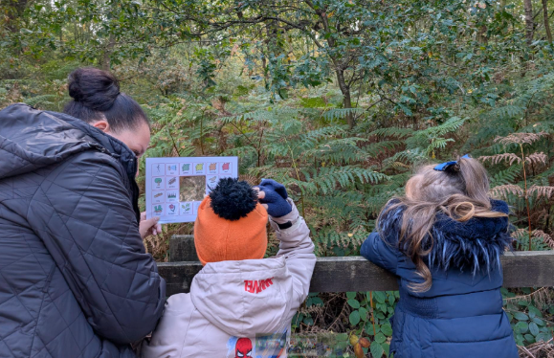
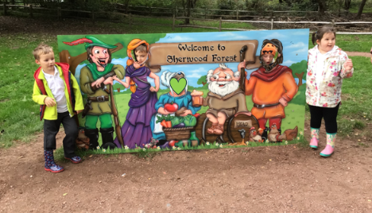
Our Nest Heroes
Our Nest children are ALL heroes this week. They made us so proud on our visit to Sherwood Forest and were all a pleasure to go on a woodland adventure with. They built dens, drank hot chocolate, enjoyed a picnic, went on a woodland walk, completed a nature hunt and found the Major Oak. Such a busy day but we had so much fun! Well done everyone!

Slide 21
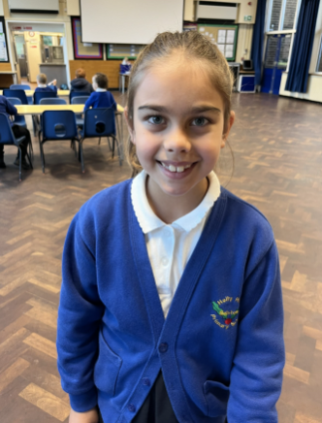
Our Wraparound Hero
Lilly is our wraparound hero this week. Lilly is always kind and welcoming to all of the other children in wraparound care. She is also exceptionally helpful to other children and adults – she is an absolute delight to have in breakfast and after school club. Well done Lilly!

Slide 22
Class Attendance winners
This week’s winners with 97.7% are Kingfisher class! Well done Kingfishers!
Remember, when you reach 3 wins, your class will get £25 to spend on books and 15 minutes extra play! Try to come to school every day to help your class be the winners!
CLASS | WIN 1 | WIN 2 | WIN 3
Cygnets 1
Cygnets 2
Puffin
Wren
Woodpecker
Kingfisher
Dove
Swallow
Owl
Falcon
Swan

Slide 23

Have the best weekend everyone.
Mrs. Steed xxx

