Slide 1

Holly Hill Heroes Assembly
HOLLY
HILL
AUTUMN TERM, 2025

Slide 2
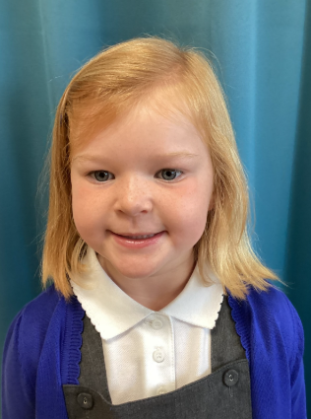
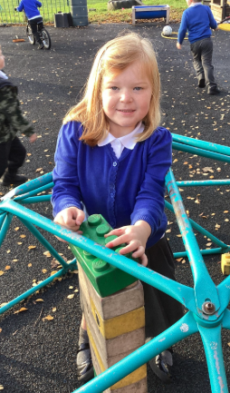
Our Cygnets Hero
Myla is an all round amazing cygnet! She plays with all children and has some fantastic ideas for play. This week she has been trying to make tall towers with the giant duplo, she even made one taller than me! She works so hard at everything she does and always has an enormous smile on her face. Keep up all the hard work and making us laugh and smile on a daily basis.

Slide 3
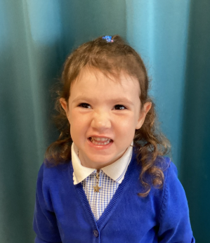
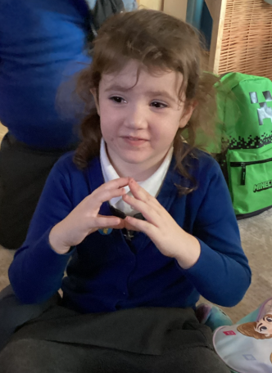
Our Cygnets Hero
Dolly has been very resilient this week in school. Her closest friend has not been in, but she has persevered and found new friends to play with. She has started to stand up and share her ideas with her classmates. We have started to learn some new songs and she already remembers all the actions. Well done Dolly!

Slide 4
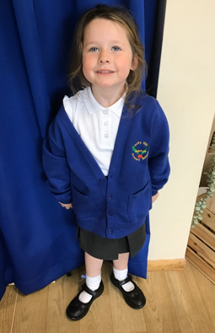
Our Cygnets Hero
We love having Gracie in the Cygnet class. She is a confident girl who has settled brilliantly into life at Holly Hill. It’s like she’s been with us for years! She follows all our routines and class rules and she is brilliantly behaved! Gracie is a little social butterfly and has made so many new friends since starting school. We always hear her chatting to her friends, often sharing her ideas and experiences with others.
We are so proud of Gracie’s name writing this week. She has been working so hard to write the letters in order and she has improved every single day! Thanks for being a super Cygnet Gracie!

Slide 5
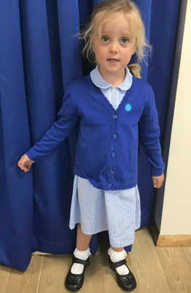
Our Cygnets Hero
Sophie is a pleasure and she makes us smile every day.
She has also settled into the Cygnets brilliantly and she has become very independent. She is more willing to try new activities and have a go, even if she finds something tricky.
We love how chatty Sophie is and she often tells us a tale! She often makes us laugh when she shares her stories.
Sophie has a super imagination and she shares some great ideas in her play. She makes the most delicious cakes and biscuits in the play dough area.
Sophie has been reading so many stories at home and we are so proud of her. Well done Sophie!

Slide 6
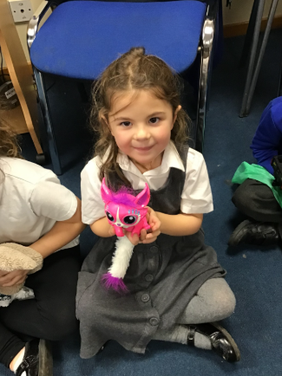
Our Puffin Hero
Violet is most definitely a Puffin Class Hero this week. She has been trying so hard with all her writing and Maths. She has particularly worked hard to use a number line to add. To start with she found it really tricky (as did many of the other children). However, after a bit of extra practice with Mrs Cottee, the following day she was able to work independently remembering what she had to do to find the answer. Well done Violet you truly are a PERFECT PUFFIN!

Slide 7

Our Puffin Hero
Carson must also be a Puffin Class Hero this week. He is such a quiet little boy who does not always like attention being drawn to him so it is so lovely to see him gradually growing in confidence. Over the past few weeks, he has really tried incredibly hard with his writing and this week in particular has blown Mrs Cottee and Mrs Cooper's sock off by writing independently. In fact, we were both so impressed that not only is he a Hero but he also had a dip in the Treat Box. Well done Carson you truly are a PERFECT PUFFIN!

Slide 8
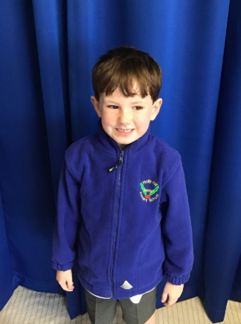
Our Wren Hero
Alfie has been an absolute superstar in Maths this week. He has been trying really hard and giving every lesson a good go. We have used the resources to help as the numbers are getting much bigger and he's flown with it! It's so lovely to see his proud smile when he's completed the work. Keep it up Alfie!

Slide 9
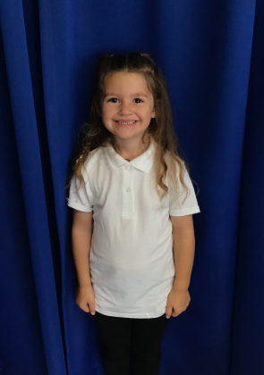
Our Wren Hero
Robyn has been a superstar in Phonics this week. She always gives it her best and has a go at reading all of the words, even the trickier ones. We have been learning lots of new graphemes and she's picking up them up each day. What a superstar! Keep it up Robyn!

Slide 10
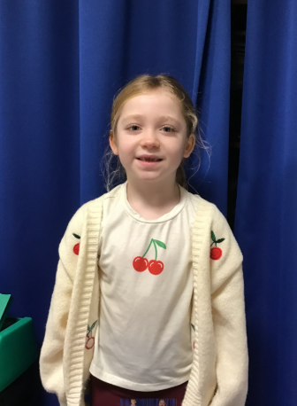
Our Woodpecker Hero
This week’s heroes are Frankie and David.
Frankie has just started in Woodpecker Class but you wouldn't know it. She has settled in so well it's like she has always been here. She has made so many friends already and is so popular. She works hard and tries her best in everything and we feel so lucky to have her in Woodpecker Class.

Slide 11
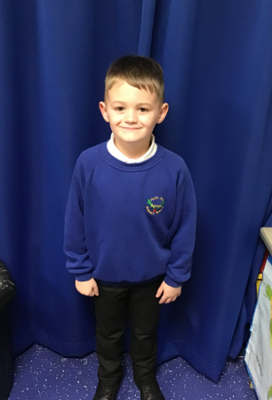
Our Woodpecker Hero
Our other hero is David. This week David has really impressed Mrs Brooks in reading groups with his sensible reading. He has been really focused and has read his book fluently and with prosody. Mrs brooks said he was a real superstar in her group. Well done David.

Slide 12
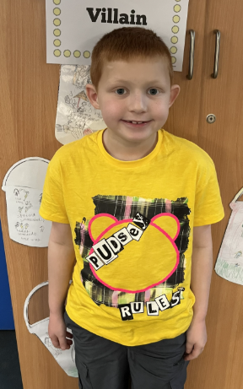
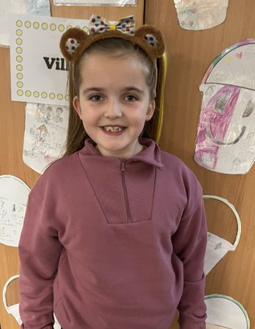
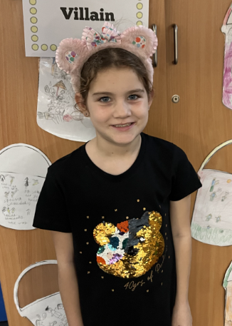
Our Kingfisher Heroes
Congratulations to our three heroes this week! Mrs Fisher has noticed Isabella, Joe and Hetty who have worked very hard in all their subjects. They are always doing the right thing and following the Holly Hill way.
We are proud of what you have achieved. Well done Kingfisher Heroes, keep up the good work! 🌟

Slide 13
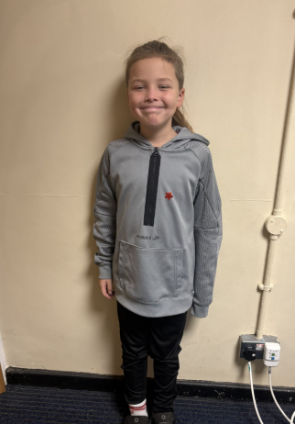
Our Dove Hero
Our first hero this week is Joshua. He has been working really hard in class especially in English with his writing. Joshua has also shown great determination in maths this week, not giving up when he found something tricky and having great success with new skills as a result. Well done Joshua!

Slide 14
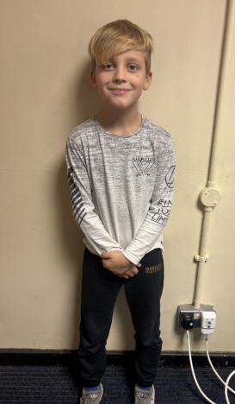
Our Dove Hero
Our second hero is Reuben. Reuben has been super motivated lately, showing great enthusiasm and concentration across the whole curriculum. He also was great ideas and is willing to share them with the class. Well done Reuben!

Slide 15
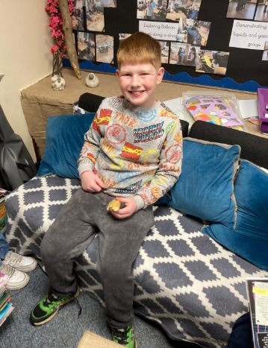
Our Swallow Hero
William is a hero this week. He has impressed me so much with his attitude to learning. He has been answering questions and made some particularly great contributions in music yesterday. Well done William - keep being fabulous!

Slide 16
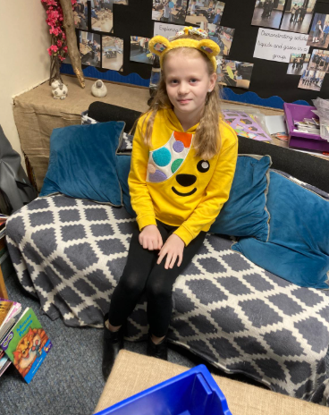
Our Swallow Hero
Holly is hero today for so many reasons. It is a pleasure to have her in Swallow class. She has worked hard in Mr Closes Maths group this week being a key contributor to the lesson. In nature group Holly has taken an active part in the group sessions and shown pure enjoyment for learning outside. We love your sense of humour and your lovely personality Holly. Keep being you.

Slide 17
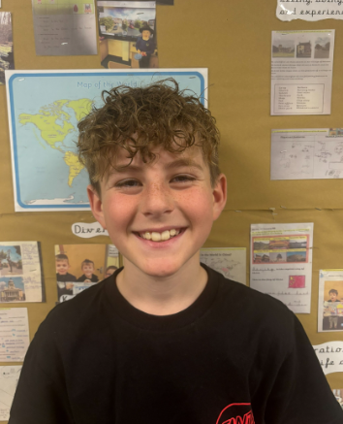
Our Owl Hero
This week’s hero is Mason. Even when Mason has found things tricky, he has persevered. Mason's effort and determination has been inspiring for the rest of the class. Well done Mason, we are all so proud!

Slide 18
Our Owl Hero
Another hero this week is Leo. Leo has really enjoyed the book we are reading in English. He has been using his imagination to come up with super ideas and descriptions of the setting! His hand is up constantly ready to share his brilliant ideas with the class. Well done Leo, I am so proud of you!

Slide 19
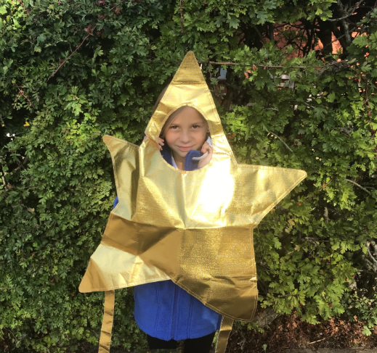
Our Falcon Hero
My first hero this week is Cerrone. Cerrone is one of those children who will always get on without a fuss and gives everything put in front of her a really good go. I have been particularly impressed with her resilience in maths recently, giving it her all with immensely tricky topics like long division. You truly are a Fantastic Falcon indeed, Cerrone!

Slide 20
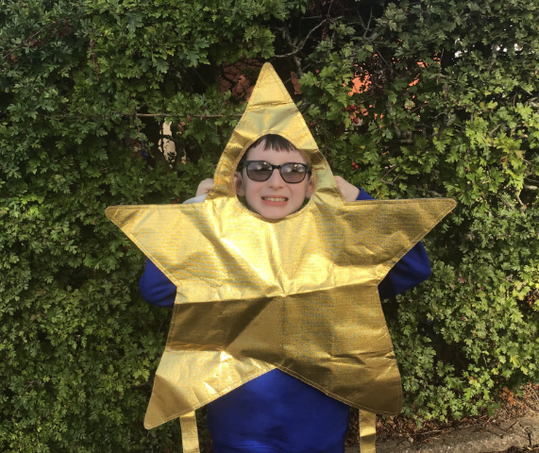
Our Falcon Hero
The next hero I want to celebrate this week is Carson! I feel he has adapted really well to some of the changes he has faced in the past couple of weeks, whether that was his friends being poorly and not in school, or Miss Hill not being in the classroom with us. Another truly Fantastic Falcon who has shown high levels of resilience. Well done, Carson!

Slide 21
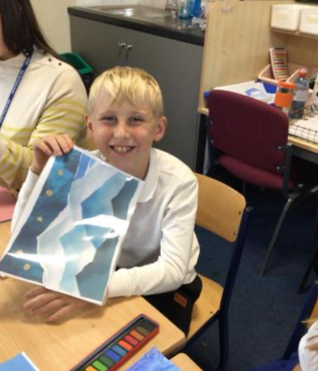
Our Swan Hero
My hero from last week is Riley. Riley had a fantastic week last week and worked so hard and his behaviour was fabulous. Riley has been enjoying our crime and punishment topic and sharing his knowledge in science lessons too. Well done Riley, keep being the best you can be because you're impressing me more and more each week! 🌟 🌟

Slide 22
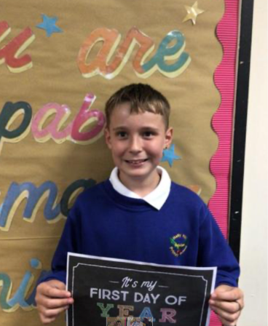
Our Swan Hero
My hero this week is Vinni. Vinni works so hard and is a pleasure to have in Swan class. Vinni is a calm role model for the rest of the school and tries hard to be the best he can be every day. He's also a maths genius!! Keep being amazing Vinni - Swan class are lucky to have you 🌟 🌟

Slide 23
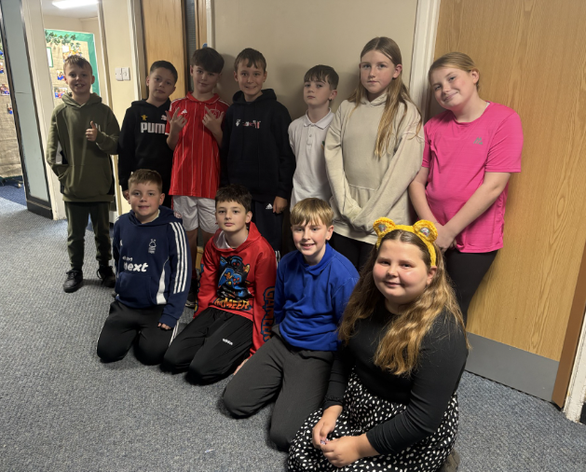
My Headteacher’s Heroes
My Headteacher’s heroes this week are this fabulous group of Year 6s who helped at the KS1 Winter Warmer on Tuesday. EVERYONE (staff, parents and children), commented on how friendly, polite, smiley and helpful they were as they manned their stalls, took money, handed out the cakes and helped to set up.
You are a credit to Holly Hill and your parents. I am extremely proud of you all - you are everything I hope a Year 6 will be by the time they are ready to leave our school (and we’ve still got 8 months to go!)
Well done Ethan, Alan, Seb, Vinni, Tyler, Isla, Amelia, Theo, Cory, Ralph and Lilly – you are the absolute best!!!

Slide 24
Class Attendance winners
This week’s winners with 96.8% are Woodpecker class! Well done Woodpeckers!
(I’ve also added on one win for Wrens and one for Swallows for the two weeks that we didn’t have Heroes)
Remember, when you reach 3 wins, your class will get £25 to spend on books and 15 minutes extra play! Try to come to school every day to help your class be the winners!
CLASS | WIN 1 | WIN 2 | WIN 3
Cygnets 1
Cygnets 2
Puffin
Wren
Woodpecker
Kingfisher
Dove
Swallow
Owl
Falcon
Swan

Slide 25
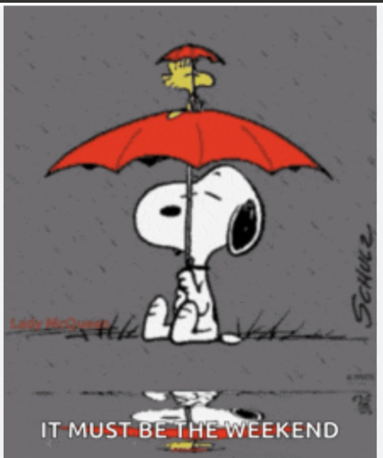
Have a lovely, slightly soggy weekend everyone!
Mrs. Steed xxx

