Slide 1

Holly Hill Heroes Assembly
HOLLY
HILL
AUTUMN TERM, 2025

Slide 2
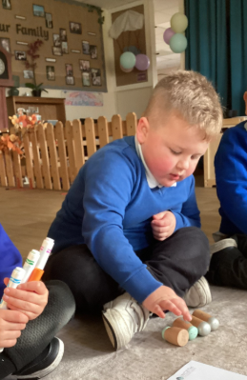
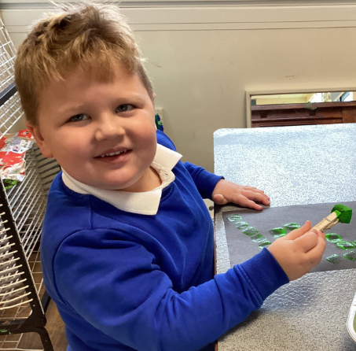
Our Cygnets Hero
Our heroes this week are Arthur and Ava
Arthur has grown so much in confidence since September and sets an amazing example to his friends. He sits wonderfully and has some great ideas which he shares with us. I particularly love some of his facial expressions when he is playing, we were acting out what an angry face would look like when we were talking about the angry stepmother in our story this week, it is brilliant. He has tried so hard to write his name and always participates in phonics. Keep up the hard work Arthur, we are so proud of you!

Slide 3
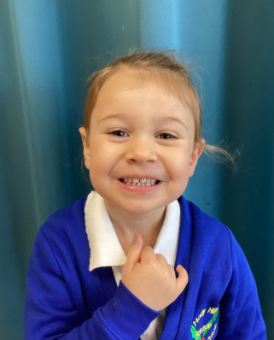
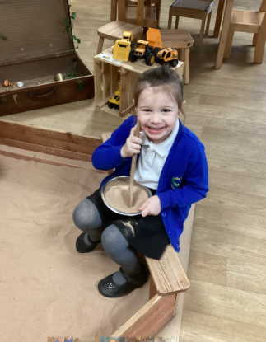
Our Cygnets Hero
Ava is such a happy, positive member of our class. She has settled so well into School and we feel like you have always been here. She is very independent and determined, happily participating in all areas of the class. She loves to draw and is very creative, often sharing her masterpieces for our wall. She is very imaginative, coming up with some very exciting games to play, meaning she always has lots of children to play with. Well done Ava, we are so glad you came to join us at Holly Hill.

Slide 4

Our Cygnets Hero
Theo is such a lovely boy and he has made so much progress since starting school in September. We are particularly proud of Theo’s listening and he trying his best to concentrate and listen carefully in our phonics and maths sessions.
Theo is very sociable and he has made some brilliant new friendships. He is very friendly and makes up some very good games to play. Theo amazes us with his physical skills and shows excellent control and co-ordination when playing ball games and riding on the bikes. He makes us laugh with his cheeky personality! WELL DONE Theo!

Slide 5
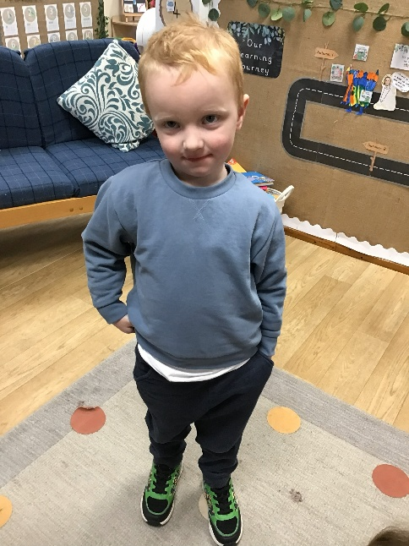
Our Cygnets Hero
Jaxon has really started to engage in some lovely play!
He comes in each morning and independently selects an activity, he knows exactly what he wants to do! He can play imaginatively with the animal toys and he likes to build tracks for the trains.
Jaxon is trying really hard to do tasks by himself and he is now more independent in organising his things. He is also getting much better at listening to instructions.
Jaxon has really impressed us with his tidying up skills this week! He has been a big help at tidy up times and putting toys away in the correct place, Thank you for being such a helpful Cygnet Jaxon!

Slide 6
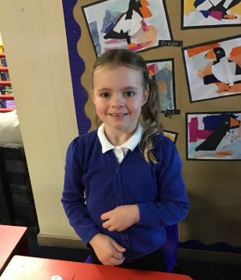
Our Puffin Hero
Wow, Harper could be Puffin Class Hero every week. She is the most fabulous, well behaved little girl who always gives 100% even this week when she is feeling under the weather. Most importantly Harper is incredibly kind and caring towards other children and treats adults with respect. Harper you truly are a PERFECT PUFFIN!

Slide 7
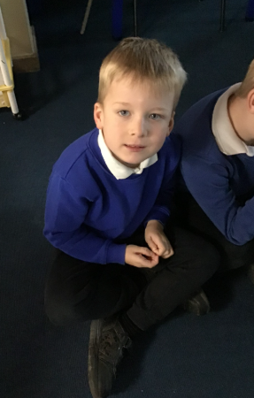
Our Puffin Hero
Max has got to be a Puffin Class Hero this week. Despite the fact that he was really poorly at the weekend and was in hospital, he has tried really hard to be super sensible and well behaved all week. He has also worked really hard over the last 2 weeks and last week wrote a fabulous description of Traction Man in English. Well done Max, you really are a PERFECT PUFFIN!

Slide 8
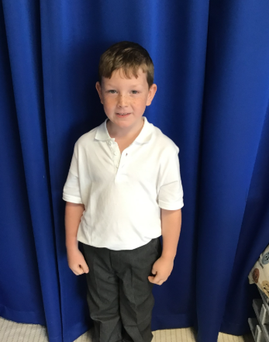
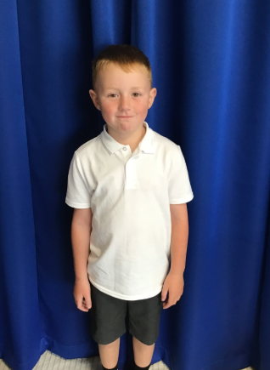
Our Wren Hero
Ronnie and Oscar have been superstars over the last few weeks, helping their peers during playtimes and during lessons. They have been fabulous role models for the year ones, supporting them with playing football, completing their maths and explaining strategies to them. What superstars! Keep it up boys, it's been a pleasure to see!

Slide 9
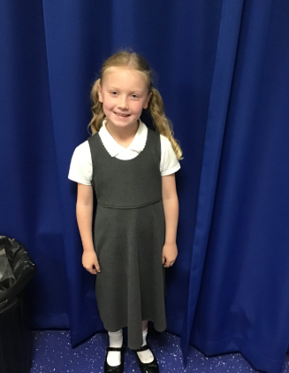
Our Woodpecker Hero
This weeks Woodpecker heroes are Lottie and Seth.
Lottie has worked super hard in her Maths this week and has really impressed me with her numbers. She has been working hard partitioning numbers and has really got the hang of it. She has also been super keen to answer questions in Maths too. Well done Lottie!

Slide 10
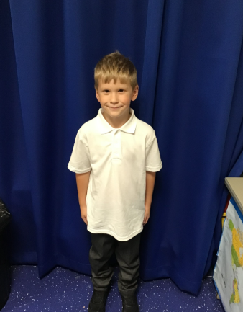
Our Woodpecker Hero
Seth has really impressed me with his writing. Last week we wrote the Traction Man story and Seth was so focused on his writing. He put his head down and wrote and wrote and wanted to do his best writing - and he did - he even got a head teachers award.
Well done both of you for all your effort.

Slide 11
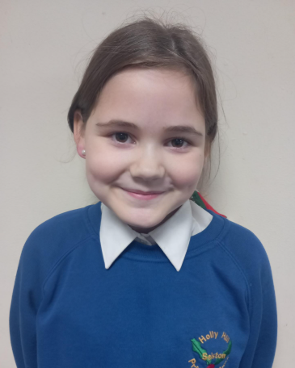
Our Dove Hero
Our first Dove Hero this week is Larna. Larna always impresses with her work but has blown Miss Quarmby away with her biography of Albert Einstein this week! She has included all the features we have asked for and has written an entertaining and engaging piece. Well done Larna!

Slide 12
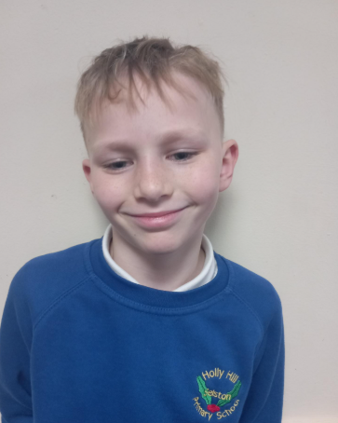
Our Dove Hero
Our second Dove Hero is Kevinas. Kevinas has only been at Holly Hill a little while but has really impressed us with how hard he is trying and the work he is producing. He is becoming a real asset to Holly Hill and a great member of Dove Class. Well done Kevinas!

Slide 13
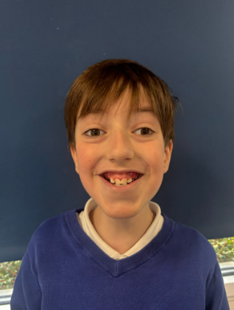
Our Owl Hero
This week’s hero is Stanley. Even when Stanley has found things tricky, he has asked for help and tried his hardest. Stanley’s singing in music has been beautiful too! Well done Stanley, we are so proud of you!

Slide 14
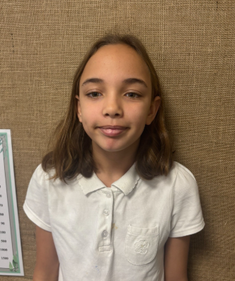
Our Owl Hero
Owl’s hero is Skyla. Skyla has found fractions tricky, but she has persevered and tried her hardest. Skyla has been working through the questions on the board independently. It is lovely to see your confidence grow Skyla. Well done!

Slide 15
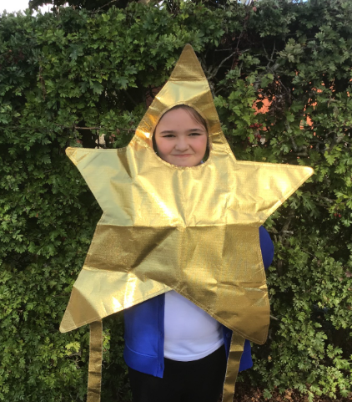
Our Falcon Hero
My first hero this week is Gwen. Gwen is one of those always children who will just get on with her work without a fuss at all. Whilst she can sometimes be quiet, I am enjoying starting to see her cheeky and more confident side come out more. I was particularly impressed with her debating skills in history last week. The vocabulary she used to word her arguments was fantastic! Keep up the amazing work, Gwen!

Slide 16
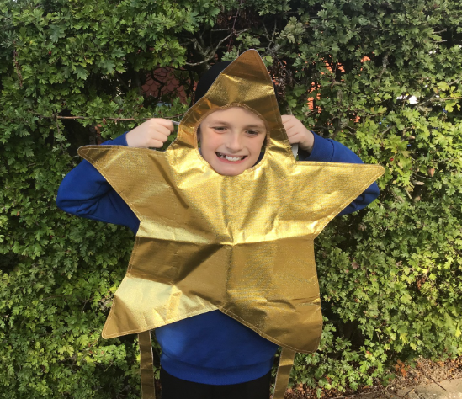
Our Falcon Hero
My next hero is Julian! I have been really impressed with how hard Julian has worked in all of our lessons over the past couple of weeks, but what I really want to celebrate is how well he has adjusted to all the changes to our timetable recently! From first aid sessions, lessons at different/ unusual times and not always having Miss Hill in the room when we usually would, I think he has coped and adjusted really well and I am immensely proud of him. Well done, Julian!

Slide 17
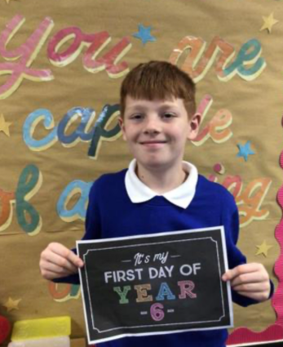
Our Swan Hero
My first hero this week is Jacob. I read Jacob’s writing to Mrs Watson this week, and she was completely blown away and said that his writing was like listening to an actual story. Jacob has amazing ideas to contribute to the class and words super hard every day. Well done everyone! 💙🦢

Slide 18
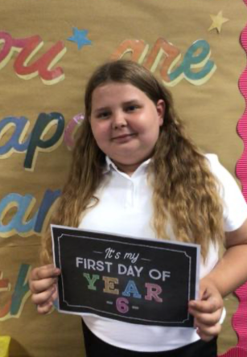
Our Swan Hero
My next hero this week is Lilly. Lilly is such a lovely friend and makes me so proud every single day. Lilly has been working so hard in our writing lessons and has produced some fabulous pieces so far this year. Her handwriting is also beautiful! Lilly, I love having you in Swan class 🦢 💜

Slide 19
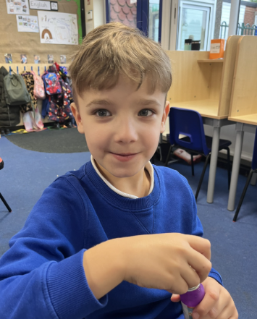
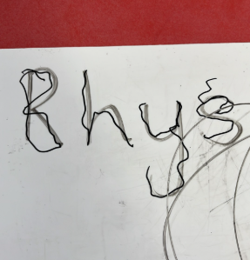
Our Nest Hero
Our Nest hero this week is Rhys. This week Rhys has written his name all on his own for the first time!! This is such a huge achievement and we are so unbelievably proud of you Rhys – well done!

Slide 20
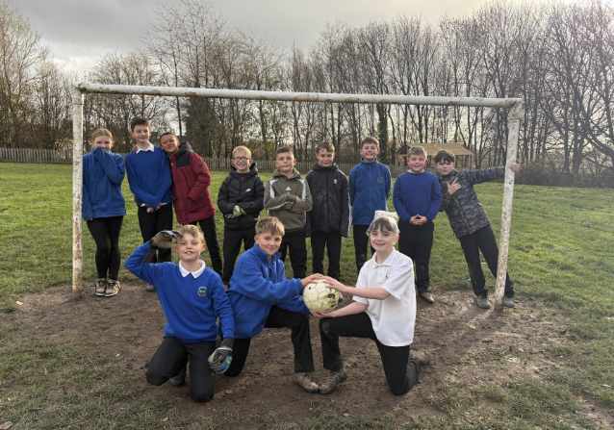
My Combined Headteacher/Lunchtime Hero mash-up heroes!
A special shout out today to Jaxon who shouted “Miss, watch out!” at lunchtime today. I moved my head to avoid the ball that was coming towards us and it hit him straight in the face!!! You were my real life hero today Jaxon – thank you!!!
This week I have chosen this fabulous group of Year 6s to be my lunchtime/Headteacher’s heroes. I have chosen them because their lunchtime behaviour is outstanding, every single day. They love to play football and they are always filthy! They take themselves down onto the field, sort their teams out, have a kickabout, laugh and make up silly games (such as Isla being the post and Tyler wearing a sandwich bag on his head!) and never cause a single problem. They are polite and friendly with all of the lunchtime staff and an absolute dream to supervise outside. I’m extremely proud of you all and very grateful that you help to make my lunchtime duties a pleasure. A huge well done to Isla, Cory, Saracen, Theo, Jaxon, Vinni, Jake, Theo, Seb, Ethan, Issac, Tyler and Alan (missing from the photo!)

Slide 21
Class Attendance winners
This week’s winners with 95.8% are Dove class! Well done Doves!
And Swallow class were our winner last week so they are the first winners of the attendance award this year! £25 and an extra playtime coming your way!
CLASS | WIN 1 | WIN 2 | WIN 3
Cygnets 1
Cygnets 2
Puffin
Wren
Woodpecker
Kingfisher
Dove
Swallow
Owl
Falcon
Swan

Slide 22
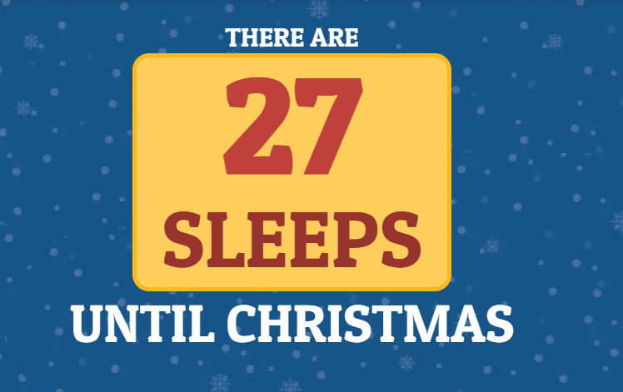
It’s never too early to start counting down right?
Have a lovely weekend everyone!
Mrs. Steed xxx

