Slide 1

Holly Hill Heroes Assembly
HOLLY
HILL
AUTUMN TERM, 2025

Slide 2
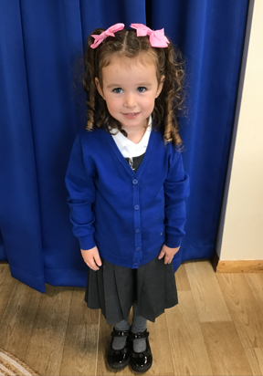
Our Cygnets Hero
Isla-Rose is a Cygnet superstar! She is such a good role model to the nursery children, often helping them out and taking good care of them. We love how Isla-Rose explores the whole environment and she is willing to try lots of new activities. She is developing a good attitude towards her learning and she is beginning to believe in herself. Isla-Rose is trying really hard in our phonics sessions and her name writing is getting better every day, We are so proud of you Isla-Rose and we love having you in the Cygnet class.

Slide 3
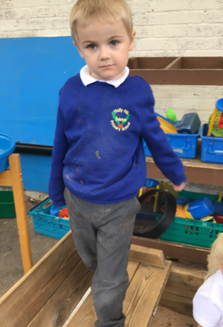
Our Cygnets Hero
Ellis is such a lovely boy and he makes our hearts happy every day. He has settled so brilliantly as an F2 and he has quickly got used to a full school day.
He comes in each morning and independently chooses an activity to do which is usually playing with Mr Potato head! He is starting to engage in play alongside some of the other children.
We are really proud of Ellis in our Christmas nativity performance. We love the way he follows and copies the children. He makes us laugh by joining in with all parts!
You really are a superstar Ellis, we are so lucky to have you.

Slide 4
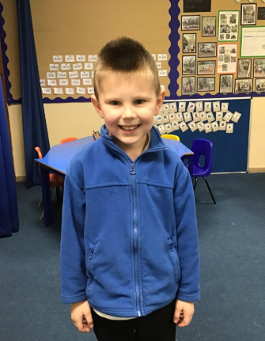
Our Puffin Hero
Alfie is a Puffin Class because he consistently tries hard with all his work and has recently put huge effort into his writing. But most importantly he is always incredibly kind to the other children and respectful to adults. Well done Alfie, you truly are a PERFECT PUFFIN and I am very proud of you!

Slide 5
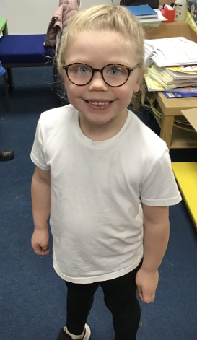
Our Puffin Hero
Ada has got to be a Puffin Class Hero this week as she has had the most amazing week. She has tried super hard to concentrate on the carpet and be sensible in class. She has been happy, smiley and loving everything we do. She has worked hard recently with her writing and this week has written a fabulous set of instructions to make a biscuit bear. Well done Ada, you truly are a PERECT PUFFIN and I am very proud of you!

Slide 6
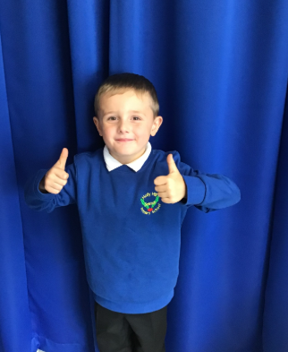
Our Wren Hero
Our first Wren hero today is Benjamin.
This is for trying super hard with his writing this week, especially his handwriting. We've been writing instructions for how we made and baked our biscuit bears and his writing looks fabulous. He's also remembered all the features needed such as bullet points and numbered steps!
Well done Benjamin, keep up the hard work!

Slide 7
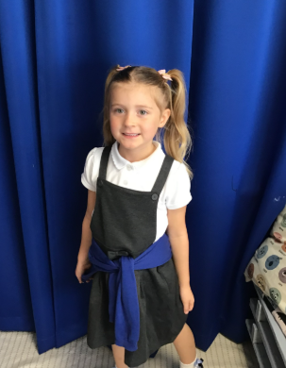
Our Wren Hero
Our second Wren hero today is Holly.
Holly has also been trying really hard this week with her Maths and Writing. She has been impressing me with her shape knowledge and has also written some wonderful instructions for making our biscuit bears.
Great work Holly – super proud of you!

Slide 8
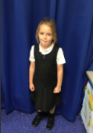
Our Woodpecker Hero
Ella is an absolute ray of sunshine in our classroom and no matter what feedback she receives, she always has a little chuckle which brightens our day. She has learnt her concert words beautifully and says them loudly and clearly. Ella you are our hero this week and we are so, so proud of you!

Slide 9

Our Woodpecker Hero
We would describe Matas as an always child as he ALWAYS does exactly what is asked of him. He sits and listens like an angel and is always on the recognition board. Matas also produces the most beautiful work daily. You are our hero this week for being an absolute superstar Matas!

Slide 10
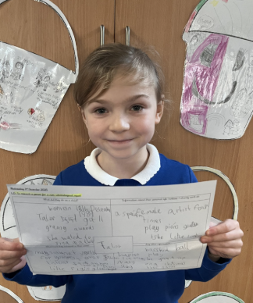
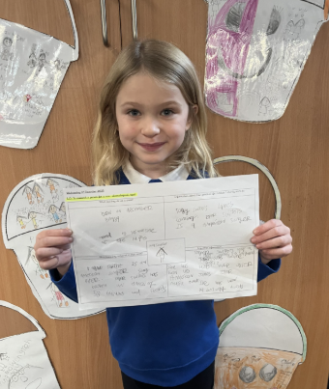
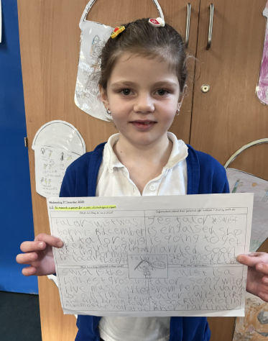
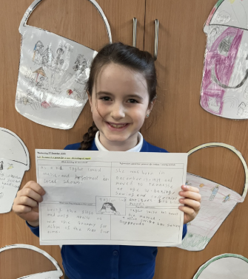
Our Dove Hero
Kingfisher heroes this week are Lucy, Lottie, Bonnie and Lacey.
I have chosen these fabulous Kingfishers for their research work about a famous person of their choice.
Not only did they find lots of interesting facts but they worked very sensibly with their groups.
Well done heroes, you did a great job! 🌟

Slide 11
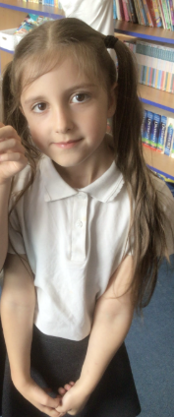
Our Dove Hero
The first Dove hero this week is Ella. Ella tries hard every single lesson and is always perfectly behaved. During her independent write this week, she really impressed us with how she tried so hard to use all the different aspects of writing we have focussed on this term. What a fabulous writer you are! Well done Ella!

Slide 12
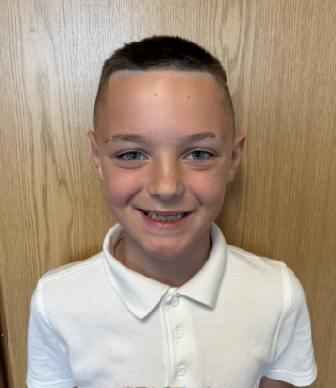
Our Dove Hero
The next Dove hero is Noah. Noah is just a perfect Dove in every way. He consistently works hard, is always ready to listen and is super helpful in every way he can be. He has produced some great writing this week too. Keep being the superstar you are Noah!

Slide 13
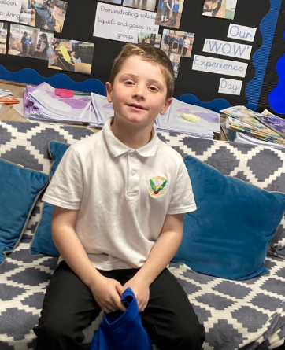
Our Swallow Hero
Thomas is becoming a maths star on a weekly basis. He is really developing his skills and confidence in this area. He made impressive contributions to our work on estimating and the efficient methods. Thomas is confident to explain his methods and justify his choices. Well done Thomas.

Slide 14
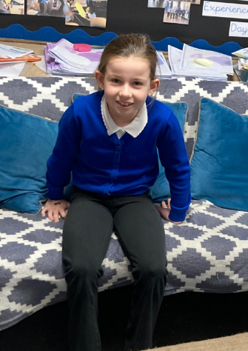
Our Swallow Hero
Amelia is also a Maths hero this week. I was so impressed with her progress in addition and subtraction column methods. Well done Amelia - you are a Maths super star!

Slide 15
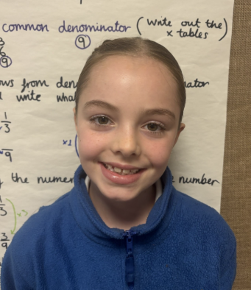
Our Owl Hero
Our Owl hero this week is Rosie. Rosie tries her hardest in every single lesson. Rosie has the most amazing imagination and contributes such brilliant ideas to our English lessons. I cannot wait to read her finished piece. I don’t know what we could do without your crazy imagination! Well done Rosie, I am so proud of you!

Slide 16
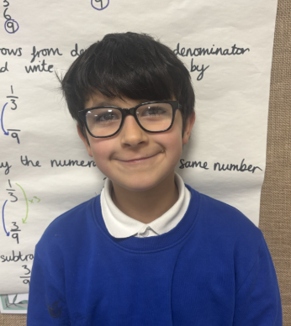
Our Owl Hero
Our Owl hero this week is Jasper. Jasper has such a brilliant attitude towards his learning. His hand is always up ready to share his amazing ideas. Jasper is our fraction expert at the moment! He is always kind and helpful to his classmates when they are struggling and makes a brilliant mini teacher! Well done Jasper, we are so proud!

Slide 17
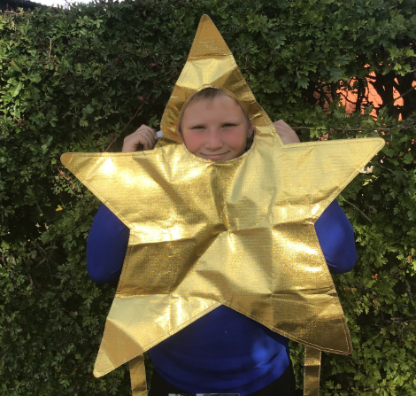
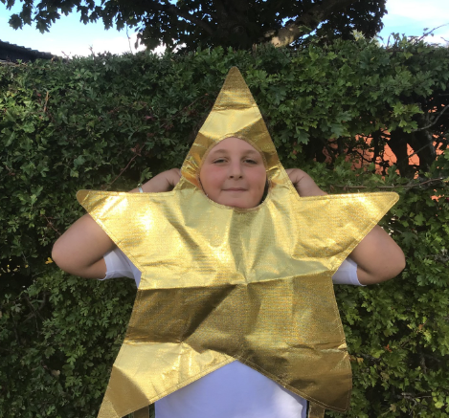
Our Falcon Hero
This week I would like to celebrate Everett and George. Both boys have seriously impressed me with how much determination and effort they are putting into practicing for the carol concert. Whether we are in the hall singing the whole school songs, or in our classroom rehearsing our class song, I know if I look over, I will see both of them giving it their all. You are doing our class proud boys - keep up the amazing effort! 🙂

Slide 18
Class Attendance winners
This week’s winners with 95.2% are Wren class! Well done Wrens!
Woodpeckers, Wrens and Kingfisher only need one more good week now to get their prize!
CLASS | WIN 1 | WIN 2 | WIN 3
Cygnets 1
Cygnets 2
Puffin
Wren
Woodpecker
Kingfisher
Dove
Swallow
Owl
Falcon
Swan

Slide 19
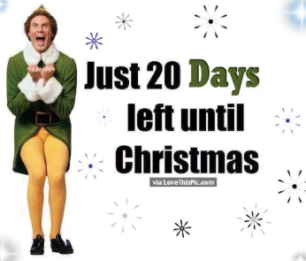
Have a lovely weekend everyone!
Mrs. Steed xxx

