Slide 1

Holly Hill Heroes Assembly
HOLLY
HILL
AUTUMN TERM, 2025

Slide 2
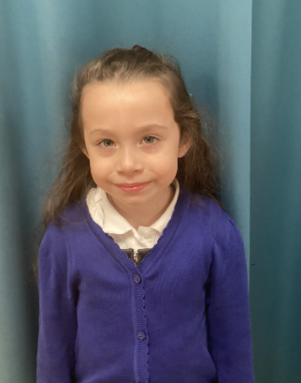
Our Cygnets Hero
Imogen only started with us at the start of this half term, but you wouldn't know - she truly has settled into Cygnets. She is such a star in the making! She loves performing and is always singing and dancing, no more so than when she performed at our Nativity - what a super star! She memorised most of her lines and said them so clearly, as well as taking on other parts when children were ill - well done.

Slide 3
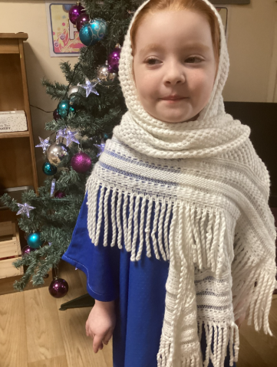
Our Cygnets Hero
Hale is such a kind-hearted member of our class and always makes sure all her friends are ok. She did an amazing job as Mary, having to remember lots of parts and actions, well done Hale. She has progressed so much since September and is now beginning to read and write. We are so proud of you - well done.
Even though Hale and Imogen are our heroes, we must celebrate all the Foundation children who have done some an amazing job at the Nativity - we are so proud of you all!

Slide 4
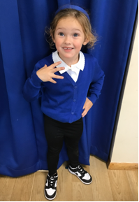
Our Cygnets Hero
Freya has amazed us this term with her super attitude towards learning! Her concentration has really improved and she is really starting to listen carefully, especially in phonics and number sessions. She was an absolute superstar in our nativity this week and was a brilliant grumpy king! Freya has such a lively, bubbly personality and she often makes us laugh with her funny stories! Well done Freya!

Slide 5
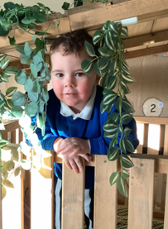
Our Cygnets Hero
It has been a joy to see Romeo grow in every way this term! He has settled so brilliantly and he now knows exactly what is expected of him at school! He follows all of our Holly Hill rules and routines. Romeo has a huge brain that is always switched on! He tries so hard in phonics and loves joining in with nursery rhymes. We are so proud of you Romeo.

Slide 6
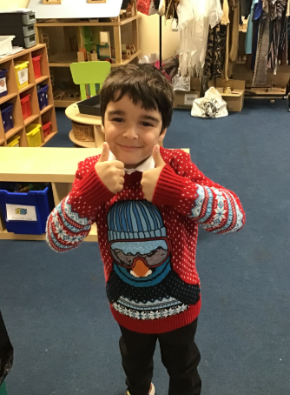
Our Puffin Hero
Amir is a Puffin Class Hero as he has been an absolute super star all week. He has been really sensible in class and tried really hard to sit and listen carefully. In our concert dress rehearsal he sang beautifully and was a fabulous donkey. Well done Amir, you truly are a PERFECT PUFFIN and I am really proud of you!

Slide 7
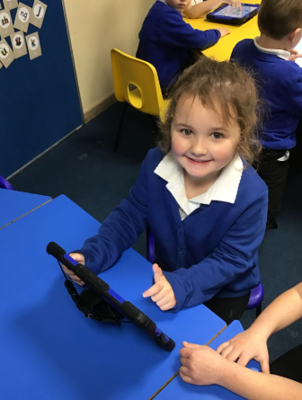
Our Puffin Hero
Isabella has got to be a Puffin class hero this week as she has been working incredibly hard to improve her writing over the last few weeks. She has tried hard to make her writing smaller, include finger spaces as well as use her phonic knowledge to write words - such a lot to remember and she has tried to do all of it. Well done, Isabella, you are a truly PERFECT PUFFIN and we are really proud of you!

Slide 8

Our Wren Hero
Ava has been a super star in our dress rehearsal this morning and was a beautiful Angel. She followed her peers and floated across the stage. We cannot wait for your family to come and watch you Ava!

Slide 9
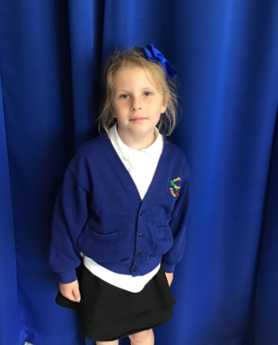
Our Wren Hero
Olivia was also a super star in our dress rehearsal. She knew when to speak, used a loud clear voice and joined in singing all our songs beautifully. Well done Olivia - your family will be so proud on Tuesday!

Slide 10
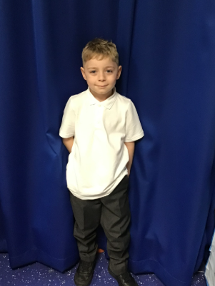
Our Woodpecker Hero
Our heroes this week are Xavier and Ivygrace.
Xavier has really impressed me this week with how keen he is to answer questions in class. He has put his had up lots and has given some really good, detailed answers, especially in Maths. Well done Xavier.

Slide 11
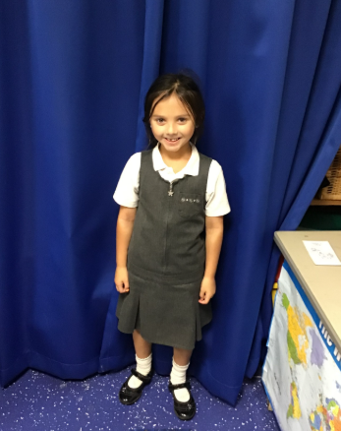
Our Woodpecker Hero
My second hero is Ivygrace.
Ivygrace is a narrator in our Christmas play and to start with she was really quiet saying her lines. She has worked really hard to learn her lines and at our dress rehearsal said them in a lovely, loud voice.
Well done Ivygrace.

Slide 12
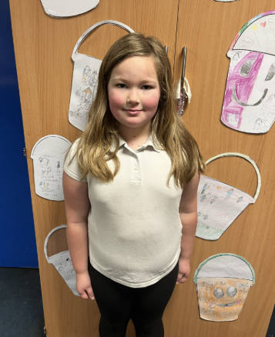
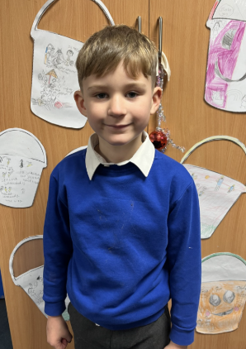

Our Kingfisher Hero
Our heroes in Kingfisher this week are Bobbi, Caben and Ruby.
This week Kingfisher have been working hard on their assessment tests.
Bobbi and Caben worked hard on their maths test and Mrs Fisher was really impressed with them.
Ruby has done brilliantly on her times table test.
Well done Kingfisher Heroes - your hard work has paid off!! 🌟

Slide 13
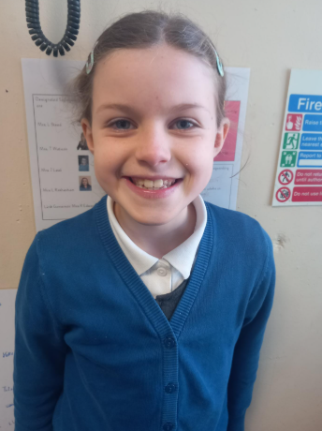
Our Dove Hero
Hanna is the first hero from Dove this week. She has shown great determination in maths with addition and subtraction. She has not given up when things have been tricky and has made wonderful progress. Well done Hanna!

Slide 14
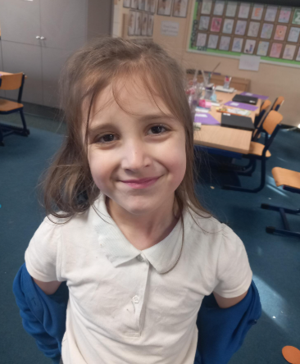
Our Dove Hero
Ella is a Dove hero this week. She also has shown great determination in maths, not giving up when she found things difficult and is now a whizz at column method for both addition and subtraction. Well done Ella!

Slide 15
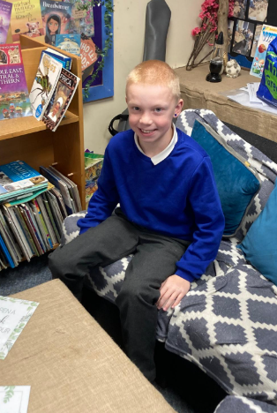
Our Swallow Hero
Jack is a hero in Swallow class.
This week he is a hero for a random act of kindness that I observed him doing. Absolutely brilliant and absolutely following our Holly Hill Way. One of our class phrases is ‘Just Be Kind!’ and you showed this today. Well done Jack!

Slide 16
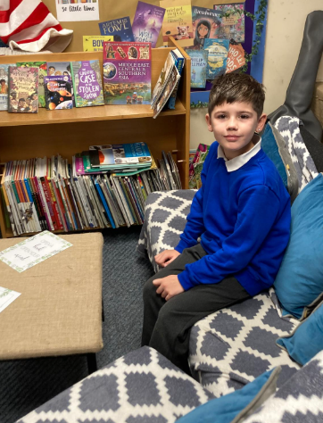
Our Swallow Hero
Jude is a hero all of the time - every single day. His attitude to his learning is amazing. He is always ready to learn. He is always respectful and he always gives 100 percent to his work. Well done Jude - it’s remarkable that every day you follow our Holly Hill Way and show us your very best!

Slide 17
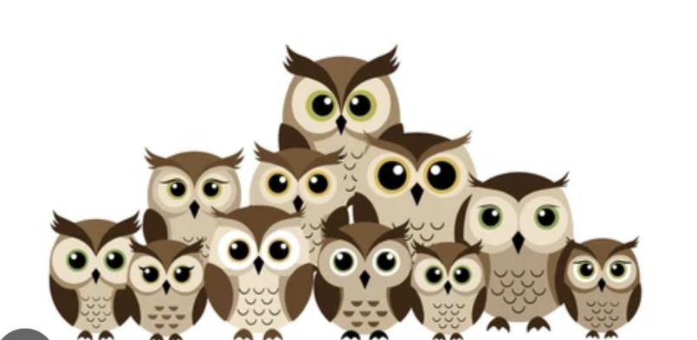
Our Owl Hero
This week, all of Owls are heroes. We have had assessment week this week and they have found some of it quite tricky. However, they have persevered and tried their best in every single test and I couldn’t ask for more! Well done Owls, I am so proud of you!

Slide 18
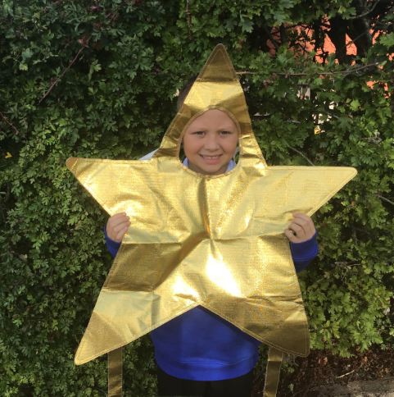
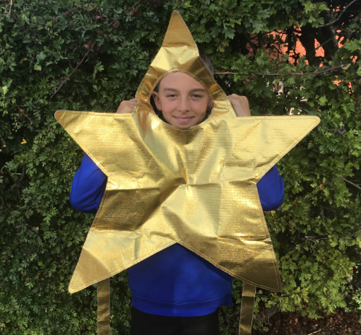
Our Falcon Hero
I would like to start by saying I think my entire class are heroes for trying their hardest in their assessments this week!
In particular, though, I would like to celebrate James and Morgan. Both boys have got on brilliantly with their assessments this week, giving it their all and not giving up, even when questions got tough. Their hard work and determination paid off, with both boys producing some of the highest Maths scores in the class! I am extremely proud of both of them and hope they continue the amazing work.
Keep it up boys!

Slide 19
Class Attendance winners
CLASS | WIN 1 | WIN 2 | WIN 3
Cygnets 1
Cygnets 2
Puffin
Wren
Woodpecker
Kingfisher
Dove
Swallow
Owl
Falcon
Swan
This week’s winners with 96.8% are Wren class again! Well done Wrens – you have won your attendance award! £25 and an extra playtime coming your way!

Slide 20
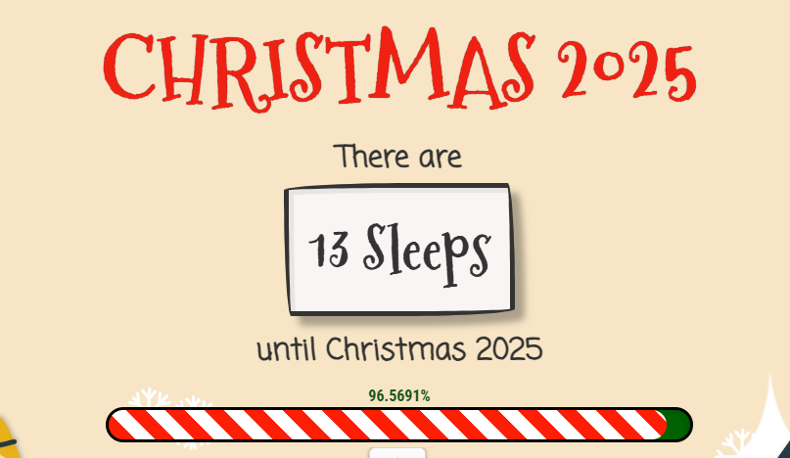
Make sure you get lots of rest this weekend – it’s our super exciting Christmas week next week and we’re going to be busy, busy, busy!!!
Mrs. Steed xxx

