Slide 1

Holly Hill Christmas Heroes Assembly
HOLLY
HILL
AUTUMN TERM, 2025

Slide 2
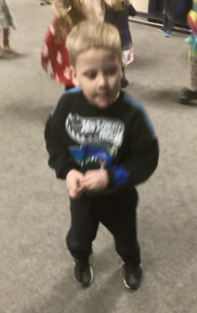
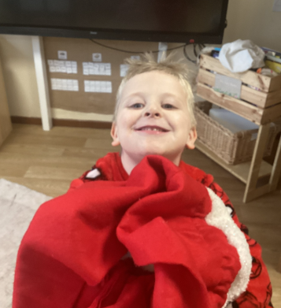
Our Cygnets Hero
Our Christmas heroes are children that have shown true Christmas spirit.
Our first hero is Carter who just has been so excited all week. It really is infectious and makes everyone smile. From exclaiming “Oh Baby Jesus” to Reverend Lee, when she visited to share the Christmas story, to his amazing dance moves at the Christmas party. There were gingerbread men in the water and Carter loved this and has thrown himself into the Christmas excitement! Carter is always enthusiastic about everything, and openly shows his excitement - two of his favourite things being phonics and handwriting. Keep smiling and sharing your excitement Carter - we are really proud of you.

Slide 3
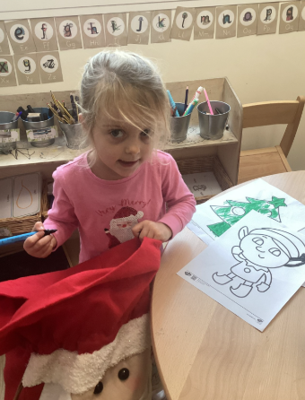
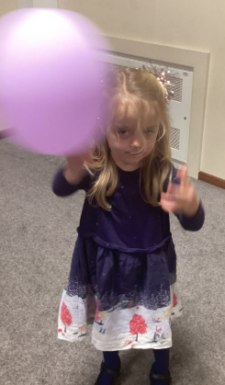
Our Cygnets Hero
Our second hero is Annabel. She has loved all of the Christmas crafts and spent a long time making sure her Christmas hat was just right for the party. She loved seeing Santa and her face lit up the whole grotto with Christmas magic. In the spirit of Christmas she helped other children with their crafts. She loved using the coloured water on the cotton pads to create baubles. Her confidence is growing all the time and she happily plays independently - we are so proud of you Annabel.

Slide 4
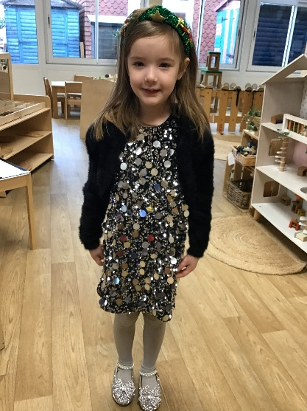
Our Cygnets Hero
Maddison has been spreading the Christmas joy this week! Even though it’s been a very busy week and the Cygnets are very tired, Maddison has continued to be a little trooper! She has taken the Christmas craziness in her stride! Maddison was also an amazing Angel Gabriel in our nativity last week. She remembered all of her lines and spoke with such confidence. Maddison, you are a Christmas angel, sent from above!

Slide 5
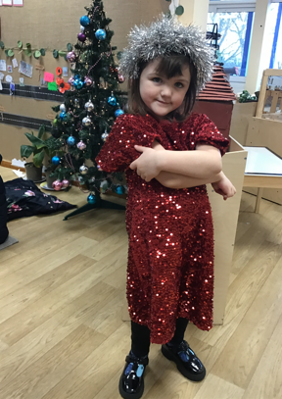
Our Cygnets Hero
We are so proud of Laila, not only this week but for the whole of this half term. She has remained so calm during all our festivities! Laila has spread some Christmas kindness this week too and has been a really good friend to other children. Laila was a ‘good sport’ during our Christmas party games and happily cheered on her friends.
You are a shining star, Laila, well done!

Slide 6
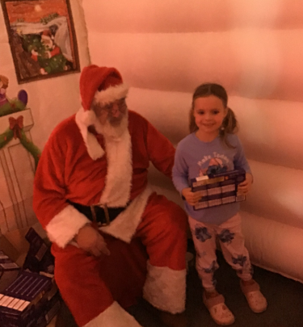
Our Puffin Hero
Harper has absolutely loved our Christmas week and I just had to choose her as a Puffin Class Christmas Hero. She has smiled all week long and her enthusiasm is infectious. On Tuesday she not only had a speaking part in our play, but also said an extra line for a child who was absent and she made the most beautiful shepherd. However, the highlight of the week for both me and Mrs Cooper was seeing the enjoyment on her face at the pantomime where she sang, danced, laughed whilst still showing incredible kindness and compassion to a member of our class who was feeling a little bit anxious. Wow Harper, you have been a ray of sunshine this week and your teachers are so incredibly proud of you! You are most definitely a PERFECT CHRISTMAS PUFFIN!

Slide 7
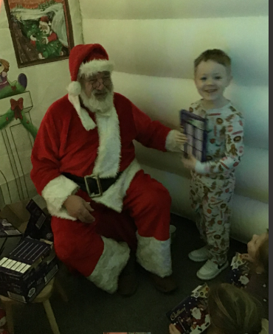
Our Puffin Hero
I have got to choose Lucas as a Puffin Class Christmas Hero - he has absolutely loved our Christmas week. It has been so lovely to see him join in with lots of whole class activities, enjoying himself with his peers. He took part in our Christmas concert and knew what he had to do and when to go on stage - a huge achievement! He has also loved lots of the dancing we have done and making a Christingle for a service on Monday. The highlight for me however was seeing his enjoyment at the pantomime - every time I looked at him, he was smiling and Lucas has the most incredible, gorgeous smile which truly made my day. Well done, Lucas, your enthusiasm and enjoyment this week have really made my school Christmas. All your teachers are super proud of you, and you are most definitely a PERFECT CHRISTMAS PUFFIN!

Slide 8

Our Wren Hero
Carter and Willow have both been super stars this week!
They were fabulous in our performance, have taken all of the festivities in their stride and although some days they haven't felt up to school, they always come in and given it their very best. They had a fabulous time at our party and enjoyed dancing, playing games and eating party food! They showed great resilience during our games and dealt with being out perfectly.
Well done my Christmas superstars!

Slide 9
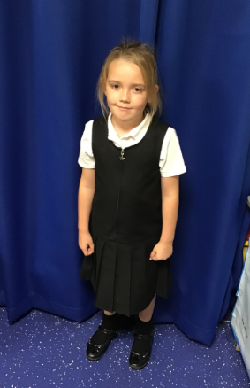
Our Woodpecker Hero
Our Woodpecker Christmas heroes are Ella and Kush.
Ella was absolutely amazing in our performances on Tuesday. Not only did she do her own part brilliantly, but she also was a super star for standing in for children who were away on the day and doing their parts too. Thank you Ella. You helped to make our performance great!

Slide 10
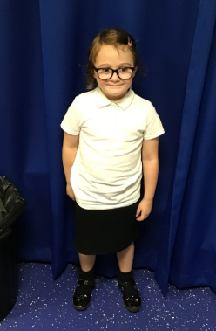
Our Woodpecker Hero
Kush is our hero for being a good friend and being so kind. At our party, Kush sat with another child and chatted away with them and made sure they were ok and happy. It's lovely things like that Kush, that makes Christmas special for everyone. Thank you for bringing so much kindness to our classroom.
Well done all Woodies for such a fab week!

Slide 11
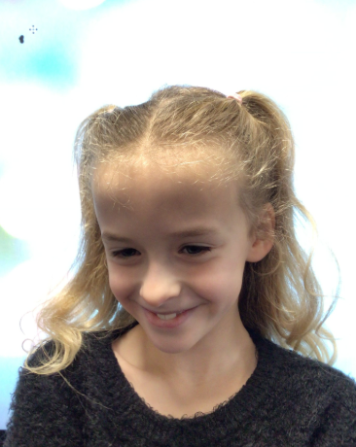
Our Kingfisher Hero
Our Christmas hero this week is Amelia. Amelia has had the biggest smile on her face all week! She loves all the games, crafts and dancing that Christmas week brings!

Slide 12
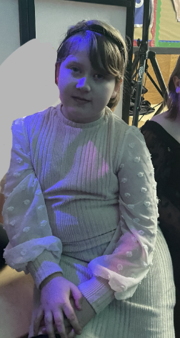
Our Kingfisher Hero
Our Christmas hero this week is Phoebe. Phoebe has shown great kindness this week. She is always looking out for her friends and offering to help. Somebody didn't have a diva to paint so she offered hers to share. Also, Phoebe is an absolutely amazing singer in the concert - she loves to sing and the audience will definitely hear her on Friday!

Slide 13
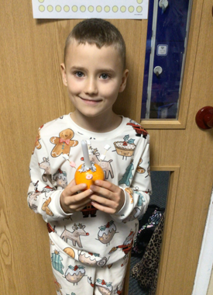
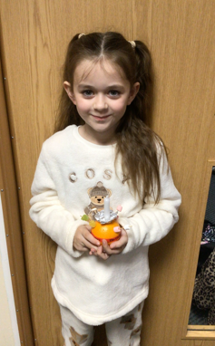
Our Dove Hero
Dove Christmas Heroes this year are Liam and Lilly. Both children have fully embraced the Christmas spirit with their fabulous performances in the concert and how they have participated and thoroughly enjoyed the disco, party games and film day. All week their enthusiasm has shone through and they have done everything with a massive smile on their faces! What fabulous Doves you are!

Slide 14
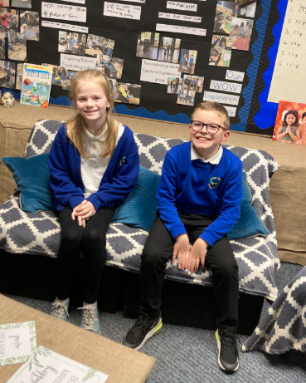
Our Swallow Hero
This pair are smiling because they are Swallow hero of heroes! Well done Holly and Fin for being our heroes. You work so hard every day, you are respectful and kind towards your peers. You follow the HH Way and everyday you make Mr Close and I smile! You have both thrown yourself into our Christmas week and have had great fun. Well done!

Slide 15
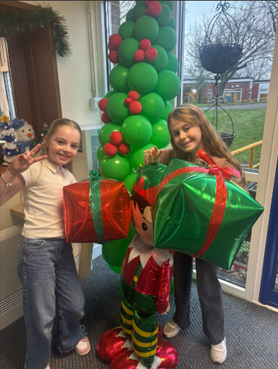
Our Owl Hero
This week's Christmas heroes in Owl Class are Rosie and Olivia. Rosie and Olivia come into school every morning with the biggest smiles on their faces and always give us a good giggle. These two have spread joy and kindness all week long. I am so proud of you both!!

Slide 16
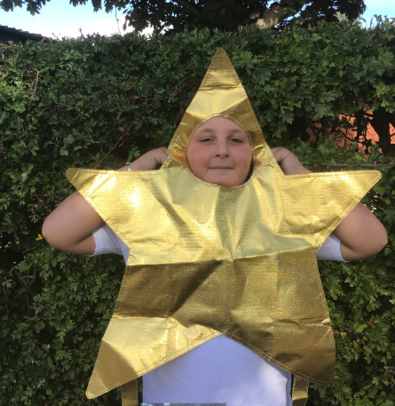
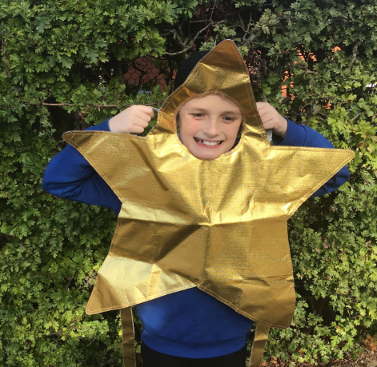
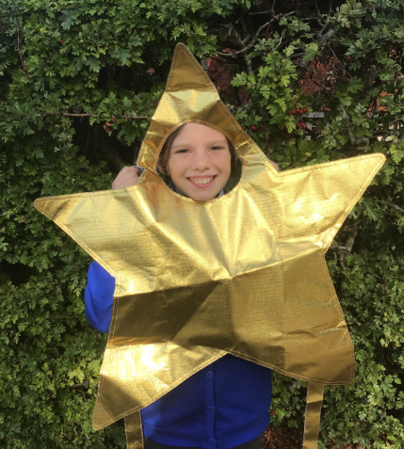
Our Falcon Hero
I have been a naughty Miss 'Elf and chosen three heroes this week! Julian, Bella and Everett have truly shone like Christmas stars this week, getting stuck into every activity we have done with lots of Christmas spirit. I am particularly proud of their performances in all of our carol concert run throughs, giving it their all and enjoying themselves whilst doing so! Keep shining like the superstars you are, my Fantastic Festive Falcons!🌟🎅🎄

Slide 17
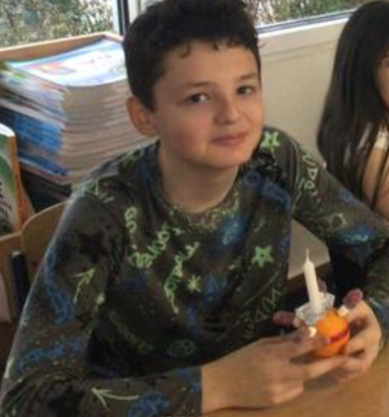
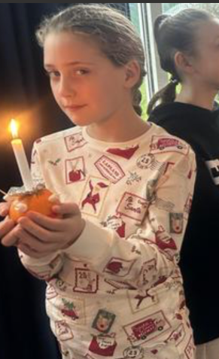
Our Swan Hero
My Christmassy heroes this week are Cory and Isla F. They have both been full of the Christmas spirit this week and have enjoyed everything we've done. Thank you for bringing the Christmas magic to Swan class! 🌟🎄🦢

Slide 18
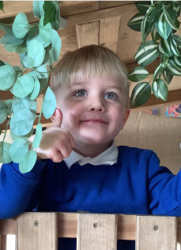
Our Wraparound Hero
Ollie is our wraparound care hero.
At first, he struggled to leave Mum in a morning but now he has settled beautifully. He has a cuddle with Mrs. Bis every morning and then goes off to play with his friends. We are so proud of you Ollie – well done!

Slide 19
Class Attendance winners
CLASS | WIN 1 | WIN 2 | WIN 3
Cygnets 1
Cygnets 2
Puffin
Wren
Woodpecker
Kingfisher
Dove
Swallow
Owl
Falcon
Swan
This week’s winners with 97% are Puffin class!
Well done Puffins!

Slide 20
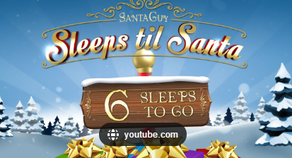
We hope you’ve all had a fabulous Christmas week at Holly Hill. We have loved every second of it and are so proud of all of you.
Have a wonderful Christmas – see you in 2026!
Mrs. Steed xxx

