Slide 1

Holly Hill Heroes Assembly
HOLLY
HILL
SPRING TERM, 2026

Slide 2

Our Cygnets Hero
This week our heroes must be all our new starters, who have settled so well into school.
Well done to Miles, Ollie, Max and Reynard.
We are so pleased to have you as part of our class and cannot wait to learn all about you. You are already sitting beautifully and following all our rules.

Slide 3
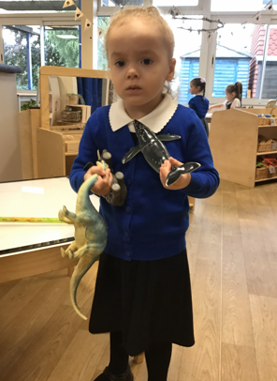
Our Cygnets Hero
Leah has made an amazing start back to school since the Christmas holidays. It’s like she’s never been away! She has remembered exactly what to do and she has been coming in each morning with a big smile on her face. We have been particularly proud of Leah’s communication this week. She has been seeking adult interaction and she has been showing us lots of things. Leah amazes us with her super vocabulary, particularly when naming animals and sea creatures. She can identify every type of dinosaur, most with VERY long names! Well done Leah!

Slide 4
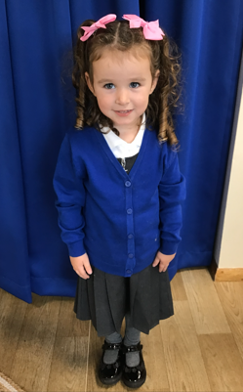
Our Cygnets Hero
Isla-Rose is our Cygnet hero this week because she has welcomed our new nursery children with such warmth and kindness.
She has taken care of them by playing nicely with them, comforting them when they miss their Mummy and taking them by the hand and showing them what to do.
You have made our hearts warm and happy this week Isla! Thank you being such a kind and caring girl.
Isla-Rose has also impressed us in reading groups this week. She is beginning to blend sounds to read the words more independently and she has been practicing this at home too!

Slide 5
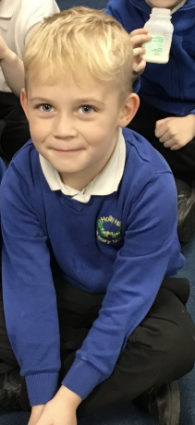
Our Puffin Hero
Theo has got to be a Puffin Class Hero this week as he has developed the most fabulous attitude to school and his learning. He always comes into school happily and is the first to be ready to learn. He has worked hard every day since Christmas, tried really hard to work independently on his writing and maths and produced some great work. Both Mrs Cooper and I are particularly proud of the huge progress he has made with his phonics. Well done Theo, you really are a PERFECT PUFFIN!

Slide 6
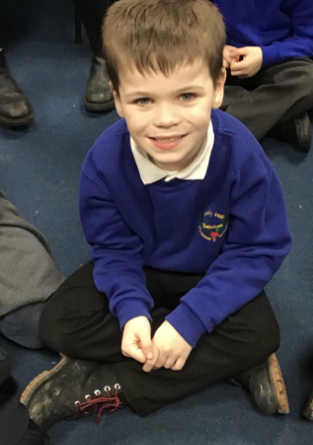
Our Puffin Hero
Bobby-Dean has had a fantastic two weeks since coming back after Christmas. He has tried particularly hard in English and was the only child in our grammar session that could remember that we need to add "ed" to a verb to make it past tense. He has also produced two fabulous pieces of writing based on our book "The Magic Paintbrush" Wow, Bobby-Dean keep up the hard work, you really are a PERFECT PUFFIN and I am so proud of you!

Slide 7
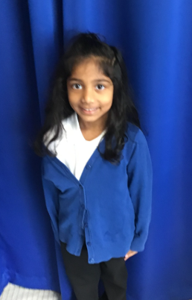
Our Wren Hero
Our first Wren hero this week is Jesona.
Jesona has returned from the holidays ready to get stuck back into her learning. She was really poorly before Christmas, but hasn't let this stop her from trying super hard and picking up where she left off with her learning. She tries hard with all her work, especially her writing. She has a wonderful passion for writing and it is often shown through her hard work.
Keep it up, Jesona!

Slide 8
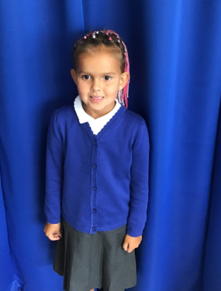
Our Wren Hero
Sienna has been trying really hard with all of her learning. She has been working on her phonics and applying this into her writing independently. She has also been trying hard with her maths and has enjoyed working more independently with more confidence within her maths books.
Great work, keep it up Sienna!

Slide 9
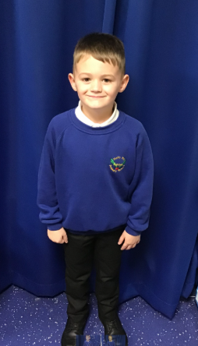
Our Woodpecker Hero
Woodpecker heroes this week are David and Toby.
David is always really kind and helpful and will notice things in the classroom that need sorting or tidying and will do it without asking. He is also trying and working really hard in all lessons so has started 2026 as a real superstar.

Slide 10
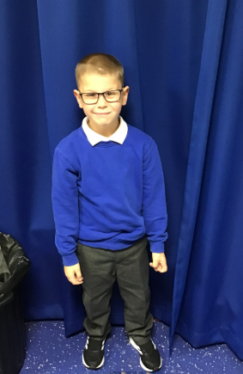
Our Woodpecker Hero
Toby is also always kind and wanting to help. He will often ask if anything needs doing to help and will sort things out in the classroom. It is so lovely to have children who want our class to be a happy and tidy place to be and will help everyone else.
Well done boys.

Slide 11
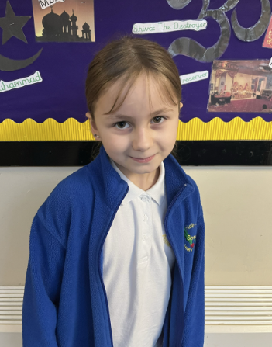
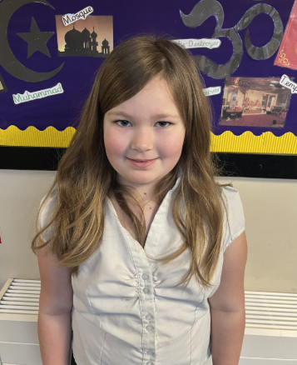
Our Kingfisher Heroes
This week, Kingfisher heroes are Bobbi and Bexley.
Bobbi has been 'on fire' this week during class discussions and independent activities. She has been so focused during her work and helpful around the class. Bobbi has worked hard and definitely deserves her weekend! Brilliant 🤩
Bexley is always following the Holly Hill way and works so hard. This week we have been working on some particularly tricky division, which has not bothered Bexley at all. She's been using her times table knowledge to help her, which is brilliant! 🤩
Keep being super stars girls!

Slide 12
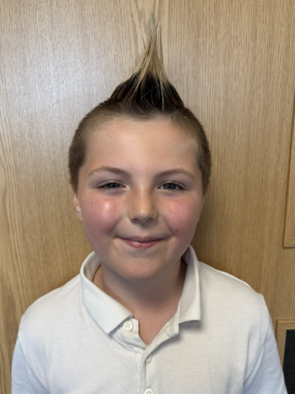
Our Dove Hero
Our first Dove hero this week is Lucian. Every day Lucian comes into class with a smile on his face and a positive attitude to his learning. He consistently tries hard with his work and this week he has really impressed us with how his knowledge of times tables is developing and growing. He has also produced some great writing. Well done Lucian! Keep it up!

Slide 13
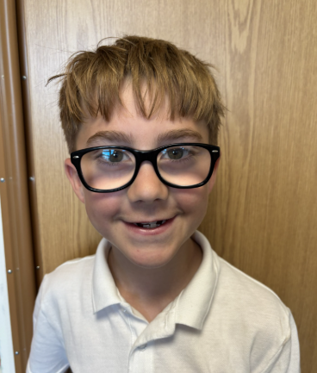
Our Dove Hero
The next Dove hero is Oliver. Oliver has really grown in confidence this week. He has regularly contributed to classroom discussions and has asked for help if he has been unsure. Oliver is always super sensible and mature and is a positive role model for others with his behaviour. What a wonderful Dove you are Oliver! Well done!

Slide 14
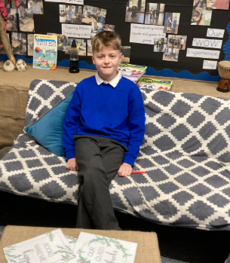
Our Swallow Hero
Harry B is a hero this week. He has followed the Holly Hill Way and been very helpful in the classroom without being asked. Well done Harry – I love having you in Swallow class!

Slide 15
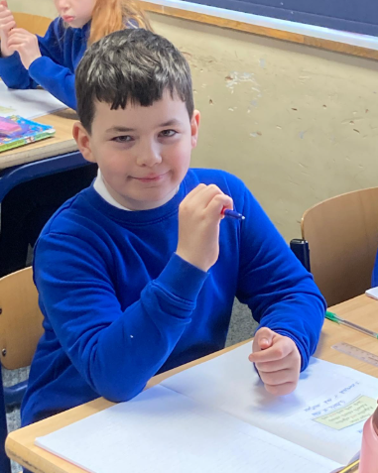
Our Swallow Hero
Harry H is a Swallow hero this week. Harry is always doing the right thing. He is putting so much effort into all of his work and he impresses me daily with his attitude and positivity. Well done Harry.

Slide 16
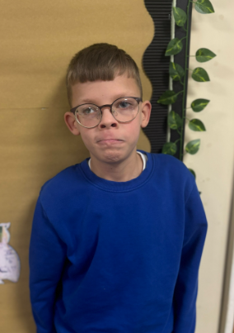

Our Owl Hero
My Owl heroes today are George and Olivia. Earlier this week both Owls represented Holly Hill at the Multi Skills Festival. Both children tried their hardest and had a great time. We are all so proud of you! Well done Olivia and George.

Slide 17
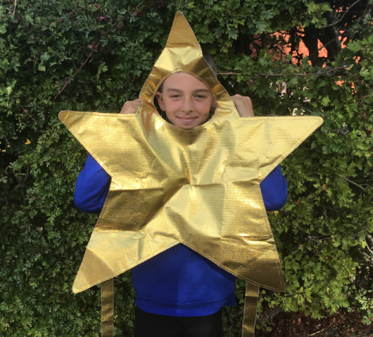
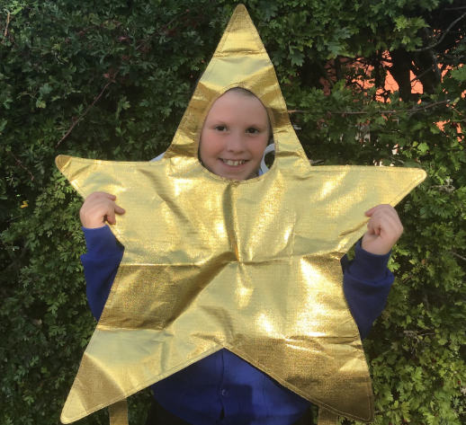
Our Falcon Hero
My heroes this week are James and Ella.
Both of them have got well and truly stuck into our first 'full' week back at school, trying their hardest in lessons and interventions. They also absolutely loved our first DART session with Mr. Kemp this week and gave some very valuable insights into their understanding of the sensitive topics at hand. Keep up the amazing work, guys!
.

Slide 18
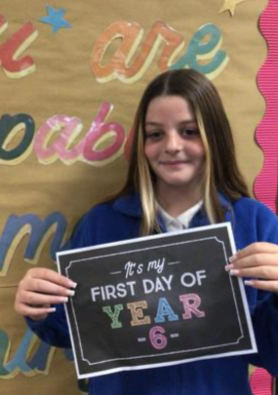
Our Swan Hero
My hero this week is Isla. Isla has been trying so hard these last few weeks to put her hand up more in lessons and contribute her ideas and share them with the class. Isla always has something valuable to add to a discussion and has fabulous ideas, and I know that other children can learn from her putting in so much effort every day. Well done Isla - you’re a super swan and I’m really proud of you 🦢 🌟

Slide 19
Class Attendance winners
This week’s winners with 97.7% are Dove class! Well done Doves!
Remember, when you reach 3 wins, your class will get £25 to spend on books and 15 minutes extra play! Try to come to school every day to help your class be the winners!
CLASS | WIN 1 | WIN 2 | WIN 3
Cygnets 1
Cygnets 2
Puffin
Wren
Woodpecker
Kingfisher
Dove
Swallow
Owl
Falcon
Swan

Slide 20

Have a lovely weekend everyone!
Mrs. Steed xxx

