Slide 1

Holly Hill Heroes Assembly
HOLLY
HILL
SPRING TERM, 2026

Slide 2
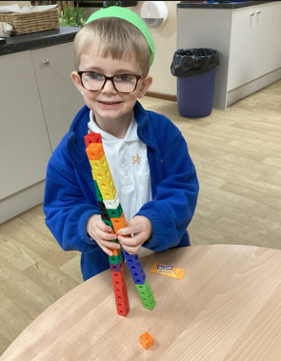
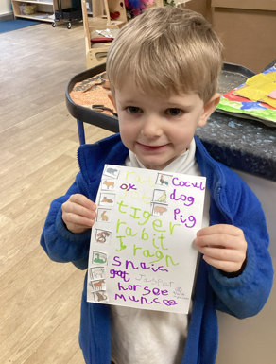
Our Cygnets Hero
Jasper is such a wonderful class member and could easily be hero every week. He is a very bright boy and I love how he is always challenging himself. We have been using cubes to consolidate our number composition. Jasper decided to build towers with all the cubes he had. When I asked him how many he told me he had 2 towers of 20 and then an extra cube, so he had 41 altogether. Amazing maths! Not content with being a maths whizz, he then went on to write me a fantastic list of all the animals in the Great Race book we have been reading.

Slide 3
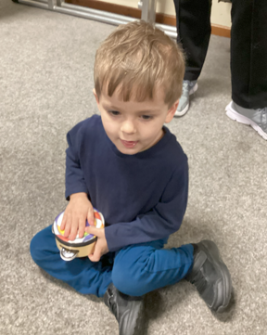
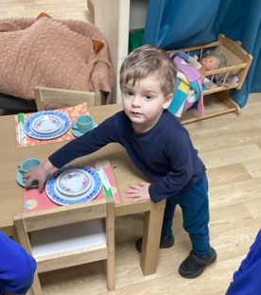
Our Cygnets Hero
Max has not been with us a whole term yet but is already a big part of our class. He already comes into school without getting upset and gives us a big smile. He can put his things away and sits beautifully on the carpet. He has already made friends and has settled really quickly. He loves to sit during our breakfast time and listen to his friends. He enjoyed our Chinese New Year celebrations, particularly playing the instruments. Well Done Max, keep up the hard work!

Slide 4
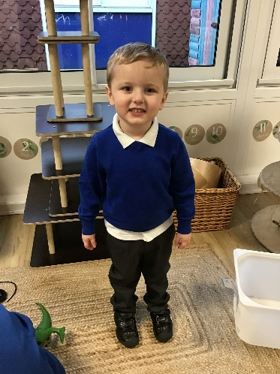
Our Cygnets Hero
Ronnie has made an amazing start to nursery and he has settled in so brilliantly!
He is coming into nursery with a big smile and leaving his Mummy nicely each morning. He is listening very carefully to instructions and doing what is asked of him straight away. Ronnie is trying really hard to sit really well during our carpet times and listen carefully. Well done Ronnie, you are a shining star1

Slide 5
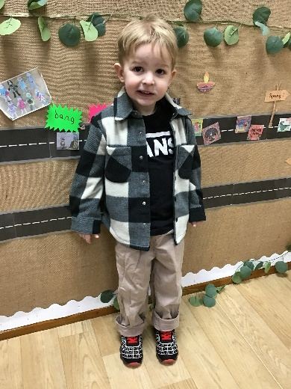
Our Cygnets Hero
Vinnie has also made an amazing start to nursery! He has settled in quickly, he knows our routines and he knows exactly what to do each day. Vinnie likes to be independent and likes to try things by himself. He is getting very good at organising his things. Vinnie is growing in confidence and is now very chatty, sharing his ideas and stories from home. We are so lucky to have you in the cygnet class with us Vinnie!

Slide 6
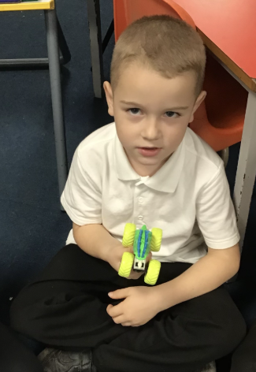
Our Puffin Hero
Karter is this week’s Puffin class hero as he has been trying incredibly hard since Christmas. In Phonics he has made enormous progress and scored an impressive 31 out of 40 on a recent phonics test. He has also been persevering to complete his writing independently. Most importantly, he is a happy and kind boy who loves to play outside with his friends. Well done Karter, you truly are a PERFECT PUFFIN!

Slide 7
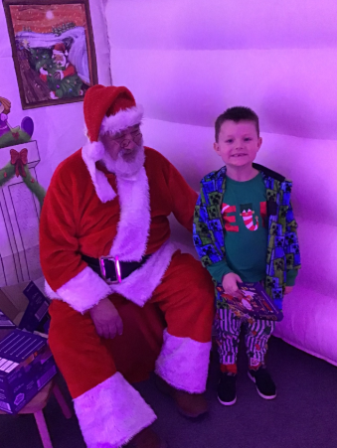
Our Puffin Hero
Harvey is a Puffin class hero this week as he has made so much progress with his Phonics this term. He has put so much effort into learning new sounds and blending over the last few weeks and he is rightly proud of himself for scoring 20 out of 40 on a recent phonics test. Most importantly he is a happy and kind boy who loves playing with his friends. Well done Harvey, you truly are a PERFECT PUFFIN!

Slide 8
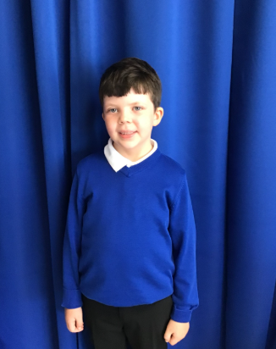
Our Wren Hero
Luca is always a wonderful friend to his class mates. He always helps look after them, helps to make people feel better when they're hurt and gives the biggest hugs. He is a fabulous Wren and has a heart of gold. Keep it up Luca!

Slide 9
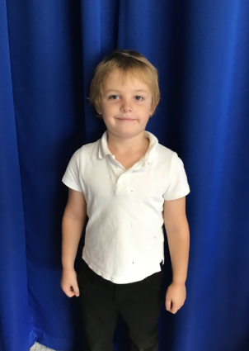
Our Wren Hero
Finnley has been trying hard with his maths this week. He has been working more independently and focusing more in maths lessons which has been great to see. Keep working hard Finnley, your love for maths is wonderful to watch. Keep it up!

Slide 10
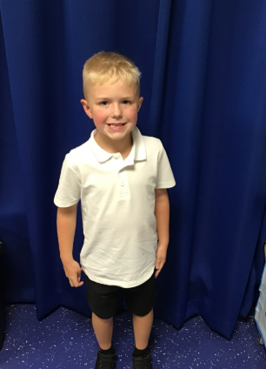
Our Woodpecker Hero
This weeks Woodpecker heroes are Harry and Kush.
Harry is one of Woodpeckers ‘always’ children and could be a hero every week. He is an absolute superstar and is one of those children you can rely on to be doing the right thing all the time. Not only that, he works hard and tries his best all the time in everything. Well done Harry.

Slide 11
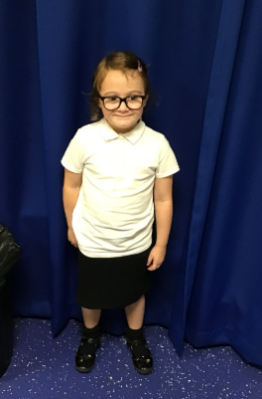
Our Woodpecker Hero
Our other hero this week is Kush. Kush has really impressed me with her fantastic reading this week. She puts in lots of effort and has been reading with fluency this week in treading groups. She showed great comprehension skills as well and answered lots of questions about our book. Well done Kush.

Slide 12
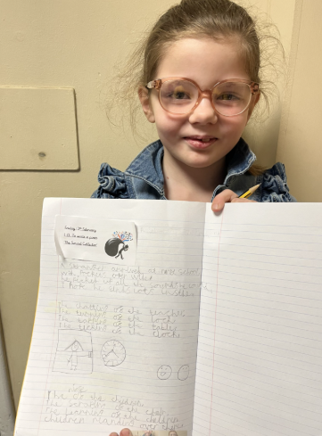
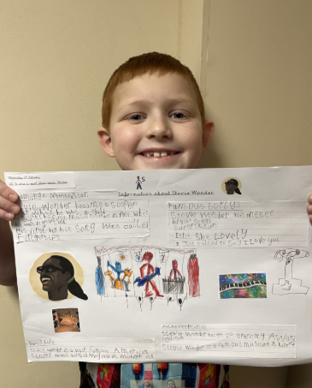
Our Kingfisher Heroes
Joe and Lucy are writing heroes this week! Joe has done some fabulous report writing about Stevie Wonder, including lots of facts and interesting information.
Lucy has written a poem about sound, and what has really impressed me is her poetry layout and presentation. It looks just like the original!
Well done Joe and Lucy - you have really taken pride in your presentation.
Keep up the good work 🌟

Slide 13
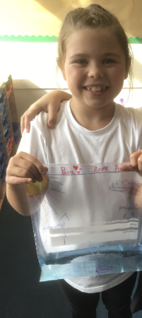
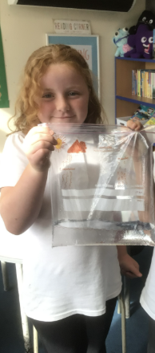
Our Dove Hero
Dove heroes this week are Phoebe and Bree. Both girls have tried exceptionally hard with their report writing this term. They have pushed themselves to write longer pieces, use fronted adverbials and just make sure that their handwriting and presentation is generally neater and all joined. Well done girls! Fabulous work!

Slide 14
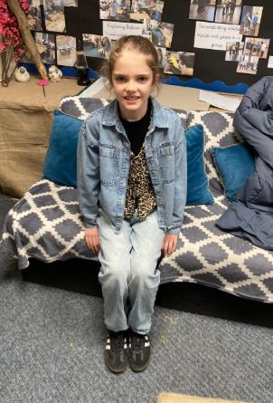
Our Swallow Hero
Bebe is our hero this week. She is a ray of sunshine in Swallow class every day. Bebe - you are happy, smiling, kind and hardworking all the time. Thank you for being an amazing Swallow.

Slide 15
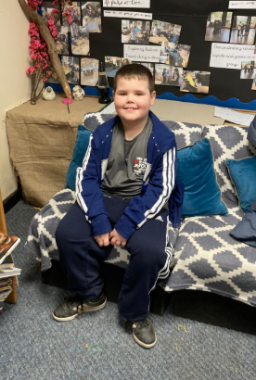
Our Swallow Hero
Cole is a hero this week. He has been so thoughtful and he has worked hard to keep our classroom tidy. Today he was an absolutely star in Maths and worked with Mr Close on work in length and perimeter.

Slide 16
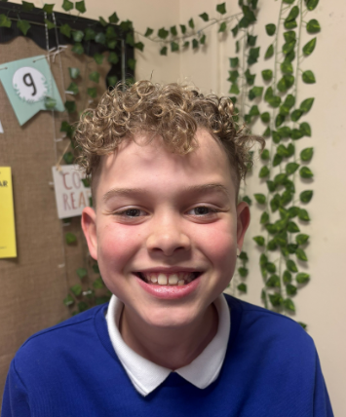
Our Owl Hero
The hero this week is Harrison, for consistently showing a wonderful attitude to learning. He tries his hardest in all lessons. Harrison is a brilliant role model, always displaying a positive attitude. He always comes in with a smile on his face and makes us all giggle in his hour-long check-ins. Well done Harrison!!

Slide 17
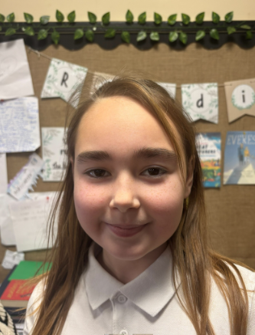
Our Owl Hero
The next hero is Bethany. Bethany comes into school every morning with the biggest smile on her face, ready to learn. She has a fantastic attitude to everyone around her and is always so keen to help. Keep being the caring and helpful person we are all so proud of!

Slide 18
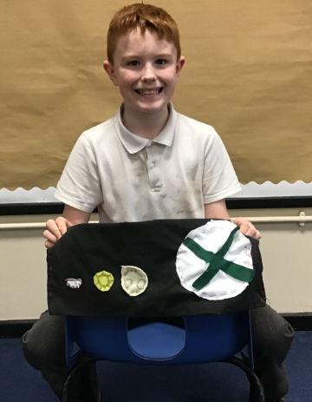
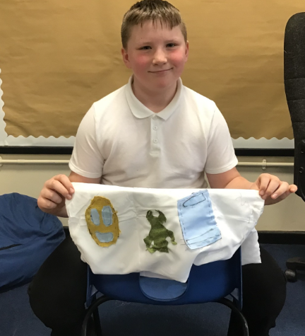
Our Falcon Hero
I have chosen Jackson and George as my heroes this week. Throughout our DT day, they showed nothing but hard work and resilience, even when things got a bit tricky and intricate! They also were more than happy to help out their friends in need as well. A very well done to you both boys! You really are Fantastic Falcons indeed!

Slide 19
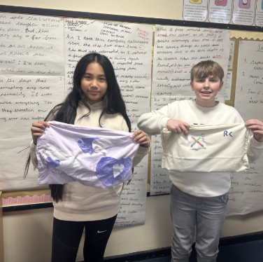
Our Swan Hero
My first heroes this week are Ralph and Angel, for their hard work during our sewing lessons. Let’s just say, getting 31 children, threading needles, tying knots and sewing is very, very tricky, but Ralph and Angel were so wonderful and helped lots of people and tried super hard. Well done super sewers- you’re fabulous! 🪡🧵

Slide 20
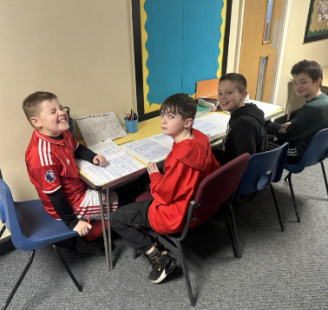
Our Swan Hero
My second heroes this week are Tyler, Cory, Alan and Theo. We have been working on writing a narrative opening for the past few weeks, and these boys have been SO enthusiastic and have worked SO hard. They are absolute role models for what a positive attitude to learning should look like and I’m so proud of them. I’m so lucky that these boys are in my class 🌟🌟

Slide 21

My Headteacher Heroes
Today, my heroes are the whole of the Year 5 and 6 corridor. On Wednesday, we had a tricky incident to deal with at lunchtime and while lots of members of staff focused on that, we needed the rest of the corridor to have an extended lunch break. We were so exceptionally proud of the children who understood that they needed to be calm and safe while we helped their friends who needed us. During the rest of the afternoon, the children showed concern, empathy, kindness and love to each other and the staff felt that they all really helped us to deal with something that was quite difficult.
Well done Year 5 and 6. When I think about what I want a Year 5/6 child to be like, you demonstrated it all on Wednesday. We are all extremely proud of you.
Mrs. Steed x

Slide 22
Class Attendance winners
Last week’s winners with 96% were Puffins. Puffins have now won their attendance treat – 15 minutes extra play and £25 to spend on classroom books.
This week’s winners with 96.9% are Swan class. Well done Swans!
Remember, when you reach 3 wins, your class will get £25 to spend on books and 15 minutes extra play! Try to come to school every day to help your class be the winners!
CLASS | WIN 1 | WIN 2 | WIN 3
Cygnets 1
Cygnets 2
Puffin
Wren
Woodpecker
Kingfisher
Dove
Swallow
Owl
Falcon
Swan

Slide 23
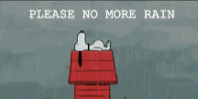
Have a lovely half term everyone!
Mrs. Steed xxx

