Slide 1

Holly Hill Heroes Assembly
HOLLY
HILL
SPRING TERM, 2026

Slide 2
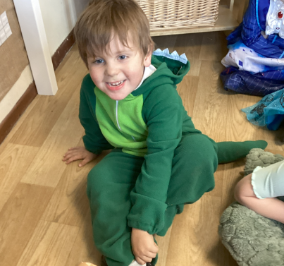
Our Cygnets Hero
What a fabulous week we have had in Cygnets. This week, we have had some amazing writing, lots of children have even wrote sentences - well done everyone!
Our heroes this week are:
Stewart - Stewart is a very caring member of our class and loves to make sure that his friends are ok. He sits on the carpet and is now acknowledging his name at register time and loves to join in, in his way. He has been working very hard with his phonics sounds and loves to listen to the phonics games. He has particularly loved making sandcastles outside. He loves number time with number blocks. Keep up the hard work, we are super proud!

Slide 3

Our Cygnets Hero
Willow - Willow has settled in our class so quickly and happily comes into class without her sister. She is very independent and likes to share her ideas at circle time. Willow loves to play in the home corner, but she is also confident to move around all the classrooms independently, playing with what she wants. We are so pleased to have you in our class Willow, we cannot wait to see you flourish, you are already making us super proud!

Slide 4
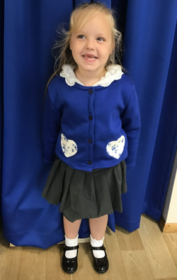
Our Cygnets Hero
Summer is absolutely blowing us away with her phonics learning right now!
She has been working so hard all year but her sound recognition, blending and segmenting skills have suddenly clicked into place. She is now flying in our phonics sessions! She is usually the first child to sound talk and blend the sounds with such confidence. Summer’s letter formation has really improved and she is now writing words more independently. Summer is such a kind and caring girl, always looking after others and making sure everyone else is ok. We are so incredibly proud of you Summer!

Slide 5
Our Cygnets Hero
Violet is a new member of the Cygnets and she has settled into life at Holly Hill so brilliantly. She has quickly made new friends and she has got used to new routines.
Violet listens so well during our phonics and maths sessions and she is now growing in confidence to share her ideas with the group. Violet uses her imagination when playing and she explores the whole environment. We are so happy that you have joined us, Violet!

Slide 6
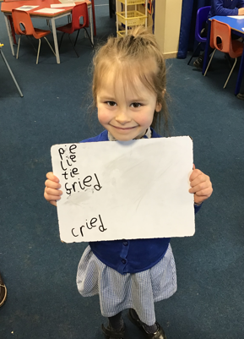
Our Puffin Hero
Halley is a Puffin class hero this week. Since half term she has been trying incredibly hard with her writing and phonics, trying really hard to remember her phonemes and use them in her writing. Most importantly, however, Halley always comes into school with a massive smile on her face and she was an incredibly cute (if wriggly) Stitch on World Book Day. Well done Halley, Mrs Cottee and Mrs Cooper are really proud of you. You are most definitely a Perfect Puffin!

Slide 7
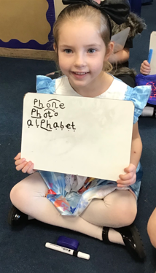
Our Puffin Hero
Ava has got to be a Puffin class hero this week. Like many adults and children, she worries a little bit about new experiences. However, despite feeling anxious about World Book Day ,Ava came into school with a tentative smile but within minutes she was her usual smiley self who fully embraced the day. Well done Ava, Mrs Cottee and Mrs Cooper are so proud of how you took part in every activity during World Book Day including reading with a KS2 child who you did not know during our Reading Class Buddy session. You are most definitely a Perfect Puffin!

Slide 8
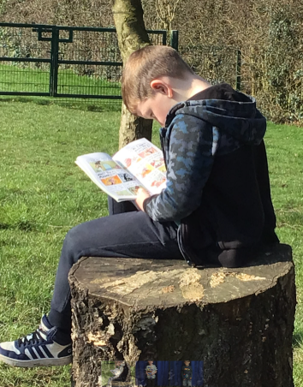
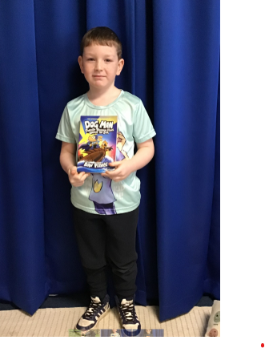
Our Wren Hero
Oscar brought his own book from home for World Book Day and thoroughly enjoyed taking time throughout the day to read it! He enjoyed sharing it with a buddy from Falcon class and even spent his own time during active 15 to sit and read his book on the tree stump. What a fabulous reader and truly showing we can read anywhere, at any time! It was wonderful to witness.

Slide 9
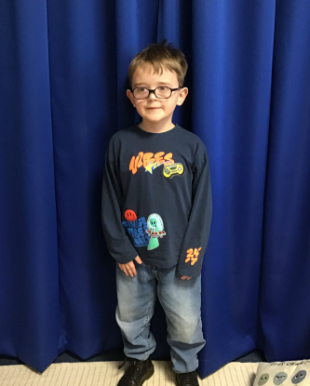
Our Wren Hero
Seth has been a maths whizz this week, we have started our new unit, numbers to 50. He has been amazing at recalling his numbers, focusing carefully on recording them the correct way and also working with the numbers going backwards! What a superstar, keep it up Seth!

Slide 10
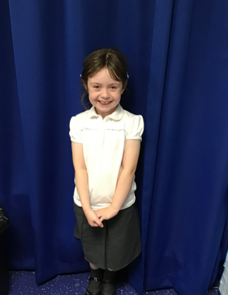
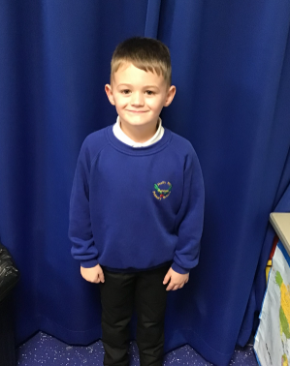
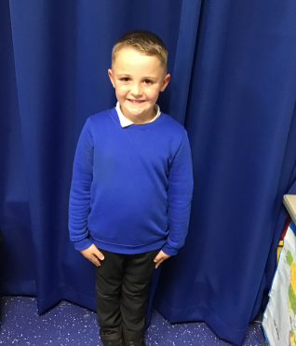
Our Woodpecker Hero
Our Woodpecker heroes this week are Chester, David and Georgia. They were all fantastic in P.E. and helped me to demonstrate different skills to the rest of Woodpecker. Georgia was absolutely brilliant at aiming carefully to hit a target and manged to hit it lots of times. David and Chester were great at throwing and catching accurately with the large and small balls. Well done you three!

Slide 11
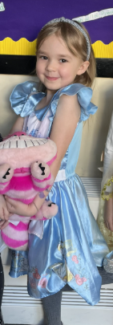
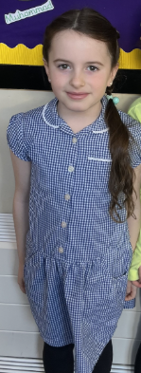
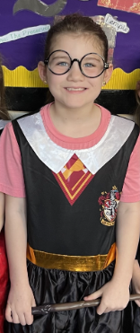
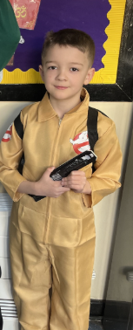
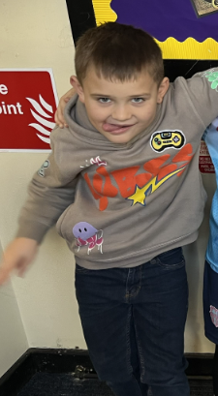
Our Kingfisher Heroes
Kingfisher Heroes this week are our fabulous pen writers ✍️
Congratulations to: Donald, Carson, Olivia, Bonnie and Hettie for consistently writing beautifully. They have earned their handwriting pen and have wowed us with their beautiful handwriting.
Keep up the amazing work 🌟

Slide 12
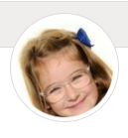
Our Dove Hero
Dove's first hero this week is Ava. Ava has been really applying herself across the whole curriculum. She has been raising her hand to answer lots of questions, trying her very best to doing everything that has been asked of her and generally been a super star. This is having a huge impact on the level of her work. Well don Ava - keep it up!

Slide 13
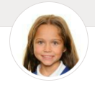
Our Dove Hero
Dove's second hero this week is Vanessa. Vanessa is one of those children we could put in any and every week. She is a fantastic member of Dove Class who always tries her best, is always doing the right thing and is a brilliant friend to all. What more could we ask for? Well done Vanessa!

Slide 14
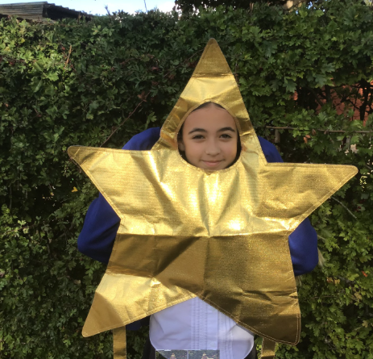
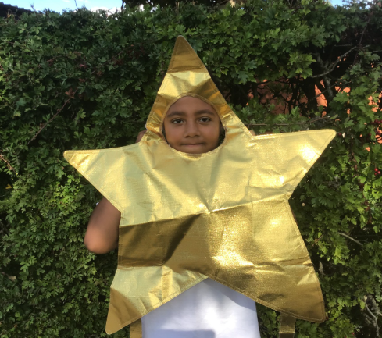
Our Falcon Hero
My heroes this week are Imogen and Pelumi.
Not only have they both worked EXTREMELY hard over the past two weeks with our assessment preparation, but I was also really proud with the maturity and sensitivity they showed during World Book Day when Wren class came to visit us and read! Pelumi really seemed to captivate his reading partner with his story telling capabilities, whilst Imogen did an amazing job of comforting one of our younger reading partners who was a bit upset. They should both be extremely proud of themselves - well done Imogen and Pelumi!

Slide 15
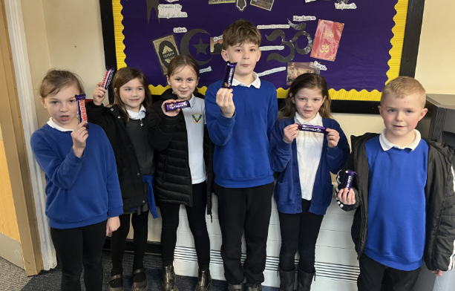
Our RE Heroes
A special group of Heroes this week...
A big thank you to everyone who designed a cover for the R.E Syllabus.
It was so hard trying to pick six finalists, but these children made it to final stage and their designs have been sent to Nottinghamshire County Council where they will be judged with all the other school entries (including high schools!)
Here they are with their prize, which got eaten seconds later 😋
We wish them all the best. Congratulations 🌟

Slide 16
Class Attendance winners
Last week’s winners with 97% were Wrens. Well done Wren class!
This week’s winners with 96.7% are Dove class. Well done Doves!
Remember, when you reach 3 wins, your class will get £25 to spend on books and 15 minutes extra play! Try to come to school every day to help your class be the winners!
CLASS | WIN 1 | WIN 2 | WIN 3
Cygnets 1
Cygnets 2
Puffin
Wren
Woodpecker
Kingfisher
Dove
Swallow
Owl
Falcon
Swan

Slide 17
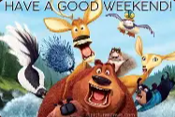
What a fabulous week!
We had such a lovely World Book Day yesterday and absolutely loved looking at all of your costumes.
Have a wonderful weekend everyone!
Love,
Mrs. Steed xxx

