Slide 1

Holly Hill Heroes Assembly
HOLLY
HILL
SPRING TERM, 2026

Slide 2
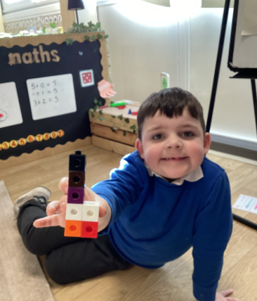
Our Cygnets Hero
JJ - you are such a superstar. You always put 100% effort into all the things you do, and you brighten up our day! JJ is such a joy to have in Cygnets class and he always has such wonderful things to say. Well done JJ.

Slide 3
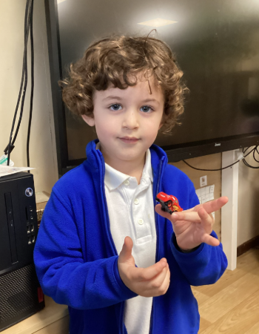
Our Cygnets Hero
Miles - Miles such a happy, energetic and kind young man. He is such a polite boy who is always trying to do the right thing! He makes sure he looks after his friends and helps the teachers. Well done Miles!

Slide 4
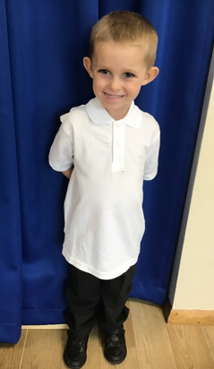
Our Cygnets Hero
Sebastian is a true Holly Hill hero this week! He has absolutely blown us away with his reading! He is trying so hard with his blending and carefully following each word, often spotting tricky words too.
He has not only amazed the teachers but his friends are noticing his super progress too. When reading a sentence in our reading group this week, the other children gave him a huge round of applause.
It was so lovely to see you looking so proud of yourself Sebastian!

Slide 5
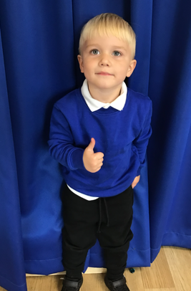
Our Cygnets Hero
Ollie is a delight to have with us in the Cygnets. He is a lovely boy and has made lots of friends. We often forget that Ollie is a nursery child as he behaves just like a big Reception child!
Ollie now has a super attitude in all that he does and he shows determination to complete task, even if he finds it a bit tricky.
We love how Ollie is starting to try new activities and show new interests. Ollie would spend all day outdoors on the bikes or playing football if he could but he now chooses to draw, write and colour pictures.
Now we often find him in the writing area!

Slide 6
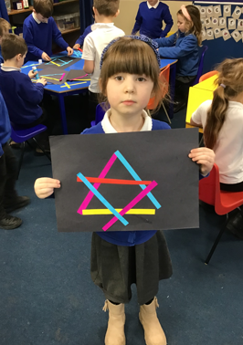
Our Puffin Hero
Freya could be a Puffin Class Hero every week as she is an absolute delight. She always comes into school each morning with a big smile on her face saying “Good morning Mrs Cottee”. Freya always works hard and this week has produced a lovely piece of writing based on our book Leon and The Place Between. It was also lovely to see her enjoying herself so much with her Mum and little sister on Thursday at our Easter Craft afternoon. Freya you are an absolutely PERFECT PUFFIN and we are so proud of you!

Slide 7
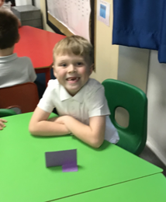
Our Puffin Hero
Ralphie is a Puffin Class Hero this week. He is always interested in everything we do and is the first child to offer ideas or suggestions during discussions. Over the last few weeks he has been trying really hard with his writing and this week has worked particularly hard to improve his writing by checking for mistakes and trying to write on the lines. Well done Ralphie, I am so proud of you for your amazing attitude. You truly are a PERFECT PUFFIN!

Slide 8
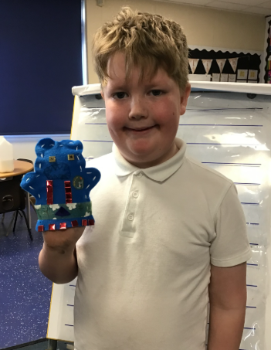
Our Wren Hero
Oscar worked really hard sewing and decorating his puppet. He was focused and looked at his design plan carefully. He was also very careful when choosing his resources and made sure not to take too many so there was enough left for his classmates. Great job Oscar!

Slide 9
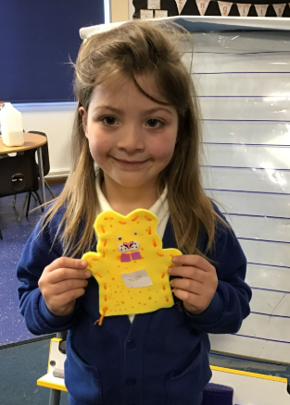
Our Wren Hero
Nancie-Jane also worked really hard sewing and decorating her puppet. Although, it wasn't easy she didn't give up. She also followed her design plan meticulously and really brought her design to life on her puppet. Fab job Nancie!

Slide 10
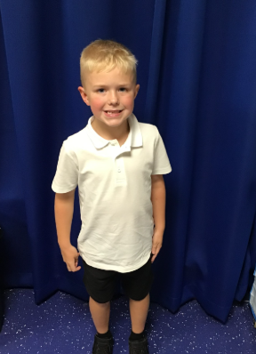
Our Woodpecker Hero
Our Woodpecker heroes this week are Harry and Gabriella.
Harry is one of our always children who could be our hero every single week. Harry is always well behaved, he always tries his best and works hard and is always a superstar. Not only that, Harry is also kind and caring and a great friend to everyone. We feel really lucky to have Harry in Woodpecker. Well done Harry. You really are a superstar every day.

Slide 11
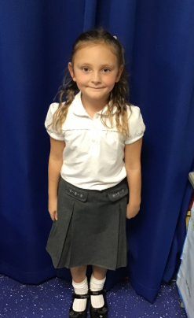
Our Woodpecker Hero
Our other hero this week is Bella. Bella has really impressed me with her work this week, especially her writing. She has been thinking of her sentences and writing them independently, which is fantastic. And she has done a brilliant job of it too. Well done Bella. Keep up the hard work.

Slide 12

Our Kingfisher Heroes
This week my heroes go to Jayden and Ruby.
Both of these children were able to overcome many fears on Monday when they were taking part in their last lesson of PE on the gymnastics apparatus.
With help from Mr Ellis, Ruby was able to climb over the top of both A frames - something that she feared before and Jayden gained great confidence to slide himself along the high bars, again something that he did not think he could do.
Well done to both - you should be incredibly proud of yourselves 🙂

Slide 13
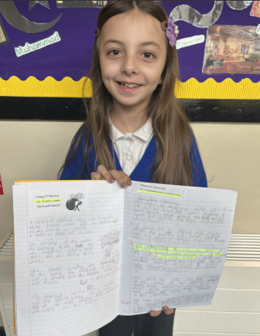
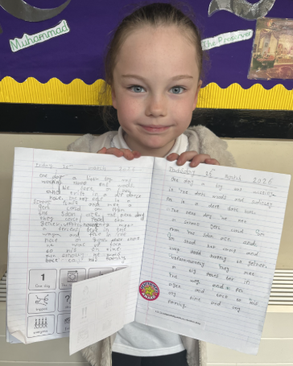
Our Kingfisher Heroes
Congratulations to our heroes this week - Gracie and Evie!
We have been writing an adventure story and working towards this for weeks.
Both of these stories bought a big smile to my face - Gracie used some lovely vocabulary and Evie wowed me with her sentence starters.
Well done for both of your hard work - we are so impressed! ⭐

Slide 14
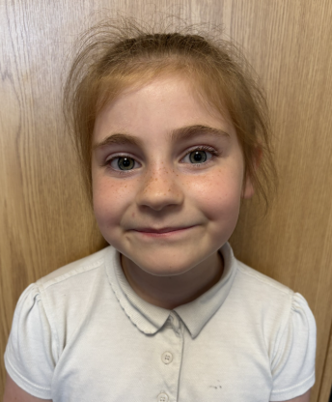
Our Dove Hero
Our first Dove hero this week has got to be Ayda. Ayda impresses us every day with how hard so works and how perfectly behaved she is but recently she has been working on her Stone Age story and has blown us away with how fantastic her writing is! She has used some wonderful vocabulary, along with fronted adverbials and beautiful handwriting to create a wonderful piece of writing. Well done Ayda! You are a writing superstar!

Slide 15
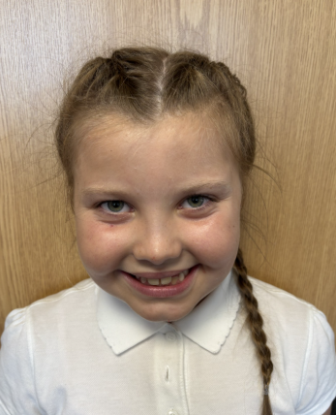
Our Dove Hero
Our next Dove hero is Olivia. Olivia has shown real dedication to her writing recently and her speed and amount produced has suddenly increased. Not only this, she is using more of her own ideas and her presentation is beautiful. She has created a fabulous Stone Age story which we have been very impressed with. Well done Olivia! Keep up the hard work!

Slide 16
Our Swallow Hero
My heroes are the whole of Swallow class because there is no way I can just choose 2. Swallows are heroes for their Stone Age stories that they have been writing this week - they are amazing!!! The children have taken on board our writing sequence and have fully emerged in their own writing using elements of the work we have done throughout the term. Some children offered to read their work out and these were all fabulous.
We can not wait to show Mrs Watson our work!

Slide 17
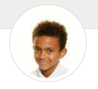
Our Swallow Hero
Just another hero from Swallow… Karson. He has been impressing me with a much improved attitude during lesson time. He is trying so hard and is completing lots of his work. Karson’s assessments were very positive and we start to see more progress being made. Well done Karson.

Slide 18
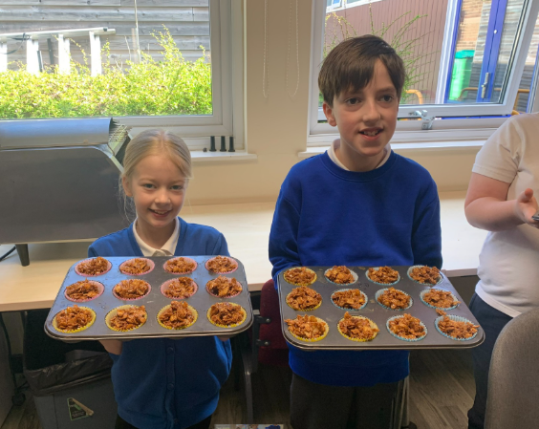
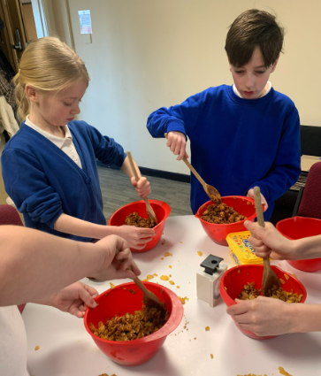
Our Owl Hero
James, Leo, Stanley and Olivia are our heroes this week for their practical maths lesson. They weighed and measured out their ingredients to make cornflake cakes for the whole class. Their weighing was super accurate and everyone enjoyed the cakes! Well done!

Slide 19
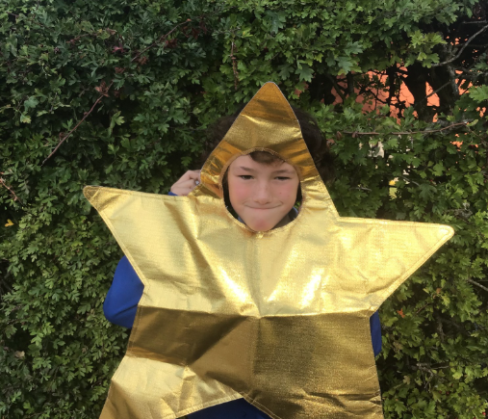
Our Falcon Hero
My first hero this week is Elliot. Elliot has really blown me away recently with how far he has come on with his maths. At the start of Year 5, he would have been the first to admit that maths wasn't really his subject. Flash forward to now, however, and you will find an amazing, blossoming mathematician who absolutely smashed his maths assessments! It has been so wonderful to see your confidence grow this year, Elliot, and I hope it continues to grow further in your school journey. Well done!

Slide 20
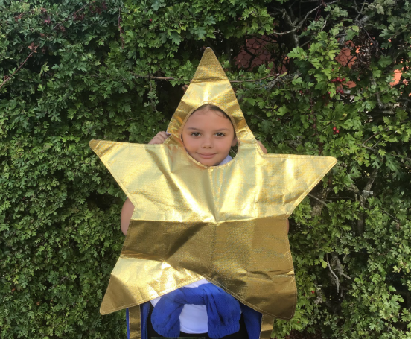
Our Falcon Hero
My next hero this week is Kailah. This week, we have been re-telling the legend of Beowulf and his gruesome fight with the monster, Grendel. The creativity Kailah has shown in her writing has truly blown me away! She has truly created, a dramatic, nail-biting piece of writing that grabs the reader's attention from the get-go. I am so excited to see what she produces next! Well done, Kailah, you superstar!

Slide 21
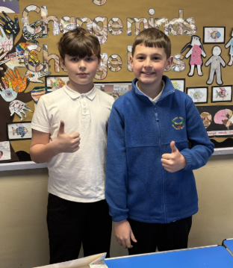
Our Swan Hero
My first heroes this week are Jake and Seb, our fabulous school councillors! The boys worked so hard today selling cakes for the Easter bake sale. It was so busy at the cake stall but the boys had such a smile on their faces! Well done boys 🎂 🍰 🧁

Slide 22
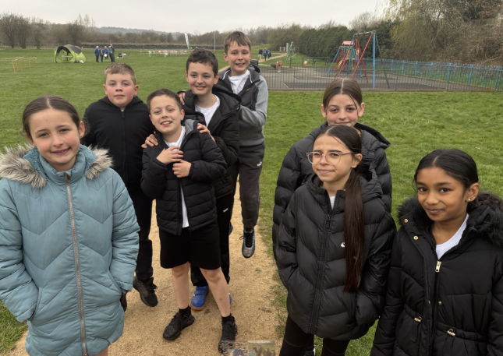
Our Swan Hero
My next heroes are my fabulous orienteering team: Shevona, Isla, Layla, Sophie, Theo, Cory, Alan and Vinni. Last Friday, Mr Close and I took the group to Jacksdale for an orienteering competition. We competed against 6 schools and these guys represented Holly Hill beautifully. Well done guys!

Slide 23
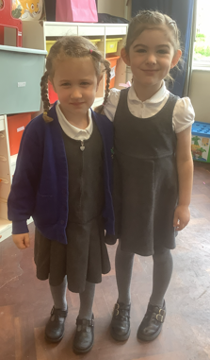
Our Lunchtime Heroes
Our Midday Supervisors have chosen Blayke and Ivy to be our lunchtime heroes today. They both sit beautifully EVERY dinner time, they eat their dinner without fuss, they stay seated and line up wonderfully when asked. They are an absolute pleasure both in the hall and on the playground. They always greet you with a beautiful smile and are happy to help others. True dinnertime heroes – well done girls!

Slide 24
Class Attendance winners
This week’s winners with 99.2% are our Cygnets classes. Well done to both classes!
Swans, you were last weeks winners – you have reached your prize!!!
Remember, when you reach 3 wins, your class will get £25 to spend on books and 15 minutes extra play! Try to come to school every day to help your class be the winners!
CLASS | WIN 1 | WIN 2 | WIN 3
Cygnets 1
Cygnets 2
Puffin
Wren
Woodpecker
Kingfisher
Dove
Swallow
Owl
Falcon
Swan

Slide 25

Yippeee!! It’s break up day!!
We were so impressed with your Easter bonnets and eggs today – I wish you could all have been winners!!
Everyone should receive an Easter egg at the end of the day today as a gift from us and our Friends of Holly Hill.
Have a lovely two week break for Easter. See you in April!
Mrs. Steed
xxx

