Slide 1
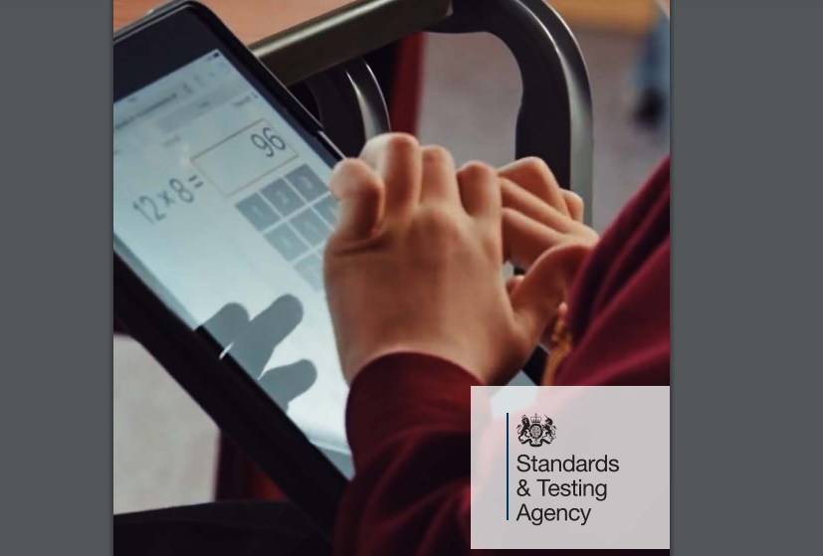
Year 4: Times Table Check

Slide 2
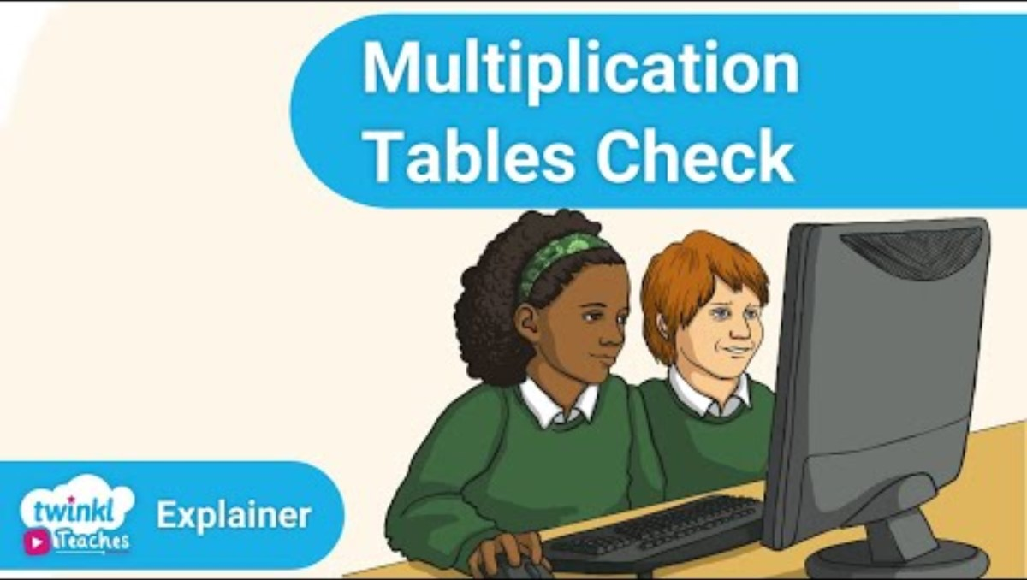

Slide 3
What is the multiplication check?
The check is a series of 25 randomised questions.
It will test their knowledge of the times tables up to 12x12.
Before the test, there will be 3 practise questions. This will give the children a chance to practise getting the answer in the head and typing it into the iPad.
The check is a statutory requirement for all pupils in Y4 across the country.

Slide 4
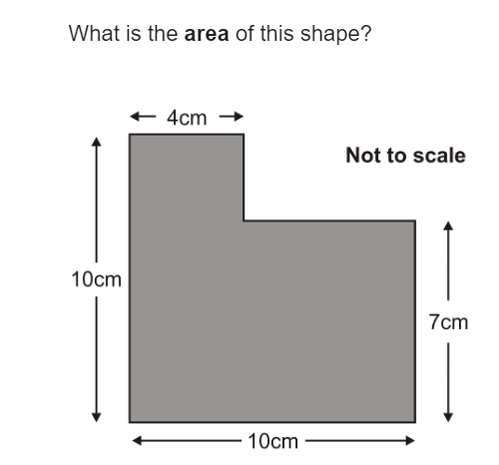
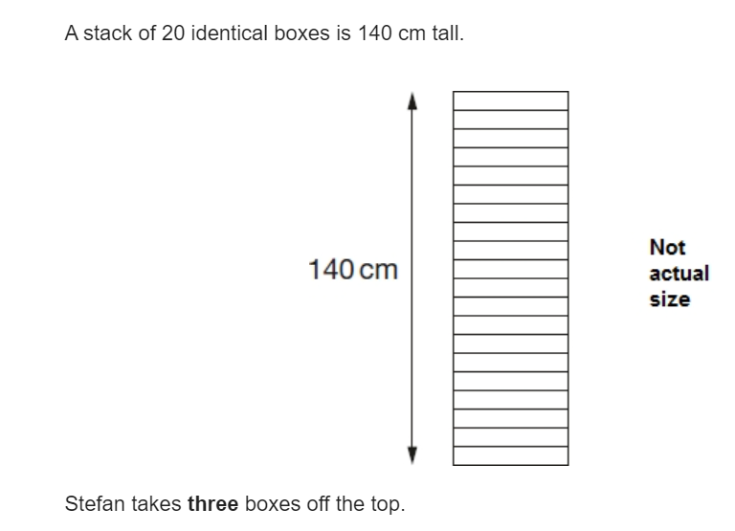
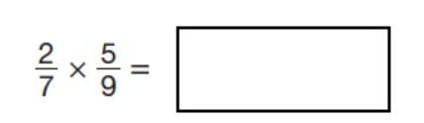
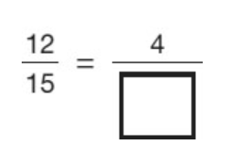
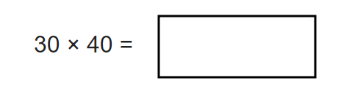
Why is learning times tables so important?
Being fluent with times tables makes multiplication faster.
They are needed for so many other areas of Maths
Fractions
Ratio
Area
Decimals
Scale factors

Slide 5
When will it take place?
W/c 8th June, the check will take place for all Year 4 Pupils.
The check will run over a week to make sure that every pupil is able to take part.
There will be a chance to practice with a mock test a few weeks before.
Tests will be administered by class teachers.

Slide 6
Will I find out my child's results?
Yes!
The results are available for schools to view end of June/early July.
You will be told your child's score by letter.

Slide 7
How are we preparing at school?
songs
Flashcards
Games
Writing and chanting
Weekly tests
TTRS
Mastering Number programme

Slide 8
What if my child can't access the test?
Teachers can put access arrangements in place to suit the needs of your child...
Remove timer
Pause / Next
Audio
Different colour
Input assistance
The check is designed to be as accessible as possible.
1:1

Slide 9
What can you do at home?
Listen to the songs on YouTube. They will stick in your head!
Practise them in a way that suits your child: singing, chanting, firing random questions at them on the school run, quizzes etc.
Use TT Rockstars
Practise flashcards at home for any that won’t stick

Slide 10
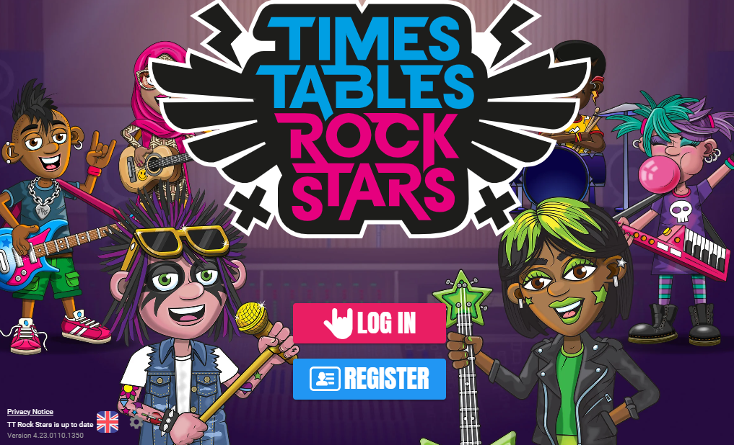

Slide 11
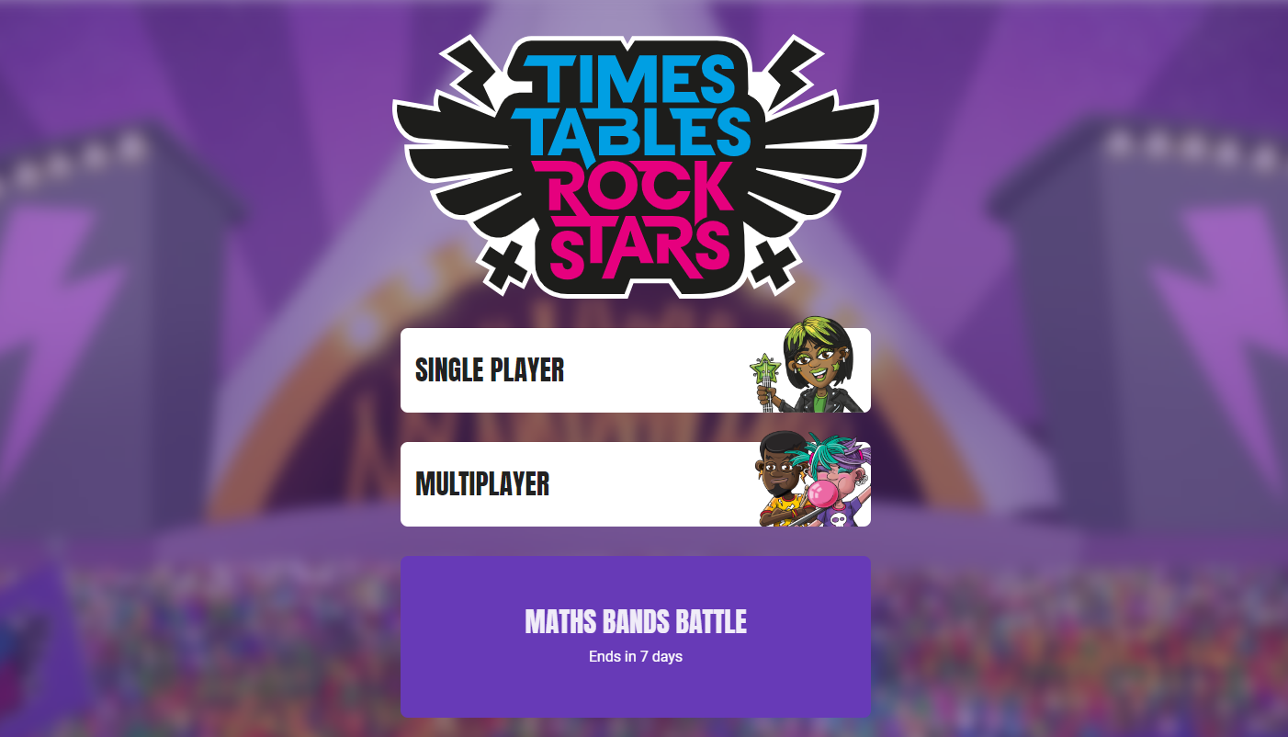
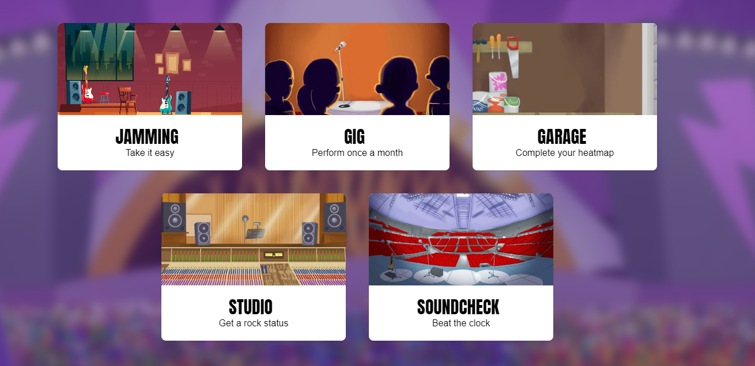
Find your login in the back of your diary. This is the page you will get to.
If there is a battle it will say here, but to earn points you can play any game.
Correct answer = 1 point..

Slide 12
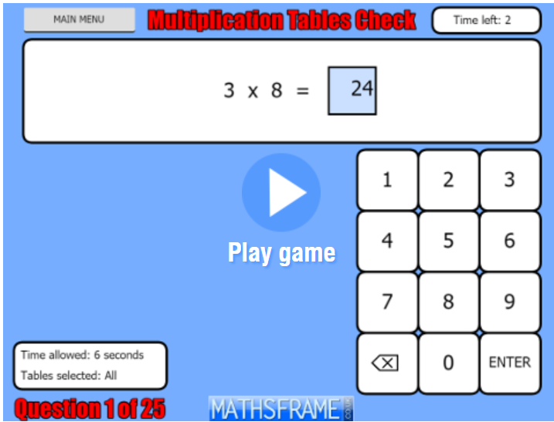
THIS IS A GOOD WEBSITE TO USE
Maths Frame Multiplication Check
https://mathsframe.co.uk/en/resources/resource/477/Multiplication-Tables-Check
The timing and layout is like the real test.
We will use this on iPads as they are easier to use than laptops.

Slide 13
ANY QUESTIONS?
Please come and speak to us after if you have any questions.
The iPads are out in case anyone would like to have a try!
There are parent information booklets from the government for you to keep.

